Slide 1
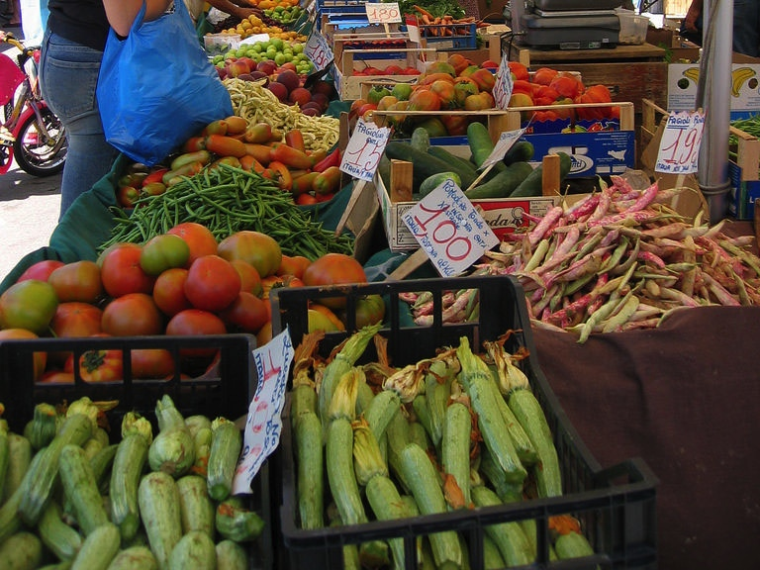
prince
FRESH PRODUCE

Slide 2
And not so fresh…
http://www.youtube.com/watch?v=2w_OxdmoiDQ

Slide 3
Selection Factors
intended use
exact name
product size
container size/type
minimum weight/case
point of origin
degree of ripeness/ripening process used

Slide 4
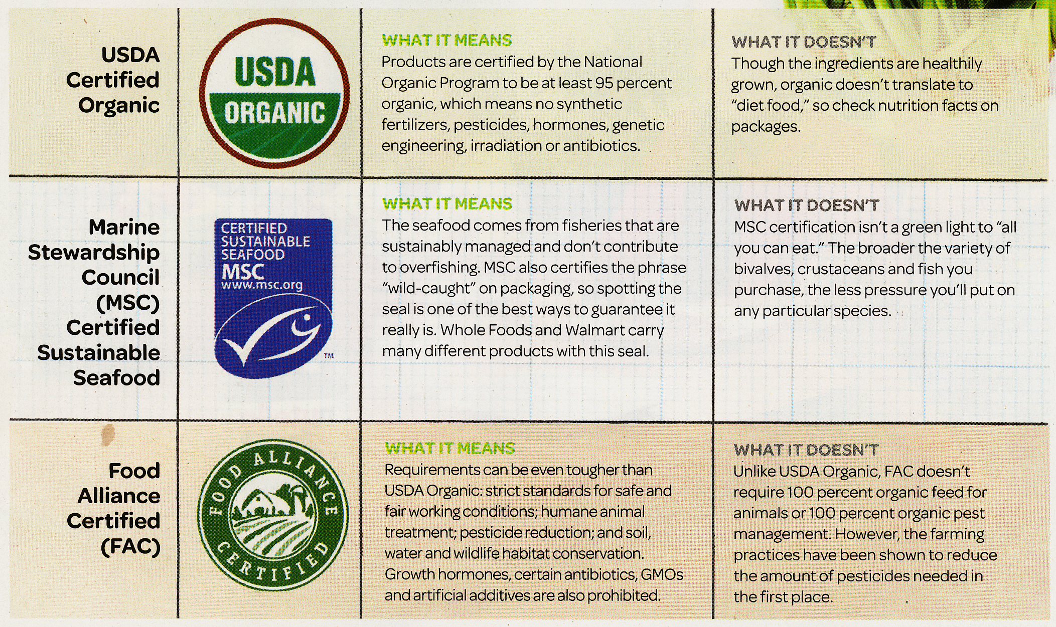
Green Labeling

Slide 5
U.S. Grades
Most commonly used:
Grading schedule varies according to product (for grapefruit the best grade is U.S. Fancy, for Apples U.S. Extra Fancy and for carrots U.S. Extra No. 1)
  Fancy (about 1%)
  No. 1 (most common)
  Commercial
  No. 2
  Combination
  (mix of 1 & 2)
  No. 3.
  Field run (ungraded

Slide 6
Purchasing Fresh Produce
PMA Fresh Produce Manual contains detailed specs for many fresh-produce items
wholesale suppliers
independent farmers

Slide 7
Example of Produce Spec
Red Delicious apples
used for fresh fruit plate item
U.S. Fancy
Washington State
72 count
30-42 pound crate
moisture-proof fiberboard
layered arrangement, cell carton
whole apples
Fresh, refrigerated
Fully ripened

Slide 8
Receiving Produce
check quality:
  look for signs of discoloration, wilting, bruising, mold, softness, over/under-ripeness insect damage
check quantity
  weight, count

Slide 9
Storing Produce
store at the correct temperature and humidity
  asparagus @ 32-36°F, bananas 50-60°F
(most) fresh produce deteriorates quickly at room temperature
some vegetables (corn, peas, etc.) lose their sugar content more rapidly at room temp.
produce should NOT be washed before storing
shelf life varies widely
  a few days (herbs) to 2 months (lemons)

Slide 10
Produce Yield
EP varies widely depending on product
  tomatoes c. 87%
  asparagus c. 56%
Precut fresh produce usually has a much higher AP price than raw (unprocessed produce)

Slide 11
A Few Apple Varieties

Slide 13
HuffPo Cheat Sheet:
Apple Variety Tasting Guide
Appearance? (Color, shape, size)
Texture? (mealy, crisp, firm, soft, hard)
Aroma?
Flavor? (sour, sweet, balanced, bland, full flavored)
Notes:
http://www.huffingtonpost.com/2011/10/07/cheat-sheet-apple-variety_n_1000281.html

Slide 14
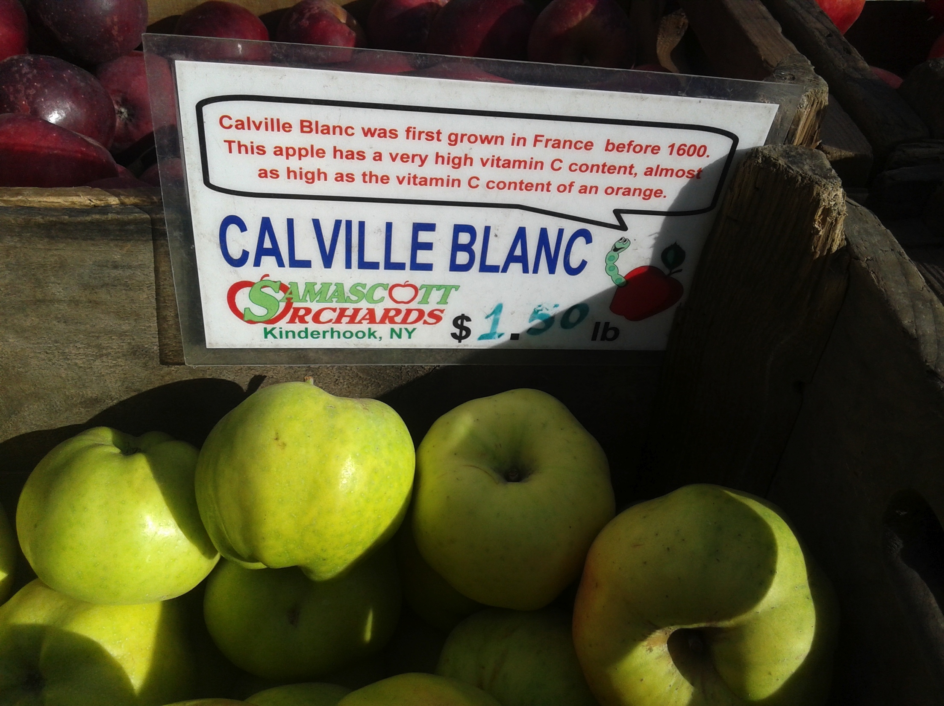

Slide 15
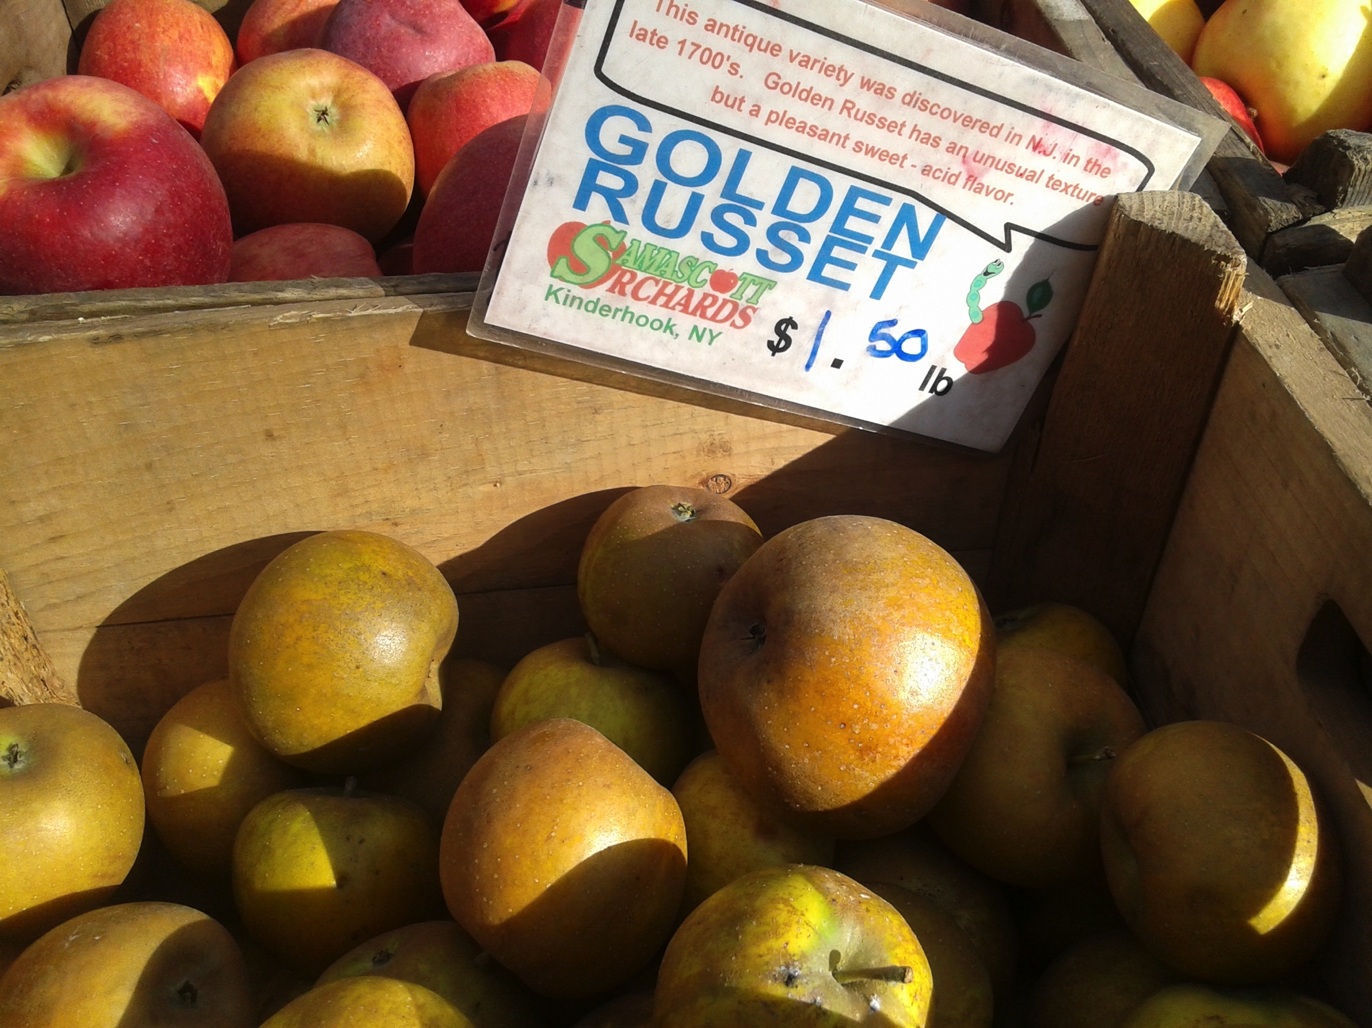

Slide 16
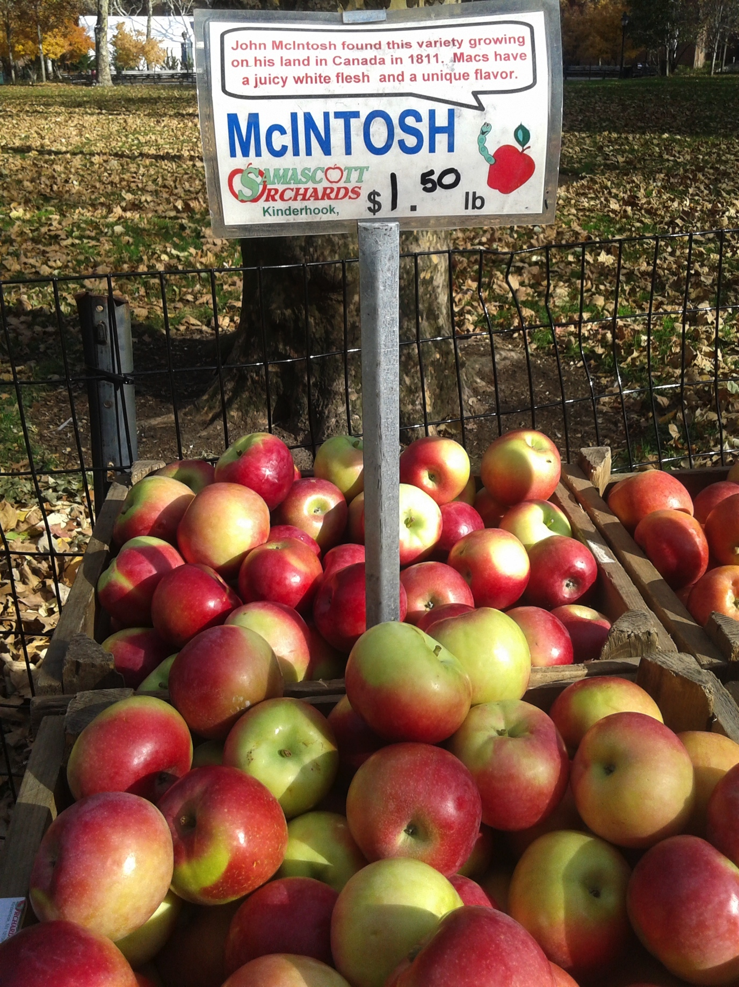

Slide 17
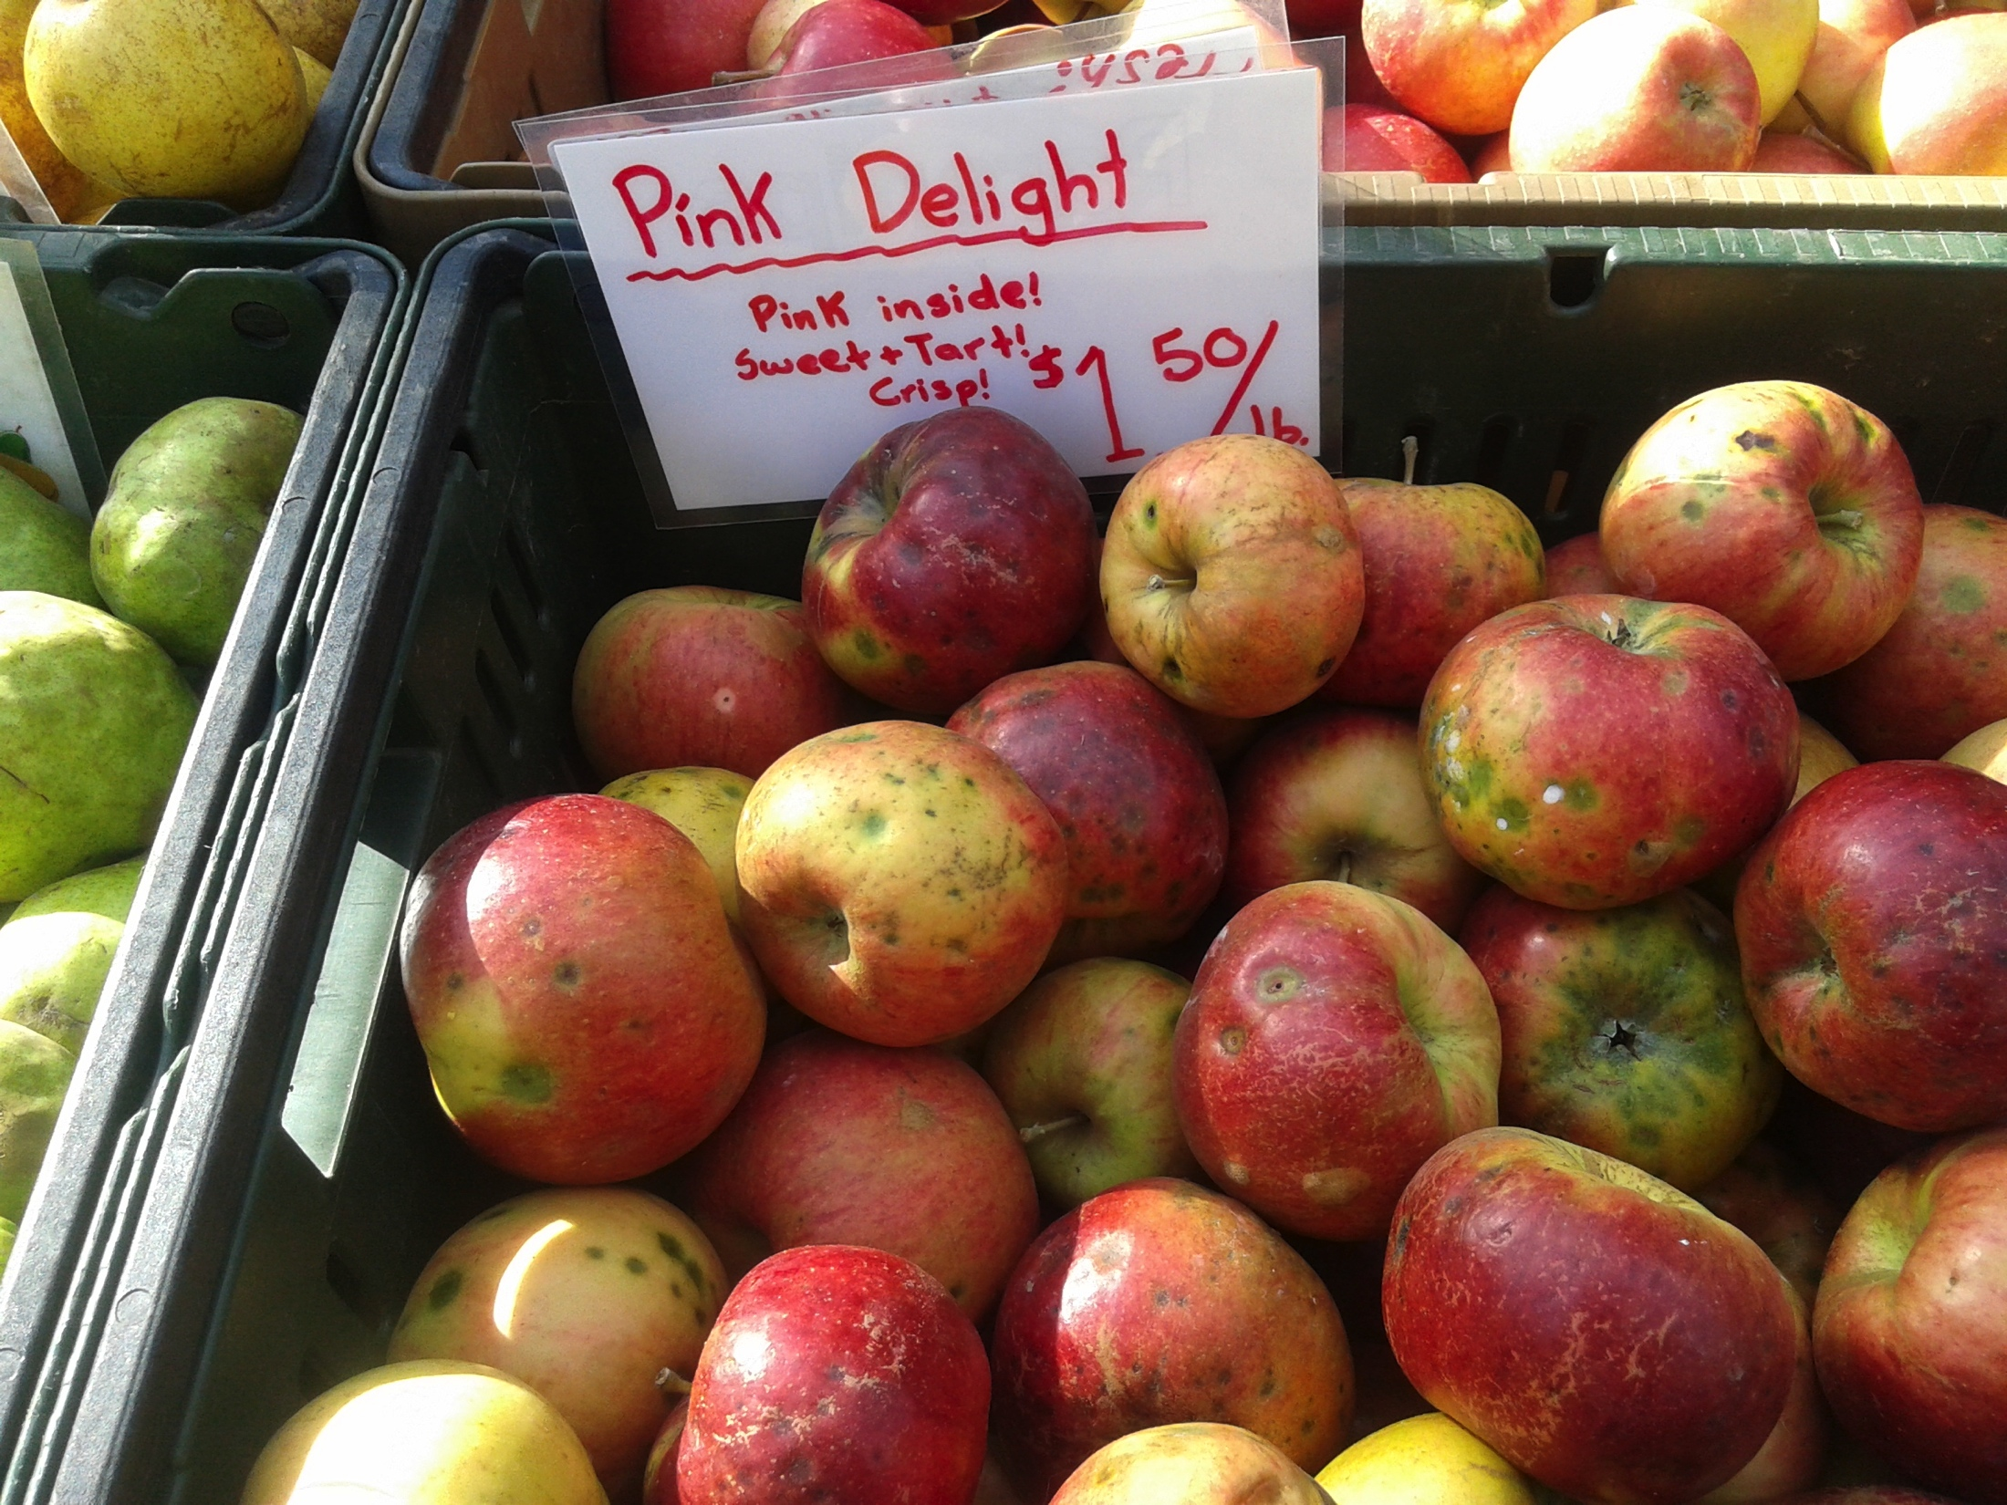

Slide 18
