Slide 1
City Tech 101
Semester Summer 2023
Professor Glenda Perreira
Email gperreira@citytech.cuny.edu
City Tech 101 by Karen Goodlad and Sarah Paruolo is licensed under a Creative Commons Attribution-NonCommercial-ShareAlike 4.0 International License.

Slide 2
Get Your Head In the Game:
Mindset + Self-Advocacy
City Tech 101
Session 5
08/18/2023
Professor Glenda Perreira
City Tech 101 by Karen Goodlad and Sarah Paruolo is licensed under a Creative Commons Attribution-NonCommercial-ShareAlike 4.0 International License.

Slide 3
Today’s Topics
“Not Yet” Grade
Growth Mindset
Habits of Successful College Students
Asking Effective Questions
Asking for Help
Self-Adovacy

Slide 4
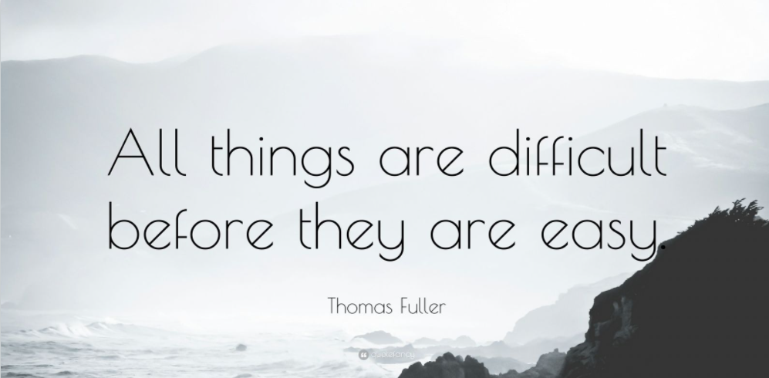
Notes:
I remember a number of people stated they wanted to meet new people at CT, well that is hard and everyone starts as a stranger until they are your best friend

Slide 5
“Not Yet” Grade

Slide 6
Discuss what a grade of “not yet” would mean to a college student and what steps might the student take to improve the grade.
What if you received a grade of “not yet”?
What would you do?

Slide 7
Growth Mindset

Slide 8
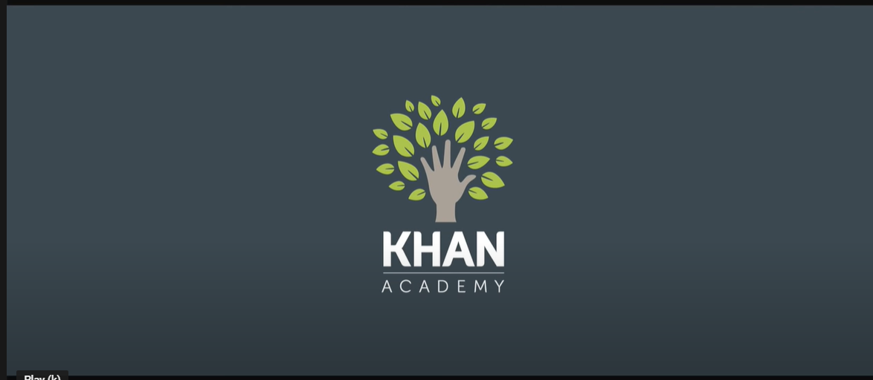
What is a growth mindset?
Do you want to know more about creating a growth mindset? Here are more resources:
Mindset, Talks at Google
Assess your Mindset
A Summary of Growth and Fixed Mindset

Slide 9
Reflective Questions from #RiseAndGrind:
Do the questions encourage a Growth or Fixed Mindset?
What life experiences have prepared me for college?
When I have been faced with a difficult situation, what strategies did I use to find a solution?
How will I create positive academic habits for myself?
What do I need to know about the resources offered by the college that I can access to help me become a better learner?
In case my original academic plan does not work out, what would be my alternative plan?
Notes:
10:40-10:45
Activate the poll

Slide 10
Habits of Successful
College Students

Slide 11
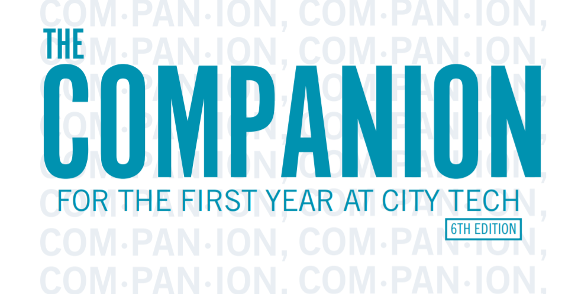
The Companion for the First Year at City Tech is available on the First Year Programs website.
Notes:
http://fyp.citytech.cuny.edu/media/2020/06/The-Companion-online.pdf
10:47

Slide 12
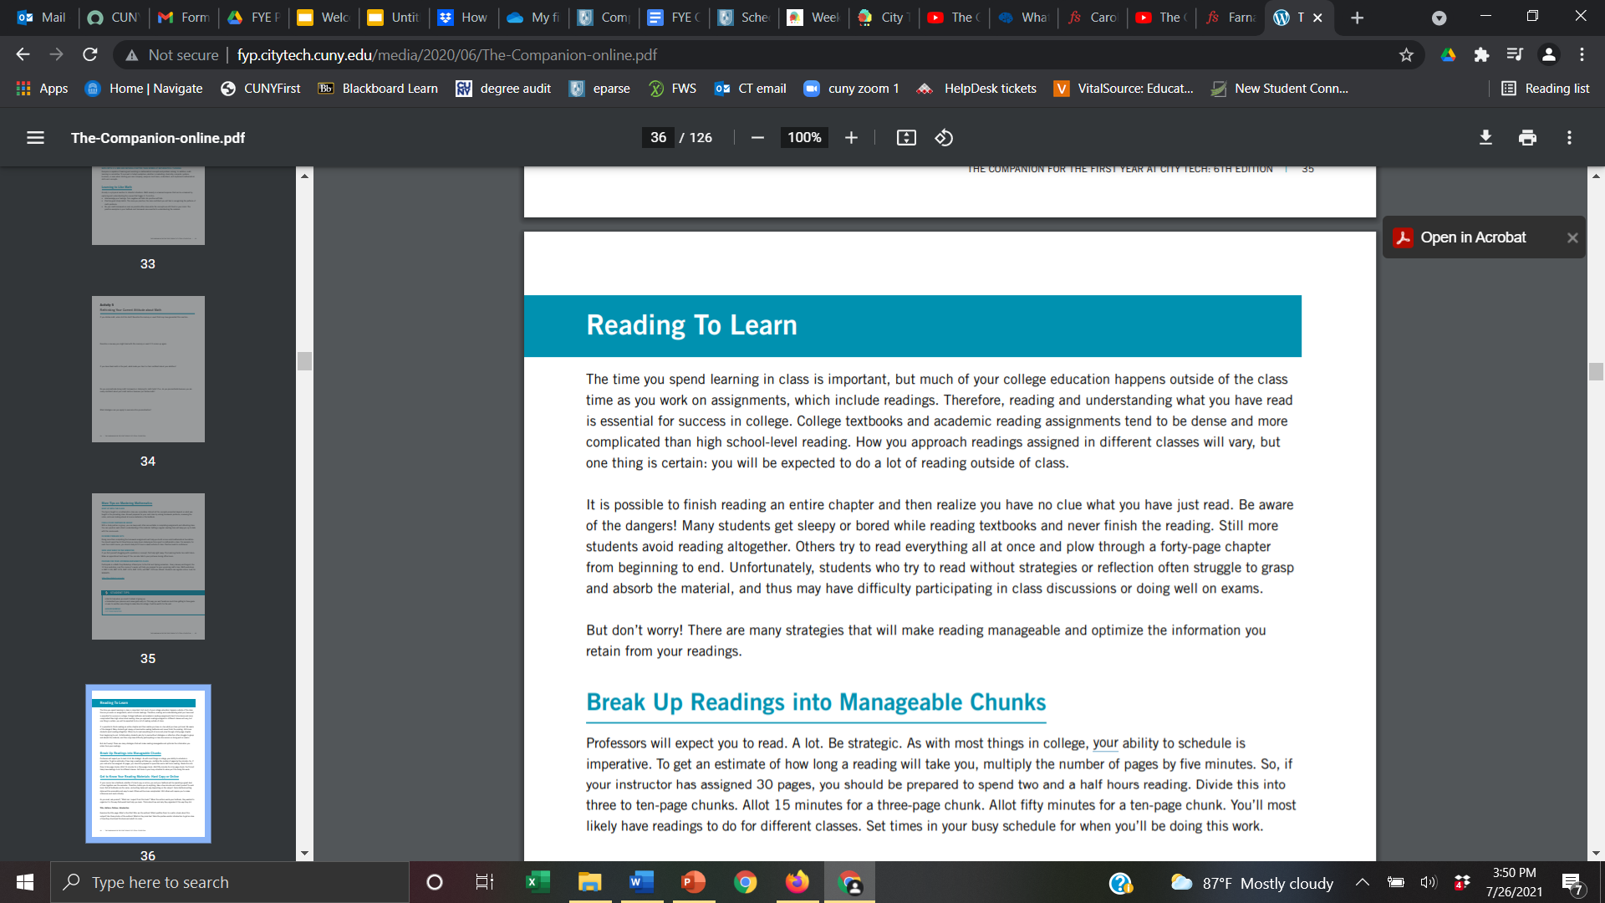
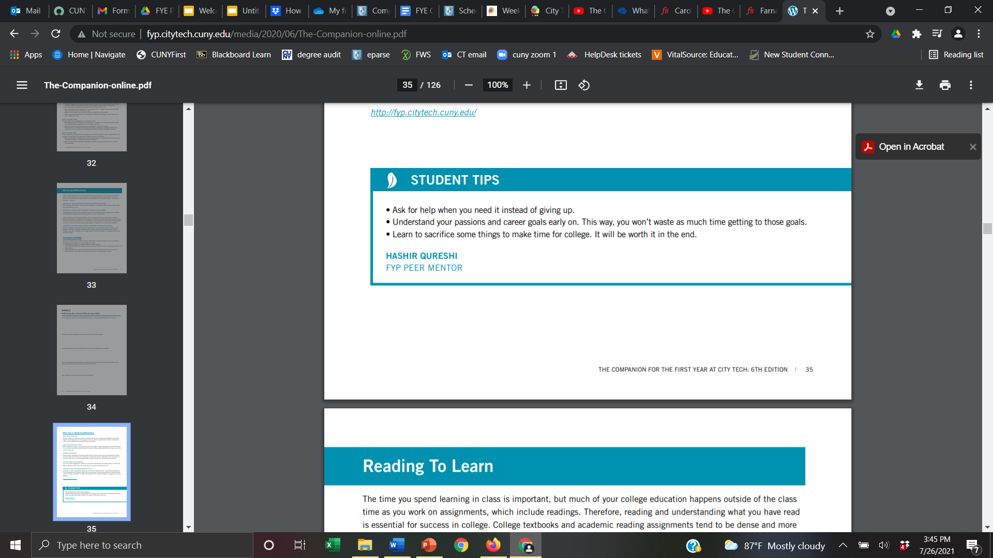
Page 36 of The Companion for the First Year at City Tech
Notes:
10:48

Slide 13
Small Group Discussion: Habits of Successful College Students
Open The Companion to page 31. Review the activity “Track your Learning Process”.
Identify a group scribe and a speaker.
Review the “Track your Learning Process” grid on page 31.
Share which of the practices you did not know successful college students used.
Share which of the practices you believe will be difficult for you to do on a regular basis and explain why you believe it will be difficult.
When you return to the larger group, copy and paste the notes into the chat, in one minute, summarize your small group discussion
Notes:
10 minutes

Slide 14
Asking Effective Questions

Slide 15

“Asking Questions is a good way to find things out.”
--Big Bird
Notes:
What makes a question a good question?
Break 11:10

Slide 16
Ask “Effective Questions”...
What does that even mean?
Notes:
11:10-11:20
Be specific
Be brief
Be thorough
Be appreciative

Slide 17
Ask “Effective Questions”...
What does that even mean?
Be specific
  What do you want as an outcome?
Be brief
  Include only relevant information
Be thorough
  But, don’t leave out supporting information
Be appreciative
  You will gain an ally
Notes:
Supporting Material:
https://www.edutopia.org/article/teaching-students-how-ask-productive-questions
https://www.edweek.org/teaching-learning/opinion-10-strategies-for-encouraging-students-to-ask-questions/2021/05
https://teaching.uchicago.edu/resources/teaching-strategies/asking-effective-questions/

Slide 18
Asking for Help

Slide 19
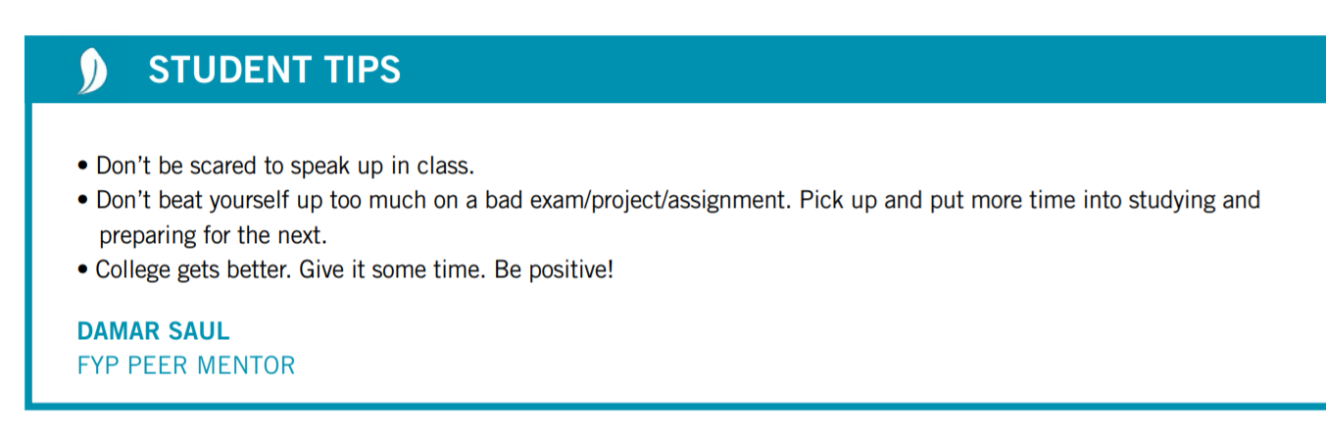
Asking For Help Is...

Slide 20
Self-Advocacy

Slide 21
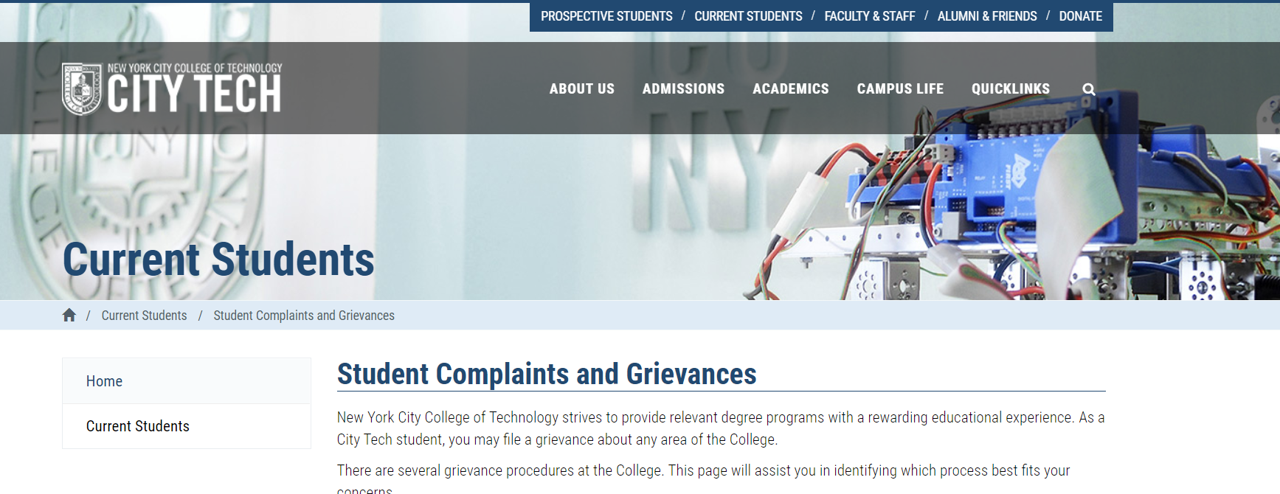
What are some reasons students may complain or file a grievance?

Slide 22
Recap
“Not Yet” Grade
Growth Mindset
Habits of Successful College Students
Asking Effective Questions
Asking for Help

Slide 23
Before Session 6…
Complete Reflection on OpenLab by replying to Reflection #5 Post.
Reflection #5
Consider the discussions we had today about mindset and self-advocacy. Share a concept you believe is important and explain what the concept means to you as a college student.
Read and comment on another student’s post.

Slide 24
Get Your Head In the Game:
Mindset + Self-Advocacy
City Tech 101
Session 5
08/18/2023
Professor Glenda Perreira
City Tech 101 by Karen Goodlad and Sarah Paruolo is licensed under a Creative Commons Attribution-NonCommercial-ShareAlike 4.0 International License.

