Slide 1
City Tech 101
Semester Summer 2023
Professor Glenda Perreira
Email gperreira@citytech.cuny.edu
City Tech 101 by Karen Goodlad and Sarah Paruolo is licensed under a Creative Commons Attribution-NonCommercial-ShareAlike 4.0 International License.

Slide 2
#RiseAndGrind
City Tech 101
Session 3
08/16/2023
Professor Glenda Perreira
City Tech 101 by Karen Goodlad and Sarah Paruolo is licensed under a Creative Commons Attribution-NonCommercial-ShareAlike 4.0 International License.

Slide 3
Today’s Topics
Creating Workspaces
Learning Styles
The Study Cycle
Your New Schedule
Time Management
Self-Care

Slide 4
Learning Spaces,
Learning Places
Notes:
Q: Where do you do your homework and study? Why? Do you think that is the best place to do it? Why/Why not?

Slide 5
On City Tech Campus
In the classroom
In the lab
In the library
In the computer lab
In other spaces
Notes:
Pros and cons:
Quiet v. Noise
Distractions
Comfort-- but not too much
Specific spaces
What kind of access will you have this/next semester?

Slide 6
Working Remotely
In your home
In your own space
In your personal classroom
Notes:
Pros and cons
Online/Remote Learning-- difficulties and advantages
Armed with the knowledge of past 2.5 years
Even if in person, will all your work be done at school? Do you need a space at home to work?

Slide 7
Create Your Own Workspace
Limit distractions and noise
Set up computer/tablet on a desk or table, not your lap
Sit in a chair, rather than a couch or bed
Have a notebook and pens/pencils nearby
Make sure there is plenty of light
Hang a calendar or weekly schedule
Post To Do list
Post pictures, images, and/or motivational quotes
Add a plant for increased oxygen
Notes:
Importance of making space
Creating the right atmosphere and routine
Train your brain to know that this is a space for work

Slide 8
Small Group Discussions:
Online Learning
Challenges
Question #1: What are some challenges you face while taking classes online/studying at home?
Question #2: What are some potential solutions for these challenges?
Directions:
5-7 minutes to discuss questions in breakout rooms
Assign scribe to take notes while you all discuss (GoogleDoc to share with group)
Assign reporter to share answers to question #1 with full class
Assign reporter to share answers to question #2 with full class
We will come back as group to discuss-- be prepared!
Notes:
Peer Mentors can float between groups
No more than 4 students to a group
Remind them to take a screenshot of the slide before they go into the breakout rooms so that they have the Qs and directions
Come back and discuss.
HIGHLIGHT the lived experiential knowledge of students, they are advantages-- not deficits

Slide 9
Learning Styles

Slide 10
Increased Personal Responsibility
Taking Control of Your Own Learning
=
Notes:
Q: What does it mean to take control of your own learning?
Q: Why is this important?
Q: How does this present as being different from how you learned in high school?

Slide 11
How do you learn something new?
How do you practice a new skill?
How do you know that you understand
a new concept?
How do you know that you can apply
a new idea?
Notes:
Open students up to the idea that they don’t actually know HOW they learn things.
I usually say something like… “At this point in your lives most of you have been professional students for at least 12 years. We expect professionals in most fields to be experts at their craft. Examples like a carpenter, a plumber, a pilot, etc. Are you an expert at learning? How could you not be? Is it possible you learned how to learn but have no idea that you did?”
This leads into why we need to understand how our brains work, and how we actually learn-- especially since it is now in their hands.

Slide 12
Learning Style Quiz
http://www.learningstylequiz.com/
Notes:
Introduce the idea that people learn in different ways, know how you learn makes a huge difference in how easy you find school/studying.
Give them 10 minutes to take the quiz.

Slide 13
Learning Style Quiz
Poll/Share
What type of learner are you?
Notes:
Show the array of results.
Q: Who is surprised with their results? Who thinks that their results make a lot of sense?

Slide 14
Kinesthetic
Learn by doing
Notes:
I do not take the time to go into depth on each one of these. I introduce what each major type means and point out one of the strategies for each on the following slide. Encourage them to go back and look at these. Encourage them to do further internet research-- lots of study tips out there based on learning style.

Slide 15
Kinesthetic
Like to touch, taste, smell, and be active within the lesson in order to best process and remember
Need a deep dive to be fully engaged with the material and learn from experiencing
Tips for optimizing the kinesthetic learning experience:
Make activities as active as possible. When learning a new language, engage in conversation regularly.
Background music or other audio stimulation tends to help kinesthetic learners engage with and retain information.
Highlight key points and/or draw sketches of the material.
Take your time when working through a lesson to make sure you are fully engaged with what is being taught.
Sensual stimuli such as foods, drinks, and physical objects that the learner can touch or interact with can be of immense help.
Make complex tasks visual and interactive.
(source: learningstylequiz.com)

Slide 16
Visual
Learn by seeing

Slide 17
Visual
Process information through writing and reading, good at taking notes.
Memorize by taking a mental picture and using the image to process.
Tips for optimizing the visual learning experience:
Use attachments such as maps, itineraries, articles, and photos to process and memorize information, and be able to recall it later.
Take notes – whether that be text, drawing, or charts. Always make sure you’re taking something with you at the end of a lesson!
Go through notes and ask questions – then modify as needed.
Pay attention to pauses in a lesson – great opportunities to ensure you have everything jotted down or drawn out.
Minimize audible or visual distractions.
Draw sketches/take notes in the margins of a page, in white space below paragraphs, or anywhere there’s room.
(source: learningstylequiz.com)

Slide 18
Auditory
Learn by listening

Slide 19
Auditory
Often talk out loud to themselves, helps process thoughts and ideas.
Can struggle with remembering what they read, or putting their thoughts to paper.
Tips for optimizing the auditory learning experience:
Finish study sessions or classes with a summary, for a chance to recap.
Listen to readings when possible (audio books, text speak programs, podcasts, etc.)
Inclusive brainstorming and small group discussion allow ideas to spoken and written simultaneously helping to express ideas and remember them.
Study groups and partnered work help things stick more easily. The more conversational, the better!
Talk to professors during office hours to reinforce ideas from class.
(source: learningstylequiz.com)

Slide 20
BE
OPEN
TO
CHANGE!
The definition of insanity is doing them same thing over and over, but expecting different results.
If you want different results, you have to do things differently.
Notes:
Prompt students to understand that do get new results, they have to be willing to try new things.
I like to share this example: When introducing new food to a child, you have to make them try it 20 times before accepting that they really don’t like the food. Not to torture them, but because our bodies are trained to be suspicious of new things. Translate this to learning.
Trying to integrate new study methods and routines will not be simple. You are going to have to push yourself for a while before it feels natural/right/comfortable.

Slide 21
The Study Cycle
Notes:
A basic plan that can be tailored to fit your own learning style. It is the structure of constant and cyclic learning/studying.
Two biggest advantages:
No cramming! (Which also means no panicking, no all nighters, no tears, no surprises…)
Early warning signs when you are falling behind or getting confused-- the sooner you know you need help, the more that help can do for you!
I don’t think most students truly follow this plan BUT I do think it gets thinking about how much studying needs to happen and how often. It also includes many basic practices that are students do not currently use.

Slide 22
The Study Cycle
1
Prepare
5
Assess
2
Attend
4
Study
3
Review
Notes:
Overview
Importance of cycle

Slide 23
Prepare Before Class
1
Prepare
Complete assigned reading before class
Annotate readings
Come up with questions to ask in class
Notes:
Q: Is there really a need to do the reading before class if the professor is just going to discuss it during class?

Slide 24
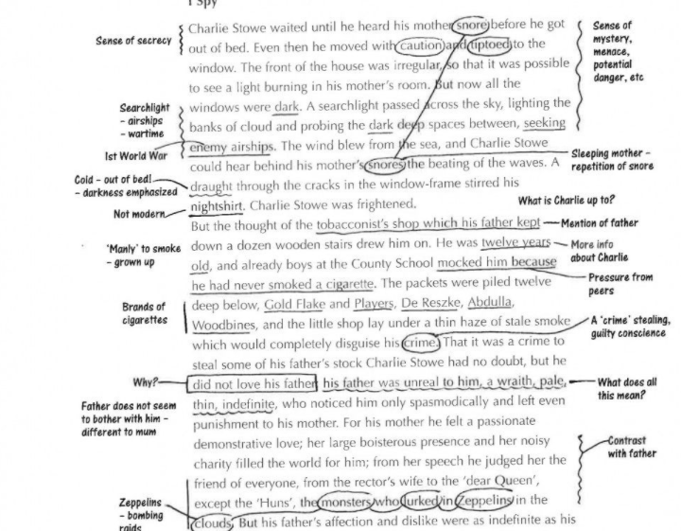
Annotating Readings
1
Prepare
1
Prepare
More than highlighting
Note key ideas
Mark unfamiliar words
Ask questions
Add mini-summaries
Make your own system
Notes:
They all learn some form of annotating in ENG 1101, so this can just be an introduction to the idea.

Slide 25
Attend Class
2
Attend
Be on time
Create a workspace at home
Choose a good seat in the classroom
Be an active learner
Ask + answer questions
Take notes
Notes:
Q: Why attend class if attendance doesn’t matter and all the powerpoints presentations are posted online?

Slide 26
Taking Notes
2
Attend
Take notes on paper, by hand
Do not try to write down every word the professor says
Recreate charts and diagrams carefully
Underline/Highlight key words and phrases
Leave extra spaces on the page, making it easy to go back and add missing pieces
At the top of each page, write the class and date
Stay organized!
Notes:
Emphasize that in many classes their professors will not give them ANY guidance on how to take notes or what to write down.
Always take notes, even if you don’t go back to them. The process of taking notes helps you to better remember the content.
Taking notes digitally vs. by hand--- all studies show by hand is MUCH better for learning and retention.

Slide 27
Rev Review After Class
3
Review
As soon as class ends, review your notes
Fill in gaps and missing pieces
Write down questions
Mark parts that are still confusing
Go back to readings to search for answers
Compare notes with a classmate
Ask your professor questions, in office hours or at beginning of next class
Notes:
This is short 5 minutes of review-- just to remember what you went over and see what you are still struggling with. Maybe send a quick email to a professor with a specific question you realize you never asked in class.

Slide 28
Study Every Day
4
Study
Repetition is key--even 10-15 minutes a day will make a huge difference
Ask yourself questions about the material, such as ‘why’, ‘how’, and ‘what if…’
Don’t just memorize, try to understand the material
Make connections to help you remember
Notes:
This is the part they are most resistant to. Explain importance of regular practice. I like to compare to sports, dance, art, etc.

Slide 29


Slide 30
Assess Your Learning
5
Assess
Check in with yourself weekly by asking:
  How are my classes going?
  Am I satisfied with my grades?
  Am I sticking to my Study Cycle routine?
  Do I need to make changes to my routine or methods?
  Do I need extra help?
Test yourself often by asking: Do I understand this enough to teach it to someone else? (Also, try to actually teach it to someone else!)
Don’t get stuck or frustrated-- get help.
Notes:
This is your early detection system!

Slide 31
Your Time, Your Success
Notes:
Students have been told about time management so many times, they think they understand it, but most do not. Trying to show them here that time management is at a whole new level in college and they will have a really hard time being successful if they don’t get this under control right away.

Slide 32
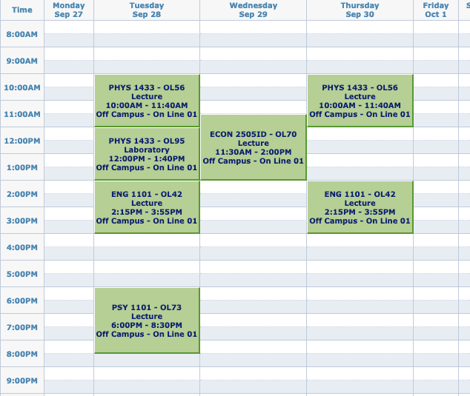
A Typical FY College Schedule
What does this schedule look like compared to your HS schedule?
What assumptions might you make based on those differences?
IMAGE
Notes:
Quick discussion
Sample Qs
What time did you have to be at high school?
What time did you leave?
Did you have free time during the day?
Did you have time in between classes?
Did you have homework due everyday?
Did your teachers know the schedules in your other classes (at least for major exams)?

Slide 33
Do you really have all that free time now??
One of the hardest parts of college is BALANCING everything—your courses,your assignments, and the rest of your life.
Notes:
Showing them that their schedules are very misleading in terms of time they need for school.

Slide 34
Question
How many hours will you spend
in class and doing work for class in one semester?
Notes:
Have them guess

Slide 35
Answer:
Over 600 hours!
That’s a lot of hours!
Let’s break it down week by week.
Notes:
We want them to feel a little overwhelmed--- giving them a real feel for the amount of work they need to do to succeed.

Slide 36
The Breakdown
15 credits = roughly 15 hours in class each week
for each hour in class, budget 2 hours for homework and studying
15 credits = roughly 30 hours of work outside of class each week
so when taking 15 credits, you should expect to spend about 45 hours each week just on school
15 credits each semester
many classes are 3 credits
often, 15 credits means
5 courses (but not always)
1 credit = approximately 1 hour in class each week
Notes:
Very important to highlight for one hour in class, budget two hours for outside work.
Explain connection between credits and hours.
Q: How many credits are you taking this/next semester? How many hours will that mean you devote to school each week?

Slide 37
Math Time!
How many hours a week do you spend doing…
https://fyp.citytech.cuny.edu/media/2020/06/The-Companion-online.pdf
(But don’t worry, you can use your calculator for this.)
Notes:
Not all hours are created equal. Open Google Doc or Zoom Whiteboard to DEMO math.
Link is to a similar activity in The Companion that they can do later on their own.

Slide 38
Be Good to Yourself!
Notes:
Q: What is self care? Why talk about it during our Rise And Grind session?

Slide 39
Self-Care JamBoard
Notes:
OPTIONAL
Sharing images and words of what self-care means to/looks like for them

Slide 40
Two Types of Self-Care
INDULGE + RELAX
Feels good right now.
RESPONSIBLE + RATIONAL
Your future self will thank you.
Both types are important and necessary!!
Notes:
People tend to focus on the first type, but the second type is also VERY important

Slide 41
Today’s Topics
Creating Workspaces
Learning Styles
The Study Cycle
Your New Schedule
Time Management
Self-Care

Slide 42
Before Session 4…
Complete Reflection on OpenLab by replying to Reflection #3 Post.
Reflection #3
Read the following quote by Dr. Pamela Brown, Provost and Vice President for Academic Affairs:
“Learning is a source of hope for a better future. It requires hard work and sacrifice which can be even more difficult in challenging times. Your time in college is also your opportunity to connect with others, lift your spirit, enrich your life, and develop the skills and knowledge to make a difference in your community.”
Choose a question below and write a reflection in the comment box below this post.
What life experiences have prepared me for college?
When I have been faced with a difficult situation, what strategies did I use to find a solution?
How will I create positive academic habits for myself?
Read and comment on another student’s post. These are your classmates, encourage them to work towards their goals.

Slide 43
#RiseAndGrind
City Tech 101
Session 3
08/16/2023
Professor Glenda Perreira
City Tech 101 by Karen Goodlad and Sarah Paruolo is licensed under a Creative Commons Attribution-NonCommercial-ShareAlike 4.0 International License.

