Slide 1
City Tech 101
August 2023
Professor Glenda Perreira
gperreira@citytech.cuny.edu
City Tech 101 by Karen Goodlad and Sarah Paruolo is licensed under a Creative Commons Attribution-NonCommercial-ShareAlike 4.0 International License.

Slide 2
The Syllabus
City Tech 101
Session 1
08/08/2023
Professor Glenda Perreira
City Tech 101 by Karen Goodlad and Sarah Paruolo is licensed under a Creative Commons Attribution-NonCommercial-ShareAlike 4.0 International License.

Slide 3
Today’s Topics
Course Organization (aka getting your act together)
What’s in a Syllabus and Why It Matters
Professors: Their Duties + Responsibilities
Students: Your Duties + Responsibilities
Academic Integrity
Effective Communication

Slide 4
Course Organization

Slide 5
DON’T
Put 40,000 things on your desktop
Dump all your work in a file called “Schoolwork”
Decide you’ll “get to it later”

Slide 6
START NOW:
Create a folder called CTFall2023
2. WITHIN that folder, create separate folders for each of your classes: ENG1101, MA1101, BIO1101, etc.
3. ANY time you do work for a certain class, put your work in the folder. (This includes drafts!)
This is going to make your life so much easier.
Promise.

Slide 7
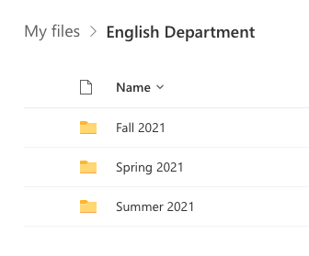
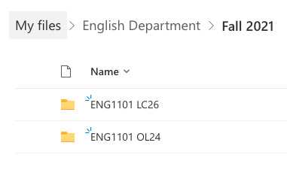
Make folders in your OneDrive
Organize by semester
Organize by course
Save ALL your work for the course
Use consistent and clear file names
Here
Paruolo_Reflection4_CT101_SU21

Slide 8
Contents of a Syllabus

Slide 9
Why is a syllabus so important?

Slide 10
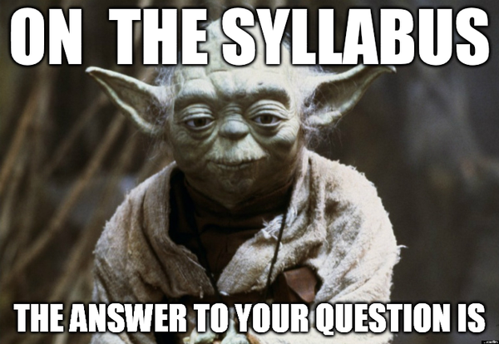

Slide 11
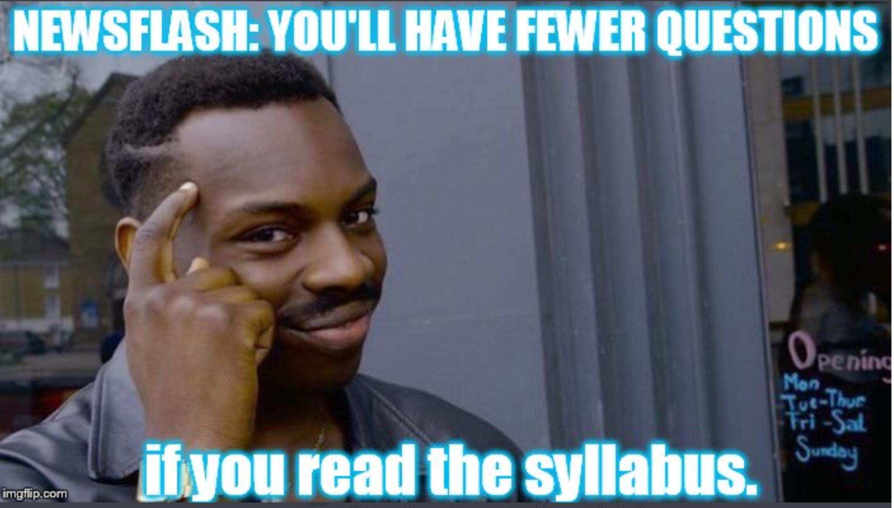

Slide 12
Think of a syllabus as a
FAQ

Slide 13
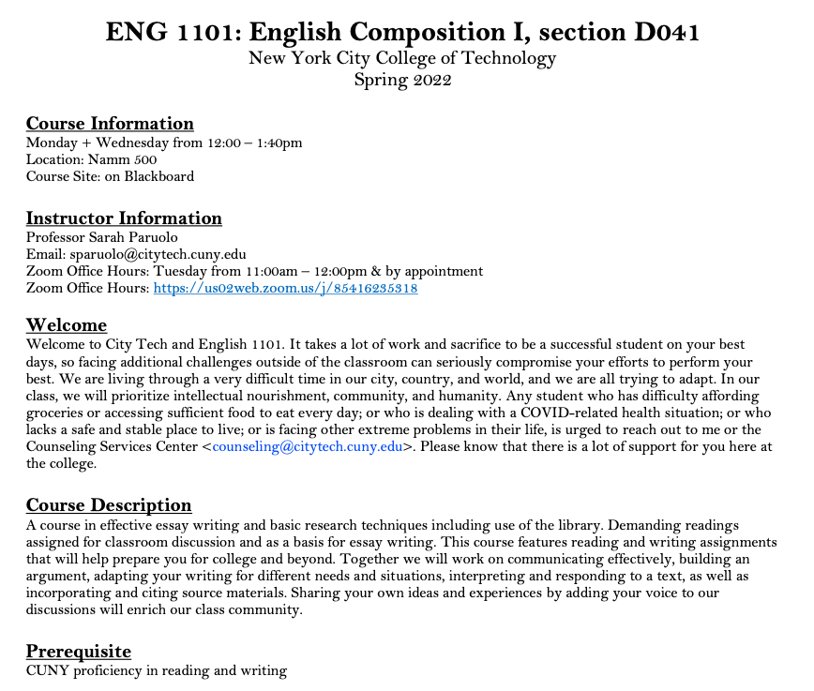
Department Abbreviation
Course Number
Course Name
Course Meeting Information
Course Site Information
Instructor Contact Information
Office Hours Information
Course Description
Pre/Co- Requisites

Slide 14
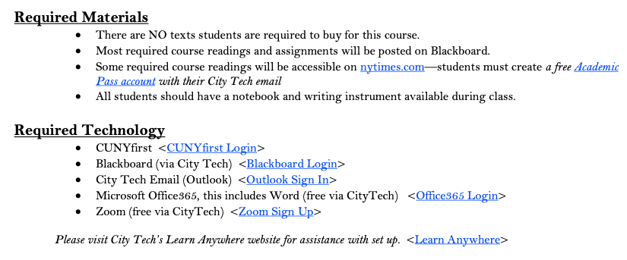
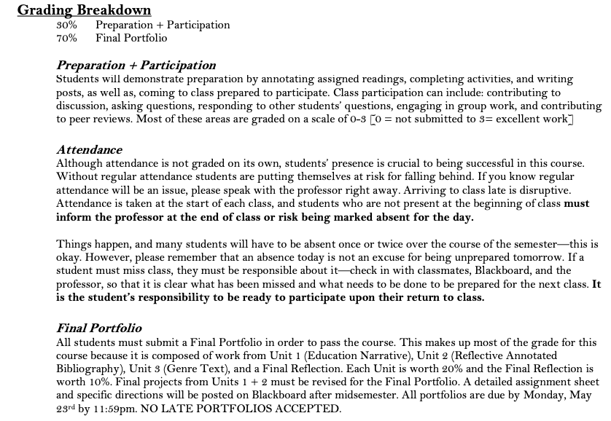
Required Texts
Required Materials
Required Technology
Grading Breakdown
Course Assignment Descriptions

Slide 15
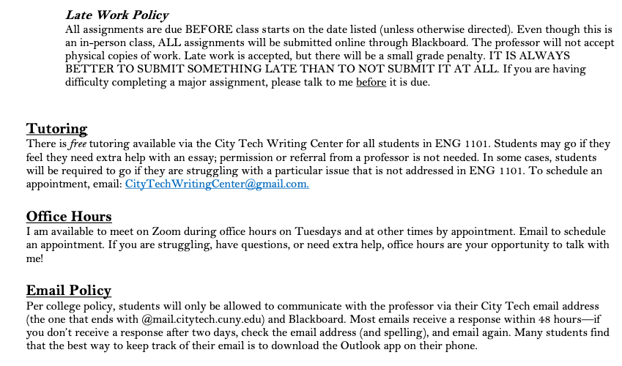
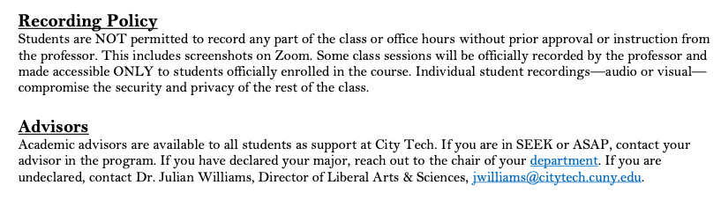
Course Policies

Slide 16
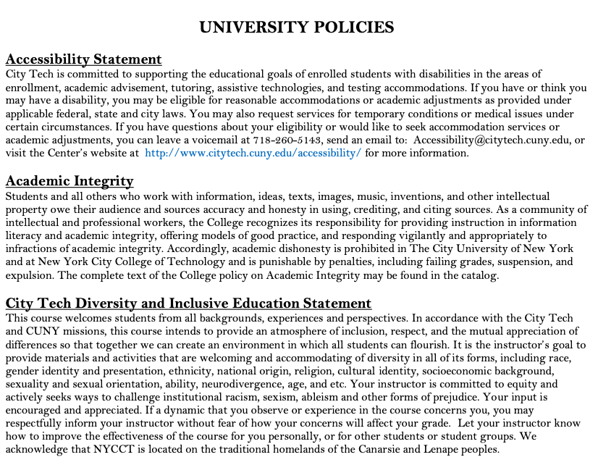
Accessibility Statement
Academic Integrity Statement
Diversity and Inclusive Education Statement

Slide 17
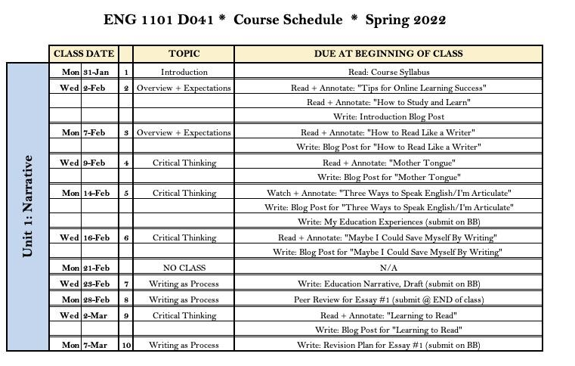

Slide 18
Duties + Responsibilities
of a Professor

Slide 19
A Professor’s Job Includes...
Creating and Distributing a Syllabus + Course Schedule (1st week of semester)
Notifying Students of Any Changes to the Course Schedule in a Timely Manner
Providing Clear Grading Scheme + Criteria
Grading Student Work Fairly
Informing Students of Midsemester Grades (8th week of semester)
Providing Clear Expectations for Students
Addressing All Learning Objectives for Course
Teaching Students Course Content
Holding Weekly Office Hours for Students
Answering Student Emails in a Timely Manner
Answering Student Questions
Assigning Final Grades
Treating All Students with Respect + Fairness

Slide 20
+
Responsibilities
Duties +
Of a Student

Slide 21
A Student’s Job Includes...
Reading + Understanding the Syllabus + Course Schedule
Being Responsible for ALL Information in the Syllabus
Asking Questions about Course Requirements, Assignments, Policies, + Grading Criteriaa
Attending Class Regularly + On Time
Informing Professor of Absences in a Timely Manner
Completing All Work in Accordance with City Tech’s Academic Integrity Policy
Contributing to an Inclusive Classroom + Campus Environment
Completing All Major Assignments + Exams
Submitting Work On Time
Learning Course Content, as Taught by Professor
Studying Course Content
Asking Questions (in class, via email, + during office hours)
Seeking Out Extra Help, When Needed
Being Prepared for All Classes

Slide 22
Academic Integrity

Slide 23
Question #1: Why do students decide to cheat and plagiarize?
Question #2: Is academic integrity important for college students? Why?
Directions:
5-7 minutes to discuss questions
Assign scribe to take notes while you all discuss
Assign reporter to share answers to question #1 with full class
Assign reporter to share answers to question #2 with full class
We will come back as group to discuss-- be prepared!
Small Group Discussion
Academic Integrity
Notes:
ADJUST FOR IN-PERSON/ONLINE CLASSES

Slide 24
City Tech’s Commitment to Academic Integrity
Students and all others who work with information, ideas, texts, images, music, inventions, and other intellectual property owe their audience and sources accuracy and honesty in using, crediting, and citing sources. As a community of intellectual and professional workers, the College recognizes its responsibility for providing instruction in information literacy and academic integrity, offering models of good practice, and responding vigilantly and appropriately to infractions of academic integrity. Accordingly, academic dishonesty is prohibited in The City University of New York (CUNY) and at New York City College of Technology (City Tech) and is punishable by penalties, including failing grades, suspension, and expulsion.
— NYCCT statement on Academic Integrity

Slide 25
Forms of Academic Dishonesty
a. Cheating is the unauthorized use or attempted use of material, information, notes, study aids, devices or communications during an academic exercise.
b. Plagiarism is the act of presenting another person’s ideas, research or writings as your own.
c. Internet plagiarism includes submitting downloaded term papers or parts of term papers, paraphrasing or copying information from the internet without citing the source, and “cutting and pasting” from various sources without proper attribution.
d. Obtaining unfair advantage is any activity that intentionally or unintentionally gives a student an unfair advantage in his/her academic work over another student.
e. Falsification of records and official documents includes, but is not limited to, forging signatures of authorization and falsifying information on an official academic record.
Notes:
Falsification includes vaccination records...

Slide 26
Examples of Cheating
Copying from another student during an examination or allowing another to copy your work.
Unauthorized collaboration on a take home assignment or examination.
Using notes during a closed book examination.
Taking an examination for another student, or asking or allowing another student to take an examination for you.
Changing a graded exam and returning it for more credit.
Submitting substantial portions of the same paper to more than one course without consulting with each instructor.
Preparing answers or writing notes in a blue book (exam booklet) before an examination.
Allowing others to research and write assigned papers or do assigned projects, including using commercial term paper services.
Giving assistance to acts of academic misconduct/ dishonesty.
Fabricating data (in whole or in part).
Falsifying data (in whole or in part).
Submitting someone else’s work as your own.
Unauthorized use during an examination of any electronic devices such as cell phones, computers or other technologies to retrieve or send information.

Slide 27
Examples of Plagiarism and Internet Plagiarism
Copying another person’s actual words without the use of quotation marks and footnotes attributing the words to their source.
Presenting another person’s ideas or theories in your own words without acknowledging the source.
Failing to acknowledge collaborators on homework and laboratory assignments.
Submitting downloaded term papers or parts of term papers, paraphrasing or copying information from the internet without citing the source, or “cutting & pasting” from various sources without proper attribution.

Slide 28
Examples of Obtaining Unfair Advantage
Stealing, reproducing, circulating or otherwise gaining advance access to examination materials.
Depriving other students of access to library materials by stealing, destroying, defacing, or concealing them.
Retaining, using or circulating examination materials which clearly indicate that they should be returned at the end of the exam.
Intentionally obstructing or interfering with another student’s work.

Slide 29
Full Academic Integrity Policy
https://www.citytech.cuny.edu/academics/docs/academic_integrity_policy.pdf

Slide 30
Effective Communication

Slide 31
Emailing with Professors
https://www.youtube.com/watch?v=nqaRp8MyLOg&t=1s

Slide 32
Tips for Effective Communication
Set up your City Tech email
Download the Outlook App for your phone
Check your City Tech email EVERY DAY
Check Blackboard and/or OpenLab EVERY DAY
Write clear emails and ask good questions
Use your professor’s office hours!

Slide 33
Recap
Course Organization
Contents of a Syllabus
Duties + Responsibilities of a Professor
Duties + Responsibilities of a Student
Academic Integrity
Effective Communication

Slide 34
Before Session 3…
Complete Reflection on OpenLab by replying to Reflection #2 Post.
  Remember, you must have an account and be logged in to OpenLab to reply to a post.
  How to Respond to a Reflection
Read the Reflection post.
Click on Comment.
Write your comment in the box.
Click Post.
Reflection #2
Review 1101 course syllabi. What does this information tell you about what you should expect this semester?
Read and comment on another student’s post. Are you taking any of these courses in the Fall? What other courses are you taking? Is anyone else in the same classes you are?

Slide 35
The Syllabus
City Tech 101
Session 2
08/08/2023
Professor Glenda Perreira
City Tech 101 by Karen Goodlad and Sarah Paruolo is licensed under a Creative Commons Attribution-NonCommercial-ShareAlike 4.0 International License.

