Slide 1
City Tech 101
Welcome!
Summer 2023
Professor Jessica Penner
jpenner@citytech.cuny.edu
City Tech 101 by Karen Goodlad and Sarah Paruolo is licensed under a Creative Commons Attribution-NonCommercial-ShareAlike 4.0 International License.

Slide 2
Quick Discussion
How are you feeling about college today, compared to how you felt a week ago?

Slide 3
Get Your Head In the Game:
Mindset
Session 5
Professor Jessica Penner
City Tech 101 by Karen Goodlad and Sarah Paruolo is licensed under a Creative Commons Attribution-NonCommercial-ShareAlike 4.0 International License.

Slide 4
Today’s Topics
What is a Growth Mindset?
Fixed Mindset Habits
Growth Mindset Habits
Skills-Based Learning

Slide 5
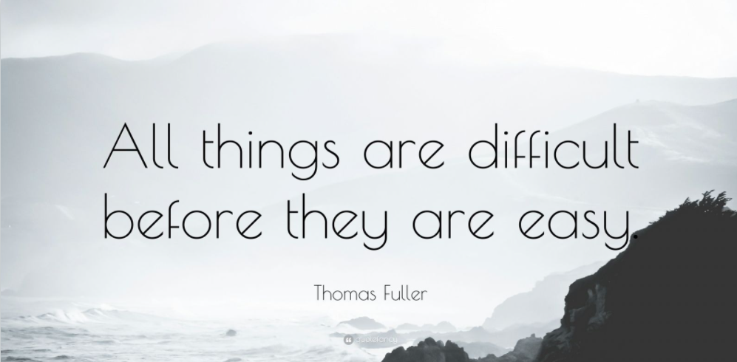
Notes:
I remember a number of people stated they wanted to meet new people at CT, well that is hard and everyone starts as a stranger until they are your best friend

Slide 6
Growth Mindset

Slide 7
Think & Discuss
Take a few minutes and check how you feel about each question on the handout I just gave you.
When time’s up, discuss your answers with a neighbor.
We won’t talk about each question as a larger group, but consider your answers as we discuss “growth mindset.”
Notes:
Use 1st page of this document:
https://docs.google.com/document/d/1MS2s2Xmydx-mnBnQdp3q1jucdeaUFfqAq-37CYb-QIo/edit

Slide 8

Here is an explanation of mindset:
This Photo by Unknown Author is licensed under CC BY-SA
Do you want to know more about creating a growth mindset? Here are more resources:
Mindset, Talks at Google
Assess your Mindset (alternate quiz—requires registration)
A Summary of Growth and Fixed Mindset

Slide 9
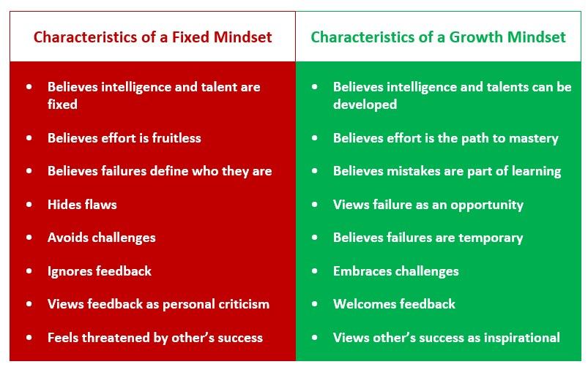
Attribution: https://thepeakperformancecenter.com/development-series/mental-conditioning/mindsets/fixed-mindset-vs-growth-mindset/

Slide 10
Habits of Fixed Mindset
College Students

Slide 11
What kinds of habits and practices do Fixed Mindset students have?

Slide 12
Fixed Mindset Behaviors:
Resistance
Procrastination
Notes:
10:40-10:45
Activate the poll

Slide 13
Resistance:
Pushing back
Refusing to engage or care about learning
Seeing anything challenging or hard to understand as “dumb” or “pointless.”
You do your work, but in a “mechanical”way–you follow directions and get the work done as quickly as possible, without caring about what you learn. Things that require intense effort or thought irritate you.
Notes:
10:40-10:45
Activate the poll

Slide 14
Procrastination
Voluntarily delaying a task or act unnecessarily and seemingly “irrationally,” even though this delay brings negative consequences
Often accompanied by negative feelings and possibly emotional dysregulation
Notes:
10:40-10:45
Activate the poll

Slide 15
What are some causes of procrastination?

Slide 16
Discuss: Which of these causes of procrastination are related to having a fixed mindset?
Anxiety/anxious feelings
Ego-identity protection
Fatigue/Burnout
Lack of motivation
Low self-esteem
Pessimism
“Self-sabotage”
Time management/executive functioning issues
Notes:
10:40-10:45
Activate the poll

Slide 17
Answer: Which of these causes of procrastination are related to having a fixed mindset?
Anxiety/Anxious feelings
Ego-identity protection
Fatigue/Burnout
Lack of motivation
Low self-esteem
Pessimism
“Self-sabotage”
Time management/executive functioning issues
Notes:
10:40-10:45
Activate the poll

Slide 18
Habits of Growth Mindset
College Students

Slide 19
What kinds of habits and practices do Growth Mindset students have?

Slide 20
Growth Mindset Behaviors:
Focus on building skills
Work with patience and engagement
Ask for what you need
Care for yourself
Notes:
10:40-10:45
Activate the poll

Slide 21
Building Skills & Growth Mindset (with Patience)

Slide 22
Skill-Building Activity: Understanding the Learning Beneath the Assignment
When your small group has gathered, identify a group scribe and a speaker.
Read the assignment prompt on the next slide. This is a typical assignment that a first year student might see.
As you read, try to identify the tasks that the assignment is asking you to accomplish. What does the assignment want you to do?
Next, look at the list of skills that is provided.
What SKILLS will you need to accomplish the tasks in the assignment?
Notes:
10 minutes
https://docs.google.com/document/d/15LwJWIIwZ-1aepkYRfGPOfM14ibkNltE/edit

Slide 23
UNIT 1: EDUCATION NARRATIVE
Now that we have read and thought about several different education narrative essays, it is time for you to create an education narrative of your own. In the education narratives we read, the writers discuss educational journeys and use their experiences as a way to draw conclusions about themselves, about education, or about the world in general. You will do the same! You may write about a single event in your educational life that transformed you or changed your way of thinking, or you may write about a series of events that all tie together to make a single point. In writing about your education, you want your reader to understand your interpretation of the events you describe and agree with your overall point (thesis).
Use the readings you have done as models to help you with this task. You may choose to use elements of several different pieces, or you may choose to use one of the pieces as a “mentor text” to help you structure your own work.
Your essay should do or have the following things:
Describe your own personal education experiences (a kind of “personal essay”) and be written in the first person (I/me pronouns)
Describe a single event/experience OR a series of different connected events/experiences
Be thoughtful—analyze your situation and its effect on you
Use specific details and precise language to convey the events and your feelings to the reader
Information should be divided into distinct, organized paragraphs
Should have a point of view and make an overall point about the events you describe and why they are significant
Should be approximately three pages or ~1000 words long

Slide 24
Questions for Discussion:
What did the assignment ask you to do?
What skills do you think you need to complete the assignment?
What was most challenging about reading the prompt and the list of skills?
Of the skills we discussed, which ones do you think you already have mastery of? Which ones have you partly mastered? Which ones do you still have to learn?
If you try to do the assignment without having mastery of all of those skills, what do you think will happen?
Why might a teacher give an assignment knowing that students might not yet have mastery of the skills needed to complete it?
How long to you think it might take to get full mastery of all of those skills? What can you do to have patience with yourself while you learn them?
How can having a Growth Mindset help you as you build skills?

Slide 25
Think back to our discussion of school resources from Session Four.
Which resources and services can help you be a Growth Mindset learner?

Slide 26
Recap
What is a Growth Mindset?
Fixed Mindset Habits
Growth Mindset Habits
Skills-Based Learning

Slide 27
Before Session 6…
Complete Reflection on OpenLab by replying to Reflection #5 Post.
Reflection #5
Consider the discussions we had today about mindset. Share a concept you believe is important and explain what the concept means to you as a college student.
Read and comment on another student’s post.

Slide 28
Get Your Head In the Game:
Mindset + Self-Advocacy
Session 5
Professor Jessica Penner
City Tech 101 by Karen Goodlad and Sarah Paruolo is licensed under a Creative Commons Attribution-NonCommercial-ShareAlike 4.0 International License.

