Slide 1
City Tech 101
Welcome!
Summer 2023
Professor Jessica Penner
jpenner@citytech.cuny.edu
City Tech 101 by Karen Goodlad and Sarah Paruolo is licensed under a Creative Commons Attribution-NonCommercial-ShareAlike 4.0 International License.

Slide 2
Academic Basics:
#WelcomeToCityTech
Session 1
Professor Jessica Penner
City Tech 101 by Karen Goodlad and Sarah Paruolo is licensed under a Creative Commons Attribution-NonCommercial-ShareAlike 4.0 International License.

Slide 3
Today’s Topics
Introductions
CT101 Syllabus + Schedule Review
Learning Tools
Instructional Modalities
Classroom Learning: Etiquette + Engagement
Online Learning: Etiquette + Engagement
Connect Day/Orientation
Campus Tour

Slide 4
Introductions

Slide 5
Connect with your Professor
Prof. Jessica Penner
jpenner@citytech.cuny.edu

Slide 6
What is a Peer Mentor?
Peer Mentors are role models who are eager to share their experiences and knowledge to help incoming City Tech students adjust to college life.
Attend CT101 with you every week
Send you Weekly Updates
Answer questions via email + office hours

Slide 7
Connect with your
Peer Mentor
Jason Birchfield
jason.birchfield@mail.citytech.cuny.edu

Slide 8
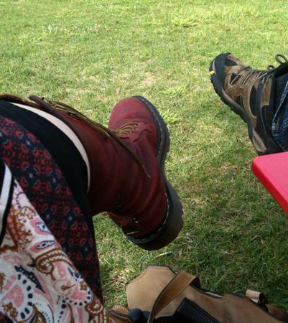
Meet My Feet
What did you learn about me?
What questions do you have?
In a moment, I’m going to group you with other students.
Share a brief story about your shoes.
After listening to each person’s story, be sure to talk about what you learned and ask questions!
You’ll get ~10 minutes, total!

Slide 9
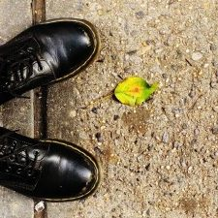
Let’s share!
Now, share what you learned about your partner(s).
What did you learn?
What questions did you have after they shared?

Slide 10
What will we do during the 8 sessions?
This workshop focuses on helping new students transition to college life, and specifically to City Tech. The workshop will enhance the new student experience with information, activities, and various opportunities to connect with faculty, staff, and current City Tech students. In addition to learning how to access a variety of college services and resources, students will develop personalized plans for their college career.

Slide 11
Syllabus + Schedule Review
Week 1
Session 1 > Academic Basics: #WelcomeToCityTech
Session 2 > The Syllabus and the Classroom
Session 3 > #RiseAndGrind
Session 4 > You Paid For It, Use It: Resources + Services
Week 2
Session 5 > Get Your Head in the Game: Mindset + Self-Care
Session 6 > #YellowJacketLife: The Buzz on Your Future
Session 7 > Coming to Terms with College Vocabulary
Session 8 > #aMAJORdecision

Slide 12
Have you completed the pre-workshop survey?
To get credit for successful completion of this workshop, you must complete it by today!
Check your email that you received info for this class for the link!

Slide 13
Learning Tools

Slide 14
Electronic Platforms Used at City Tech
Administrative Apps
CUNYFirst
Schedule Builder
DegreeWorks
General College Activities
City Tech Email (Outlook)
Microsoft Office
OneDrive (Microsoft)
DropBox
In the Classroom
Blackboard
OpenLab
Zoom
Blackboard Collaborate
Which of these are you familiar with?

Slide 15
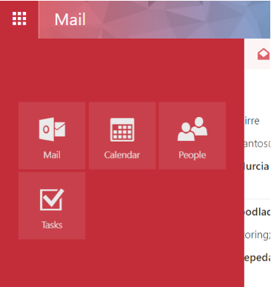
City Tech Email (Outlook)
Email
Calendar
Teams
Tasks

Slide 16
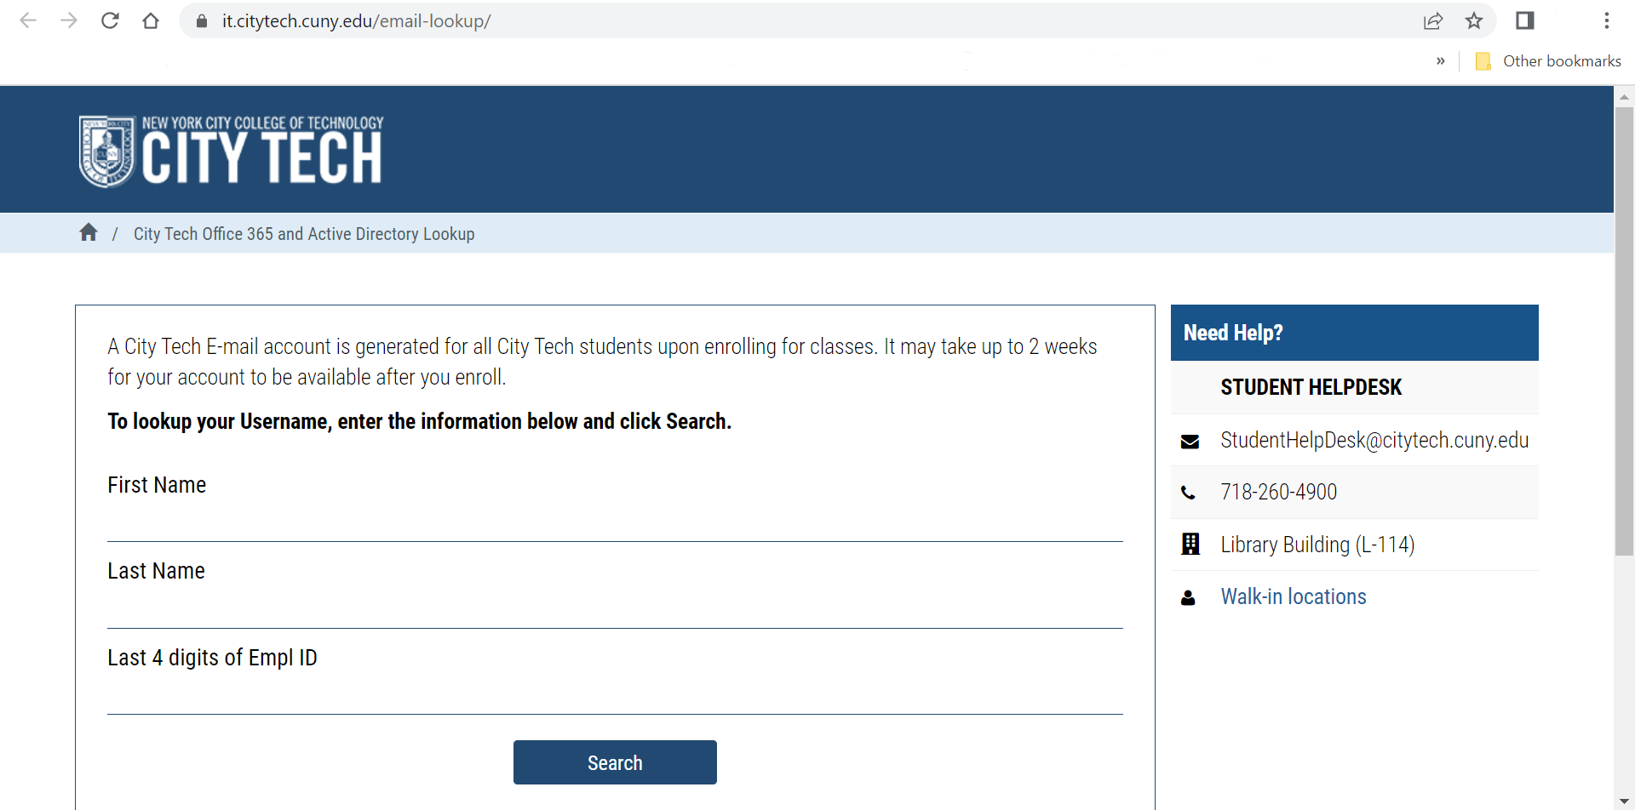
City Tech Email (Outlook)
Have you activated your email?
Notes:
http://cis.citytech.cuny.edu/Student/it_student_findemail.aspx

Slide 17
Activating Your City Tech Email (Outlook)
Visit Email Address Look Up to find your email.
Go to the Microsoft Office 365 email login at https://myapps.microsoft.com/
Log in using the following:
YourPassword: First initial of first name UPPERCASE + first initial of last name lowercase + MMDDYYYY + last 4 of your EMPL ID.
For example: If your name is John Doe and your date of birth is 01/06/1986 and the last four digits of your EMPL ID are 1234, your password is: Jd010619861234
You will be asked a number of security questions. If prompted to create a new password, do so, but make sure to write it down!
You will also need to complete your e-mail security verification, which will enable you to reset your password if you forget it. To do this:
Open a new tab in your browser and type https://myapps.microsoft.com in the address line.
Click Verify Now.
Set up authentication for cellphone and email and verify them. Set up security questions and answers.
Click Finish.
Click the Outlook icon to access your email.

Slide 18
Log in. What is the most recent message you have received?
Have you received emails from any of your professors?
What can you do in Outlook besides email?

Slide 19
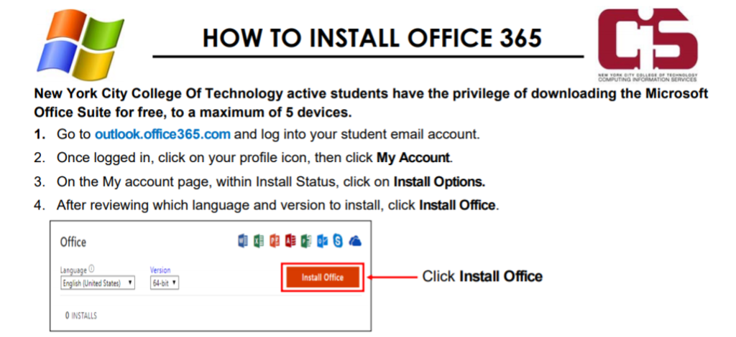
Students have access to Microsoft Word, Excel, Powerpoint, and
One Drive (cloud storage)!

Slide 20
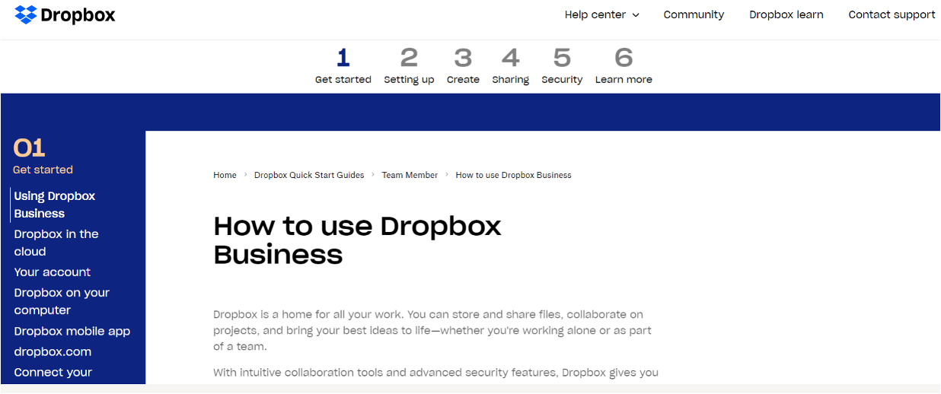
Some professors use DropBox for course materials and collecting student work.
Notes:
https://help.dropbox.com/guide/team/how-to-use-dropbox#how-to-use-dropbox-business

Slide 21

Blackboard (Bb) is a Learning Management System– this is where your courses live online. Some professors will use Bb to post syllabi, schedules, assignments, homework, quizzes, grades, etc.
Some professors will meet with their online or hybrid classes in Bb using Blackboard Collaborate Ultra. This is like Zoom, but built into Bb.
Notes:
https://bbhosted.cuny.edu/webapps/login/noportal

Slide 22
Log in to Blackboard…
Are any of your classes available yet?
Have any professors posted a welcome message or other info?
Don’t forget to complete your ESPARC training!

Slide 23
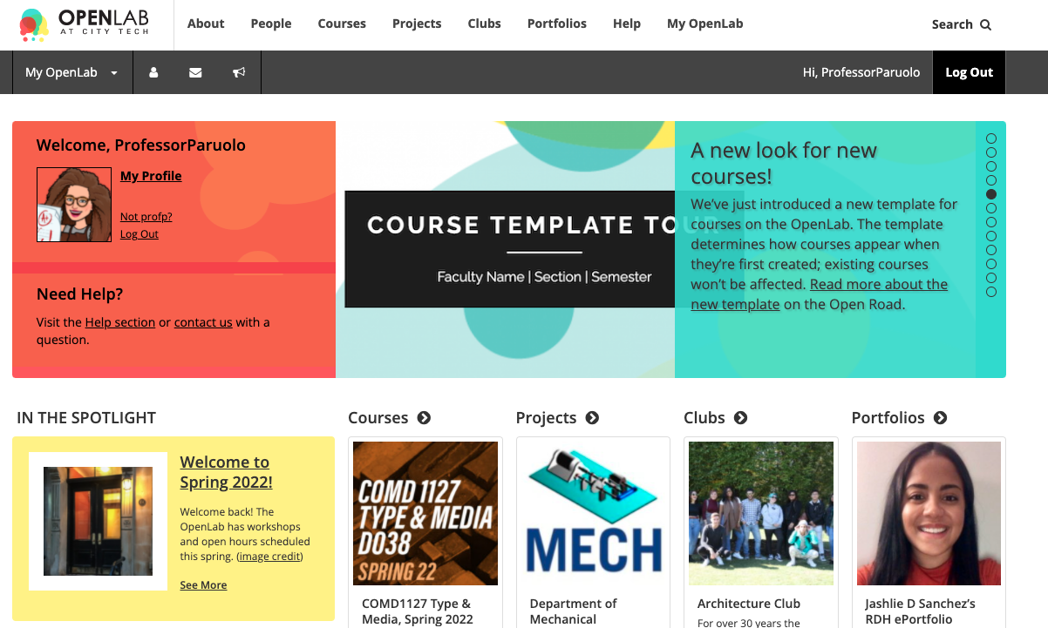
OpenLab (OL) is similar to Blackboard– this is a place where your courses live online. Some professors may use it in the same way as Bb. OL also has projects, clubs, and portfolios, which you will not find on Bb.
Notes:
https://openlab.citytech.cuny.edu/

Slide 24
We will be using OpenLab as the classroom management tool for our CT101 Workshop.
Please take a moment now to go to openlab.citytech.cuny.edu to set up your account and join this course!
https://openlab.citytech.cuny.edu/pennerct101summer2023/

Slide 25
How to Respond to a Reflection
Read the Reflection post.
Click on Comment.
Write your comment in the box.
Click Post.
Let’s take a minute to start your first reflection! You don’t have to finish it right away, but I want to be sure everyone knows how to do this!
Go to our OpenLab workshop site.
Click on Activities > Reflection > Reflection #1

Slide 26

Students use Zoom to attend online or hybrid classes, meet with professors, attend school events, and more.
Notes:
https://it.citytech.cuny.edu//docs/Login_CUNY_Zoom.pdf

Slide 27
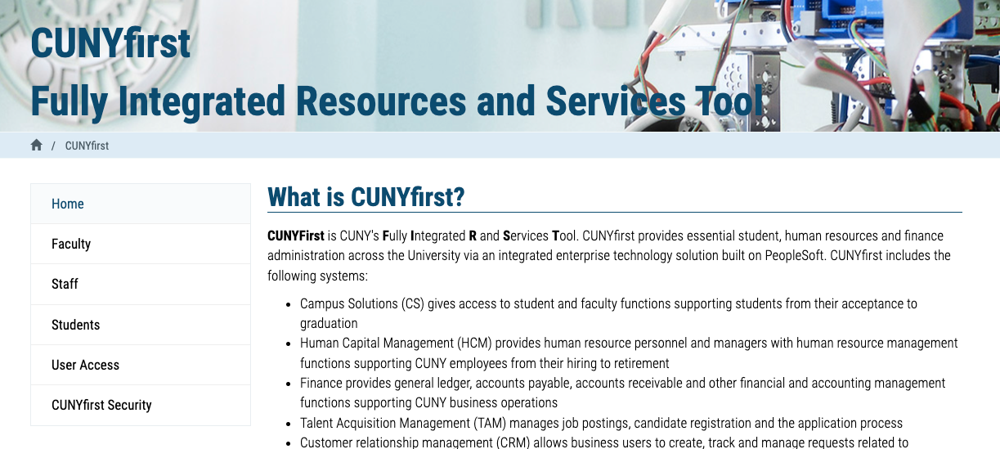
Students use CUNYfirst for management of almost all personal records.
Notes:
https://home.cunyfirst.cuny.edu/oam/Portal_Login1.html

Slide 28

Students use Schedule Builder to register for classes.
Notes:
https://www.cuny.edu/wp-content/uploads/sites/4/page-assets/about/administration/offices/registrar/resources/schedulebuilder/SB-student-guide_2.6.2020.pdf

Slide 29
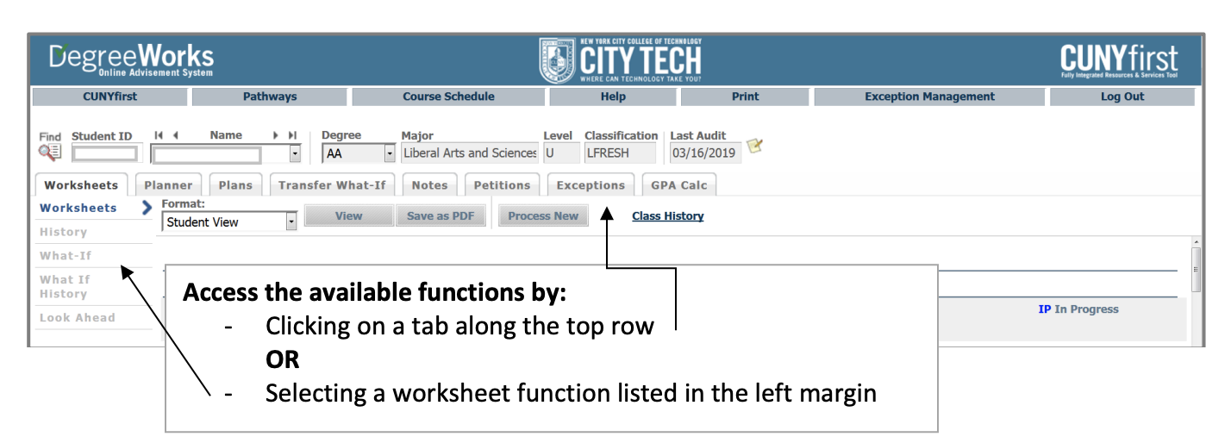
Students use DegreeWorks to track academic progress and degree requirements.

Slide 30
Instructional Modalities

Slide 31
Instructional Modalities at City Tech
In person
Online
  Synchronous
  Asynchronous
Hybrid

Slide 32
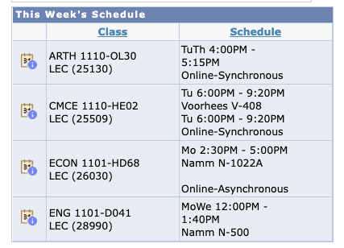
Modalities
Which class is fully in person?
Which class is Online, Synchronous?
Which class is Online, Asynchronous?
Which class is Hybrid?

Slide 33
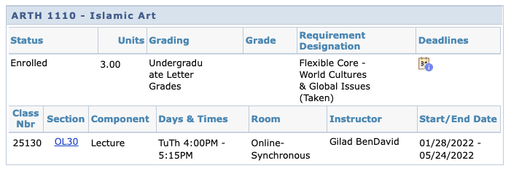
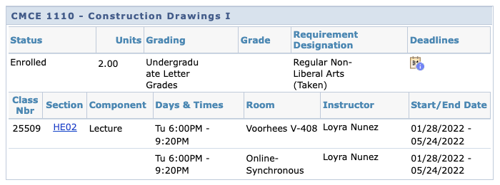

Slide 34
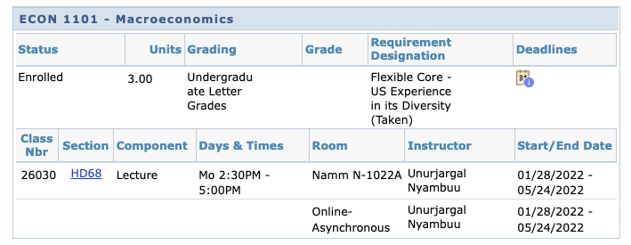
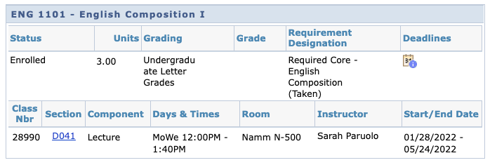

Slide 35
Learning Etiquette + Engagement

Slide 36
Classroom Learning: Etiquette + Engagement
Prepared to participate
Ready to take notes
Asking and answering questions
Addressing your professors
Active learning doesn’t always mean speaking up
Choose your seat wisely (when in person!)
Headphones off/out (again, in person)
Phones on silent and put away
Arriving late and leaving early
Excusing yourself during class

Slide 37
Online Learning: Etiquette + Engagement
Everything from Classroom Learning plus…
Camera on? Sure!
Camera off? That’s fine too.
Mute your microphone, not your voice!
Chatting to stay connected throughout class.
Breakout Rooms

Slide 38
Schedule Issues? CUNYfirst Issues? Communication Issues?
Stay at the end of the session today for help with your schedule or other problems.

Slide 39
Mark your calendars…

Slide 40
Department Connect Day
Connect Day for Fall 2023 takes place on August 31.
You can find more information on Connect Day here.

Slide 41
New Student Orientation
TUESDAY 8/15: School of Arts & Sciences
WEDNESDAY 8/16: School of Professional Studies
THURSDAY 8/17: School of Technology & Design
8:30 a.m.-4:30 p.m. in the Academic Building (285 Jay St.)
RSVP here.

Slide 42
Let’s take a tour!
Notes:
https://docs.google.com/document/d/1apeK0Zl95Q8qO_o1ixxz18Ud1T1ZhVAz/edit?usp=sharing&ouid=111774375294871248054&rtpof=true&sd=true

Slide 43
Recap
Introductions
CT101 Syllabus + Schedule Review
Learning Tools
Instructional Modalities
Classroom Learning: Etiquette + Engagement
Online Learning: Etiquette + Engagement
Connect Day/Orientation
Campus Tour

Slide 44
Before Session 2…
Download and review 1101 syllabi (plural of syllabus) posted on OpenLab.
  The syllabi can be found on our site underneath Help & Resources > Course Resources
Complete Reflection on OpenLab by replying to Reflection #1 Post.
  Remember, you must have an account and be logged in to OpenLab to reply to a post.
  How to Respond to a Reflection
Read the Reflection post.
Click on Comment.
Write your comment in the box.
Click Post.
Reflection #1
What do you want your classmates to know about you? Consider
sharing your goals as a college student, why you chose City Tech,
what you hope to learn in your first semester at City Tech or
anything important to you.
Read other classmate’s posts and help welcome each other by
writing a response.
Notes:
ADD LINK

Slide 45
Academic Basics:
#WelcomeToCityTech
Session 1
Professor Jessica Penner
City Tech 101 by Karen Goodlad and Sarah Paruolo is licensed under a Creative Commons Attribution-NonCommercial-ShareAlike 4.0 International License.

