Slide 1

Compiling a Client List
Business 0f Illustration

Slide 2
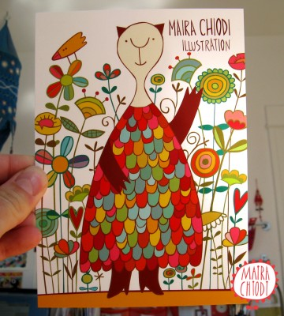
Building a Contact List
In order to promote yourself as an illustrator, you need to get your work into the right people’s hands.
The traditional way is to send out a promotional mailer.
Before you can do that, though, you need to build a solid contact list of art directors to send it to.

Slide 3
Building a Contact List
There are three vital pieces of information necessary for a complete contact:
The name of a company that commissions illustration
The art director’s name at that company
The address to send your promo to
The first one is fairly straightforward: just look at wherever you see illustration and jot it down.
The second one can be a lot more difficult, though, since finding the art director’s name may take a bit of work.
The third one is usually a simple Google search away once you know #1 and #2.
The following represent some of the options that are available towards building a list that contains all of the above.

Slide 4
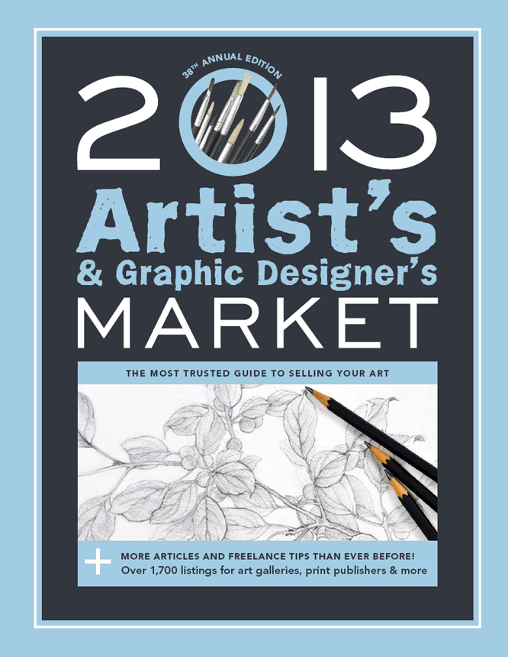
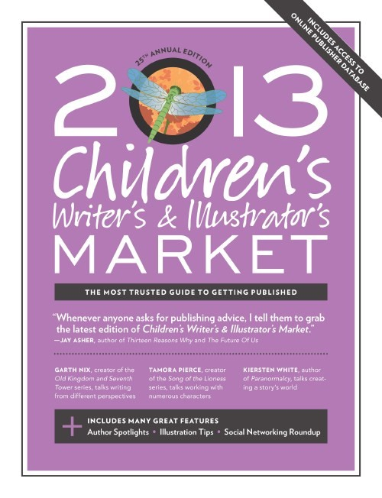
Artist's & Graphic Designer's Market
Is a reference guide for artist’s and designers who wants to establish or expand a career in fine art, illustration or graphic design.
Inside you'll find more than 650 listings for children's book markets (publishers, agents, magazines, and more)--including a point of contact, how to properly submit your work, and what categories each market accepts.

Slide 5
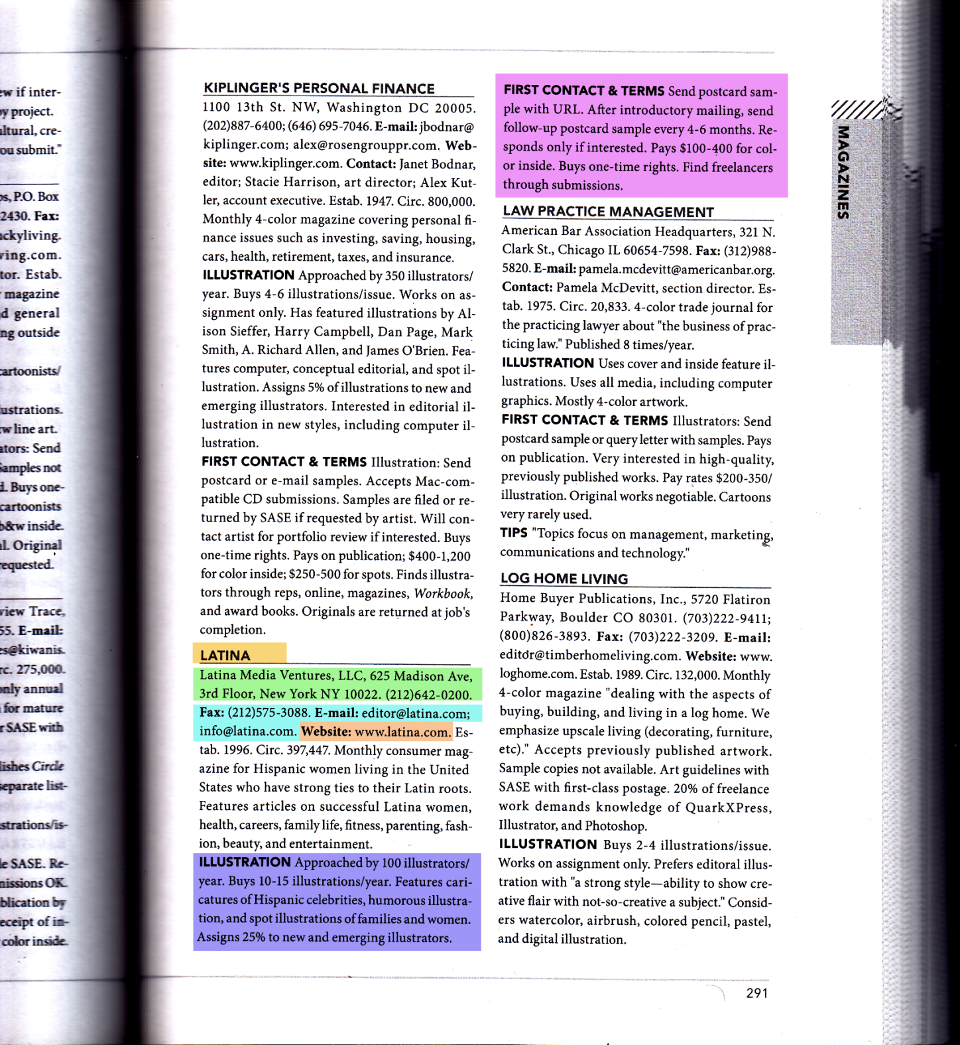
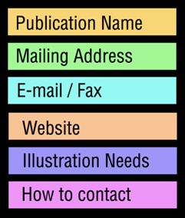
Artist's & Graphic Designer's Market

Slide 6
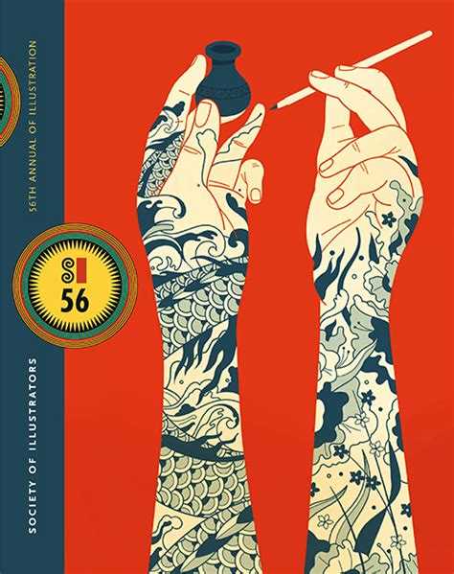
Annuals
There are a variety of illustration annuals that come out every year, the most well-known being The Society of Illustrators Annual, American Illustration Annual, and Communication Arts Annual.
If you look at the information for each entry, it will list the art director and the company for whom it was commissioned.
Write it down, Google the address, and you’re good to go! (Side note: businesses fail regularly and people job hop quite a bit, so only use the most recent annuals.)

Slide 7
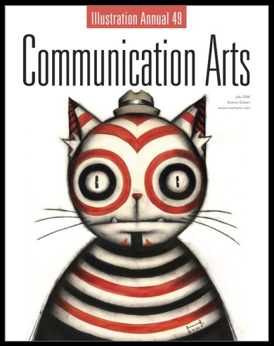
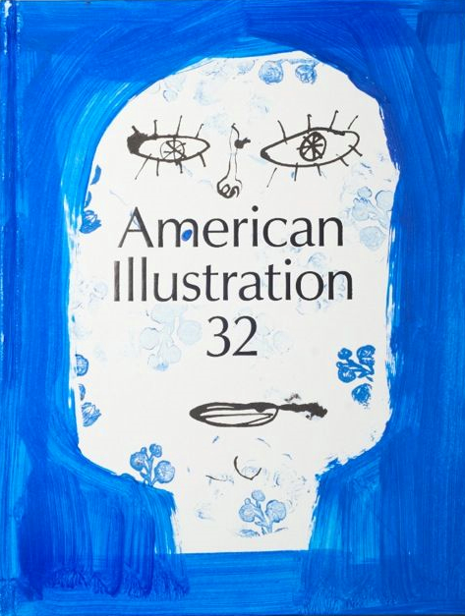

Slide 8
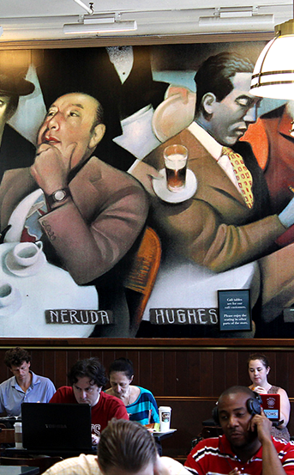
Bookstores
Go to your local bookstore and browse through the magazine and newspaper section. Look at the periodicals that commission illustration on a frequent basis (skip magazines and papers that use illustration sporadically as the odds will be stacked against you). In the front, they’ll list a masthead. That will give you all the information you need.
If you see yourself as a book cover artist, go to the book section and check out the jacket flaps of some recent books. Usually on the back flap towards the bottom you’ll see the phrase, “Jacket design by ___.” In most instances, that’s the same person who commissioned the art. If it’s an illustrated book, look on the copyright page. If they list the interior designer (it will usually say something like “Interior design by ___” or “Typography by ___”) then that may very well be the person who commissioned the interior art.

Slide 9
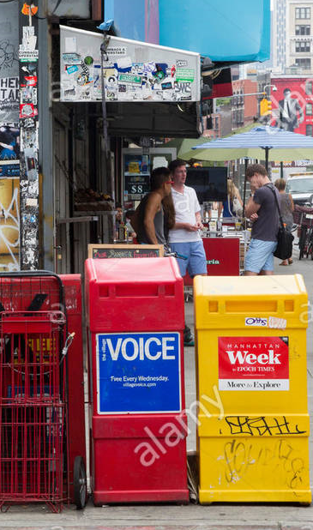
Websites
There’s a lot of useful information on the web to find art directors and companies who commission illustration, including:
LinkedIn
LinkedIn can be a great resource. Just type in “Art Director” into the search field and look at the wealth of information that pops up.
AltWeeklies
Every major city has at least one alternative newsweekly. Altweeklies are those free papers you see in bins on the street . They’re amazing places to get your first gigs. Since they don’t pay very much, they’re always looking for young talent willing to work relatively cheap.
A great resource that compiles data on all the alt-weekly papers is altweeklies.com. You can do a people search through their directory to find all the art directors and their associated publications currently listed. That’s over 150 contacts!

Slide 10
Websites
Illustrator Websites
If you go to the portfolio sites of your favorite illustrators, there’s a good chance that person may list the art director and client next to each piece that was commissioned. If not, check out his or her blog and social media links where, oftentimes, he or she may give a shout-out to whomever commissioned the work when it’s posted. If you already follow a bunch of illustrators on Twitter or Facebook, you don’t have to comb through their feeds; just remember to jot down any information when it comes up.
Behance
Behance is also a great illustration resource if you dig around enough. You may only be able to find a client for a specific project someone did, but at least that’s a start. From there, you can try to Google the other information.

Slide 11
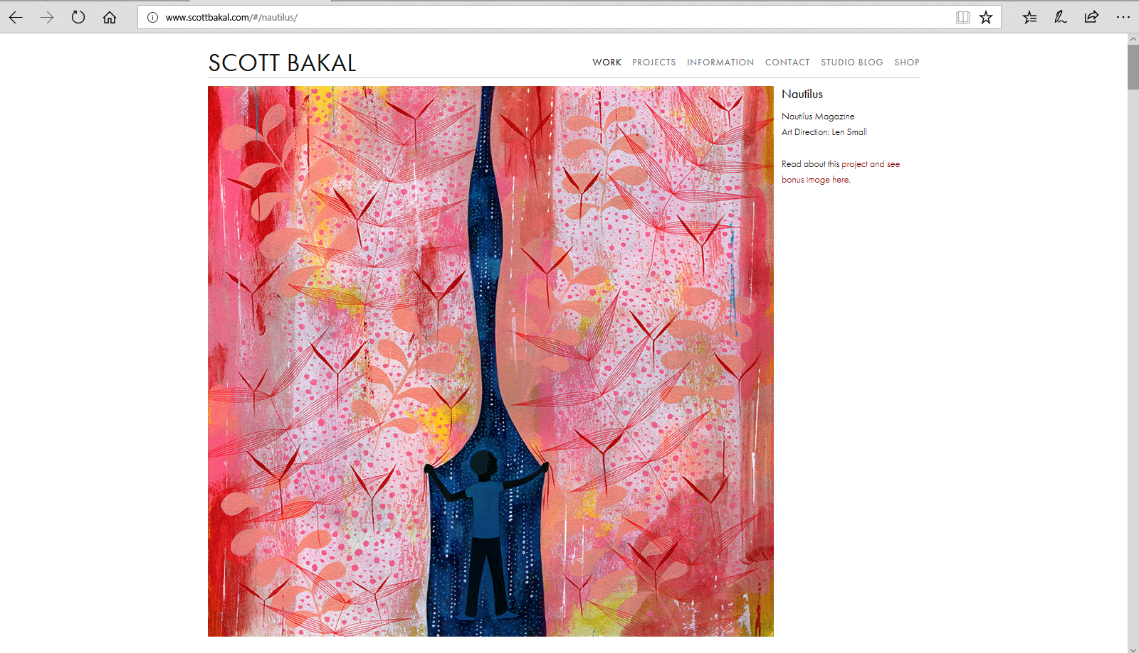

Slide 12

Networking
Another great way to find out about art directors is to actually leave your house/studio and go to illustration-related events.
If you’re particularly social, you’ll have no problem making contacts to send your work to.
Check out events like the American Illustration party, receptions at The Society of Illustrators, and the occasional show at The New York Times offices among others.

Slide 13
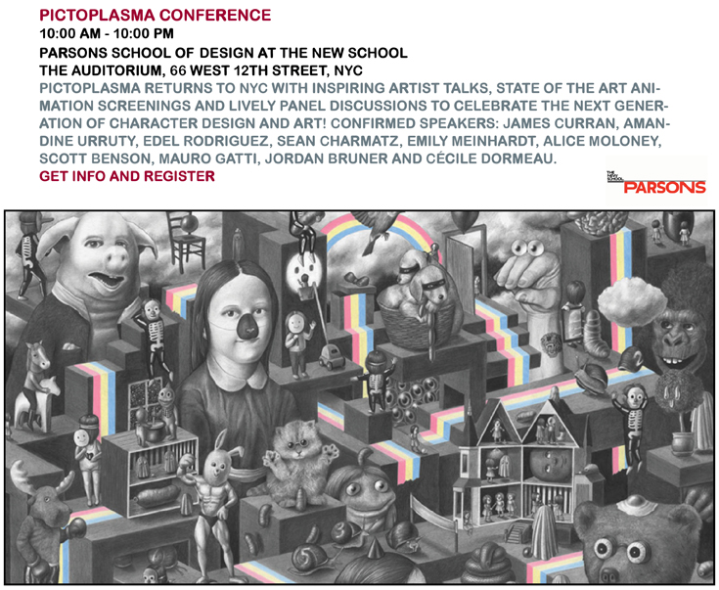

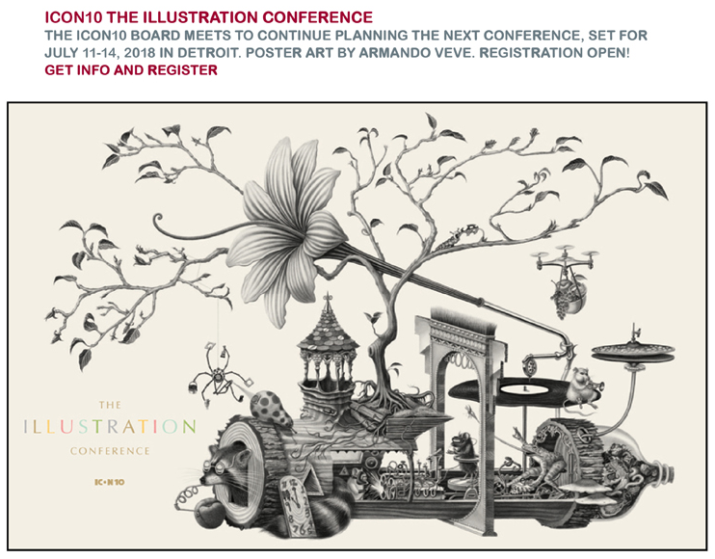
Networking
Illustration Week
Each year, the Society of Illustrators, along with other participating illustration organizations, hosts events for illustrators from all over the world visiting NYC during the first full week of November.

Slide 14
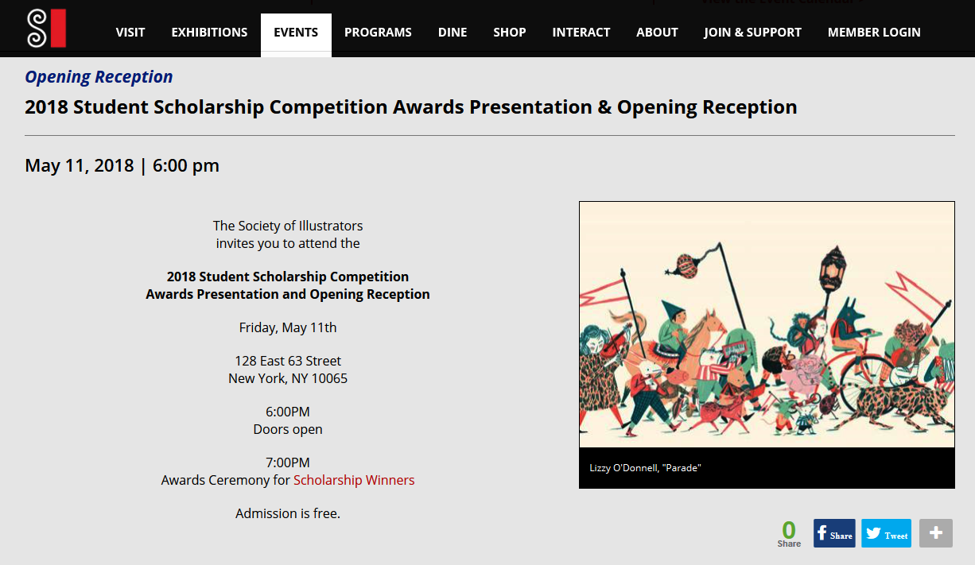
Networking

Slide 15

Conferences
Conferences can also be a good way to find out about art directors and prospective clients. There are many illustration-related conferences like ICON, and MOCCA Fest hosted by the Society of Illustrators, and various design talks all throughout NYC and other large cities.
You don’t necessarily need to attend these conferences to get the contact names, though.
Simply go to the conference website and jot down who the speakers and special guests will be and that should be enough info to get you started.

Slide 16
Pay Lists
Of course, if all this researching seems like a drag, you could very easily just purchase a list.
While they do cost a bit of money, consider that they’re targeted, frequently updated, and contain many names and publications you would never discover on your own (particularly for advertising and industry-specific publications).
The most well-known supplier is Agency Access, which, for roughly $800, will give you access to their database plus 1,500 contacts for direct email blasts.
Definitely worth doing when you’re ready for a large mailing

Slide 17
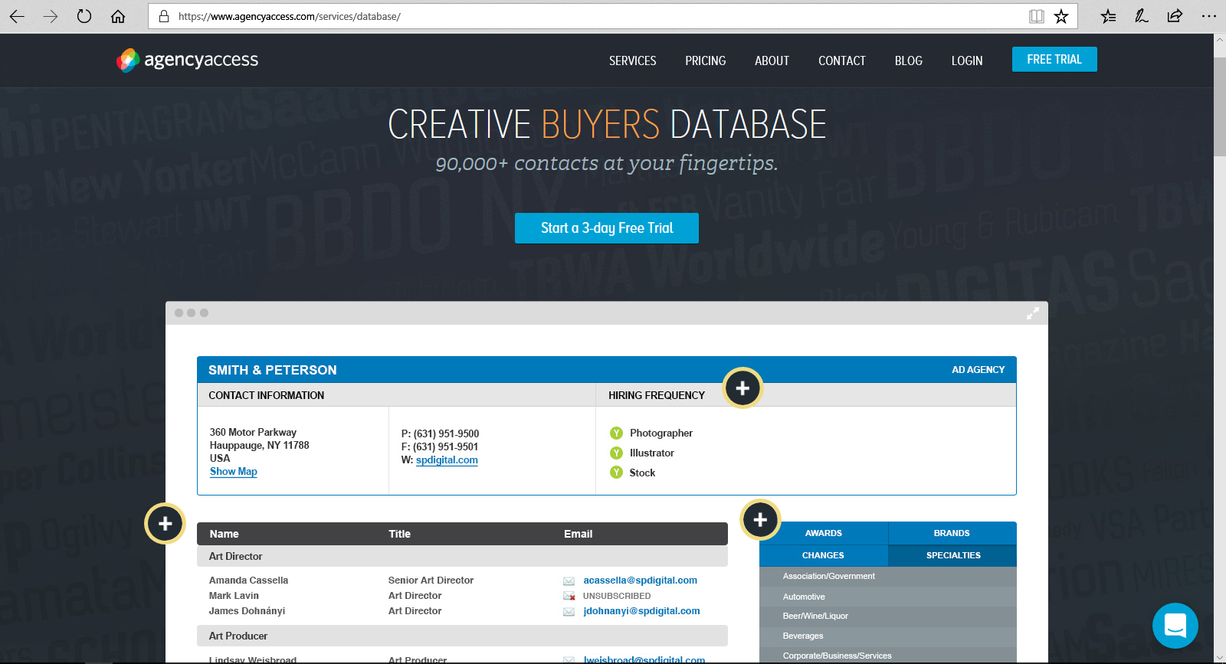

Slide 18


Final Thoughts
As you can see, there are a variety of ways to go about acquiring contact information for your promotional mailers.
However, just because you do obtain a contact, doesn’t mean that person is appropriate to send your work to. Consider the type of illustration that the particular art director and client use to see if your art fits into their niche.
For instance, it wouldn’t make sense to send your erotic nudes to a children’s book publisher, and Playboy may not be interested in your anthropomorphic cartoon turtles either.
So, as you’re compiling all of this information, you’ll want to weed out the places that just won’t be a good fit.

Slide 19
Final Thoughts
Consider, as well, that there may be more than one art director at a particular company. If it’s appropriate, feel free to send a promo to all the art directors there as each may have a different use for—or opinion about—your work.
Finally, start small. While it’s nice to have a huge list, if this is your first promotional mailer, 1,000 postcards may be a bit excessive until you test the waters.
To start, I’d recommend compiling a highly targeted list of 100 – 200 people who would actually conceivably use your work. From there, you can continue to grow your list into larger mailings as you get more work and higher profile clients.
One of my biggest clients contacted me through a promotional booklet that was sent to a different book publisher.

Slide 20
Assignment 3: Promotional Piece
Due next week.
PART 1:
Compile a list of ten possible clients that fit what you consider to be
your niche. Include the following info:
The name of a company that uses YOUR type of illustration
The art director’s name at that company
The address to send your promo to
PART 2:
Create several rough sketch ideas for a prom piece.
Sketch sizes: 5”X7” (72 dpi)
Final Art Size: 8.5” X 12” (300 dpi)

Slide 21


