Slide 1
City Tech 101
Spring 2023
Session 6
City Tech 101 by Karen Goodlad and Sarah Paruolo is licensed under a Creative Commons Attribution-NonCommercial-ShareAlike 4.0 International License.

Slide 2
#YellowJacketLife:
The Buzz on Your Future
City Tech 101
Session 6
City Tech 101 by Karen Goodlad and Sarah Paruolo is licensed under a Creative Commons Attribution-NonCommercial-ShareAlike 4.0 International License.

Slide 3
Today’s Topics
Why Participate?
Co-curriculars @City Tech
Extracurriculars @City Tech
Department Connect Day/New Student Welcome
Beginning of Semester Action Plan
Next Steps

Slide 4
Why Participate?

Slide 5
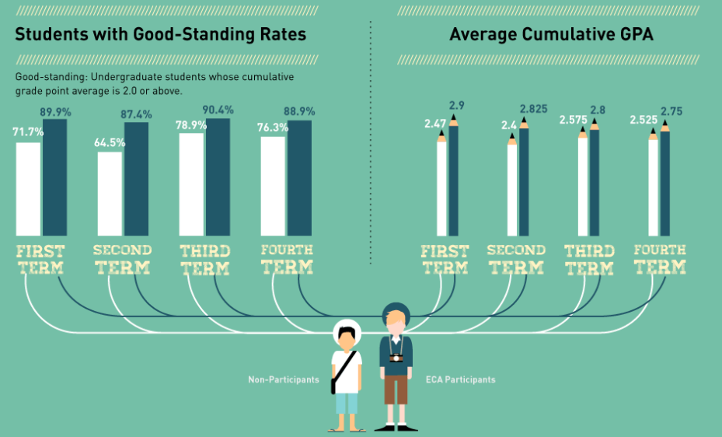

Slide 6
Building Skills Through Participation
Decision-Making Skills
Interpersonal Skills
Managerial Skills
General Workplace Knowledge

Slide 7
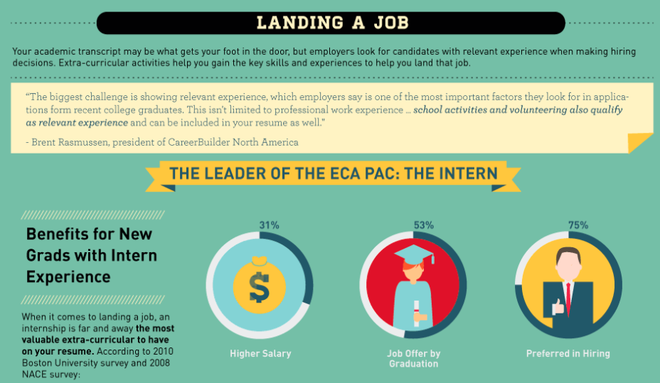

Slide 8
Sources
Boston University
California State University, Sacramento
Careerbuilder.com
The College Board
Collegiate Assessment
Elearninginfographics.com
Graduate Management Admissions Council
Harris Interactive
National Association of Colleges and Employers
National Center for Education Statistics
Stanford University

Slide 9
Co-curriculars
@City Tech

Slide 10
Co-curricular
Extracurricular
Programs, clubs, + activities directly related to what you are studying in college
Programs, clubs, + activities NOT directly related to what you are studying in college, but still relevant to your growth as a student

Slide 11
Co-curricular Examples
Honors Scholars Program Internships/Externships
Emerging Scholars Program Clubs related to a major or department
Undergraduate Research Events related to a major or department
Academic Competitions Study Abroad Programs
Place-based Learning
More information: http://citytech.cuny.edu/research/
http://www.citytech.cuny.edu/pdc/
https://www.citytech.cuny.edu/student-life/

Slide 12
Extracurriculars
@City Tech

Slide 13
Co-curricular
Extracurricular
Programs, clubs, + activities directly related to what you are studying in college
Programs, clubs, + activities NOT directly related to what you are studying in college, but still relevant to your growth as a student

Slide 14
Extracurricular Examples
Affinity Clubs (ex. Bengali Students Club, Chinese Christian Fellowship)
Social Clubs (ex. E-sports Club, Step Team)
Student Government
Peer Mentoring (ex. FYP Peer Mentors, Perkins Peer Advisement)
Social Events (ex. Welcome Back Bash, De-Stress Week)
Community Events (ex. PLAN Week, Literary Arts Festival)
Volunteering (ex. Spoons Across America)
More information: https://www.citytech.cuny.edu/student-life/
https://www.citytech.cuny.edu/sga/

Slide 15
If you can’t find what you are looking for...
Start your own club!

Slide 16
How To Get Involved
SLD website
OpenLab
Instagram
Facebook
Flyers on campus
Club + Activities Fair
Email Announcements
Discord Chat
Weekly PM Newsletter

Slide 17
Department Connect Day
+
New Student Welcome

Slide 18
Beginning of Semester
Action Plan

Slide 19
Recap
Why Participate?
Co-curriculars @City Tech
Extracurriculars @City Tech
Department Connect Day/New Student Welcome
Beginning of Semester Action Plan
Next Steps

Slide 20
Before Session 7…
Complete Reflection on OpenLab by replying to Reflection #6 Post.
Reflection #6
We invite you to tell a story about how you are preparing to be a City Tech student*. Research has shown that first-semester students often worry about their transition to college, yet eventually they become comfortable and find a community of people with whom they are close and feel they belong. Share your own story of preparing to be a college student.
*This reflection is inspired by the “Our Stories” project. You can visit the site and read the stories of other City Tech students. You are invited to comment on these stories.

Slide 21
#YellowJacketLife:
The Buzz on Your Future
City Tech 101
Session 6
Date
Professor
City Tech 101 by Karen Goodlad and Sarah Paruolo is licensed under a Creative Commons Attribution-NonCommercial-ShareAlike 4.0 International License.

