Slide 1
City Tech 101
Welcome!
Spring 2023
City Tech 101 by Karen Goodlad and Sarah Paruolo is licensed under a Creative Commons Attribution-NonCommercial-ShareAlike 4.0 International License.

Slide 2
Academic Basics:
#WelcomeToCityTech
City Tech 101
Session 1
City Tech 101 by Karen Goodlad and Sarah Paruolo is licensed under a Creative Commons Attribution-NonCommercial-ShareAlike 4.0 International License.

Slide 3
Today’s Topics
Introductions
CT101 Syllabus + Schedule Review
Learning Tools
Classroom Learning: Etiquette + Engagement
Online Learning: Etiquette + Engagement
Instructional Modalities
If the walls could talk…

Slide 4
Introductions

Slide 5
Connect with your Professor
Prof. Name and Email

Slide 6
What is a Peer Mentor?
Peer Mentors are role models who are eager to share their experiences and knowledge to help incoming City Tech students adjust to college life.
Attend CT101 with you
Send you Weekly Updates during the Fall semester
Answer questions via email + at weekly office hours

Slide 7
Connect with your
Peer Mentors
Name and Email
Name and Email

Slide 8
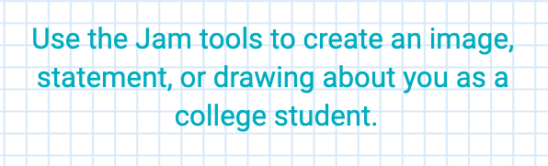
Jamboard
or
Other Ice Breaker Activity
Notes:
ht

Slide 9
What will we do during the eight sessions?
This workshop focuses on helping new students transition to college life, and specifically to City Tech. The workshop will enhance the new student experience with information, activities, and various opportunities to connect with faculty, staff, and current City Tech students. In addition to learning how to access a variety of college services and resources, students will develop personalized plans for their college career.

Slide 10
Syllabus + Schedule Review
Session 1 > Academic Basics: #WelcomeToCityTech
Day/Date/Time
Session 2 > The Syllabus
Day/Date/Time
Session 3 > #RiseAndGrind
Day/Date/Time
Session 4 > You Paid For It, Use It: Resources + Services
Day/Date/Time
Session 5 > Get Your Head in the Game: Mindset + Self-Advocacy
Day/Date/Time
Session 6 > #YellowJacketLife: The Buzz on Your Future
Day/Date/Time
Session 7 > Coming to Terms with College Vocabulary
Day/Date/Time
Session 8 > #aMAJORdecision
Day/Date/Time

Slide 11
Learning Tools

Slide 12
Electronic Platforms Used at City Tech
General College Activities
CUNYFirst
Schedule Builder
DegreeWorks
Communication
City Tech Email (Outlook)
Microsoft Office
OneDrive (Microsoft)
DropBox
In the Classroom
Blackboard
OpenLab
Zoom
Blackboard Collaborate
Which of these are you familiar with?

Slide 13
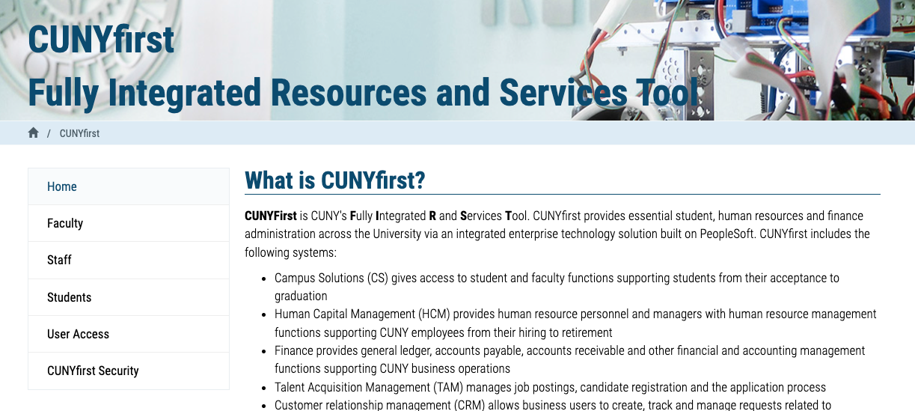
Students use CUNYfirst for management of almost all personal records.
Notes:
https://home.cunyfirst.cuny.edu/oam/Portal_Login1.html

Slide 14

Students use Schedule Builder to register for classes.
Notes:
https://www.cuny.edu/wp-content/uploads/sites/4/page-assets/about/administration/offices/registrar/resources/schedulebuilder/SB-student-guide_2.6.2020.pdf

Slide 15
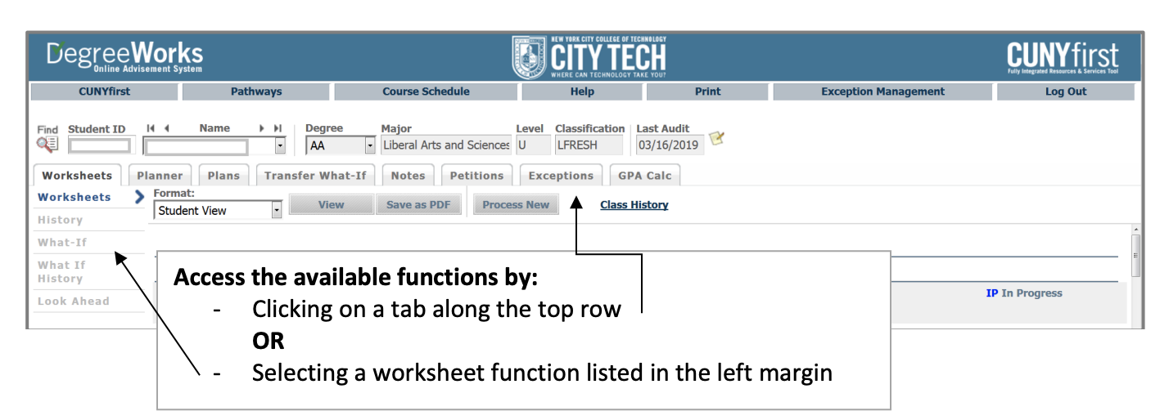
Students use DegreeWorks to track academic progress and degree requirements.

Slide 16
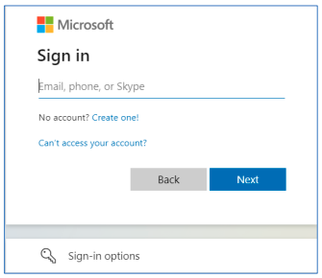
City Tech Email (Outlook)
Have you activated your email?
Notes:
http://cis.citytech.cuny.edu/Student/it_student_findemail.aspx

Slide 17
Activating Your City Tech Email (Outlook)
1. Visit Email Address Look Up to find your email.
2. Go to the website: myapps.microsoft.com.
3. Enter your Student Email, then click Next.
4. Enter the temporary password: (First initial of your first name (must be capitalized), First initial of your last name (must be lower case), your date of birth in the format MMDDYYYY and the last 4 digits of your EMPL ID e.g. JdMMDDYYYY9367 then click Sign in.
5. Click Next on the More information required page.
6. Additional Security Verification, Step 1: How should we contact you? Enter your phone number (numbers ONLY) and select Method Send me a code by text message, click Next.
7. Check to see the verification sent via text. Enter the 6 digit code and click Verify
8. If verification has been completed you should be presented with a Verification Successful message. Click Done.
9. Enter the current password, new password, confirm your new password, and click Sign in.
10. Click on the Outlook icon to access your email account.
Notes:
http://cis.citytech.cuny.edu/Student/it_student_findemail.aspx

Slide 18
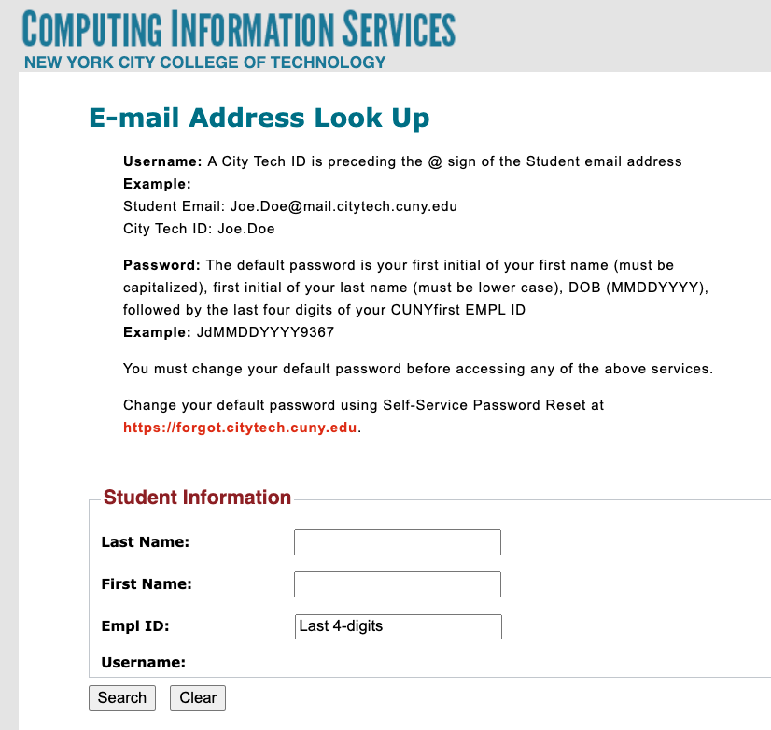
City Tech Email (Outlook)
What is the most recent message you received?
Have you received emails from any of your professors?
What can you do besides email?
Notes:
http://cis.citytech.cuny.edu/Student/it_student_findemail.aspx

Slide 19
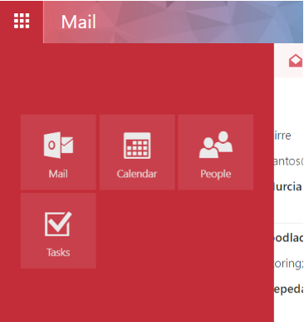
City Tech Email (Outlook)
Email
Calendar
Teams
Tasks

Slide 20
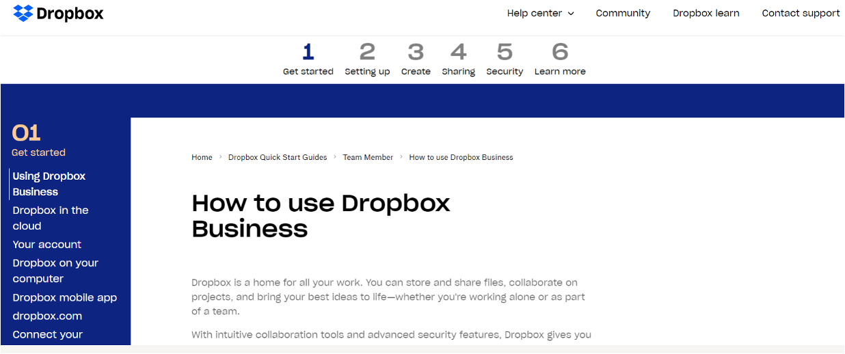
Some professors use DropBox for course materials and collecting student work.
Notes:
https://help.dropbox.com/guide/team/how-to-use-dropbox#how-to-use-dropbox-business

Slide 21
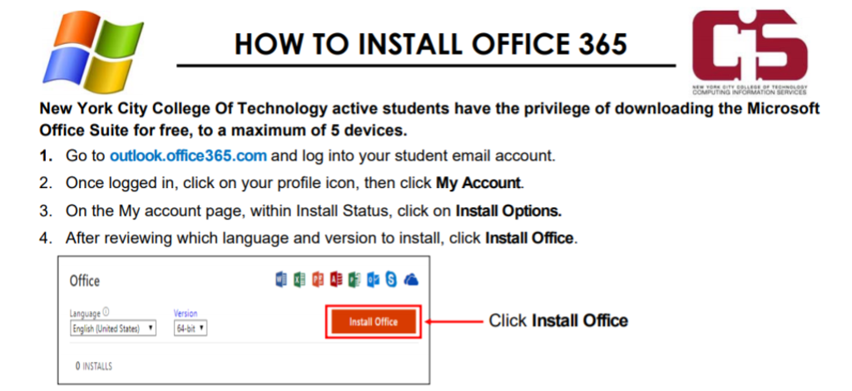
Students have access to Microsoft Word, Excel, Powerpoint, and
One Drive (cloud storage)!

Slide 22

Blackboard (Bb) is a Learning Management System– this is where your courses live online. Some professors will use Bb to post syllabi, schedules, assignments, homework, quizzes, grades, etc.
Some professors will meet with their online or hybrid classes in Bb using Blackboard Collaborate Ultra. This is like Zoom, but built into Bb.
Notes:
https://bbhosted.cuny.edu/webapps/login/noportal

Slide 23
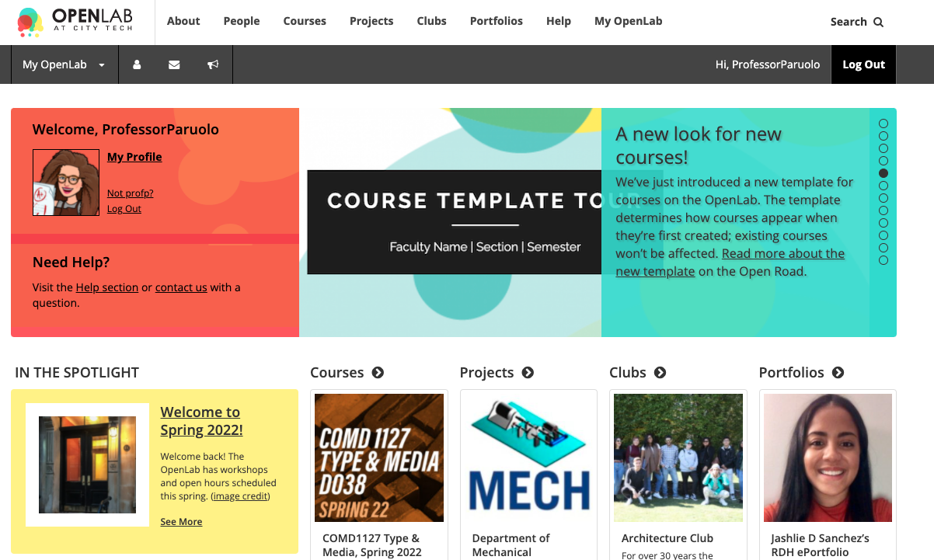
OpenLab (OL) is similar to Blackboard– this is a place where your courses live online. Some professors may use it in the same way as Bb. OL also has projects, clubs, and portfolios, which you will not find on Bb.
Notes:
https://openlab.citytech.cuny.edu/

Slide 24

Students use Zoom to attend online or hybrid classes, meet with professors, attend school events, and more.
Notes:
https://it.citytech.cuny.edu//docs/Login_CUNY_Zoom.pdf

Slide 25
Learning Etiquette + Engagement

Slide 26
Classroom Learning: Etiquette + Engagement
Prepared to participate
Ready to take notes
Asking and answering questions
Addressing your professors
Active learning doesn’t always mean speaking up
Choose your seat wisely
Headphones off/out
Phones on silent and put away
Arriving late and leaving early
Excusing yourself during class

Slide 27
Online Learning: Etiquette + Engagement
Everything from Classroom Learning plus…
Camera on? Sure!
Camera off? That’s fine too.
Mute your microphone, not your voice!
Chatting to stay connected throughout class.
Breakout Rooms

Slide 28
Instructional Modalities

Slide 29
Instructional Modalities at City Tech
In person
Online
  Synchronous
  Asynchronous
Hybrid

Slide 30
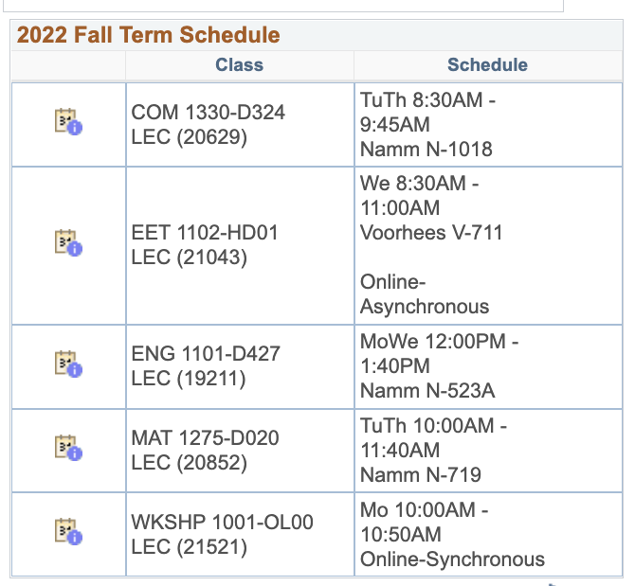
Modalities
Which class is fully in person?
Which class is Online, Synchronous?
Which class has an Online, Asynchronous component?
Which class is Hybrid?

Slide 31
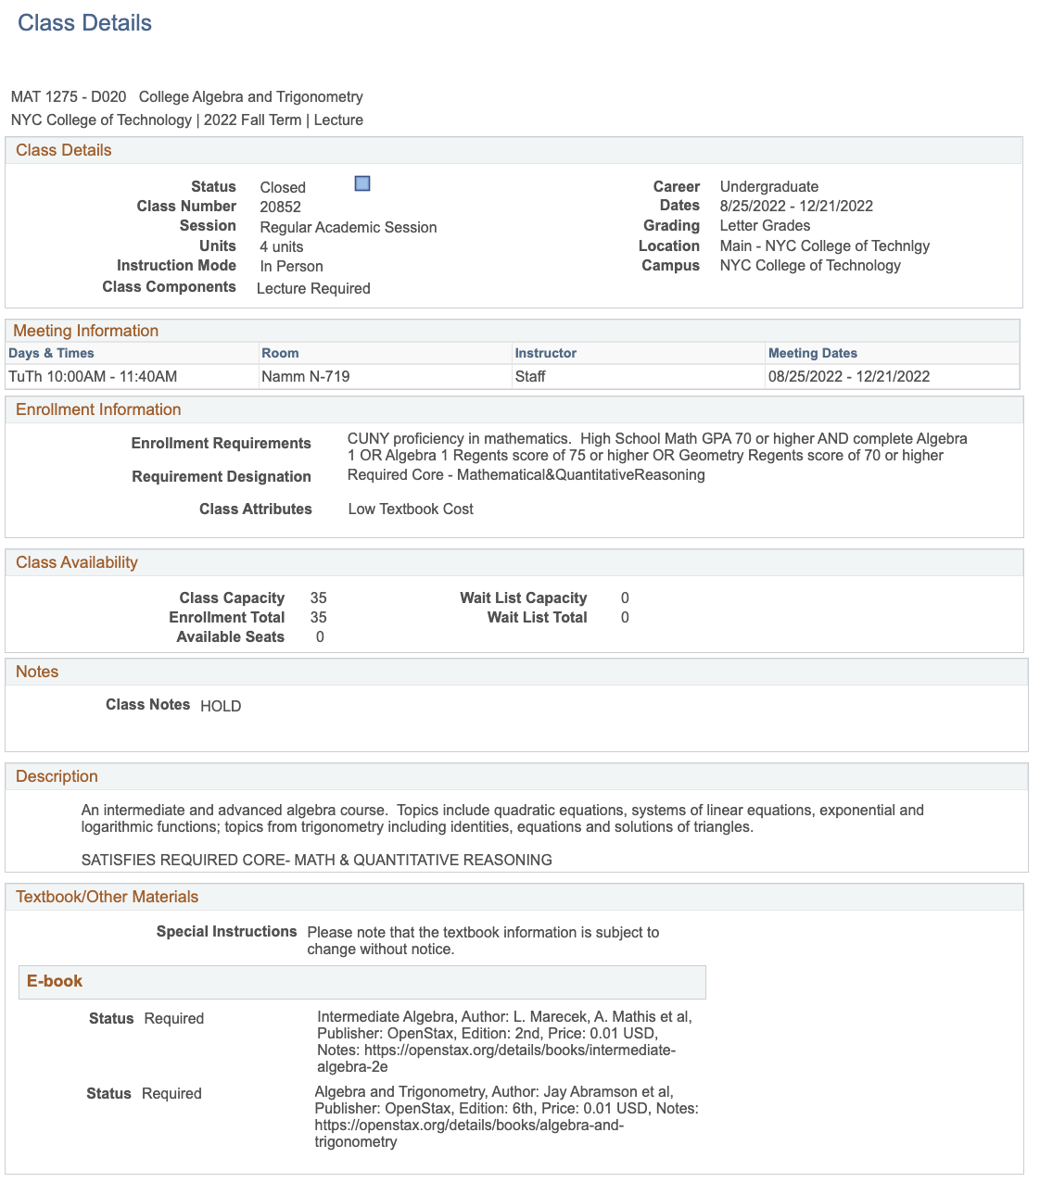
In-person

Slide 32
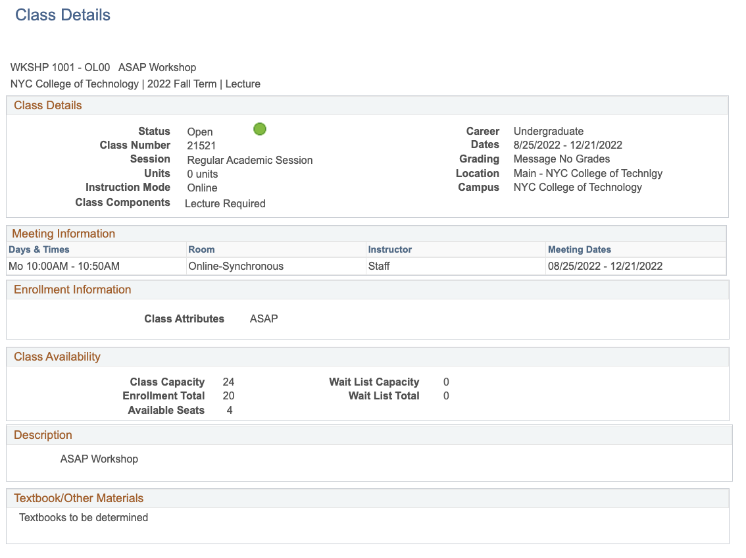
Online, Synchronous

Slide 33
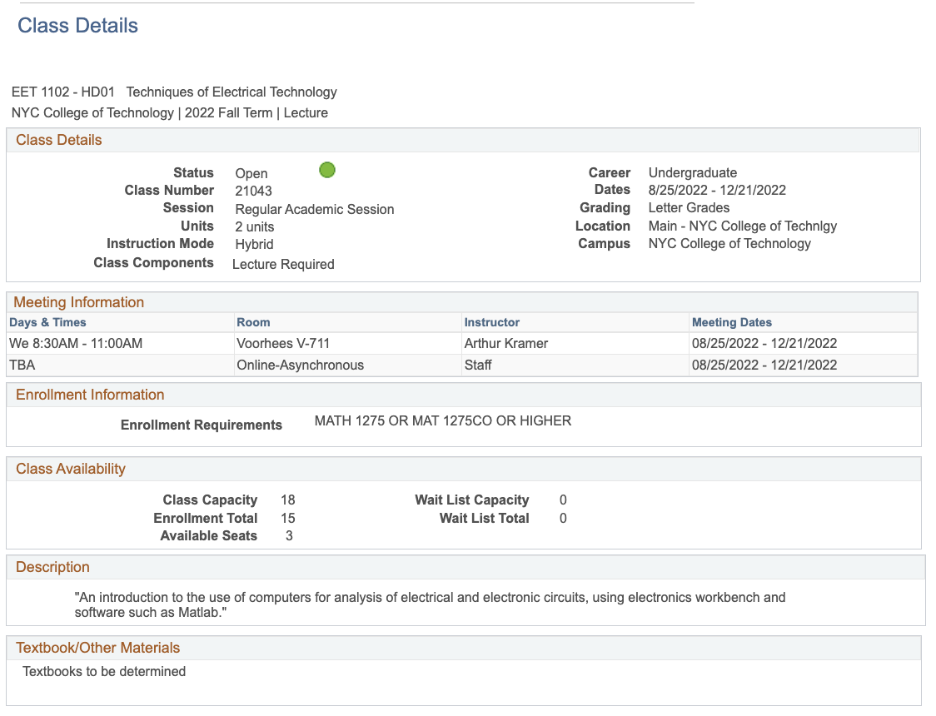
Hybrid

Slide 34
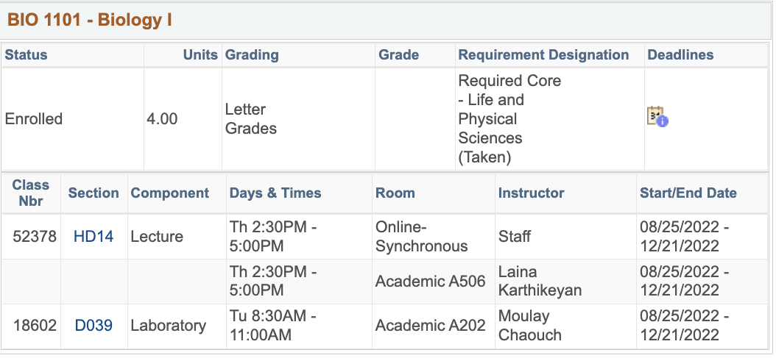
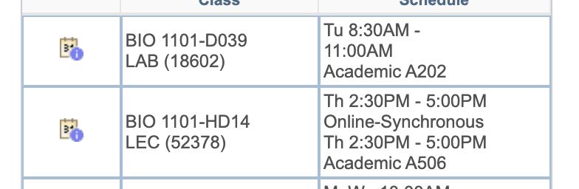
Hybrid with Lab

Slide 35
Schedule Issues?
Stay at the end of the session today for help with your schedule.

Slide 36
If the walls could talk…
Notes:
https://docs.google.com/document/d/1apeK0Zl95Q8qO_o1ixxz18Ud1T1ZhVAz/edit?usp=sharing&ouid=111774375294871248054&rtpof=true&sd=true

Slide 37
Course Information
Next Meeting: ADD DATE
Workshop Location: ADD ROOM
Open Lab site: ADD LINK
Prof. email: ADD LINK
Peer Mentor 1 Email: ADD LINK
Peer Mentor 2 Email: ADD LINK

Slide 38
Recap
Introductions
CT101 Syllabus + Schedule Review
Learning Tools
Classroom Learning: Etiquette + Engagement
Online Learning: Etiquette + Engagement
Instructional Modalities
If the walls could talk…

Slide 39
Before Session 2…
Download 1101 syllabi (plural of syllabus) posted on OpenLab.
Complete Reflection on OpenLab by replying to Reflection #1 Post.
  Remember, you must have an account and be logged in to OpenLab to reply to a post.
  How to Respond to a Reflection
Read the Reflection post.
Click on Comment.
Write your comment in the box.
Click Post.
Reflection #1
What do you want your classmates to know about you? Consider
sharing your goals as a college student, why you chose City Tech,
what you hope to learn in your first semester at City Tech or
anything important to you.
Read other classmate’s posts and help welcome each other by
writing a response.
Notes:
ADD LINK

Slide 40
Academic Basics:
#WelcomeToCityTech
City Tech 101
Session 1
City Tech 101 by Karen Goodlad and Sarah Paruolo is licensed under a Creative Commons Attribution-NonCommercial-ShareAlike 4.0 International License.

