Slide 1

WELCOME TO
STUDENT LIFE &
DEVELOPMENT

Slide 2


EMPOWERING OUR STUDENTS
TO SUCCEED
Leadership Development
Diversity Education
Community Service and Civic Engagement
Social and Community Awareness

Slide 3
Student Organizations
Student Government
Peer Navigators
City Tech
Food Pantry
International Student Services
The National Society
of Leadership
and Success

Slide 4
STUDENT LIFE & DEVELOPMENT
STUDENT GOVERNMENT
Student government exists to provide a good quality experience for students at City Tech. They provide the student perspective to the administration and advocate for student needs. Through their participation, institutional accountability is maintained.

Slide 5
STUDENT LIFE & DEVELOPMENT
STUDENT ORGANIZATIONS
City Tech clubs are an integral part of college life because they allow students with common interests to come together and work toward a common goal. They are also a great way to meet your peers, get to know the college, expand your college education beyond the classroom, and participate in student-sponsored social events on campus.

Slide 6
STUDENT CLUBS
Sabrina Santos, Activity & Club Coordinator – SSantos@citytech.cuny.edu
City Tech clubs are an integral part of college life because they allow students with common interests to come together and work towards a common goal. They are also a great way to meet your peers, get to know the college, expand your college education beyond the classroom, and participate in student-sponsored social events on campus.
Any student at City Tech is welcome to start a club; the process is simple. First, clubs must have four student officers (president, vice-president, secretary and treasurer), at least 15 people interested in being members and identify a club advisor (City Tech faculty or staff member).

Slide 7
STUDENT CLUBS
Sabrina Santos, Activity & Club Coordinator – SSantos@citytech.cuny.edu
City Tech for the past few academic years has had over 30+ clubs certified ranging from Academic & Professional Clubs and Special Interest
Clubs are an essential part to making sure you are engaged in your campus life
Some of the clubs we have are: Anna Nurse Culinary Workshops Club, Find a Solution! Chemistry Club, America Society of Civil Engineers (ASCE), Student American Dental Hygienists' Association (SADHA), Jaws Club, Art & Design Club, City Tech Tea Club, VR & AI Club and much more.

Slide 8
STUDENT LIFE & DEVELOPMENT
PEER NAVIGATORS
Navigators are student leaders who provide one-on-one support and insight about the college experience. Through guidance and outreach, Peer Navigators provide a safe space to help you transition to college life and further assist you in navigating through all that City Tech has to offer.

Slide 9
National Society of Leadership & Success
Kim Bun, NSLS Chapter Advisor – SBun@citytech.cuny.edu
The NSLS program helps students build confidence and learn how to better present oneself. Students learn how to create goals and achieve them throughout the process of induction.
Students who achieve a GPA of 3.0, receive an invitation to the program.
There are 4 steps to induction: Orientation, Leadership Training, Watching speaker broadcasts, and Success Networking Team Meetings.

Slide 10
National Society of Leadership & Success
Kim Bun, NSLS Chapter Advisor – SBun@citytech.cuny.edu
After induction, you will receive your Welcome package and you will gain access to many of the programs benefits such as:
Scholarships and Awards
Resume Enhancements
Large Job Bank
Customized Recommendation Letters
Partner Discounts

Slide 11
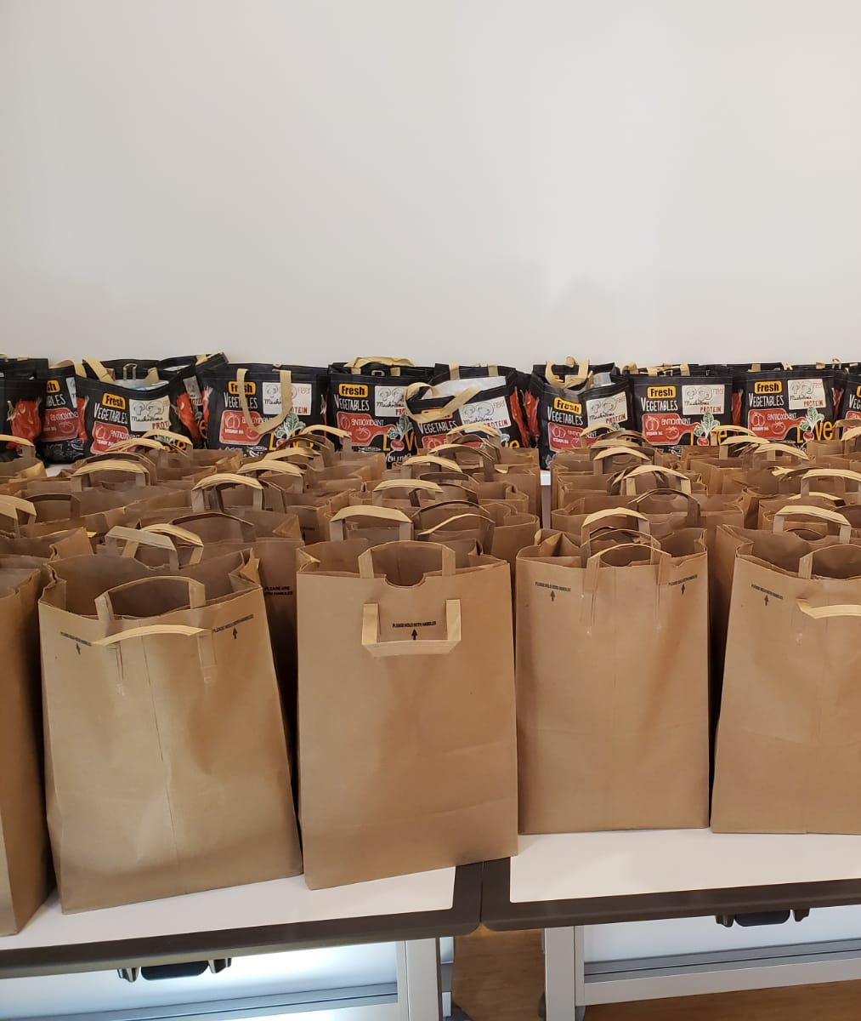
THE N.E.S.T. FOOD PANTRY
Gerson I. Ramirez, Food Pantry Coordinator
GERamirez@citytech.cuny.edu
The food pantry started as a pop-up in November 2020, during the pandemic
The official food pantry opened in February 2022, in a temporary space
The pantry is named the N.E.S.T. (Nutrition for Education and Student Achievement)

Slide 12
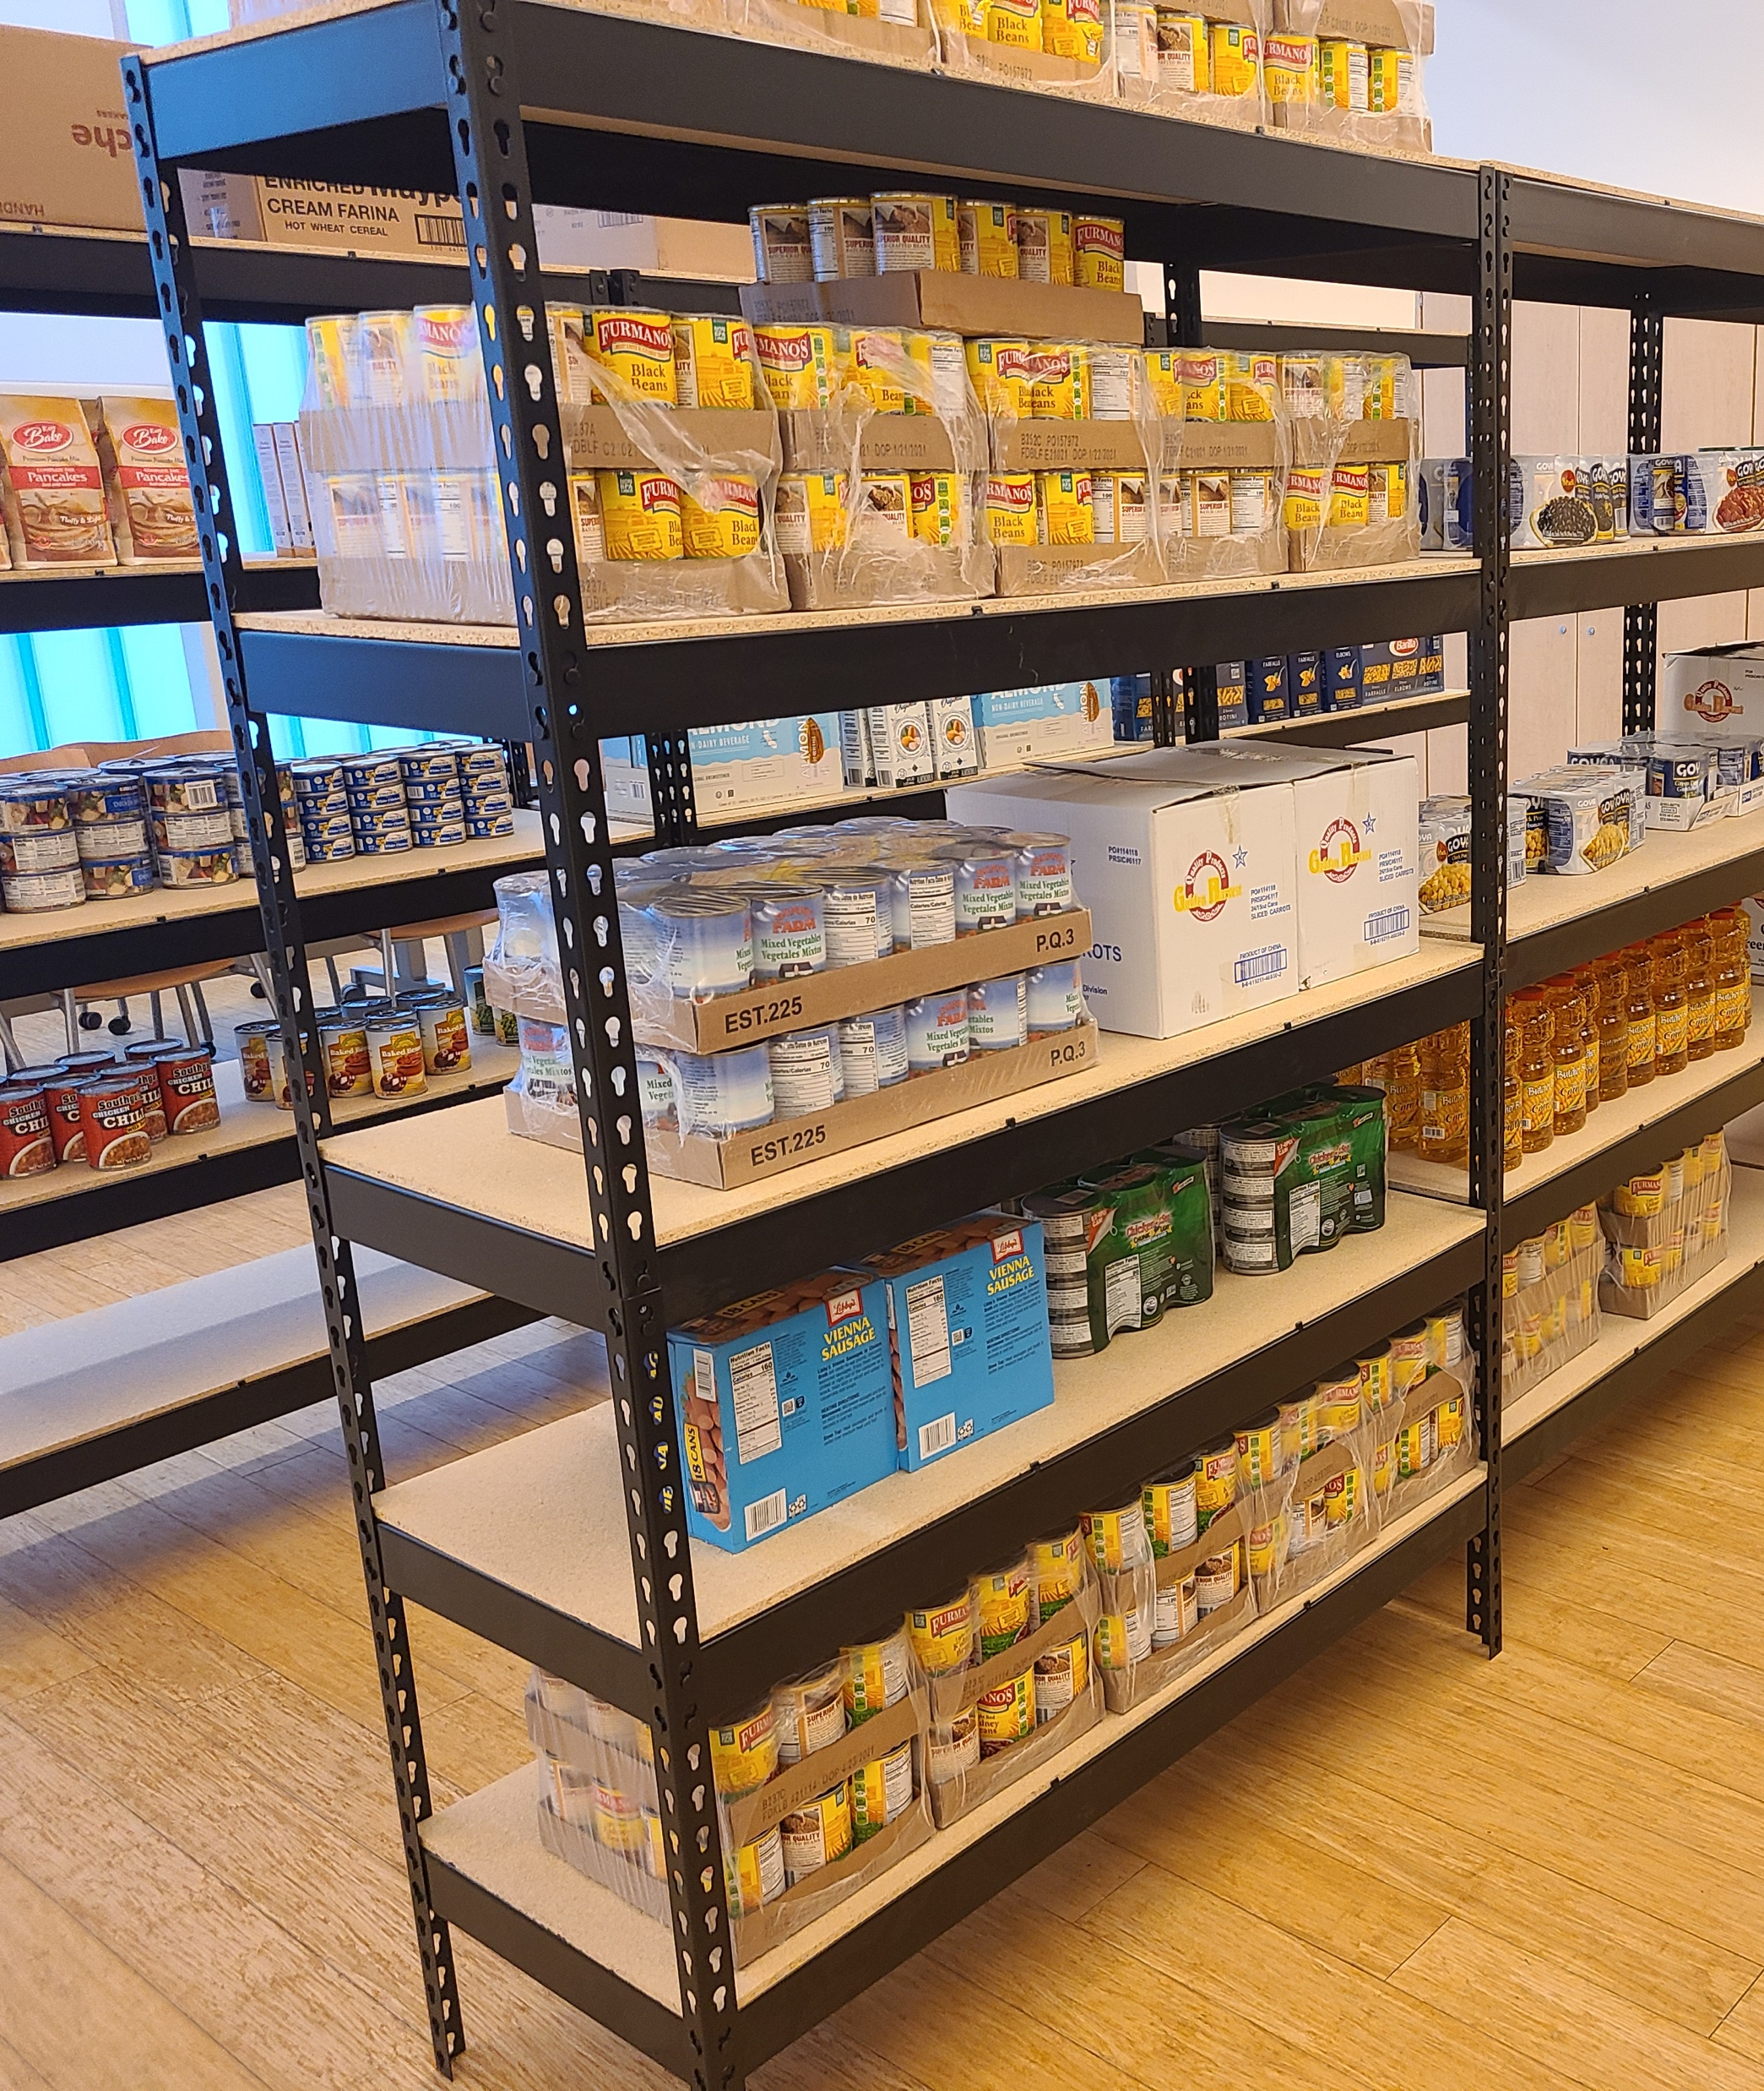
THE N.E.S.T. FOOD PANTRY
Gerson I. Ramirez, Food Pantry Coordinator
GERamirez@citytech.cuny.edu
The N.E.S.T. has adopted a market style allowing students the freedom to pick things they like/prefer
We are attempting to cover all dietary/cultural needs
Available only to currently enrolled CUNY students
The pantry is temporarily closed, but it is set to reopen by early November
The new location will be G414 in the General Building

Slide 13
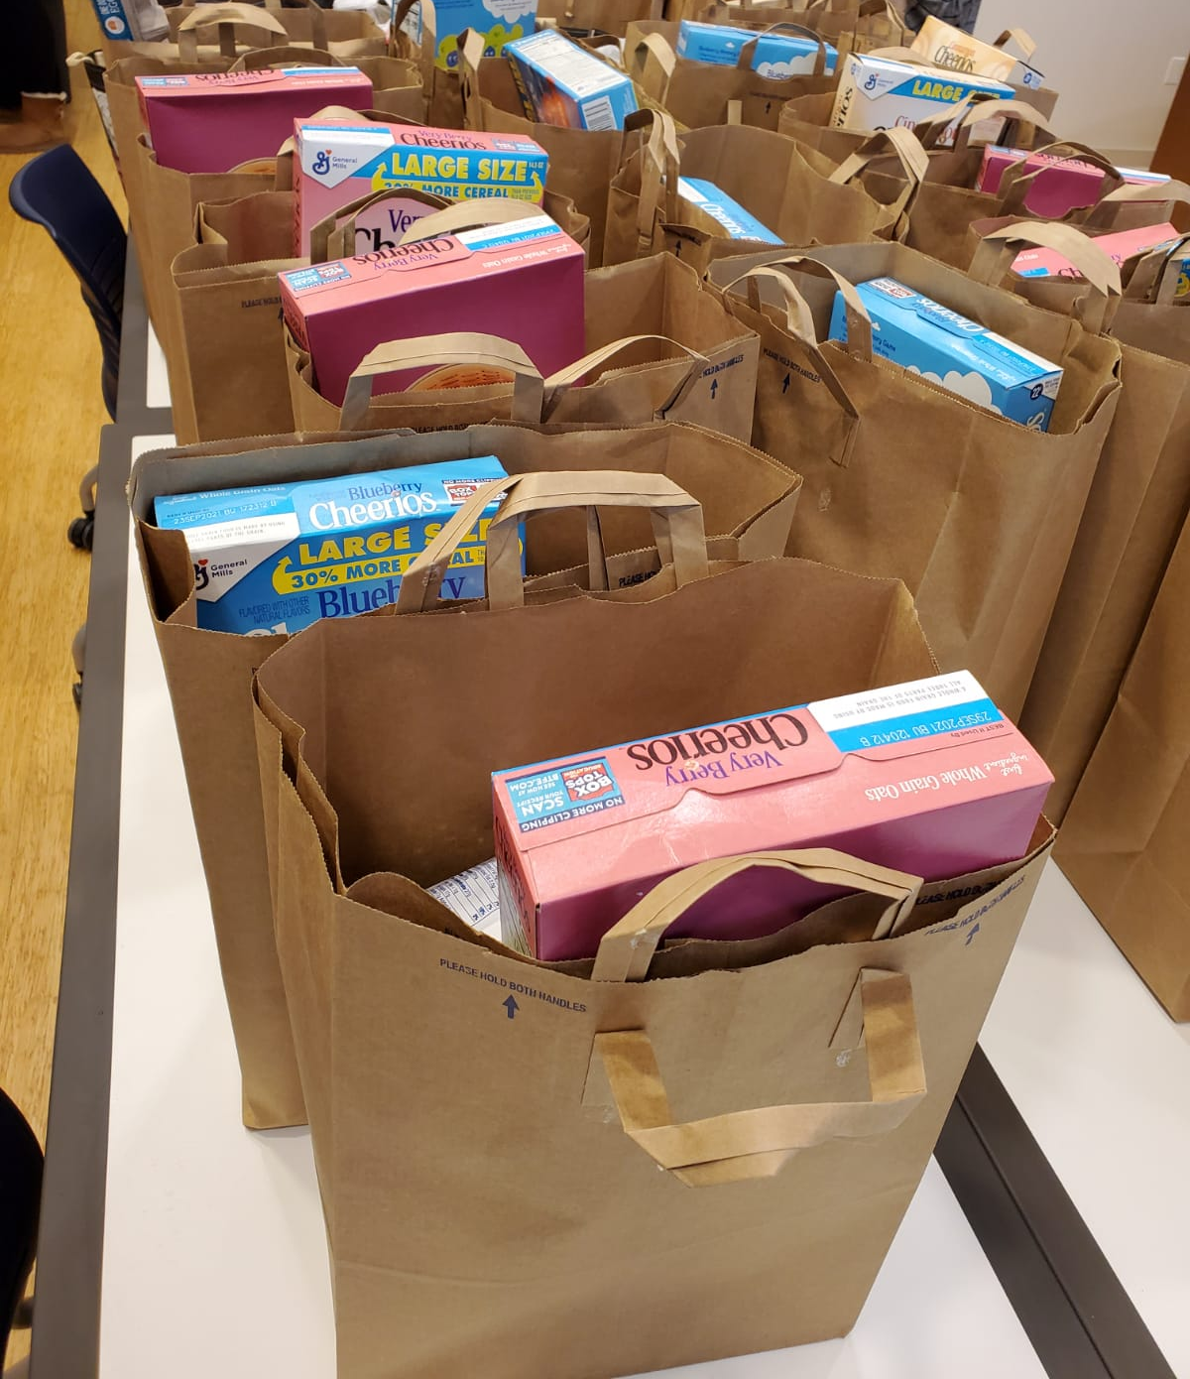
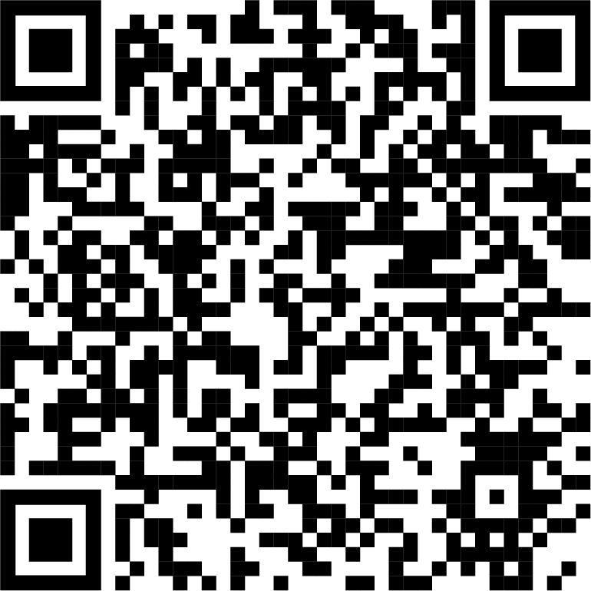
THE N.E.S.T. FOOD PANTRY
Gerson I. Ramirez, Food Pantry Coordinator
GERamirez@citytech.cuny.edu
The schedule will be as follows
  Tuesday, 9am - 12pm
  Wednesday, 3pm - 6pm
  Thursday, 12pm - 3pm
Once open, students will be required to make
appointments via Calendly (Scan QR).

Slide 14
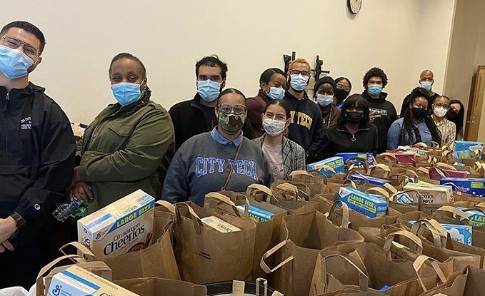
THE N.E.S.T. FOOD PANTRY
Gerson I. Ramirez, Food Pantry Coordinator
GERamirez@citytech.cuny.edu
VOLUNTEEERS
If you’d like to volunteer and help your fellow City Tech community, please reach out to the food pantry coordinator,
Gerson I. Ramirez.

Slide 15
INTERNATIONAL STUDENT SERVICES
Melany Chavez Ordonez, International Student Advisor - MChavezOrdonez@citytech.cuny.edu
INTERNATIONAL STUDENTS' SERVICES
The office of International Students Services, offers support throughout students’ academic journey at City Tech. They provide resources for counseling and advisement, in-depth assistance on F-1 status rules and regulations, compliance, immigration policy updates, employment options, personal matters, student life at the college, and information about living in
New York City.

Slide 16
INTERNATIONAL STUDENT SERVICES
Melany Chavez Ordonez, International Student Advisor - MChavezOrdonez@citytech.cuny.edu
APPLICATION PROCESS
Apply to City Tech
Applicants on a temporary visa who were educated in a non-English environment are asked to submit results from TOEFL, IELTS, PTE, or Duolingo when applying to the college as an international student freshman or transfer.
Once accepted to City Tech, request I-20 from DSO (Designated School Official)

Slide 17
INTERNATIONAL STUDENT SERVICES
Melany Chavez Ordonez, International Student Advisor - MChavezOrdonez@citytech.cuny.edu
FRESHMAN STUDENTS
Complete the I-20 request form
Provide financial documents (bank statement)
Copy of passport
Pay the SEVIS fee
Register for class ( if registration is open)
Pay the SEVIS fee
Schedule Embassy appointment for F-1 visa

Slide 18
INTERNATIONAL STUDENT SERVICES
Melany Chavez Ordonez, International Student Advisor - MChavezOrdonez@citytech.cuny.edu
TRANSFER STUDENTS
Complete the I-20 request form
Provide financial documents (bank statement)
Copy of I-94
Copy of passport
Complete Transfer release.
Register for class

Slide 19
INTERNATIONAL STUDENT SERVICES
Melany Chavez Ordonez, International Student Advisor - MChavezOrdonez@citytech.cuny.edu
MAINTAINING STATUS
Students who come to the US under a nonimmigrant classification of “F-1” are required to follow certain regulations to keep their legal status in the country. It is a student’s responsibility to understand and follow these rules as they apply to their status. (Speaker refers to the city tech website for rules)

Slide 20
STUDENT LIFE & DEVELOPMENT BENEFITS
Be in the Know About What’s Happening on Campus
Build Connections with Peers, Faculty
& Staff
Be Part of Creating Change on Campus
Expand Your Experience Working Collaboratively
with Others
Increase Your Leadership Skills
Learn About Campus Finances
Learn How
to Curate Your
Public Image
Networking Opportunities to Help Your Career
Gain An Area of Expertise

Slide 21
WHEN YOU EMBRACE EVERYTHING THAT SLD HAS TO OFFER,
YOU GAIN HUGE BENEFITS
Increased Support
A Rise in Creativity & Productivity
More Innovation
Collaborative Opportunities
Better Decision Making

Slide 22
THE YELLOW JACKET JOURNEY
WHAT IS PRESENCE?
A student engagement platform where students can stay up to date with activities on campus
The City Tech Presence portal is named Yellow Jacket Journey
Student Life & Management manages the platform
https://citytech-cuny.presence.io/

Slide 23
THE YELLOW JACKET JOURNEY
WHAT CAN YOU FIND IN PRESENCE?
Get involved - Join a student club!
Stay in the know - browse campus events and RSVP!
Earn points and win rewards for staying engaged!
As a club, you have access to create events, polls and forms
Access the Student Orientation Experience with 8 modules of information and polls
During Student Elections, learn about candidates and fill out your ballot
https://citytech-cuny.presence.io/

Slide 24
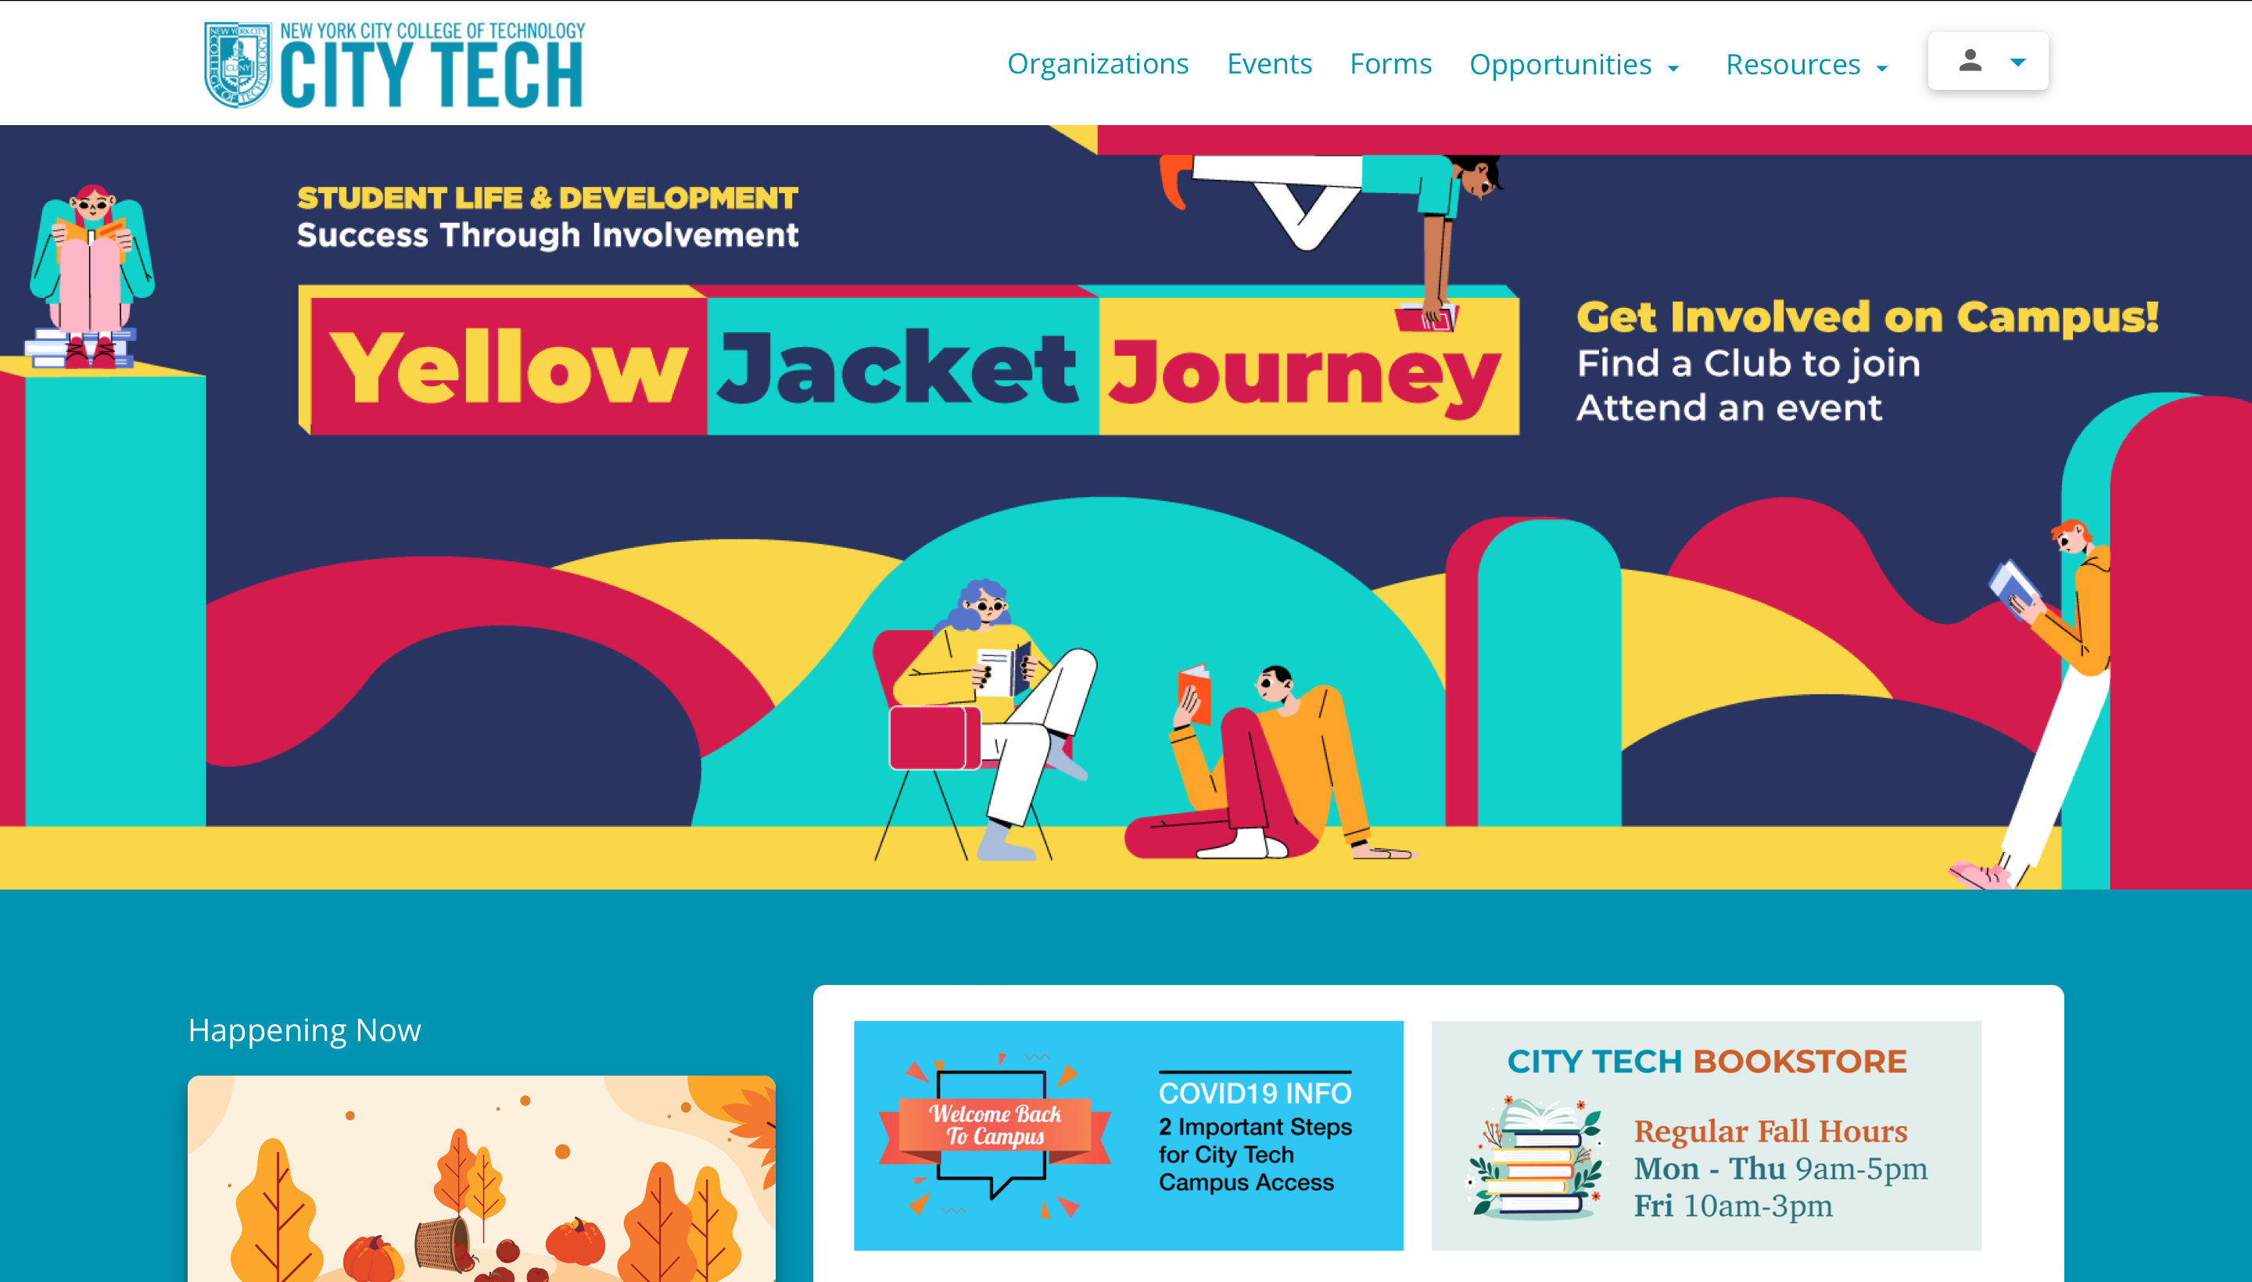
https://citytech-cuny.presence.io/

Slide 25
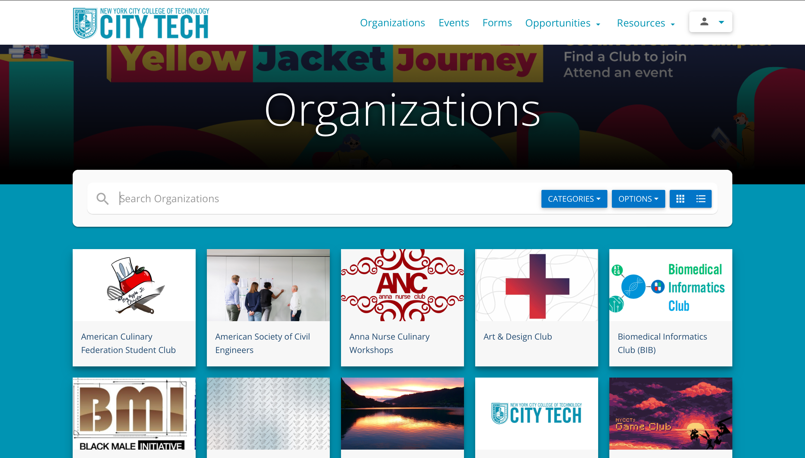

Slide 26
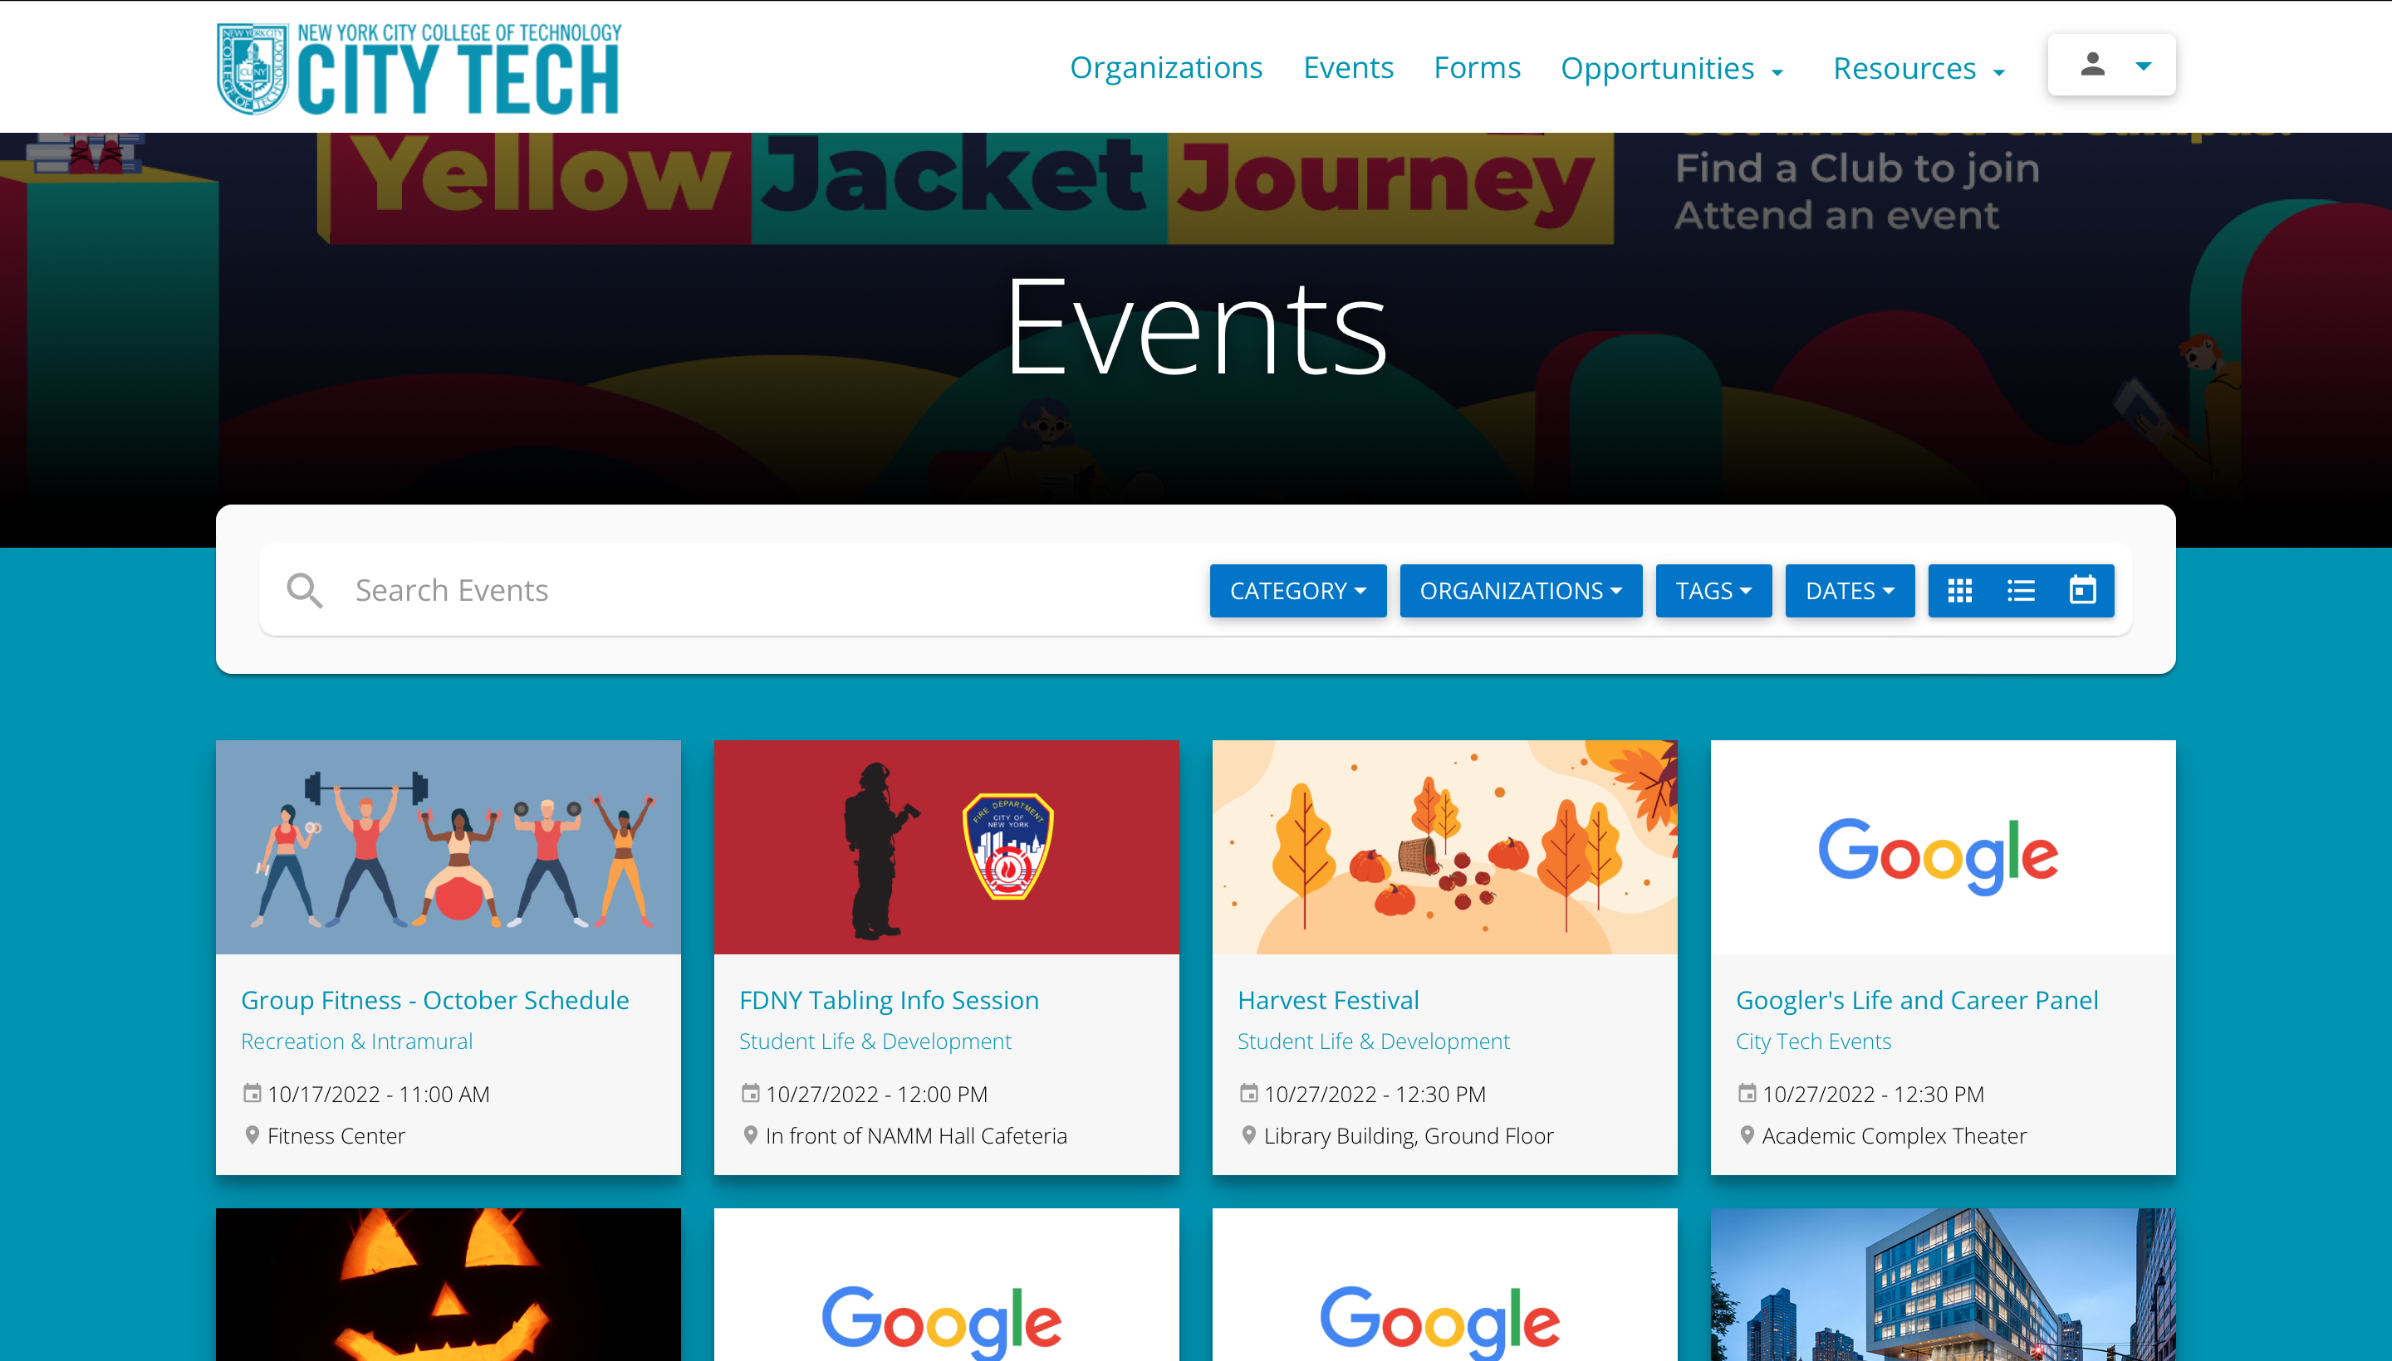

Slide 27


CONTACT INFO
WHERE CAN YOU FIND STUDENT LIFE & DEVELOPMENT?
Phone: 718-260-5391
Email: StudentLife@citytech.cuny.edu
Visit https://www.citytech.cuny.edu/student-life/
Location: General Building, Room G-516
Follow Us @CityTechSLD
YouTube: Student Life & Development
Presence: https://citytech-cuny.presence.io/

Slide 28
!
THANK YOU!
Questions?

