Slide 1
The Syllabus and the Classroom
City Tech 101
Prof. Jessica DeCoux
Fall 2022

Slide 2
Today’s Topics
Duties + Responsibilities of a Student
Duties + Responsibilities of a Professor
Course Organization
Contents of a Syllabus
Effective Communication

Slide 3
Question: What are a student’s responsibilities when taking a class? Brainstorm your answers and collect them as a group.
Directions:
5-7 minutes to discuss questions in breakout rooms
Assign scribe to take notes while you all discuss (or use GoogleDoc to share with group)
Assign reporter to share your answers
We will come back as group to discuss-- be prepared!
Small Group Discussion
A Student’s
Classroom Resposibilities

Slide 4
Duties + Responsibilities
of a Student

Slide 5
A Student’s Job Includes...
Reading + Understanding the Syllabus + Course Schedule
Being Responsible for ALL Information in the Syllabus
Asking Questions about Course Requirements, Assignments, Policies, + Grading Criteria
Attending Class Regularly + On Time
Informing Professor of Absences in a Timely Manner
Completing All Work in Accordance with City Tech’s Academic Integrity Policy
Contributing to an Inclusive Classroom + Campus Environment
Completing All Assignments + Exams
Submitting Work On Time
Learning Course Content, as Taught by Professor
Studying Course Content
Asking Questions (in class, via email, + during office hours)
Seeking Out Help, When Needed
Being Prepared for All Classes

Slide 6
Duties + Responsibilities
of a Professor

Slide 7
A Professor’s Job Includes...
Creating and Distributing a Syllabus + Course Schedule (1st week of semester)
Notifying Students of Any Changes to the Course Schedule in a Timely Manner
Providing Clear Grading Scheme + Criteria
Grading Student Work Fairly
Informing Students of Midsemester Grades (8th week of semester)
Providing Clear Expectations
Addressing All Learning Objectives for Course
Teaching Students Course Content
Holding Weekly Office Hours for Students
Answering Student Emails in a Timely Manner
Answering Student Questions
Assigning Final Grades
Treating All Students with Respect + Fairness

Slide 8
What can you do if your professor doesn’t fulfill their responsibilities?

Slide 9
Start with the professor
Or speak to the department chair (head)
The academic dean is the last step
The chief student affairs office can give you advice

Slide 10
Before the semester starts…

Slide 11
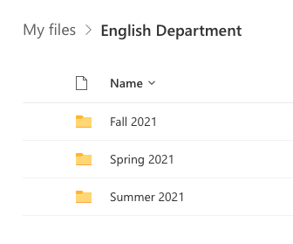
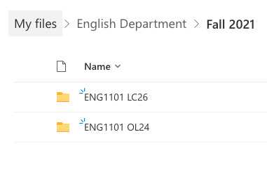
Organize your materials
Make folders in your OneDrive or Dropbox
Organize by semester
Organize by course
First file is your syllabus + schedule
Save ALL your work for the course!
Use consistent and clear file names
LastName_Assignment_Class_Semester
For example: DeCoux_Reflection4_CT101_SU21

Slide 12
Make sure you are prepared for the first day of classes:
Check your schedule
Check your City Tech email regularly
Make sure CT has the right contact info on file for you
Email your professor or reach out to the right department if anything isn’t clear!
Collect your materials:
Spiral notebook or binder for notes
Loose leaf paper
Writing implements
Small pencil sharpener
Small stapler
Any required books/texts
Any additional tools (calculator, compass, protractor, utensils, etc.)

Slide 13
The
Syllabus

Slide 14
Why is a syllabus so important?

Slide 15

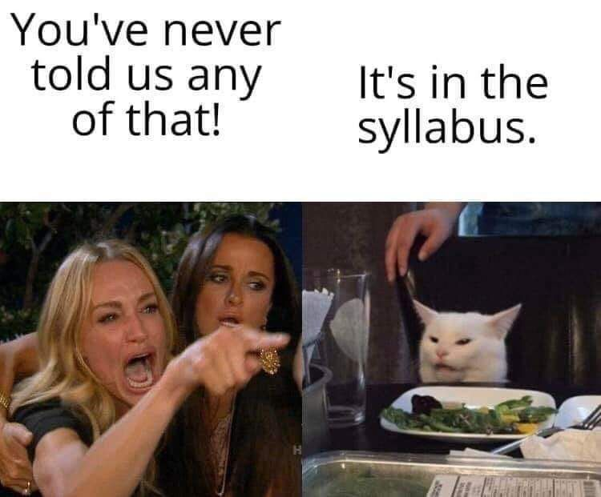
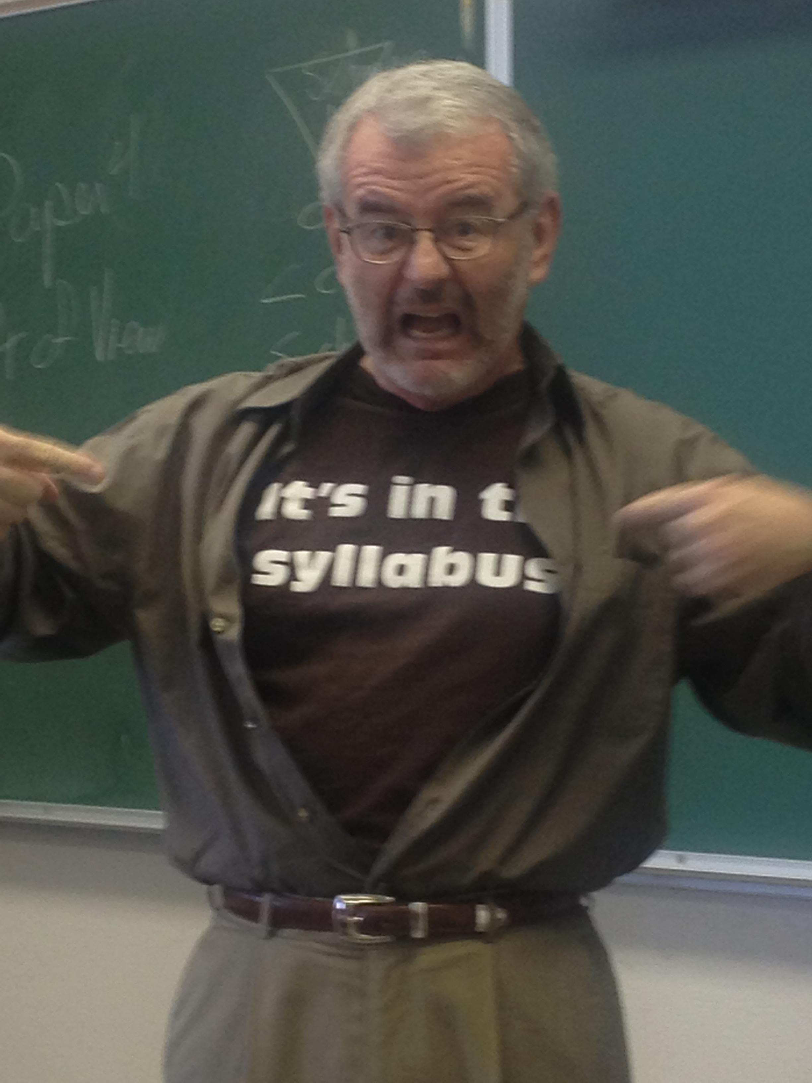
Professors’ got jokes...

Slide 16
A Syllabus Should Include…
Title, course number, and section number
Professor’s name and contact information
Office hours (times and location)
Virtual links, if needed
Course description
Learning objectives/Learning outcomes/Course aims
Info on any apps or course management tools used
Description of major units and assignments (by unit, week, or day)
Grading Policies and Requirements
Required texts and materials
Attendance/Lateness Policies
Accessibility Policy
Academic Integrity Policy
A syllabus is your guidebook to the course!

Slide 17
A Sample
Syllabus

Slide 18
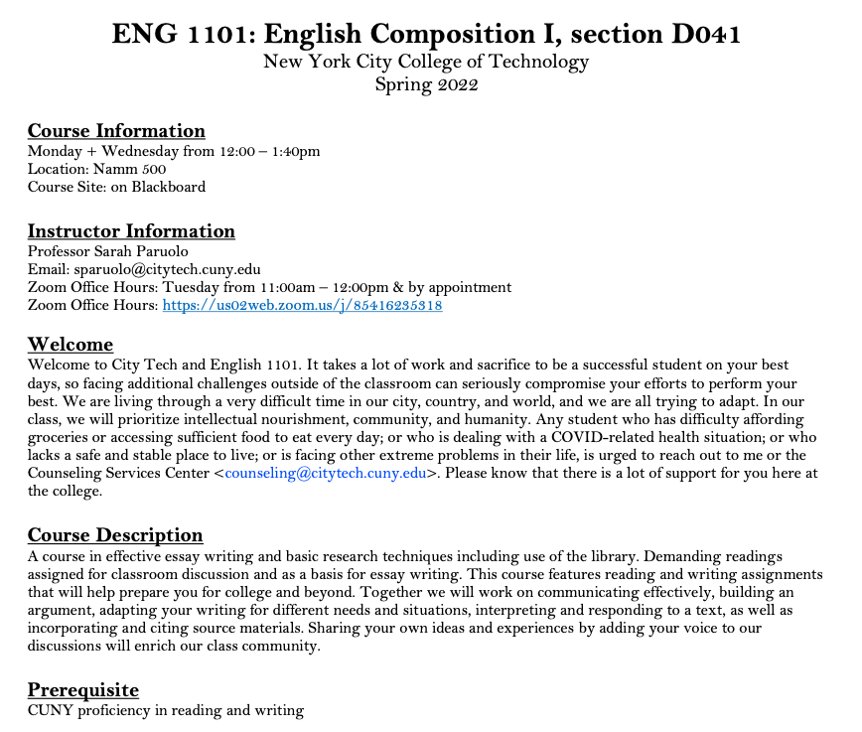
Department Abbreviation
Course Number
Course Name
Course Meeting Information
Course Site Information
Instructor Contact Information
Office Hours Information
Course Description
Pre/Co- Requisites

Slide 19
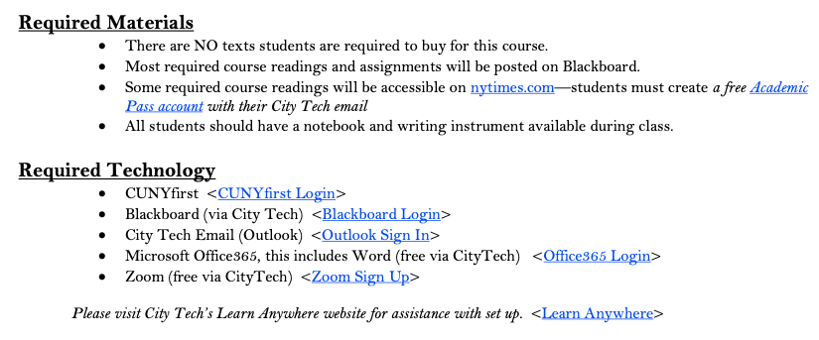
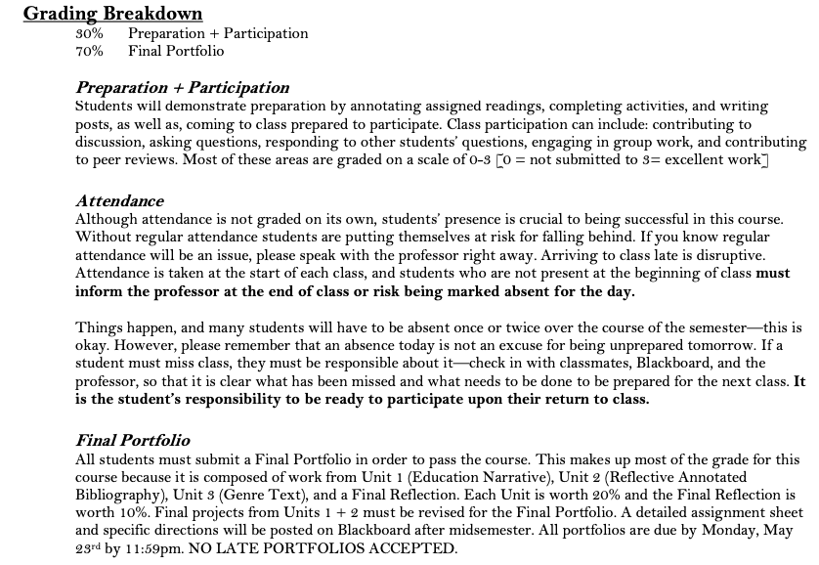
Required Texts
Required Materials
Required Technology
Grading Breakdown
Course Assignment Descriptions

Slide 20
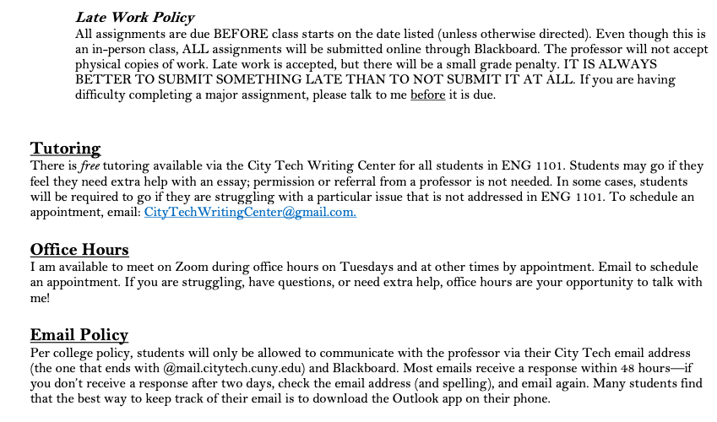
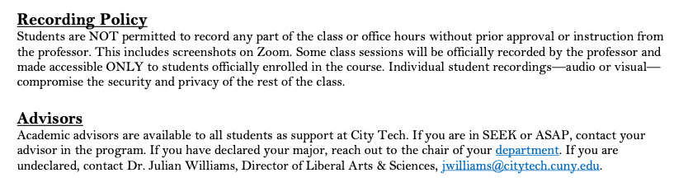
Course Policies

Slide 21
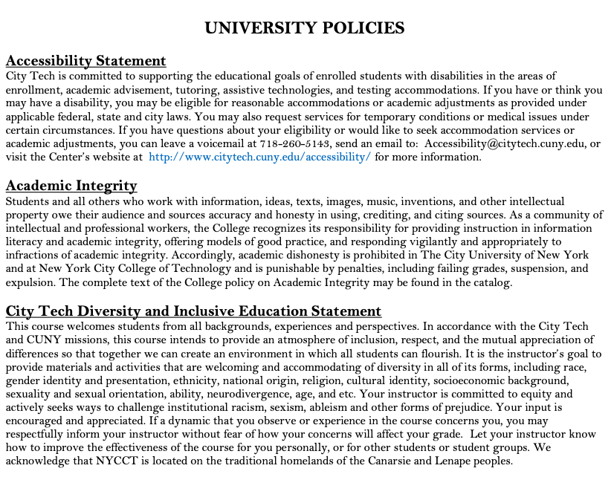
Accessibility Statement
Academic Integrity Statement
Diversity and Inclusive Education Statement

Slide 22
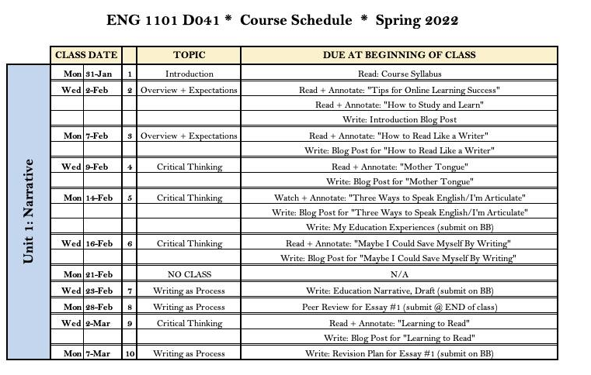

Slide 23
Other Sample Syllabi:
https://openlab.citytech.cuny.edu/groups/ct-101-14-session-fall-2022-lc05/files/

Slide 24
Effective Communication

Slide 25
Emailing with Professors
https://www.youtube.com/watch?v=nqaRp8MyLOg&t=1s

Slide 26
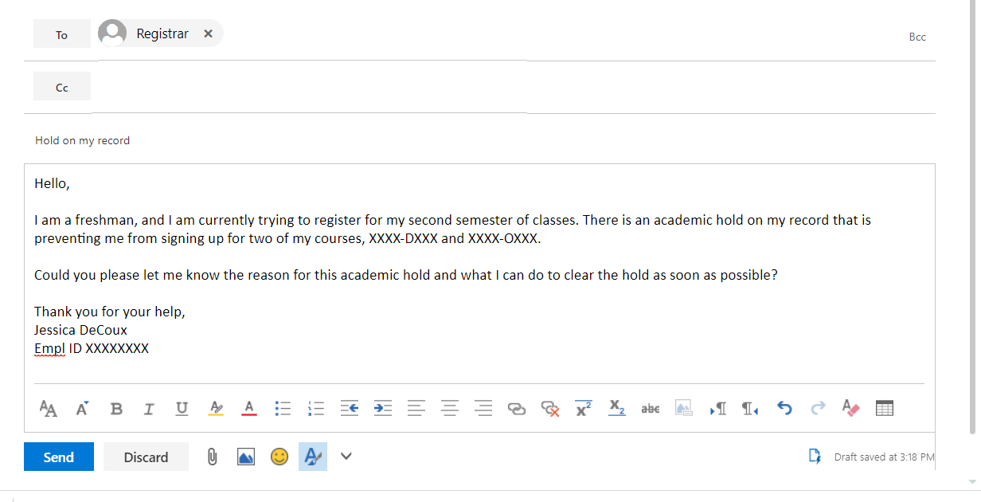
Emails should include…
a subject line
A clear statement of the information or request you are communicating
a greeting
any necessary background info
Be polite—especially if making a request!
A sign-off that includes your name
Remember, an email is NOT a text!

Slide 27
Tips for Effective Communication
Set up your City Tech email
Download the Outlook App for your phone
Check your City Tech email EVERY DAY
Check Blackboard and/or OpenLab EVERY DAY (or on the schedule th Prof. sets)
Write clear emails and ask good questions
Utilize professor office hours

Slide 28
For next time...
Complete this Reflection on Openlab:
Review your course syllabi. What does this information tell you about what you should expect at the start of the semester? What seems most important? What do you notice that surprises, confuses, or interests you?

