Slide 1
City Tech 101
Welcome!
Fall 2022
Jessica DeCoux
jdecoux@citytech.cuny.edu
City Tech 101 by Karen Goodlad and Sarah Paruolo is licensed under a Creative Commons Attribution-NonCommercial-ShareAlike 4.0 International License.

Slide 2
Academic Basics:
#WelcomeToCityTech
Session 1
August 29, 2022
Prof. DeCoux
City Tech 101 by Karen Goodlad and Sarah Paruolo is licensed under a Creative Commons Attribution-NonCommercial-ShareAlike 4.0 International License.

Slide 3
Today’s Topics
Introductions
CT101 Syllabus + Schedule Review
Learning Tools
Classroom Learning: Etiquette + Engagement
Online Learning: Etiquette + Engagement
Instructional Modalities
If the walls could talk…

Slide 4
Introductions

Slide 5
Connect with your Professor
Jessica DeCoux
jdecoux@citytech.cuny.edu

Slide 6
What is a Peer Mentor?

Slide 7
What is a Peer Mentor?
Peer Mentors are role models who are eager to share their experiences and knowledge to help incoming City Tech students adjust to college life.
Attend CT101 with you every week
Send you Weekly Updates
Answer questions via email + office hours

Slide 8
Connect with your
Peer Mentors
Christina Cantone:
Christina.cantone@mail.citytech.cuny.edu
Ester Tavarez:
Ester.tavarez@mail.citytech.cuny.edu

Slide 9
Ice Breaker Activity
Notes:
ht

Slide 10
What will we do during the fourteen sessions?
This workshop focuses on helping new students transition to college life, and specifically to City Tech. The workshop will enhance the new student experience with information, activities, and various opportunities to connect with faculty, staff, and current City Tech students. In addition to learning how to access a variety of college services and resources, students will develop personalized plans for their college career.

Slide 11
Syllabus + Schedule Review
Session 1 > Academic Basics: #WelcomeToCityTech
Monday, August 29
Session 2 > The Syllabus
Monday, September 12
Session 3 > #RiseAndGrind
Monday, September 19
Session 4 > Behind the Scenes: What You Can Do at City Tech
Thursday, September 29
Session 5 > You Paid For It, Use It: Resources + Services
Monday, October 3
Session 6 > Get Your Head In the Game: Mindset Matters
Monday, October 17
Session 7 > #aMAJORdecision: Practical Steps
Monday, October 24
Session 8 > Coming to Terms with College Vocabulary
Monday, October 31
Session 9 > A Long-Term Decision
Monday, November 7
Session 10 > #YellowJacketLife: The Buzz on Your Future
Monday, November 14
Session 11 > Self-Advocacy + Motivation
Monday, November 21
Session 12 > Academic Integrity
Monday, November 28
Session 13 > Moving Forward: Buzzing Toward Graduation
Monday, December 5
Session 14 > Emerging From ‘The Cave’: What We Know Now
Monday, December 12

Slide 12
Learning Tools

Slide 13
Electronic Platforms Used at City Tech
Communication
City Tech Email (Outlook)
Microsoft Office
OneDrive (Microsoft)
DropBox
In the Classroom
Blackboard
OpenLab
Zoom
Blackboard Collaborate
General College Activities
CUNYFirst
Schedule Builder
DegreeWorks
Which of these are you familiar with?

Slide 14
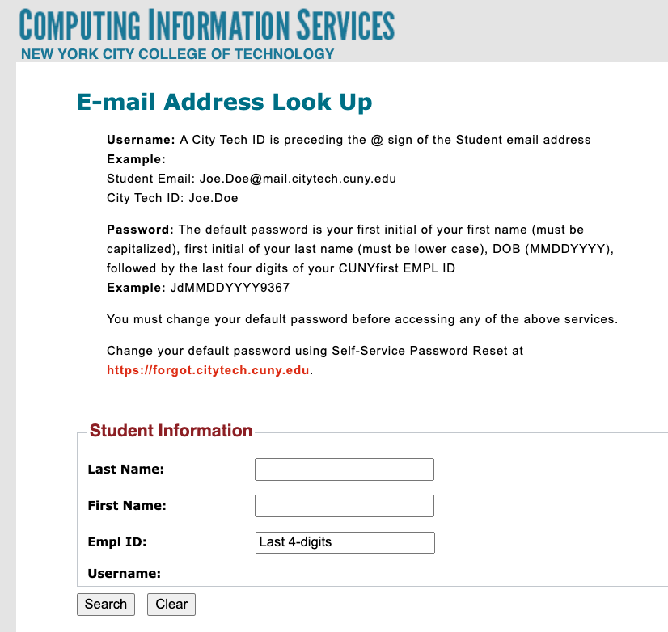
City Tech Email (Outlook)
Have you activated your email?
Log in. What is the most recent message you have received?
Have you received emails from any of your professors?
What can you do besides email?
Notes:
http://cis.citytech.cuny.edu/Student/it_student_findemail.aspx

Slide 15
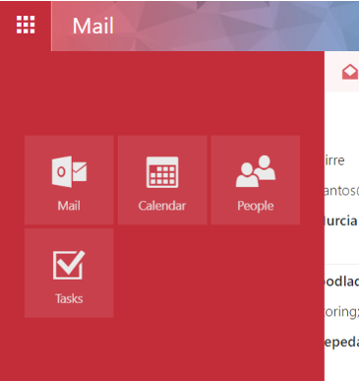
City Tech Email (Outlook)
Email
Calendar
Teams
Tasks

Slide 16
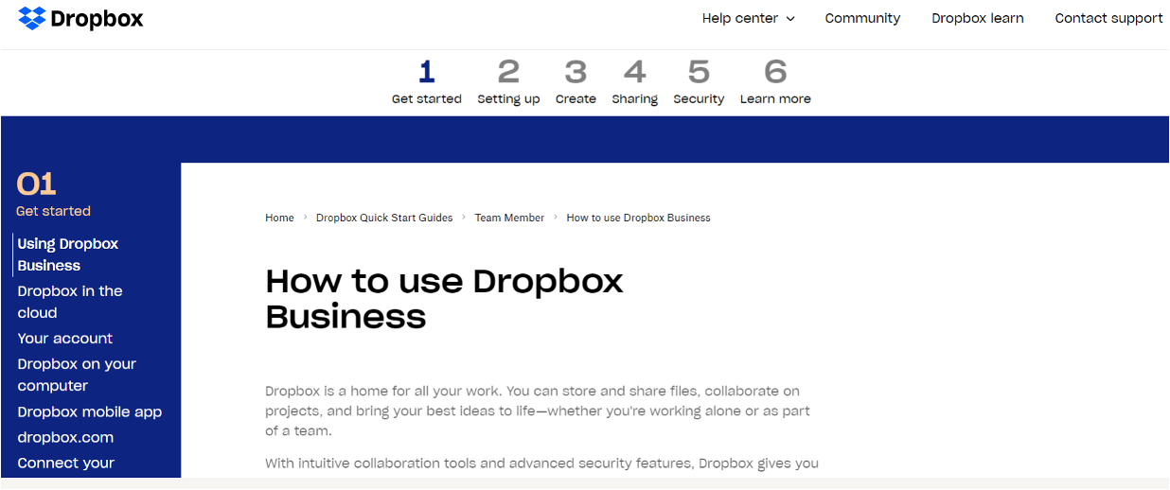
Some professors use DropBox for course materials and collecting student work.
Notes:
https://help.dropbox.com/guide/team/how-to-use-dropbox#how-to-use-dropbox-business

Slide 17
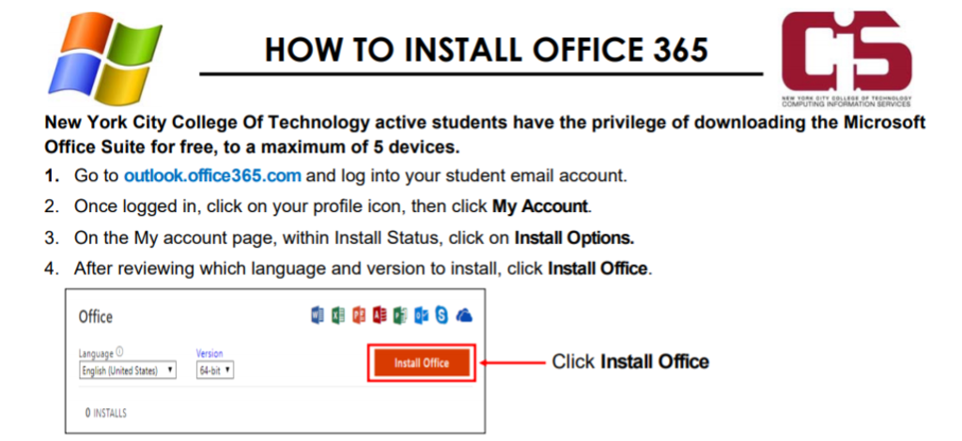
Students have access to Microsoft Word, Excel, Powerpoint, and
One Drive (cloud storage)!

Slide 18

Blackboard (Bb) is a Learning Management System– this is where your courses live online. Some professors will use Bb to post syllabi, schedules, assignments, homework, quizzes, grades, etc.
Some professors will meet with their online or hybrid classes in Bb using Blackboard Collaborate Ultra. This is like Zoom, but built into Bb.
Notes:
https://bbhosted.cuny.edu/webapps/login/noportal

Slide 19
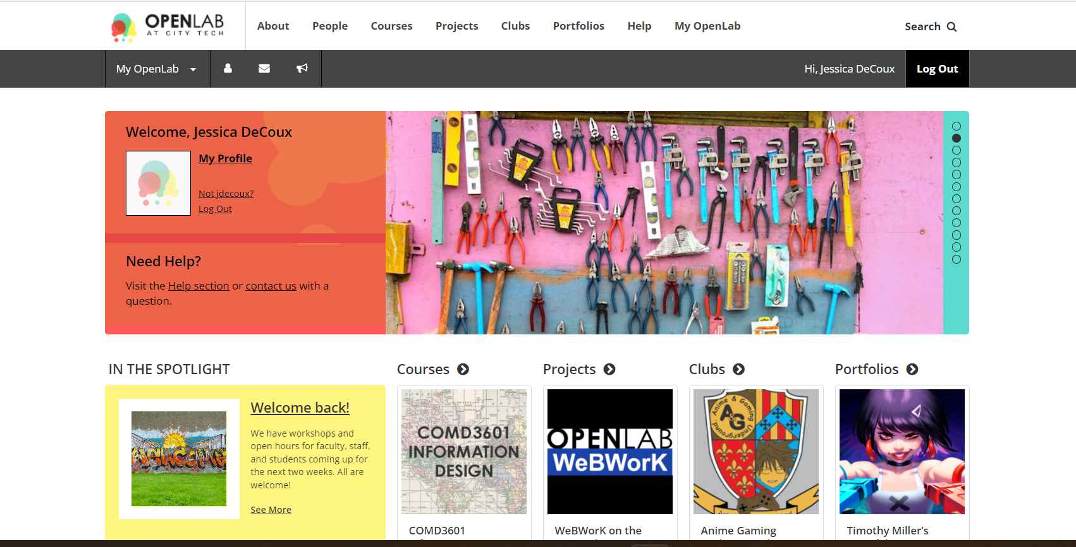
OpenLab (OL) is similar to Blackboard– this is a place where your courses live online. Some professors may use it in the same way as Bb. OL also has projects, clubs, and portfolios, which you will not find on Bb.
Notes:
https://openlab.citytech.cuny.edu/

Slide 20

Students use Zoom to attend online or hybrid classes, meet with professors, attend school events, and more.
Notes:
https://it.citytech.cuny.edu//docs/Login_CUNY_Zoom.pdf

Slide 21
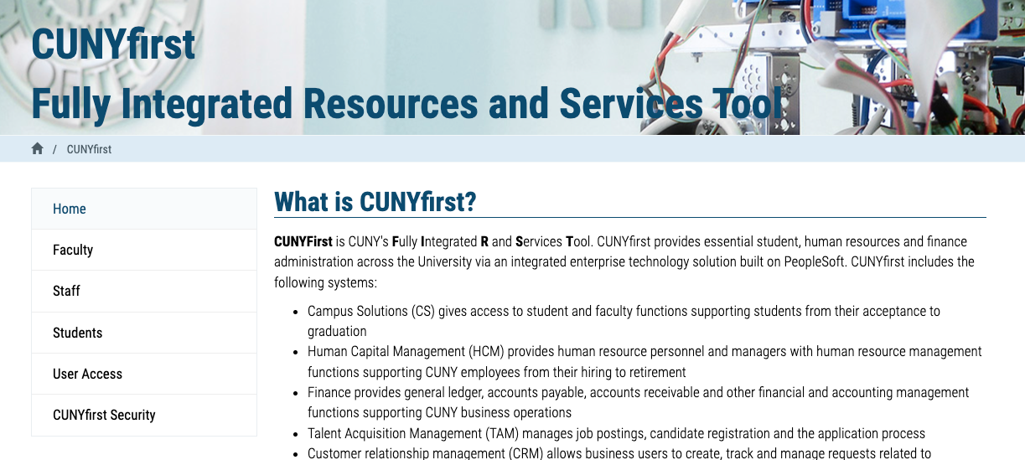
Students use CUNYfirst for management of almost all personal records.
Notes:
https://home.cunyfirst.cuny.edu/oam/Portal_Login1.html

Slide 22

Students use Schedule Builder to register for classes.
Notes:
https://www.cuny.edu/wp-content/uploads/sites/4/page-assets/about/administration/offices/registrar/resources/schedulebuilder/SB-student-guide_2.6.2020.pdf

Slide 23
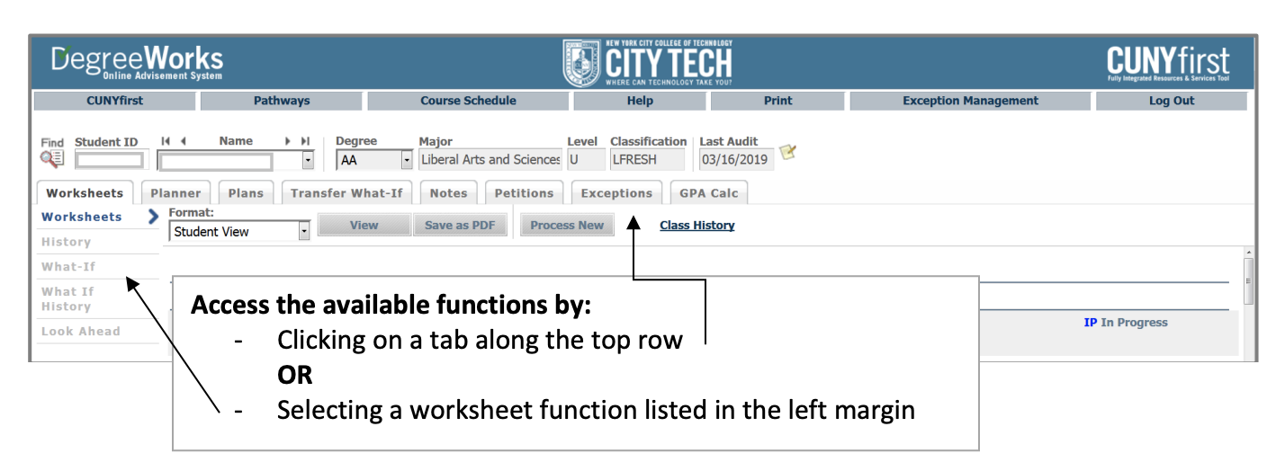
Students use DegreeWorks to track academic progress and degree requirements.

Slide 24
Learning Etiquette + Engagement

Slide 25
Classroom Learning: Etiquette + Engagement
Prepared to participate
Ready to take notes
Asking and answering questions
Addressing your professors
Active learning doesn’t always mean speaking up
Choose your seat wisely
Headphones off/out
Phones on silent and put away
Minimize arriving late and leaving early
When to excuse yourself during class?

Slide 26
Online Learning: Etiquette + Engagement
Everything from Classroom Learning plus…
Camera on? Sure!
Camera off? That’s fine too.
Mute your microphone, not your voice!
Chatting to stay connected throughout class.
Breakout Rooms

Slide 27
Instructional Modalities

Slide 28
Instructional Modalities at City Tech
In person
Online
  Synchronous
  Asynchronous
Hybrid

Slide 29
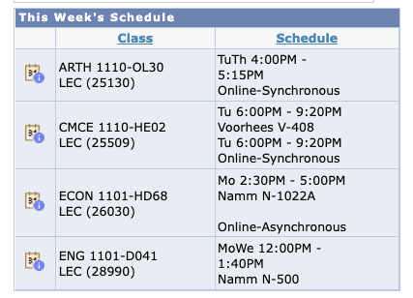
Modalities
Which class is fully in person?
Which class is Online, Synchronous?
Which class is Online, Asynchronous?
Which class is Hybrid?

Slide 30
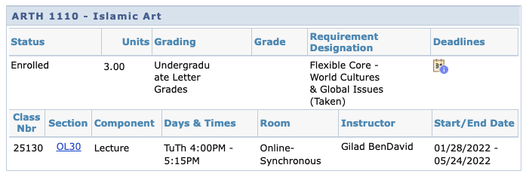
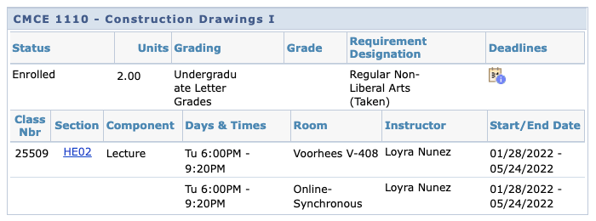

Slide 31
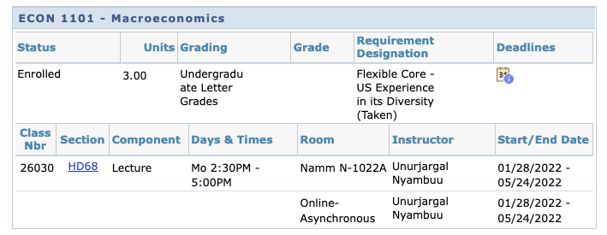
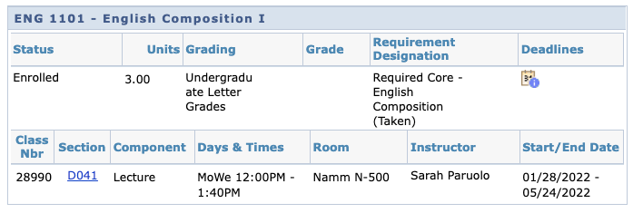

Slide 32
Schedule Issues?
Stay at the end of the session today for help with your schedule.

Slide 33
If the walls could talk…
Here’s the worksheet for our shared activity
Notes:
c

Slide 34
Course Information
Next Meeting: Monday, September 12
Workshop Location: Namm Room 606
Open Lab site: https://openlab.citytech.cuny.edu/decoux-ct101-fall2022-lc05/
Prof. email: jdecoux@citytech.cuny.edu
Peer Mentor 1 Email: christina.cantone@mail.citytech.cuny.edu
Peer Mentor 2 Email: ester.tavarez@mail.citytech.cuny.edu

Slide 35
Recap
Introductions
CT101 Syllabus + Schedule Review
Learning Tools
Classroom Learning: Etiquette + Engagement
Online Learning: Etiquette + Engagement
Instructional Modalities
If the walls could talk…

Slide 36
Before Session 2…
Download and review 1101 syllabi (plural of syllabus) posted on OpenLab.
Complete Reflection on OpenLab by replying to Reflection #1 Post.
  Remember, you must have an account and be logged in to OpenLab to reply to a post.
  How to Respond to a Reflection
Read the Reflection post.
Click on Comment.
Write your comment in the box.
Click Post.
Reflection #1
What do you want your classmates to know about you? Consider
sharing your goals as a college student, why you chose City Tech,
what you hope to learn in your first semester at City Tech or
anything important to you.
Read other classmate’s posts and help welcome each other by
writing a response.
Notes:
ADD LINK

Slide 37
Academic Basics:
#WelcomeToCityTech
Session 1
August 29, 2022
Prof. DeCoux
City Tech 101 by Karen Goodlad and Sarah Paruolo is licensed under a Creative Commons Attribution-NonCommercial-ShareAlike 4.0 International License.

