Slide 1
Intro to Hospitality Management
Class 7
Reflections on ethics and sustainability
Sustainability Paper assigned
Costing review
Specifications (specs)

Slide 2
— Alice Waters
I have always believed that a restaurant can be no better than the ingredients it has to work with. As much as by any other factor, Chez Panisse has been defined by the search for ingredients. That search and what we have found along the way have shaped what we cook and ultimately who we are. The search has made us part of a community—a community that has grown from markets, gardens, and suppliers and has gradually come to include farmers, ranchers, and fishermen.
It has also made us realize that, as a restaurant, we are utterly dependent on the health of the land, the sea, and the planet as a whole, and that this search for good ingredients is pointless without a healthy agriculture and a healthy environment.

Slide 3

“We have not inherited the world from our forefathers. We have borrowed it from our children.”

Slide 4


whe
Biodiversity
Monoculture
Sustainable—
  Agriculture
  Aquaculture
  Fishing
Organic
Natural
Green
Notes:
https://www.youtube.com/watch?v=W6iOHRoxxaU&t=97s

Slide 5
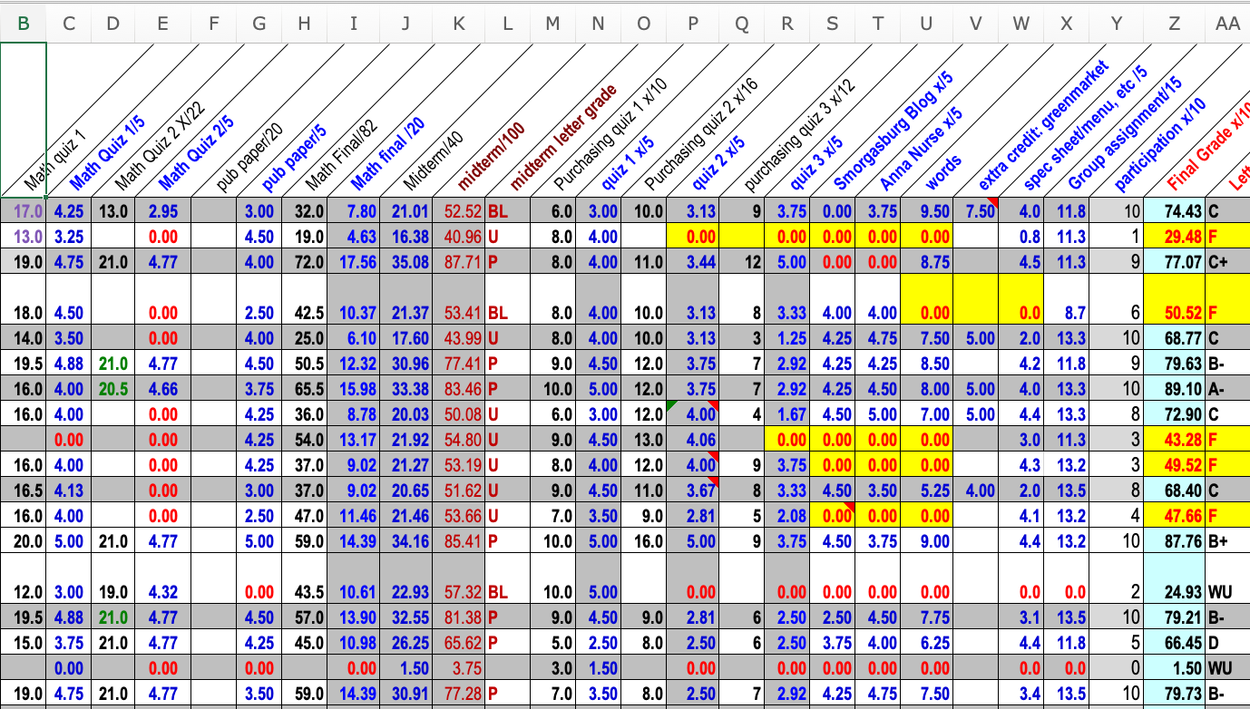
Sample Grade Breakdown

Slide 6
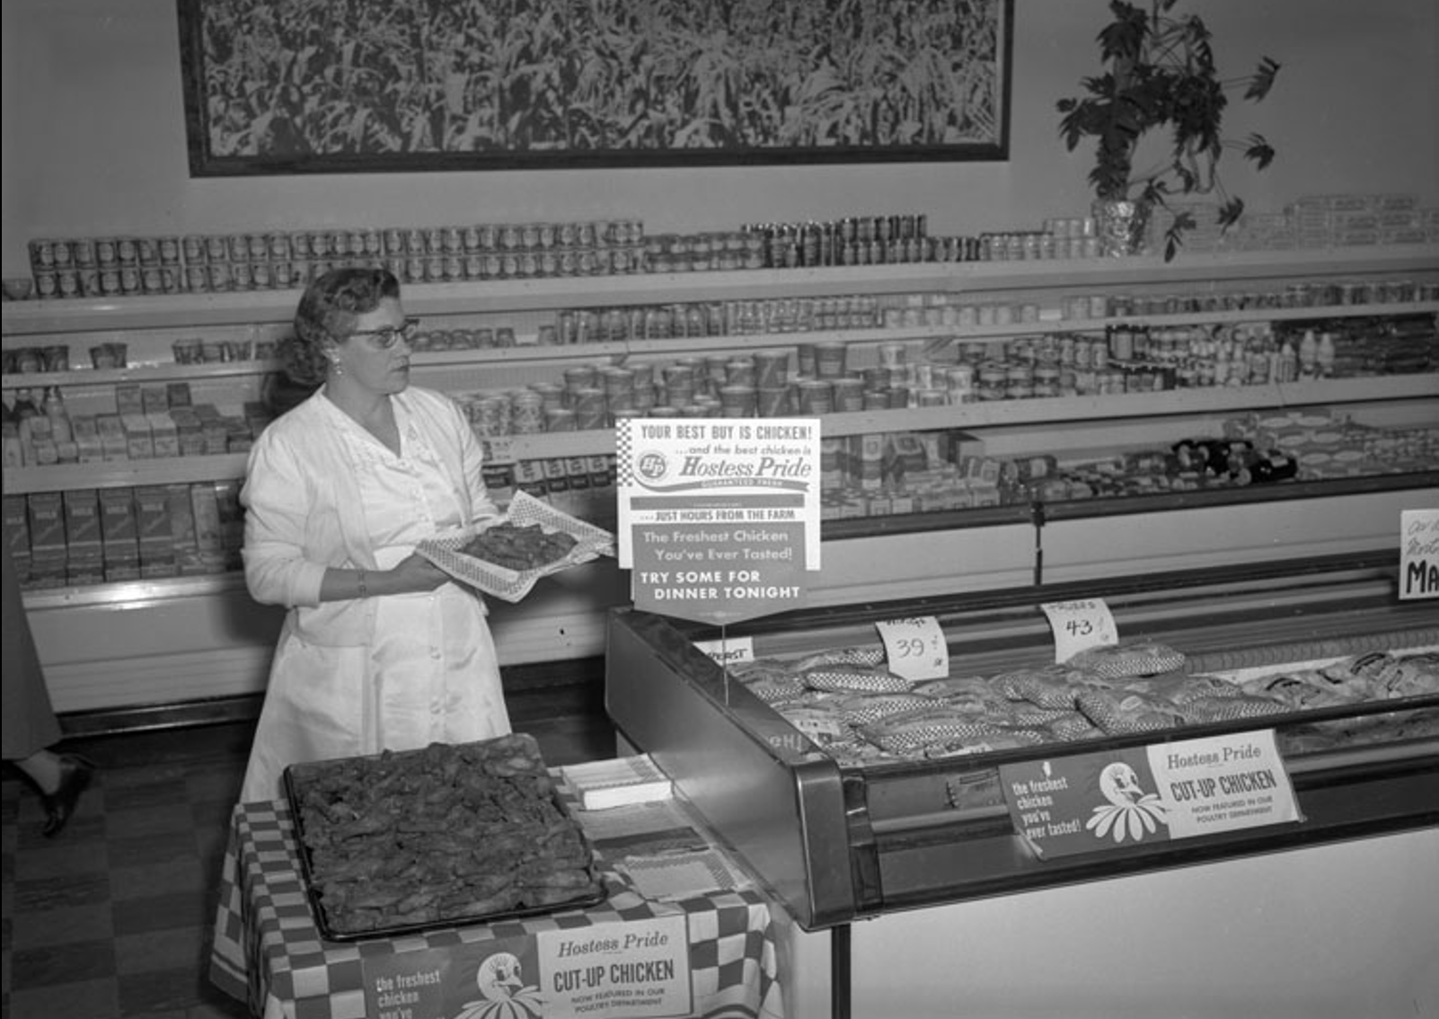
Purchasing:
Intro to Specifications

Slide 7
Planning the Menu
Target market
Consumer demand
Required contribution margins
  Will it make money?
Available staff/facilities/equipment
Ingredient availability
  Seasonality
Owner/operator/chef preferences

Slide 8
The Purchasing Cycle 1
decide
implement
monitor
evaluate

Slide 9
Standardized Recipe
ingredients
instructions
yield, portion size
consistency, cost control

Slide 10
Intro to “Specs”
(Product Specification Sheet)
A very detailed description of a product.
It is generated by the business and given to the supplier.
Ask for price sheet in return.

Slide 11
What is included in the spec?
quality
cut
size
packaging
fresh/frozen
point of origin
ripeness
brand
etc.
Notes:
Yield-how many servings, pieces, slices, the more packaging the more expensive, maybe worth it
Quality- prime beef, good pasta, or generic
How many packages in the box? Labels will be in each pack, not case. In Styrofoam? In paper, in plastic?
Processing- peanuts used, kosher, dried pasta, in oil, in water, Smoked
Origin- Where is it from? Local, France, Spinach from Calif?
Chemical- Organic, wheat-free, Ripeness- bananas, avocadoes

Slide 12
Why do Specs?
Quality control
Cost control
Avoid misunderstanding
Avoid corruption
Notes:
You have in writing what it is you want, doesn’t matter whose day off it is

Slide 13
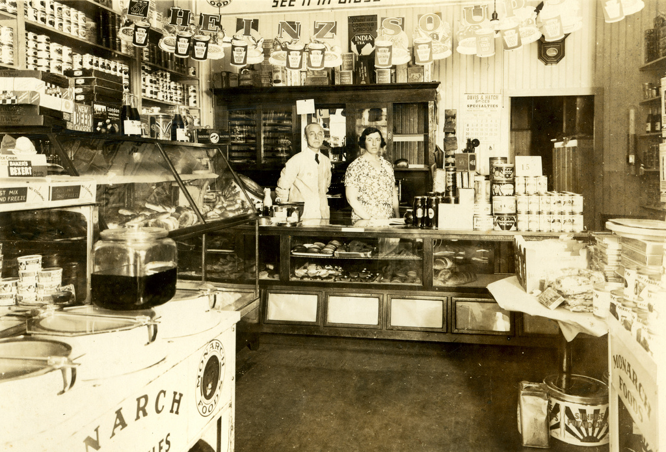
Purchasing:
Where & How

Slide 14
Purchasing & the Market
Markets
  Primary (prime vendor)
  Secondary
  Local
  Direct

Slide 15
SOURCES
Growers
Farmers, ranchers
Wheat
Manufacturers
Production from raw materials
Flour
Processors
Combine one or more food products
Pasta

Slide 16
DISTRIBUTION CHAIN
Canned Peas
Contract⇒ grower⇒ processor⇒ Commission Agent⇒ Broker⇒Wholesaler⇒Food service
Butter
Dairy farm⇒Creamery⇒wholesaler⇒food service
Poultry
Hatchery⇒Poultry raiser⇒processor⇒distributor⇒food service

Slide 17
Methods of Purchasing
Informal
Formal
Bid Buying
Independent & Centralized Purchasing
Group Purchasing
Warehouse Club Purchasing

Slide 18
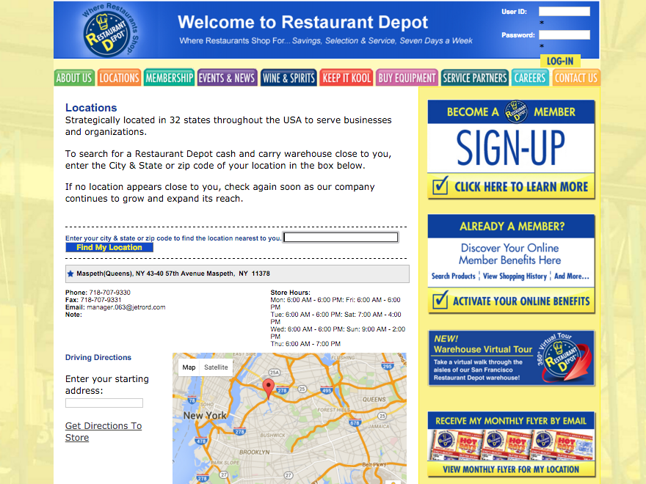

Slide 19
INTERMEDIARIES
Middleman
Broker
Manufacturer’s Representative

Slide 20
Determining quality: FDA
Standards of identity
Standards of quality
Standards of fill of containers
Nutrition Labeling
Adulterated
Miller Pesticide Amendment
Irradiation
GMO

Slide 21
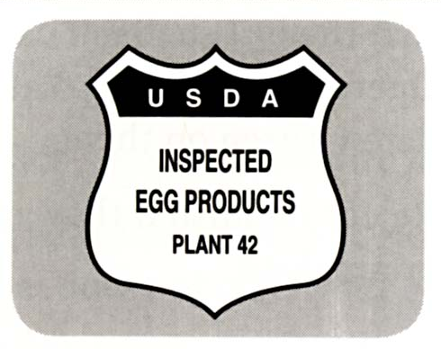
Determining quality: USDA
Grading Standards
Meat, Poultry, Egg Inspection

Slide 22
COST OF AN ITEM
Why do we pay what we do?
Time Value- availability
Storing goods, no need to pre-stock
Form Value- convenience
Raw- whole fresh chicken
User friendly- Chicken nuggets
Place Value- delivery
Information Value- price breaks, recipes

Slide 23
ETHICS IN PURCHASING
Favoring suppliers
Friends, relatives
Accepting gifts from suppliers
Free samples, alcohol, dinners
Limiting quantity
Creating a shortage to jack up prices
Under bidding
Kickbacks- $$$$
Accepting discounts
Quantity, volume, cash, promotional
Notes:
Quantity-large quantity of a product
Volume-lots of items to make a purchase a large quantity
Paying in cash or COD to get a discount instead of billing
Promotional-buying a product at a discount but having to promote in the establishment, table cards, samples

Slide 24
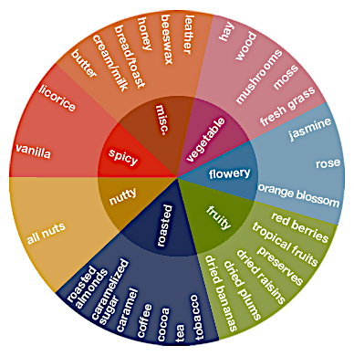
Chocolate Flavor Wheel

