Slide 1
City Tech 101
Semester
Professor Jessica Penner
jpenner@citytech.cuny.edu
City Tech 101 by Karen Goodlad and Sarah Paruolo is licensed under a Creative Commons Attribution-NonCommercial-ShareAlike 4.0 International License.

Slide 2
Self-Advocacy + Motivation
Session 11
11/11
Professor Jessica Penner
City Tech 101 by Karen Goodlad and Sarah Paruolo is licensed under a Creative Commons Attribution-NonCommercial-ShareAlike 4.0 International License.

Slide 3
Today’s Topics
Motivation
Counseling Center
Asking Effective Questions
Asking For Help
Self-Advocacy

Slide 4
Motivation!

Slide 5

Michelle Obama's Best Advice For Students | How To Succeed In Life

Slide 6
Discuss
Here’s a transcript of Michelle Obama’s speech. We just listened to it, now take a moment and read what she says:
  https://docs.google.com/document/d/1DNRwqlzY6WDaxu03nTzJ5JbI3vqJPk2cGvFWFTFjYsY/edit?usp=sharing
What is she saying in this speech? Summarize it!
What does this mean you need to do?

Slide 7
Other Media
TEDTalks
  The Danger of Silence by Clint Smith
  What You Discover When You Really Listen by Hrishikesh Hirway
Podcast
  Non Traditional College Success

Slide 8
Counseling Center

Slide 9
Asking Effective Questions

Slide 10

“Asking Questions is a good way to find things out.”
--Big Bird
Notes:
What makes a question a good question?
Break 11:10

Slide 11
Ask “Effective Questions”...
What does that even mean?
Notes:
11:10-11:20
Be specific
Be brief
Be thorough
Be appreciative

Slide 12
Ask “Effective Questions”...
What does that even mean?
Be specific
  What do you want as an outcome?
Be brief
  Include only relevant information
Be thorough
  But, don’t leave out supporting information
Be appreciative
  You will gain an ally
Notes:
Supporting Material:
https://www.edutopia.org/article/teaching-students-how-ask-productive-questions
https://www.edweek.org/teaching-learning/opinion-10-strategies-for-encouraging-students-to-ask-questions/2021/05
https://teaching.uchicago.edu/resources/teaching-strategies/asking-effective-questions/

Slide 13
Asking for Help

Slide 14
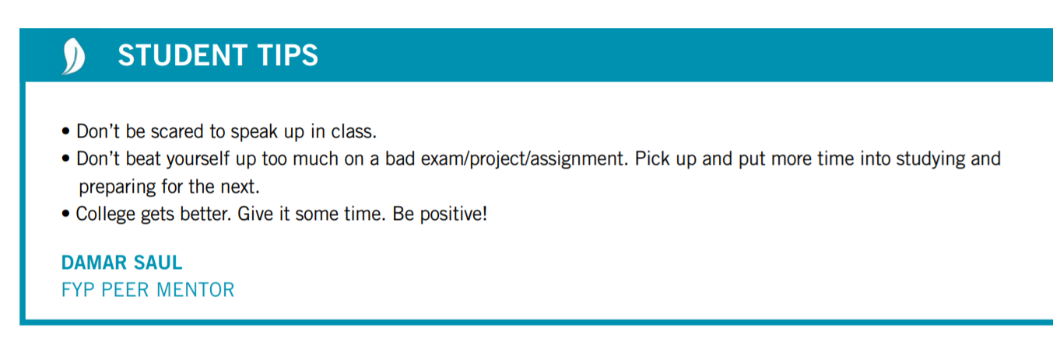
Asking For Help Is...

Slide 15
Self-Advocacy

Slide 16
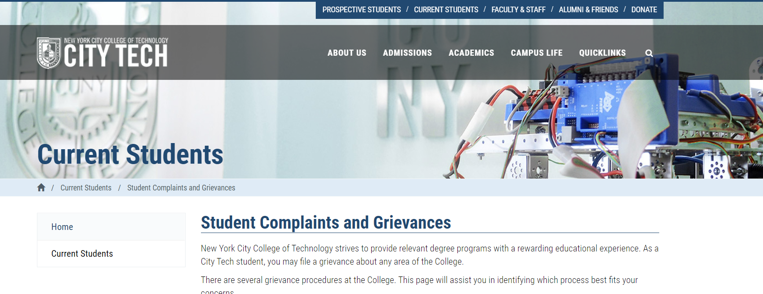
What are some reasons students may complain or file a grievance?

Slide 17
Recap
Motivation
Counseling Center
Asking Effective Questions
Asking For Help
Self-Advocacy

Slide 18
Before Session 12…
Complete Reflection #11 on OpenLab.
Reflection #11
Consider the discussions we had today about self-advocacy and motivation. Share a concept you believe is important and explain
what the concept means to you as a college student/learner.
Read and comment on another student’s post.
Notes:
ADD LINK

Slide 19
Self-Advocacy + Motivation
Session 11
11/11
Professor Jessica Penner
City Tech 101 by Karen Goodlad and Sarah Paruolo is licensed under a Creative Commons Attribution-NonCommercial-ShareAlike 4.0 International License.

