Slide 1
City Tech 101
Fall 2022
Professor Jessica Penner
jpenner@citytech.cuny.edu
City Tech 101 by Karen Goodlad and Sarah Paruolo is licensed under a Creative Commons Attribution-NonCommercial-ShareAlike 4.0 International License.

Slide 2
Get Your Head In the Game:
Mindset + Self-Advocacy
City Tech 101
Session 6
10/7
Professor Jessica Penner
City Tech 101 by Karen Goodlad and Sarah Paruolo is licensed under a Creative Commons Attribution-NonCommercial-ShareAlike 4.0 International License.

Slide 3
Today’s Topics
“Not Yet” Grade
Growth Mindset
Habits of Successful College Students

Slide 4
Discuss
“All things are difficult before they are easy.” – Thomas Fuller
What does this mean, exactly?
Here’s a personal example: When I started teaching at City Tech, I only knew one other professor, and I rarely saw them because our schedules were so different. I like to make friends. I need people to chat with about what’s going on. So, I decided I needed to make other friends. There was this one person who was often in the adjunct office at the same time. She was talkative and seemed nice. I decided we might be friends. Over time, we started talking—at first just about our classes, but slowly, we shared things about our personal lives. We walked to classes at Midway and Voorhees together. Now, she’s one of my best friends. We get together, text each other, and share meals together on a regular basis. It was hard at first, but eventually, it became easy!
Does anyone else want to share an example of something that was difficult before it was easy? It can be academic or something else!
How does this relate to what we’re doing in this workshop and at City Tech?
Notes:
I remember a number of people stated they wanted to meet new people at CT, well that is hard and everyone starts as a stranger until they are your best friend

Slide 5
“Not Yet” Grade

Slide 6
What do you think a grade of “not yet,” instead of a traditional F grade means?
What if you received a grade of “not yet”?
What would you do next?

Slide 7
Growth Mindset

Slide 8
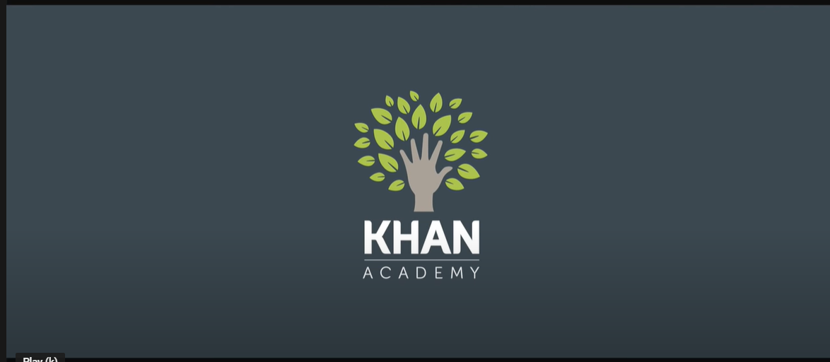
What is a growth mindset?
Let’s hear about it!
Do you want to know more about creating a growth mindset? Here are more resources:
Mindset, Talks at Google
Assess your Mindset
A Summary of Growth and Fixed Mindset

Slide 9
Reflective Questions from #RiseAndGrind:
Do the questions encourage a Growth or Fixed Mindset?
In your breakout room, discuss your answers to the following questions (these were the questions posed on Reflection #5). Be ready to share with the larger group when time’s up!
What life experiences have prepared me for college? Share one!
When I have been faced with a difficult situation, what strategies did I use to find a solution? Share one!
How will I create positive academic habits for myself? Share one!
Notes:
10:40-10:45
Activate the poll

Slide 10
Habits of Successful
College Students

Slide 11
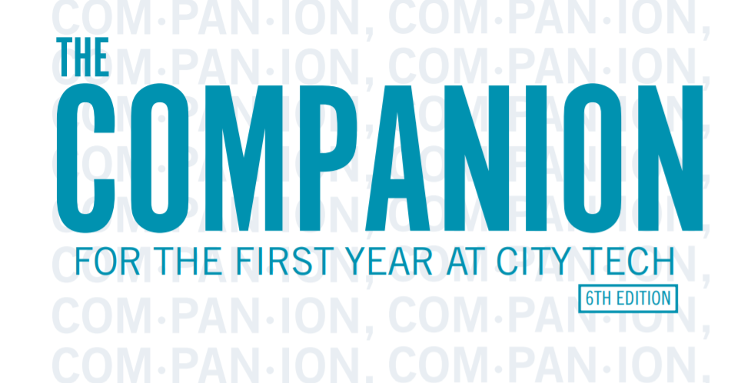
The Companion for the First Year at City Tech is available on the First Year Programs website.
Notes:
http://fyp.citytech.cuny.edu/media/2020/06/The-Companion-online.pdf
10:47

Slide 12
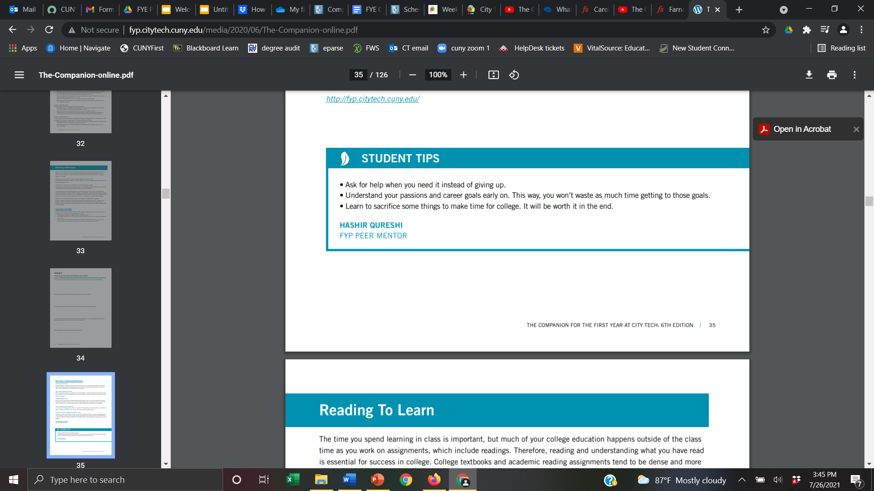
In The Companion, there are tips from Peer Mentors about becoming a better student.
The one above is from page 35.
Let’s hear from our Peer Mentors about their top tips!
Notes:
10:48

Slide 13
Small Group Discussion: Habits of Successful College Students
Open The Companion to page 31.
Do the activity “Track your Learning Process” just for week 6 on your own for 5 minutes.
When time’s up, I’ll put you in a small group.
Notes:
10 minutes

Slide 14
Small Group Discussion: Habits of Successful College Students
When you’re in the breakout room, identify a group scribe and a speaker. Be sure to take a screenshot of this slide before you join your group AND be sure the scribe takes notes—you’ll need them later!
Review the “Track your Learning Process” grid on page 31.
Share which of the practices you did not know successful college students used.
Share which of the practices you believe will be difficult for you to do on a regular basis and explain why you believe it will be difficult.
Notes:
10 minutes

Slide 15
Small Group Discussion: Habits of Successful College Students
Scribes: When you return to the larger group, copy and paste the notes into the chat.
Leaders: In one minute, summarize your small group discussion.
Share which of the practices the group did not know successful college students used.
Share which of the practices the group believes will be difficult to do on a regular basis and explain why they believe it will be difficult.
Notes:
10 minutes

Slide 16
Recap
“Not Yet” Grade
Growth Mindset
Habits of Successful College Students

Slide 17
Before Session 7…
Complete Reflection on OpenLab by replying to Reflection #6 Post.
Reflection #6
Consider the discussion we had today about mindset. Share a concept you believe is important and explain what the concept means to you as a college student.
Read and comment on another student’s post.

Slide 18
Get Your Head In the Game:
Mindset + Self-Advocacy
City Tech 101
Session 6
10/7
Professor Jessica Penner
City Tech 101 by Karen Goodlad and Sarah Paruolo is licensed under a Creative Commons Attribution-NonCommercial-ShareAlike 4.0 International License.

