Slide 1

City Tech 101
Fall 2022
Professor Jessica Penner
jpenner@citytech.edu
City Tech 101 by Karen Goodlad and Sarah Paruolo is licensed under a Creative Commons Attribution-NonCommercial-ShareAlike 4.0 International License.

Slide 2
You Paid For It, Use It:
Resources + Services at City Tech
City Tech 101
Session 5
9/30
Professor Sarah Paruolo
City Tech 101 by Karen Goodlad and Sarah Paruolo is licensed under a Creative Commons Attribution-NonCommercial-ShareAlike 4.0 International License.

Slide 3
Today’s Topics
College Success
Overview of Resources + Services
Accessing Resources + Services
Asking for Help

Slide 4

College
Success

Slide 5
Three Keys to Success
Work Hard!
Get Involved!
Ask for Help!
How do you “work hard” in college?
How do you “get involved” in college?
How do you “ask for help” in college?

Slide 6
Today’s Focus: Ask for help!
In a small group, discuss the following questions:
Why is it sometimes difficult to ask for help?
In high school, where did you go when you needed academic help?
How about social help?
How about emotional help?
How can we change how we view asking for help?

Slide 7

Resources
+ Services
@City Tech

Slide 8

Academic
Resources + Services

Slide 9
Tutoring
We’ll briefly look at the following sites:
Atrium Learning Center
Writing Center
Comprehensive Tutoring Schedule
Department Specific Tutoring
Self-Paced Department Resources

Slide 10
Student Success Center
More Info coming soon
Room Number: LG18R
studentsuccesscenter@citytech.cuny.edu
Website to launch in July 2022

Slide 11
Professor Office Hours
Questions from class
Questions about careers
Questions about majors or tracks
Questions about advisement
Questions about college or City Tech

Slide 12
Peer Leaders
First Year Programs Peer Mentors
Math Peer Leaders
Perkins Peer Advisement
Student Success Coaches

Slide 13
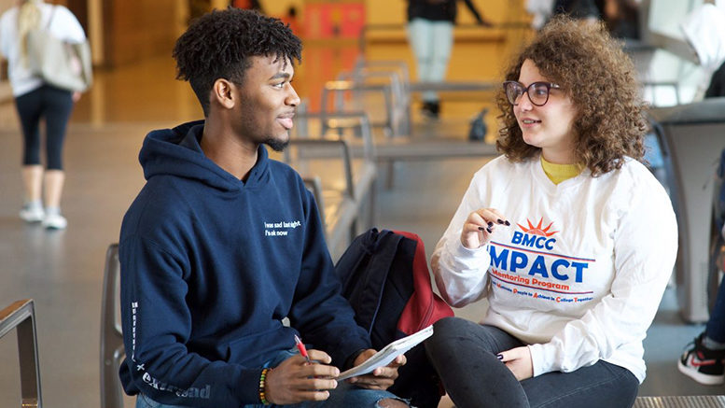
Peer Mentor Experience

Slide 14
City Tech Library
Reference Desk
Ask A Librarian
Research Guides
Technology Loans
Reserve Materials
Scanning + Photocopies
LGBTQ+ Resource
Website

Slide 15
Center For
Student Accessibility
If you had an IEP in high school
If you have any type of disability
If you are sick or unable to attend classes for more than a day or two
Website
City Tech is committed to supporting the educational goals of enrolled students with disabilities in the areas of enrollment, academic advisement, tutoring, assistive technologies, and testing accommodations. If you have or think you may have a disability, you may be eligible for reasonable accommodations or academic adjustments as provided under applicable federal, state and city laws. You may also request services for temporary conditions or medical issues under certain circumstances. If you have questions about your eligibility or would like to seek accommodation services or academic adjustments, you can leave a voicemail at 718-260-5143, send an email to: Accessibility@citytech.cuny.edu, or visit the Center’s website at http://www.citytech.cuny.edu/accessibility/ for more information.

Slide 16
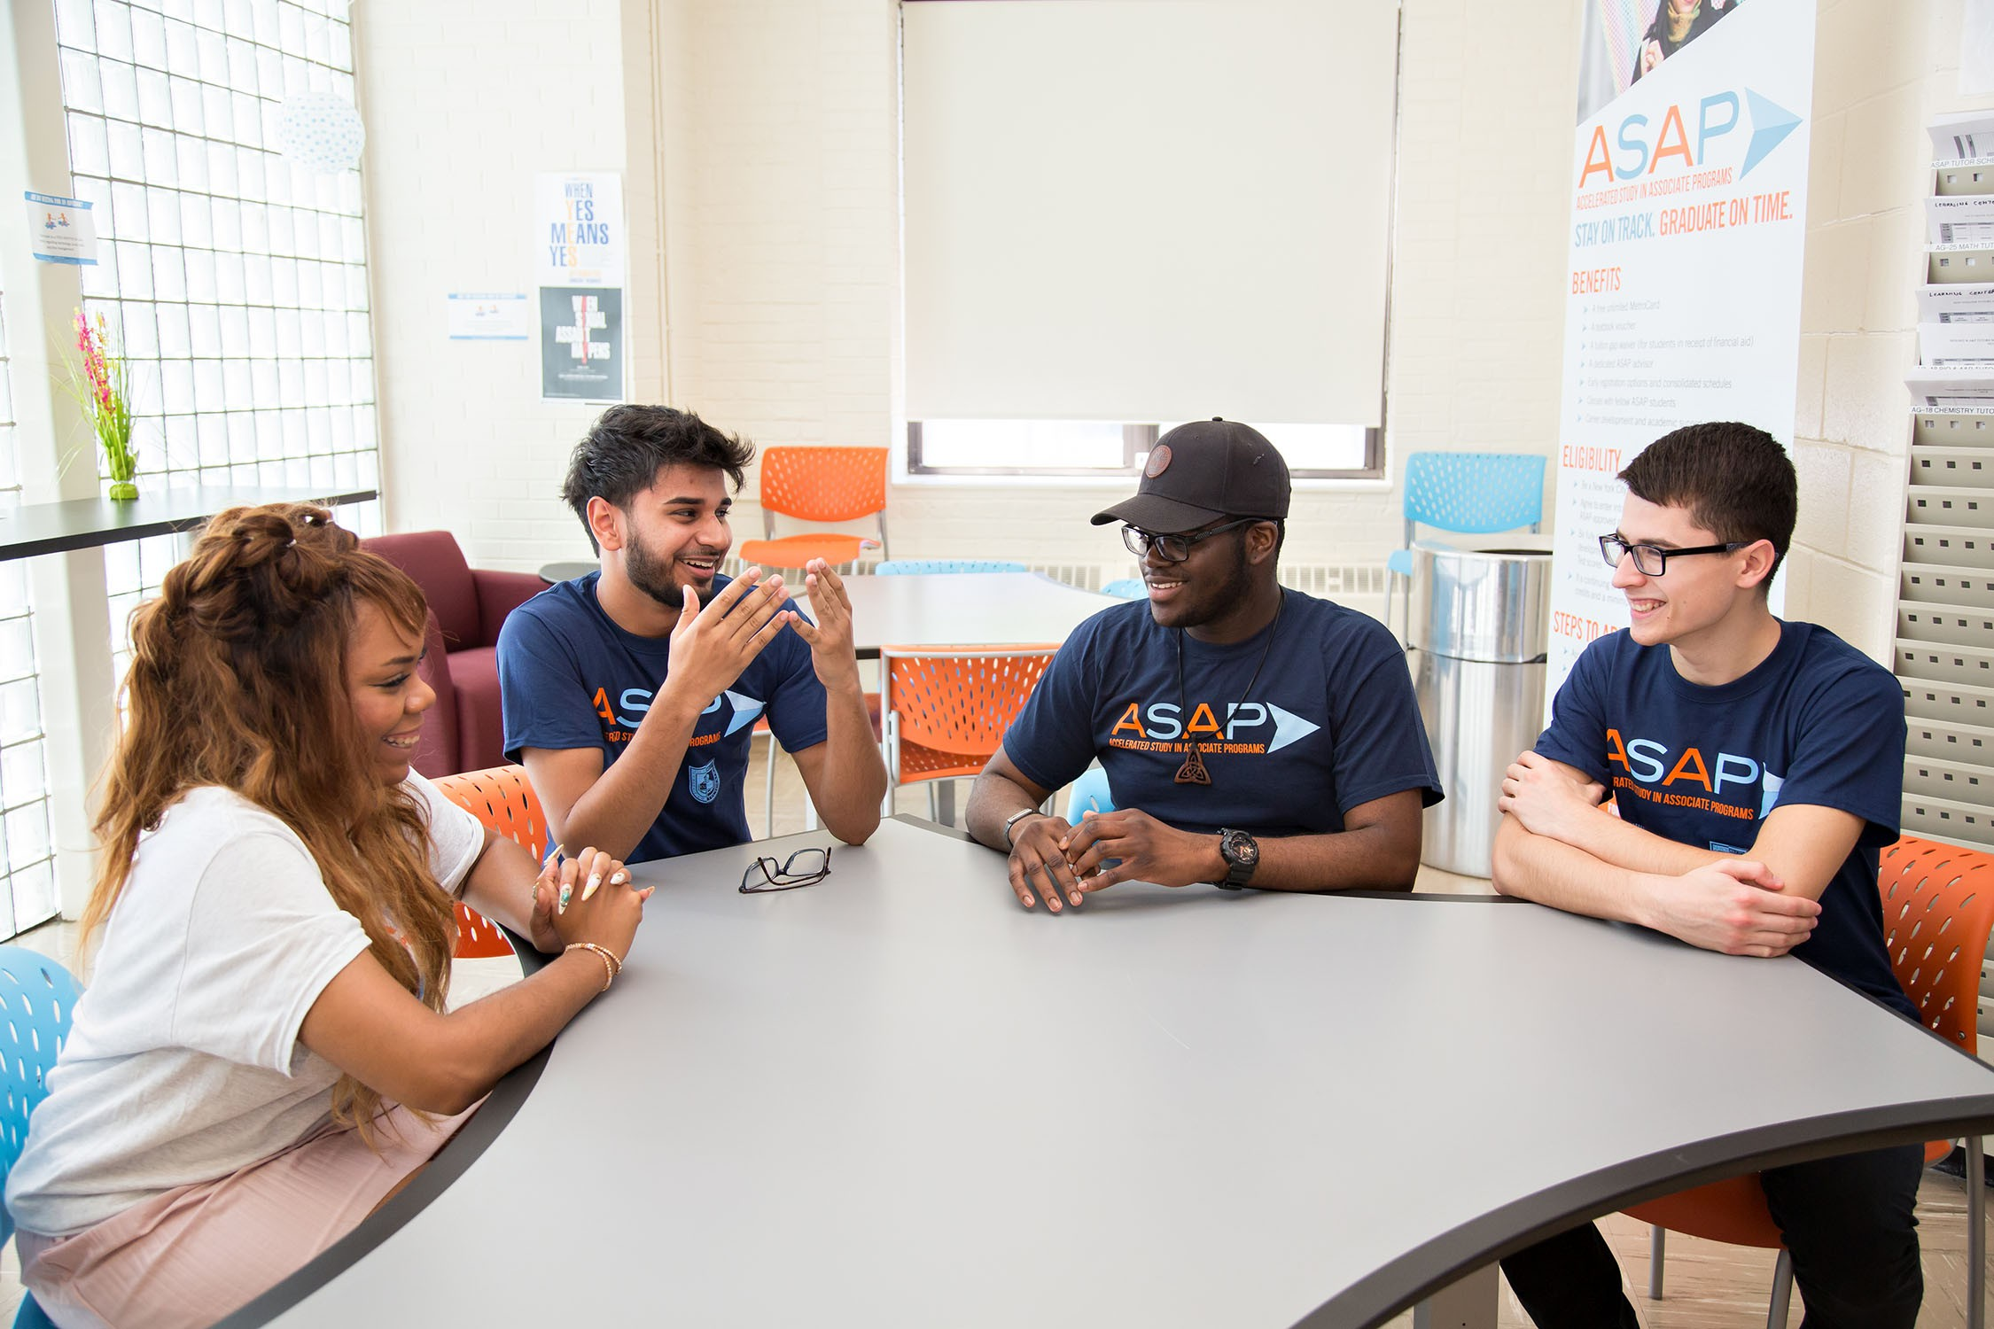
Comprehensive Programs

Slide 17
Full Service
ASAP
SEEK
CUNY EDGE

Slide 18
Peer Mentor Experience

Slide 19
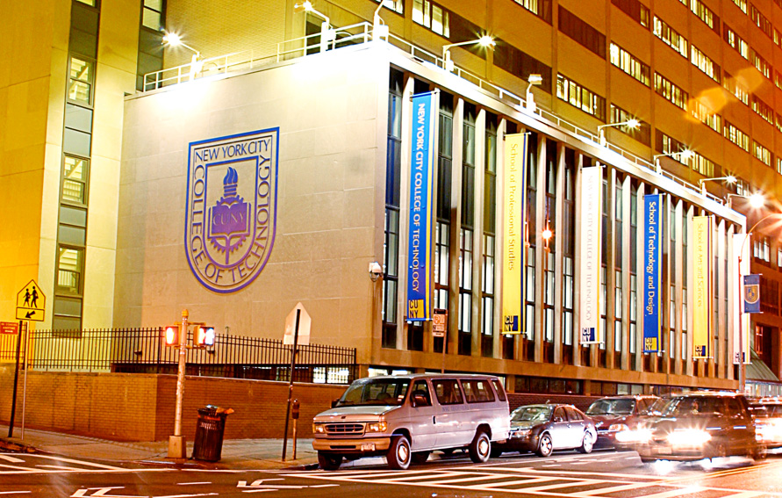
Administrative
Resources + Services

Slide 20
College Administration
Registrar
Bursar
Financial Aid
Scholarship & Residency Services
International Student Services

Slide 21
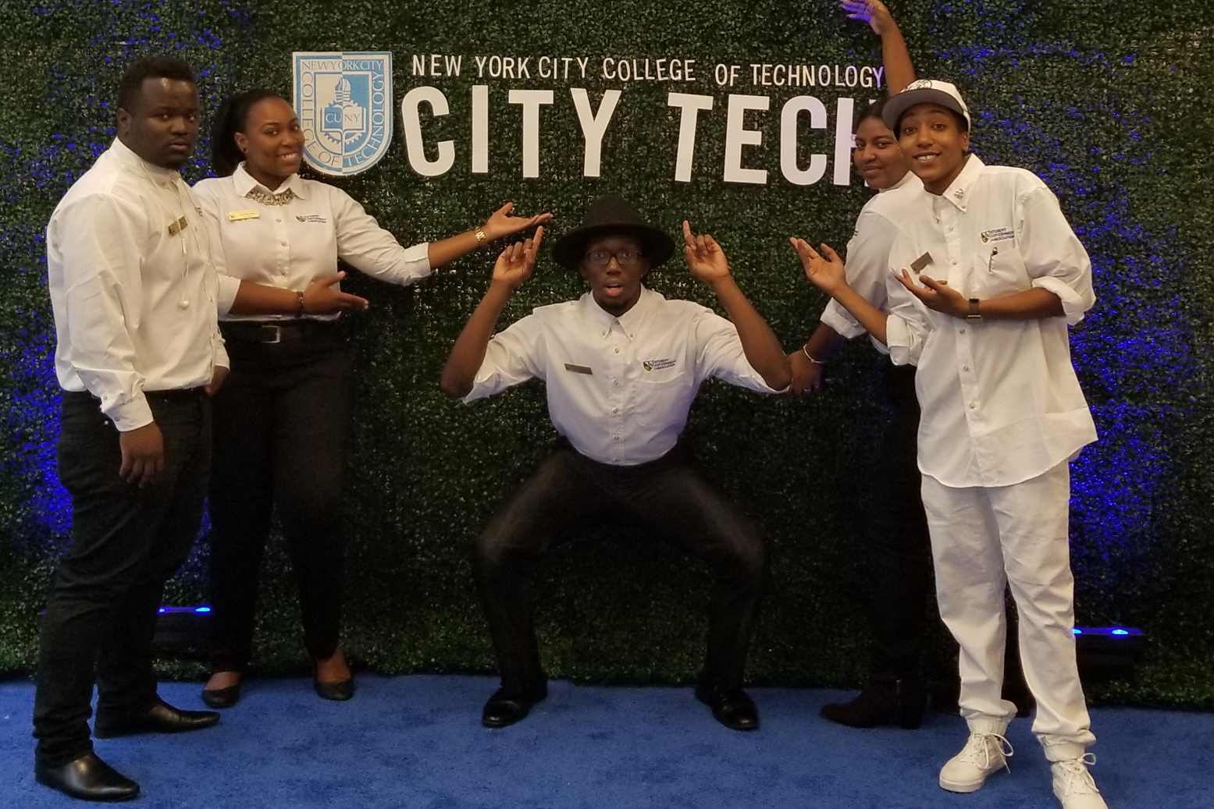
Student-Centered
Resources + Services

Slide 22
First Year Students
First Year Programs
FYP Peer Mentors

Slide 23
Student Leaders
Student Government Association (SGA)
NYPIRG
CUNY ServiceCorps

Slide 24
Student Clubs + Events
Student Life + Development (SLD)
Yellow Jacket Journey (Presence)

Slide 25
Peer Mentor Experience

Slide 26
Professional
Development Center
Exploring majors, interests, and values
Resume and Cover letter critiques
Interview preparation & Mock interviews
Graduate School Exploration
Virtual Workshops & Seminars
Virtual Informational Sessions with Employers
Virtual Networking Events
Website

Slide 27
Workshops and Speakers
Targeted topics
Experts in different areas
Department specific
Notes:
Not sure what to do with this slide!

Slide 28
Peer Mentor Experience

Slide 29
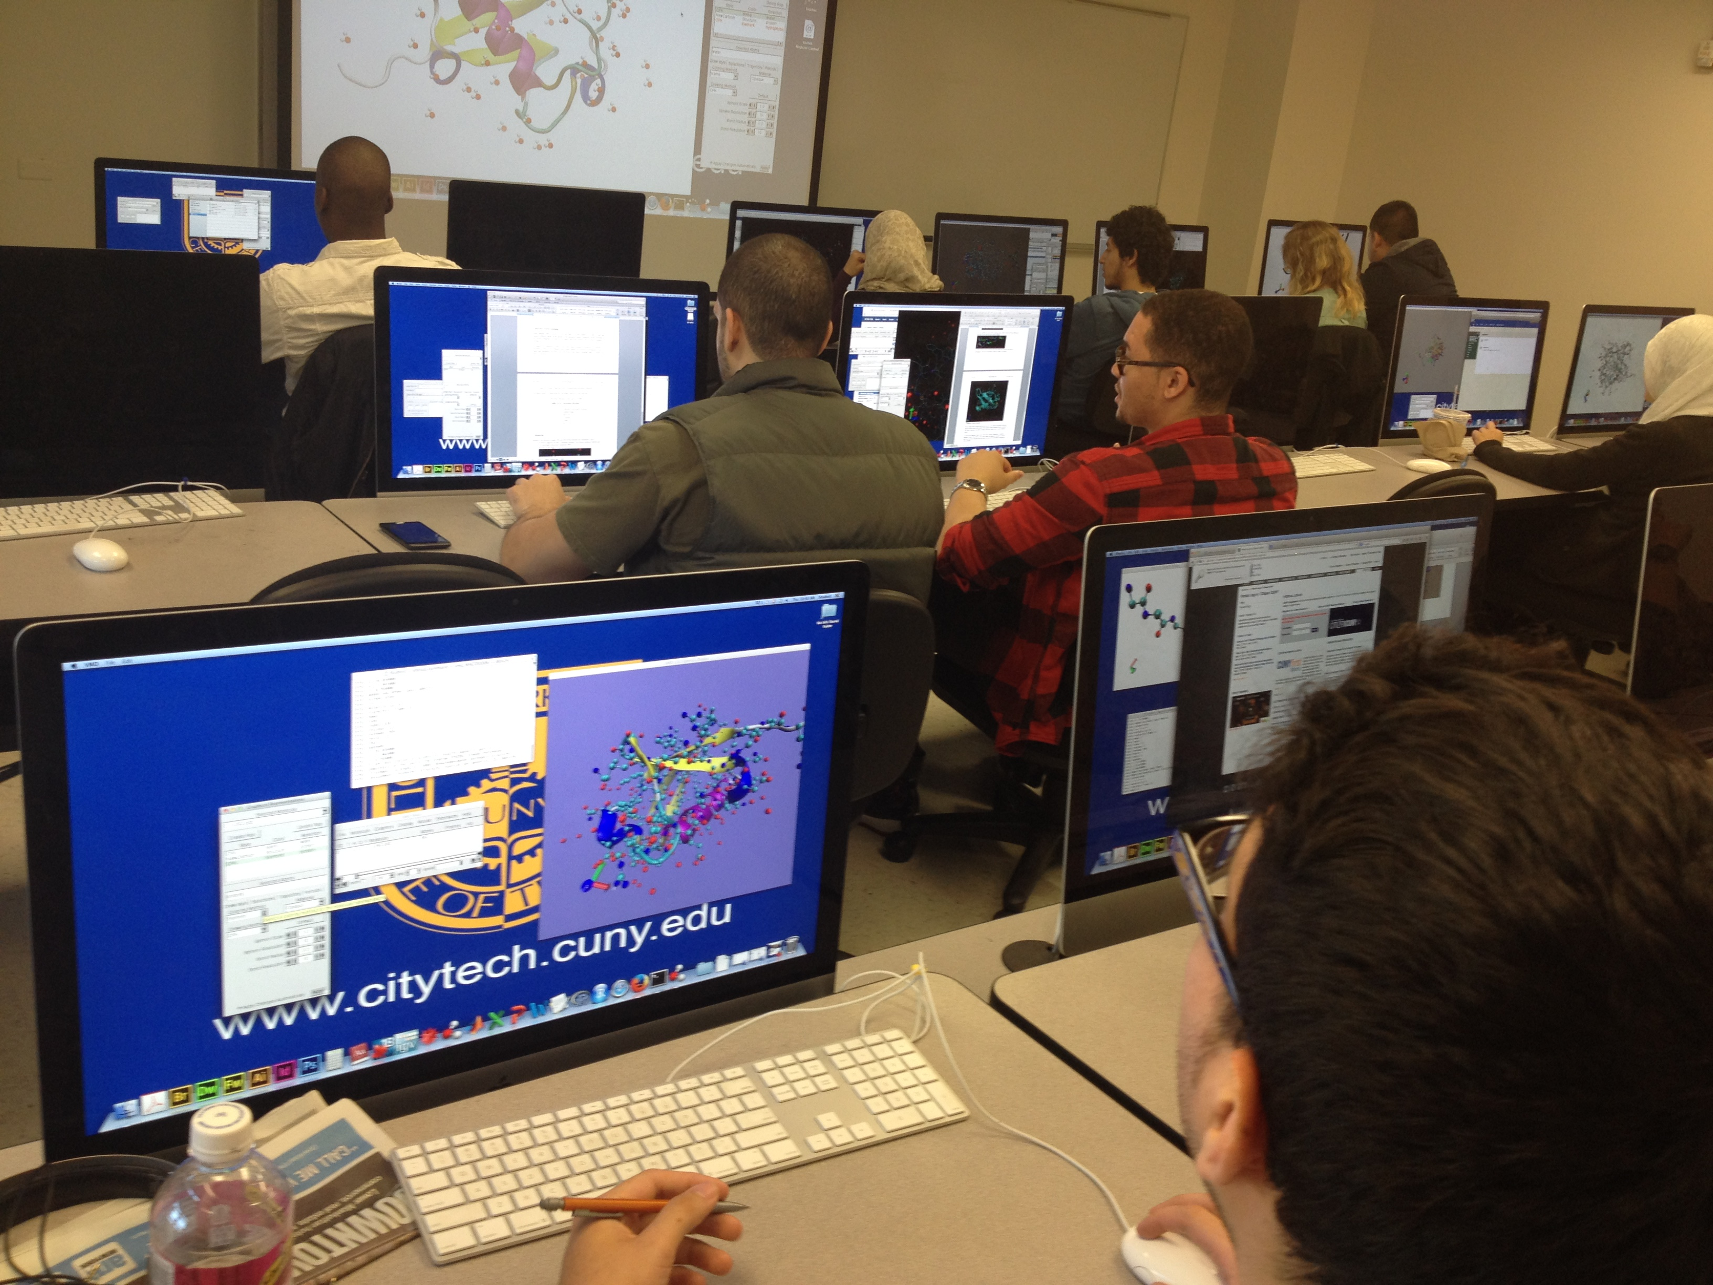
Technology
Resources + Services

Slide 30
Computer Labs
Atrium Learning Center, Library Building, ground floor
Library, 4th floor
General Building, 6th floor
Vorhees, 2nd floor
Virtual Computer Lab

Slide 31
Student Help Desk
CUNYFirst
CT email + Email Lookup
One Drive + Microsoft Office
Blackboard
OpenLab
Zoom
Specialized Programs + Tools

Slide 32
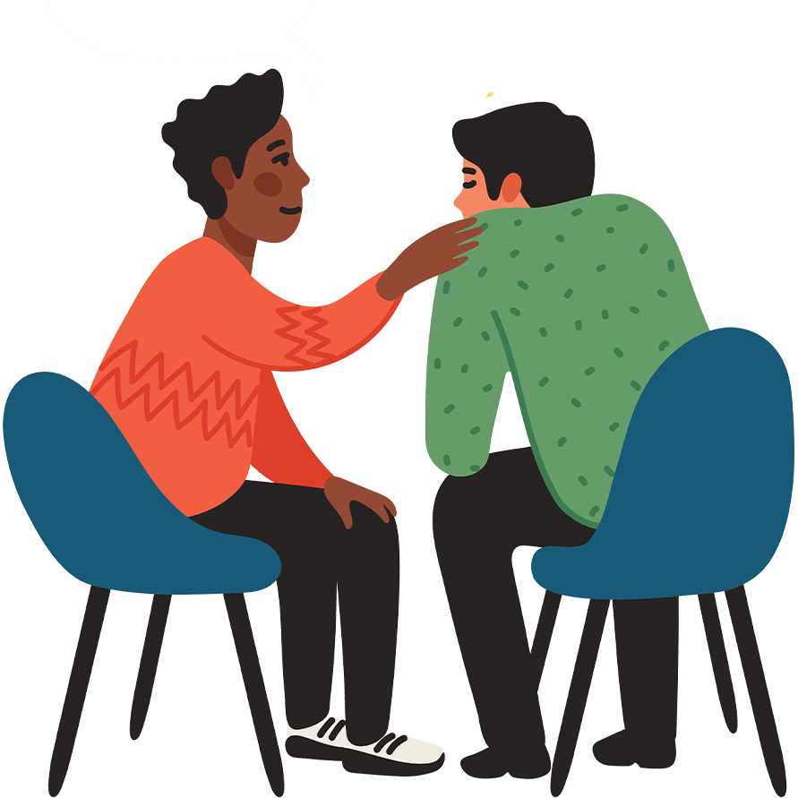
Targeted Resources + Services

Slide 33
Student Health + Well-Being
Counseling Services
Community Standards
Wellness Center
Pop-up Food Pantry
Public Safety
Petrie Fund
Fitness Center/Zoom Fitness Classes
Gym (opening tbd)

Slide 34
Affinity Support
Black Male Initiative (BMI)
Veteran Support Services
Childcare Center
CREAR Futuros

Slide 35
Peer Mentor Experience

Slide 36

Accessing Resources
+ Services

Slide 37
Navigating the
City Tech Website
www.citytech.cuny.edu

Slide 38
Small Group Scavenger Hunt
Directions:
Using the information from class today and the City Tech website, find the answers to the following questions.
The group with the most correct answers at the end of 15 minutes wins!
Accessing
Resources
+ Services

Slide 39
SCAVENGER HUNT
[INCLUDE LINK]

Slide 40

What have we learned about asking for help?

Slide 41

Asking for help is...
Responsible
Healthy
Proactive
Normal

Slide 42
Asking for help is NOT...
A sign of weakness
A sign of failure
A sign that you don’t belong in college

Slide 43
“Be strong enough to stand alone;
Smart enough to know when you need help; and brave enough to ask for it.”

Slide 44
Recap
College Success
Overview of Resources + Services
Accessing Resources + Services
Asking for Help

Slide 45
Before Session 6…
Complete Reflection on OpenLab by replying to Reflection #5 Post.
Reflection #5
Read the following quote by Dr. Pamela Brown, Provost and Vice President for Academic Affairs:
“Learning is a source of hope for a better future. It requires hard work and sacrifice which can be even more difficult in challenging times. Your time in college is also your opportunity to connect with others, lift your spirit, enrich your life, and develop the skills and knowledge to make a difference in your community.”
Choose a question below and write a reflection in the comment box below this post.
What life experiences have prepared me for college?
When I have been faced with a difficult situation, what strategies did I use to find a solution?
How will I create positive academic habits for myself?
Read and comment on another student’s post. These are your classmates, encourage them to work towards their goals.

Slide 46
You Paid For It, Use It:
Resources + Services at City Tech
City Tech 101
Session 5
9/30
Professor Sarah Paruolo
City Tech 101 by Karen Goodlad and Sarah Paruolo is licensed under a Creative Commons Attribution-NonCommercial-ShareAlike 4.0 International License.

