Slide 1
City Tech 101
Fall 2022
Professor Jessica Penner
jpenner@citytech.cuny.edu
City Tech 101 by Karen Goodlad and Sarah Paruolo is licensed under a Creative Commons Attribution-NonCommercial-ShareAlike 4.0 International License.

Slide 2
How are you feeling today (visually)?
Find a picture that reflects some of what you’re feeling today.
Go to this link and follow the directions:
https://docs.google.com/document/d/1B0jVd1OwKPbF2GLFVX5vG9ULiQ0cuhHCuhYDwf-hYos/edit?usp=sharing

Slide 3
#RiseAndGrind
City Tech 101
Session 3
9/16
Professor Jessica Penner
City Tech 101 by Karen Goodlad and Sarah Paruolo is licensed under a Creative Commons Attribution-NonCommercial-ShareAlike 4.0 International License.

Slide 4
Today’s Topics
Creating Workspaces
Learning Styles
The Study Cycle
Your New Schedule
Time Management
Self-Care

Slide 5
Learning Spaces,
Learning Places
Where do you usually study?
Do you think this is the best place?
Notes:
Q: Where do you do your homework and study? Why? Do you think that is the best place to do it? Why/Why not?

Slide 6
On City Tech Campus
In the classroom
In the lab
In the library
In the computer lab
In other spaces
Pros and cons?
Notes:
Pros and cons:
Quiet v. Noise
Distractions
Comfort-- but not too much
Specific spaces
What kind of access will you have this/next semester?

Slide 7
Working Remotely
In your home
In your own space
In your personal classroom
Pros and cons?
Notes:
Pros and cons
Online/Remote Learning-- difficulties and advantages
Armed with the knowledge of past 2.5 years
Even if in person, will all your work be done at school? Do you need a space at home to work?

Slide 8
Create Your Own Workspace
Limit distractions and noise
Set up computer/tablet on a desk or table, not your lap
Sit in a chair, rather than a couch or bed
Have a notebook and pens/pencils nearby
Make sure there is plenty of light
Hang a calendar or weekly schedule
Post To Do list
Post pictures, images, and/or motivational quotes
Add a plant for increased oxygen
Notes:
Importance of making space
Creating the right atmosphere and routine
Train your brain to know that this is a space for work

Slide 9
Small Group Discussions:
Online Learning
Challenges
Question #1: What are some challenges you face while taking classes online/studying at home?
Question #2: What are some potential solutions for these challenges?
Directions:
5-7 minutes to discuss questions
Take a screen shot of this slide so you can remember the questions
Assign scribe to take notes (create a Google doc) while you all discuss
Assign reporter to share answers to question #1 with full class
Assign reporter to share answers to question #2 with full class
We will come back as group to discuss-- be prepared!
Notes:
Peer Mentors can float between groups
No more than 4 students to a group
Remind them to take a screenshot of the slide before they go into the breakout rooms so that they have the Qs and directions
Come back and discuss.
HIGHLIGHT the lived experiential knowledge of students, they are advantages-- not deficits

Slide 10
Learning Styles

Slide 11
Increased Personal Responsibility
Taking Control of Your Own Learning
=
Notes:
Q: What does it mean to take control of your own learning?
Q: Why is this important?
Q: How does this present as being different from how you learned in high school?

Slide 12
How do you…?
…learn something new?
…practice a new skill?
…know that you understand
a new concept?
…know that you can apply
a new idea?
Notes:
Open students up to the idea that they don’t actually know HOW they learn things.
I usually say something like… “At this point in your lives most of you have been professional students for at least 12 years. We expect professionals in most fields to be experts at their craft. Examples like a carpenter, a plumber, a pilot, etc. Are you an expert at learning? How could you not be? Is it possible you learned how to learn but have no idea that you did?”
This leads into why we need to understand how our brains work, and how we actually learn-- especially since it is now in their hands.

Slide 13
Learning Style Quiz
http://www.learningstylequiz.com/
Notes:
Introduce the idea that people learn in different ways, know how you learn makes a huge difference in how easy you find school/studying.
Give them 10 minutes to take the quiz.

Slide 14
Learning Style Quiz
Poll/Share
What type of learner are you?
Notes:
Show the array of results.
Q: Who is surprised with their results? Who thinks that their results make a lot of sense?

Slide 15
Kinesthetic
Learn by doing
Notes:
I do not take the time to go into depth on each one of these. I introduce what each major type means and point out one of the strategies for each on the following slide. Encourage them to go back and look at these. Encourage them to do further internet research-- lots of study tips out there based on learning style.

Slide 16
Kinesthetic
Like to touch, taste, smell, and be active within the lesson in order to best process and remember
Need a deep dive to be fully engaged with the material and learn from experiencing
Tips for optimizing the kinesthetic learning experience:
Make activities as active as possible. When learning a new language, engage in conversation regularly.
Background music or other audio stimulation tends to help kinesthetic learners engage with and retain information.
Highlight key points and/or draw sketches of the material.
Take your time when working through a lesson to make sure you are fully engaged with what is being taught.
Sensual stimuli such as foods, drinks, and physical objects that the learner can touch or interact with can be of immense help.
Make complex tasks visual and interactive.
(source: learningstylequiz.com)

Slide 17
Visual
Learn by seeing

Slide 18
Visual
Process information through writing and reading, good at taking notes.
Memorize by taking a mental picture and using the image to process.
Tips for optimizing the visual learning experience:
Use attachments such as maps, itineraries, articles, and photos to process and memorize information, and be able to recall it later.
Take notes – whether that be text, drawing, or charts. Always make sure you’re taking something with you at the end of a lesson!
Go through notes and ask questions – then modify as needed.
Pay attention to pauses in a lesson – great opportunities to ensure you have everything jotted down or drawn out.
Minimize audible or visual distractions.
Draw sketches/take notes in the margins of a page, in white space below paragraphs, or anywhere there’s room.
(source: learningstylequiz.com)

Slide 19
Auditory
Learn by listening

Slide 20
Auditory
Often talk out loud to themselves, helps process thoughts and ideas.
Can struggle with remembering what they read, or putting their thoughts to paper.
Tips for optimizing the auditory learning experience:
Finish study sessions or classes with a summary, for a chance to recap.
Listen to readings when possible (audio books, text speak programs, podcasts, etc.)
Inclusive brainstorming and small group discussion allow ideas to spoken and written simultaneously helping to express ideas and remember them.
Study groups and partnered work help things stick more easily. The more conversational, the better!
Talk to professors during office hours to reinforce ideas from class.
(source: learningstylequiz.com)

Slide 21
BE
OPEN
TO
CHANGE!
It's a mistake to do the same thing again and again and to expect different results
If you want different results, you must do things differently.
Notes:
Prompt students to understand that do get new results, they have to be willing to try new things.
I like to share this example: When introducing new food to a child, you have to make them try it 20 times before accepting that they really don’t like the food. Not to torture them, but because our bodies are trained to be suspicious of new things. Translate this to learning.
Trying to integrate new study methods and routines will not be simple. You are going to have to push yourself for a while before it feels natural/right/comfortable.

Slide 22
The Study Cycle
Notes:
A basic plan that can be tailored to fit your own learning style. It is the structure of constant and cyclic learning/studying.
Two biggest advantages:
No cramming! (Which also means no panicking, no all nighters, no tears, no surprises…)
Early warning signs when you are falling behind or getting confused-- the sooner you know you need help, the more that help can do for you!
I don’t think most students truly follow this plan BUT I do think it gets thinking about how much studying needs to happen and how often. It also includes many basic practices that are students do not currently use.

Slide 23
The Study Cycle
1
Prepare
5
Assess
2
Attend
4
Study
3
Review
Notes:
Overview
Importance of cycle

Slide 24
Prepare Before Class
1
Prepare
Complete assigned reading before class
Annotate readings
Come up with questions to ask in class

Slide 25
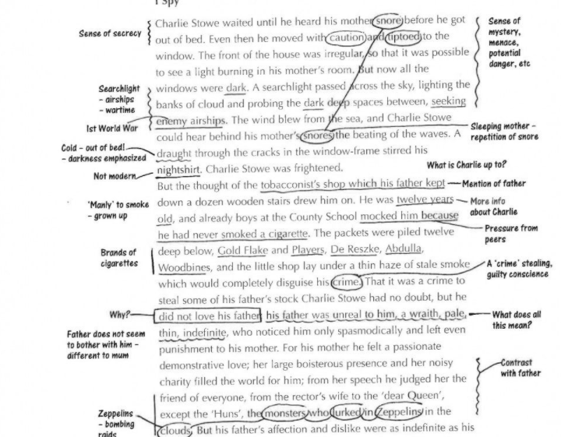
Annotating Readings
1
Prepare
1
Prepare
More than highlighting
Note key ideas
Mark unfamiliar words
Ask questions
Add mini-summaries
Make your own system
Notes:
They all learn some form of annotating in ENG 1101, so this can just be an introduction to the idea.

Slide 26
Attend Class
2
Attend
Be on time
Choose a good seat in the classroom OR Create a workspace at home
Be an active learner
Ask + answer questions
Take notes

Slide 27
Taking Notes
2
Attend
Take notes on paper, tablet, or laptop
If using a tablet or laptop, be sure to save the document with a clear title (for example: ENG1101_6.22.22) so you can locate the notes easily.
Do not try to write down every word the professor says
If using paper, recreate charts and diagrams carefully, underline/Highlight key words and phrases, leave extra spaces on the page, making it easy to go back and add missing pieces, at the top of each page, write the class and date
The takaway? Stay organized!

Slide 28
Rev Review After Class
3
Review
As soon as class ends, review your notes
Fill in gaps and missing pieces
Write down questions
Mark parts that are still confusing
Go back to readings to search for answers
Compare notes with a classmate
Ask your professor questions, either in office hours or at beginning of next class

Slide 29
Study Every Day
4
Study
Repetition is key--even 10-15 minutes a day will make a huge difference
Ask yourself questions about the material, such as ‘why’, ‘how’, and ‘what if…’
Don’t just memorize, try to understand the material
Make connections to help you remember

Slide 30


Slide 31
Assess Your Learning
5
Assess
Check in with yourself weekly by asking:
  How are my classes going?
  Am I satisfied with my grades?
  Am I sticking to my Study Cycle routine?
  Do I need to make changes to my routine or methods?
  Do I need extra help?
Test yourself often by asking: Do I understand this enough to teach it to someone else? (Also, try to actually teach it to someone else!)
Don’t get stuck or frustrated-- get help.

Slide 32
Your Time, Your Success

Slide 33
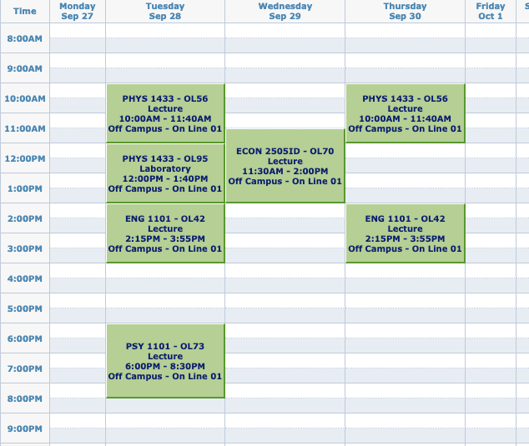
A Typical FY College Schedule
What does this schedule look like compared to your HS schedule?
What assumptions might you make based on those differences?
IMAGE

Slide 34
Do you really have all that free time now??
One of the hardest parts of college is BALANCING everything—your courses,your assignments, and the rest of your life.

Slide 35
Question
How many hours will you spend
in class and doing work for class in one semester?
Notes:
Have them guess

Slide 36
Answer:
Over 600 hours!
That’s a lot of hours!
Let’s break it down week by week.

Slide 37
The Breakdown
15 credits = roughly 15 hours in class each week
for each hour in class, budget 2 hours for homework and studying
15 credits = roughly 30 hours of work outside of class each week
so when taking 15 credits, you should expect to spend about 45 hours each week just on school
15 credits each semester
many classes are 3 credits
often, 15 credits means
5 courses (but not always)
1 credit = approximately 1 hour in class each week

Slide 38
Math Time!
How many hours a week do you spend doing…
https://fyp.citytech.cuny.edu/media/2020/06/The-Companion-online.pdf
Go to page 20!
(But don’t worry, you can use your calculator for this.)
Notes:
Not all hours are created equal. Open Google Doc or Zoom Whiteboard to DEMO math.

Slide 39
Be Good to Yourself!
Notes:
Q: What is self care? Why talk about it during our Rise And Grind session?

Slide 40
Two Types of Self-Care
INDULGE + RELAX
Feels good right now.
RESPONSIBLE + RATIONAL
Your future self will thank you.
Both types are important and necessary!!
Notes:
People tend to focus on the first type, but the second type is also VERY important

Slide 41
Today’s Topics
Creating Workspaces
Learning Styles
The Study Cycle
Your New Schedule
Time Management
Self-Care

Slide 42
Before Session 4…
Complete Reflection on OpenLab by replying to Reflection #3 Post.
Reflection #3
Our Stories https://openlab.citytech.cuny.edu/fylc/writing-as-reflection/

Slide 43
#RiseAndGrind
City Tech 101
Session 3
9/16
Professor Jessica Penner
City Tech 101 by Karen Goodlad and Sarah Paruolo is licensed under a Creative Commons Attribution-NonCommercial-ShareAlike 4.0 International License.

