Slide 1
City Tech 101
Welcome!
Fall 2022
Professor Jessica Penner
jpenner@citytech.cuny.edu
City Tech 101 by Karen Goodlad and Sarah Paruolo is licensed under a Creative Commons Attribution-NonCommercial-ShareAlike 4.0 International License.

Slide 2
The Syllabus
City Tech 101
Session 2
9/9
Professor Jessica Penner
City Tech 101 by Karen Goodlad and Sarah Paruolo is licensed under a Creative Commons Attribution-NonCommercial-ShareAlike 4.0 International License.

Slide 3
Today’s Topics
Course Organization
Contents of a Syllabus
Duties + Responsibilities of a Professor
Duties + Responsibilities of a Student
Effective Communication
If these [online] walls could talk…

Slide 4
Course Organization

Slide 5
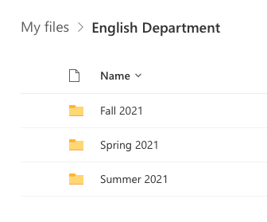
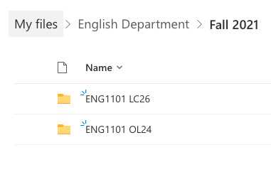
Make folders in your OneDrive
Organize by semester
Organize by course
First file is your syllabus + schedule
Save ALL your work for the course
Use consistent and clear file names
LastName_Assignment_Class_Semester
Paruolo_Reflection4_CT101_SU21

Slide 6
Contents of a Syllabus

Slide 7
Why is a syllabus so important?

Slide 8
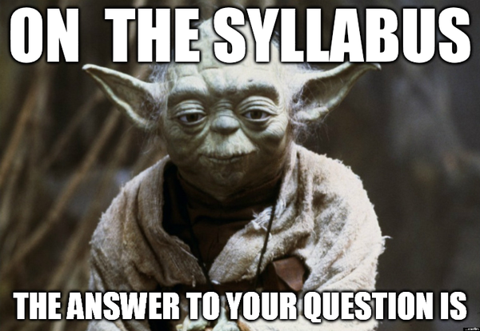

Slide 9

Department Abbreviation
Course Number
Course Name
Course Meeting Information
Course Site Information
Instructor Contact Information
Office Hours Information
Course Description
Pre/Co- Requisites

Slide 10
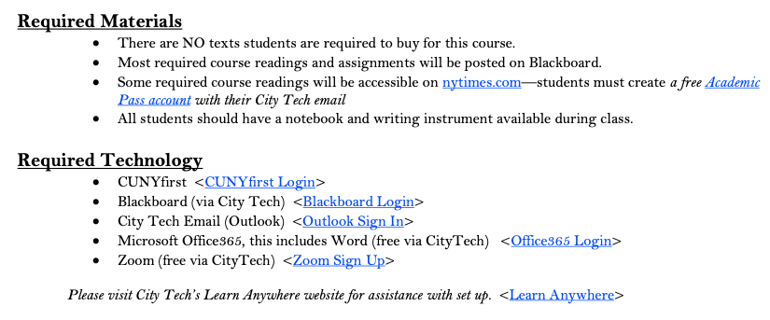
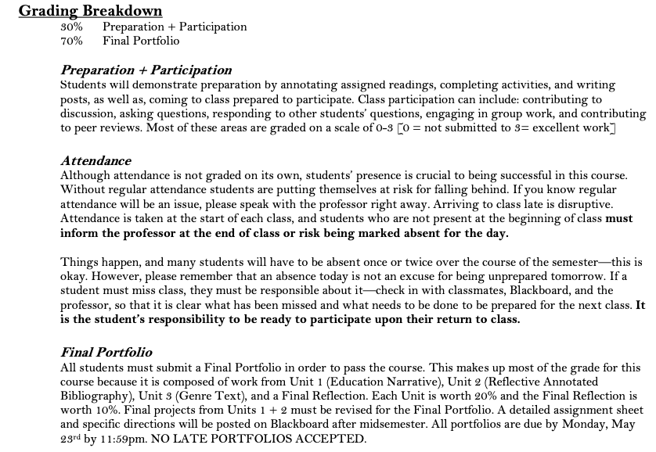
Required Texts
Required Materials
Required Technology
Grading Breakdown
Course Assignment Descriptions

Slide 11
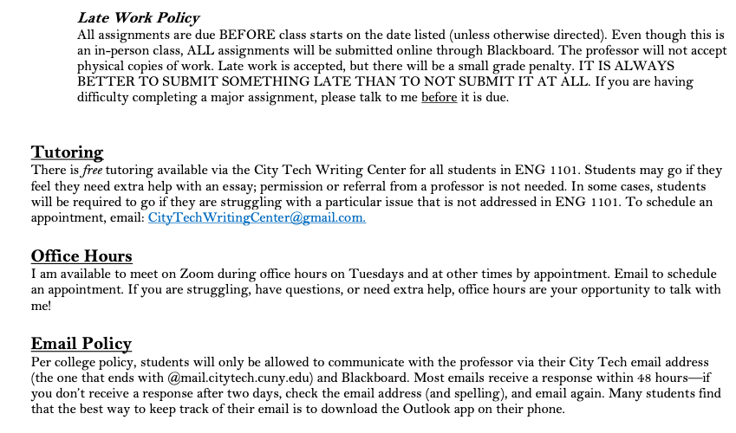
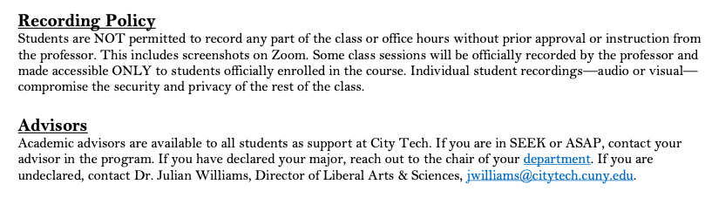
Course Policies

Slide 12
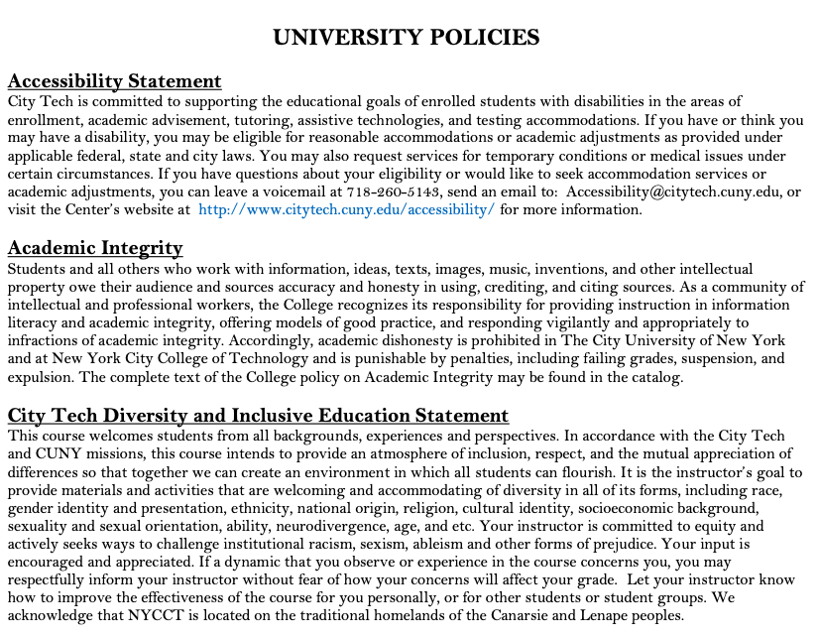
Accessibility Statement
Academic Integrity Statement
Diversity and Inclusive Education Statement

Slide 13
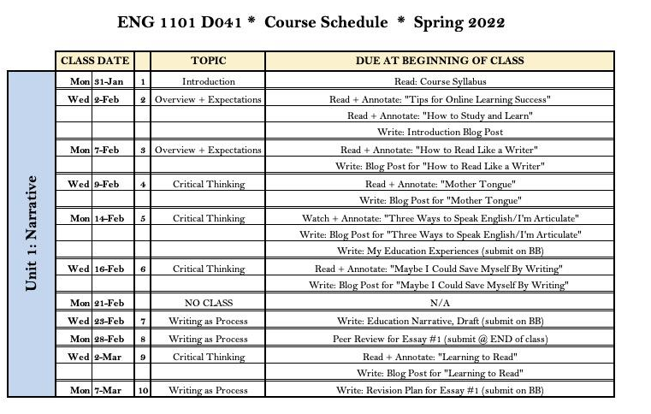

Slide 14
Other Example Syllabi
Peer Mentors: Can you share one of your syllabi and talk about how you utilize it throughout the semester?

Slide 15
Duties + Responsibilities
of a Professor

Slide 16
A Professor’s Job Includes...
Creating and Distributing a Syllabus + Course Schedule (1st week of semester)
Notifying Students of Any Changes to the Course Schedule in a Timely Manner
Providing Clear Grading Scheme + Criteria
Grading Student Work Fairly
Informing Students of Midsemester Grades (8th week of semester)
Providing Clear Expectations for Students
Addressing All Learning Objectives for Course
Teaching Students Course Content
Holding Weekly Office Hours for Students
Answering Student Emails in a Timely Manner
Answering Student Questions
Assigning Final Grades
Treating All Students with Respect + Fairness

Slide 17
Duties + Responsibilities
of a Student

Slide 18
A Student’s Job Includes...
Reading + Understanding the Syllabus + Course Schedule
Being Responsible for ALL Information in the Syllabus
Asking Questions about Course Requirements, Assignments, Policies, + Grading Criteria
Attending Class Regularly + On Time
Informing Professor of Absences in a Timely Manner
Completing All Work in Accordance with City Tech’s Academic Integrity Policy
Contributing to an Inclusive Classroom + Campus Environment
Completing All Major Assignments + Exams
Submitting Work On Time
Learning Course Content, as Taught by Professor
Studying Course Content
Asking Questions (in class, via email, + during office hours)
Seeking Out Extra Help, When Needed
Being Prepared for All Classes

Slide 19
Effective Communication

Slide 20
Emailing with Professors
https://www.youtube.com/watch?v=nqaRp8MyLOg&t=1s

Slide 21
Emailing with Professors
Peer Mentors: Can you share an email you’ve written to a professor or advisor?

Slide 22
Tips for Effective Communication
Set up your City Tech email
Download the Outlook App for your phone
Check your City Tech email EVERY DAY
Check Blackboard and/or OpenLab EVERY DAY
Write clear emails and ask good questions
Utilize professor office hours

Slide 23
If these [online] walls could talk…
Notes:
https://docs.google.com/document/d/1apeK0Zl95Q8qO_o1ixxz18Ud1T1ZhVAz/edit?usp=sharing&ouid=111774375294871248054&rtpof=true&sd=true

Slide 24
Recap
Course Organization
Contents of a Syllabus
Duties + Responsibilities of a Professor
Duties + Responsibilities of a Student
Effective Communication

Slide 25
Before Session 3…
Complete Reflection on OpenLab by replying to Reflection #2 Post by 11:59 PM tonight.
  Remember, you must have an account and be logged in to OpenLab to reply to a post.
  How to Respond to a Reflection
Read the Reflection post.
Click on Comment.
Write your comment in the box.
Click Post.
Reflection #2
Review 1101 course syllabi. What does this information tell you about what you should expect this semester?

Slide 26
The Syllabus
City Tech 101
Session 2
9/9
Professor Penner
City Tech 101 by Karen Goodlad and Sarah Paruolo is licensed under a Creative Commons Attribution-NonCommercial-ShareAlike 4.0 International License.

