Slide 1
City Tech 101
Welcome!
Fall 2022
Professor Jessica Penner
jpenner@citytech.cuny.edu
City Tech 101 by Karen Goodlad and Sarah Paruolo is licensed under a Creative Commons Attribution-NonCommercial-ShareAlike 4.0 International License.

Slide 2
Academic Basics:
#WelcomeToCityTech
Session 1
8/26
Professor Jessica Penner
City Tech 101 by Karen Goodlad and Sarah Paruolo is licensed under a Creative Commons Attribution-NonCommercial-ShareAlike 4.0 International License.

Slide 3
Today’s Topics
Introductions
CT101 Syllabus + Schedule Review
Learning Tools
Classroom Learning: Etiquette + Engagement
Online Learning: Etiquette + Engagement
Instructional Modalities
If these [online] walls could talk…

Slide 4
Introductions

Slide 5
Connect with your Professor
Prof. Jessica Penner
jpenner@citytech.cuny.edu

Slide 6
What is a Peer Mentor?
Peer Mentors are role models who are eager to share their experiences and knowledge to help incoming City Tech students adjust to college life.
Attend CT101 with you every week
Send you Weekly Updates
Answer questions via email + office hours

Slide 7
Connect with your
Peer Mentors
Aneeza Hussain aneeza.hussain@mail.citytech.cuny.edu
Madelyn Kelly
madelyn.kelly@mail.citytech.cuny.edu

Slide 8
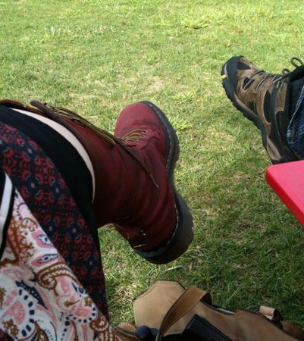
Meet My Feet
What did you learn about me?
What questions do you have?
In a moment, I’m going to put you in a breakroom with other students.
When you’re in the breakroom, share a brief story about your favorite pair of shoes.
After listening to each person’s story, be sure to talk about what you learned and ask questions!
You’ll get 15 minutes, total!

Slide 9
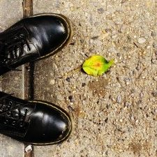
Let’s share!
Now, we need at least two volunteers to share shoe stories with the entire class.
What did you learn?
What questions do you have?

Slide 10
What will we do during the fourteen sessions?
This workshop focuses on helping new students transition to college life, and specifically to City Tech. The workshop will enhance the new student experience with information, activities, and various opportunities to connect with faculty, staff, and current City Tech students. In addition to learning how to access a variety of college services and resources, students will develop personalized plans for their college career.

Slide 11
Syllabus + Schedule Review (Fridays at 11AM)
Session 1 > Academic Basics: #WelcomeToCityTech
8/26
Session 2 > The Syllabus
9/9
Session 3 > #RiseAndGrind
9/16
Session 4 > Behind the Scenes: What You Can Do at City Tech
9/23
Session 5 > You Paid For It, Use It: Resources + Services
9/30
Session 6 > Get Your Head In the Game: Mindset Matters
10/7
Session 7 > #aMAJORdecision: Practical Steps
10/14
Session 8 > Coming to Terms with College Vocabulary
10/21
Session 9 > A Long-Term Decision
10/28
Session 10 > #YellowJacketLife: The Buzz on Your Future
11/4
Session 11 > Self-Advocacy + Motivation
11/11
Session 12 > Academic Integrity
11/18
Session 13 > Moving Forward: Buzzing Toward Graduation
12/2
Session 14 > Emerging From ‘The Cave’: What We Know Now
12/9

Slide 12
Learning Tools

Slide 13
Electronic Platforms Used at City Tech
General College Activities
CUNYFirst
Schedule Builder
DegreeWorks
Communication
City Tech Email (Outlook)
Microsoft Office
OneDrive (Microsoft)
DropBox
In the Classroom
Blackboard
OpenLab
Zoom
Blackboard Collaborate
Which of these are you familiar with?

Slide 14
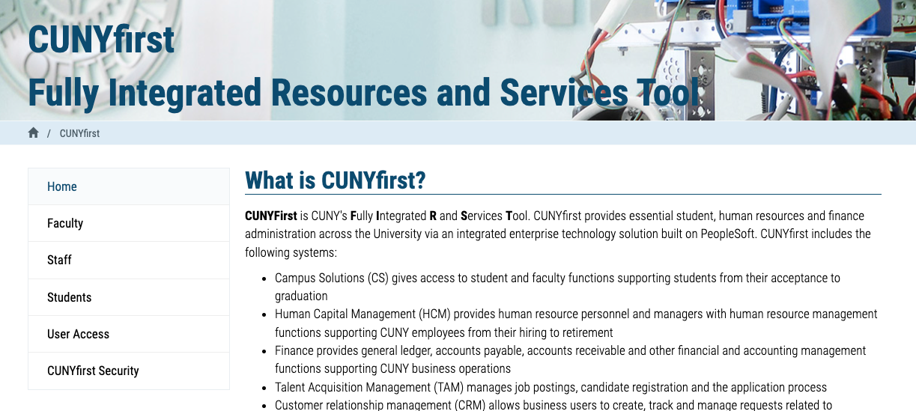
Students use CUNYfirst for management of almost all personal records.
Notes:
https://home.cunyfirst.cuny.edu/oam/Portal_Login1.html

Slide 15

Students use Schedule Builder to register for classes.
Notes:
https://www.cuny.edu/wp-content/uploads/sites/4/page-assets/about/administration/offices/registrar/resources/schedulebuilder/SB-student-guide_2.6.2020.pdf

Slide 16
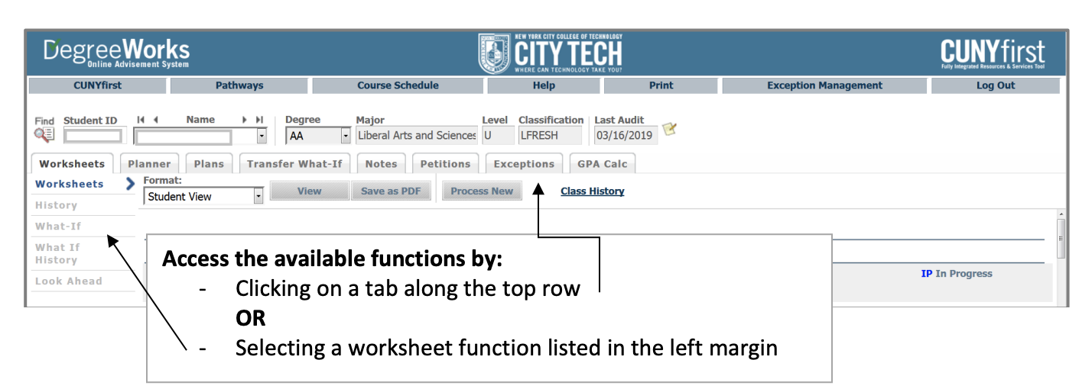
Students use DegreeWorks to track academic progress and degree requirements.

Slide 17
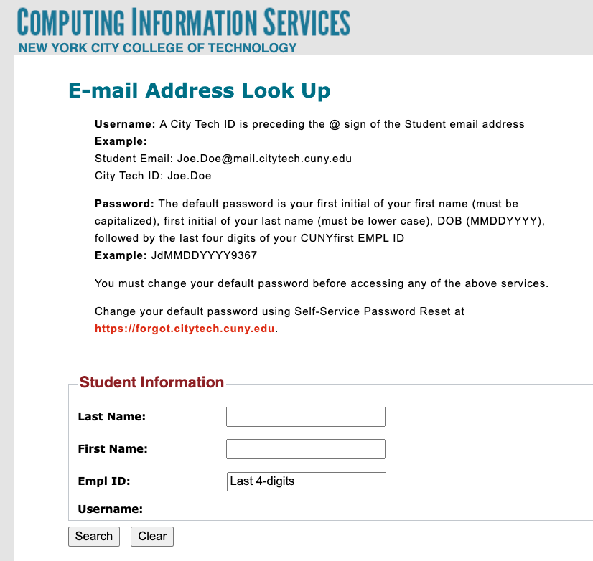
City Tech Email (Outlook)
Have you activated your email?
Log in. What is the most recent message you have received?
Have you received emails from any of your professors?
What can you do besides email?
Notes:
http://cis.citytech.cuny.edu/Student/it_student_findemail.aspx

Slide 18
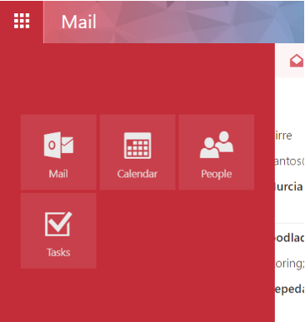
City Tech Email (Outlook)
Email
Calendar
Teams
Tasks

Slide 19
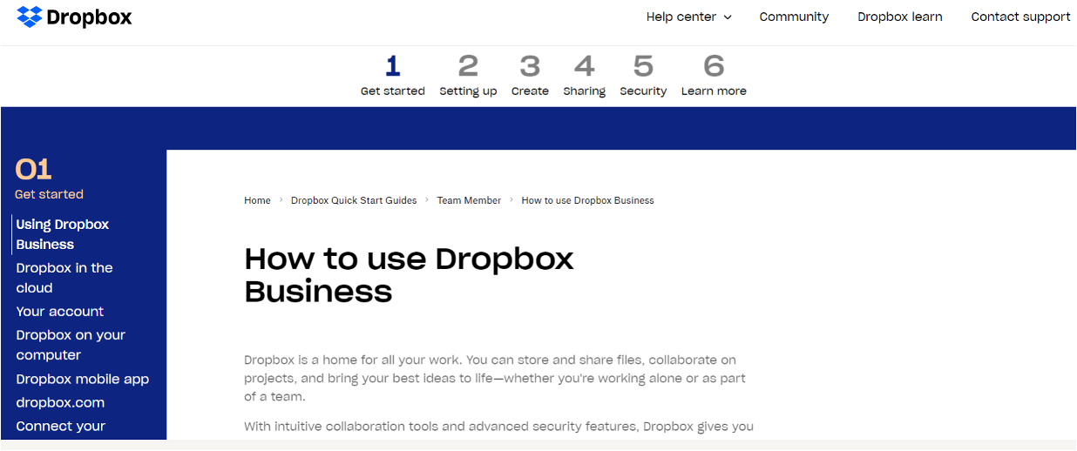
Some professors use DropBox for course materials and collecting student work.
Notes:
https://help.dropbox.com/guide/team/how-to-use-dropbox#how-to-use-dropbox-business

Slide 20
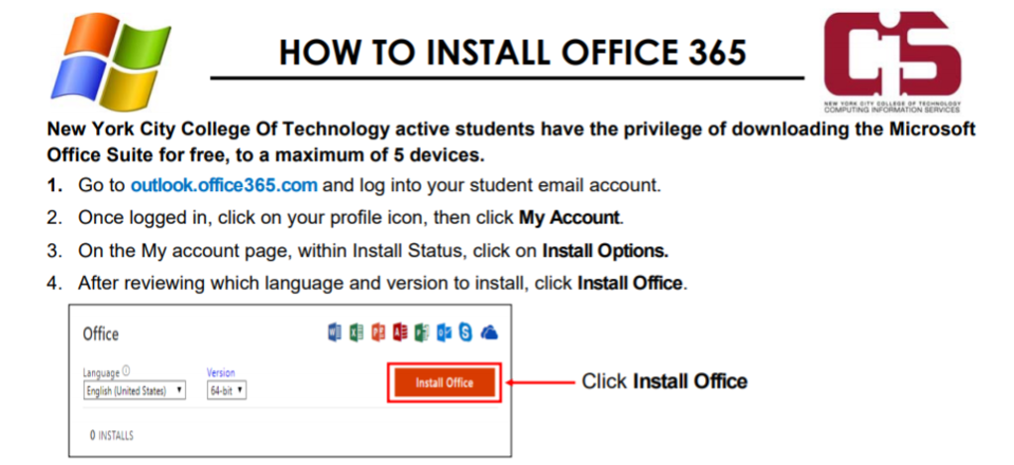
Students have access to Microsoft Word, Excel, Powerpoint, and
One Drive (cloud storage)!

Slide 21

Blackboard (Bb) is a Learning Management System– this is where your courses live online. Some professors will use Bb to post syllabi, schedules, assignments, homework, quizzes, grades, etc.
Some professors will meet with their online or hybrid classes in Bb using Blackboard Collaborate Ultra. This is like Zoom, but built into Bb.
Notes:
https://bbhosted.cuny.edu/webapps/login/noportal

Slide 22

Students use Zoom to attend online or hybrid classes, meet with professors, attend school events, and more.
Notes:
https://it.citytech.cuny.edu//docs/Login_CUNY_Zoom.pdf

Slide 23
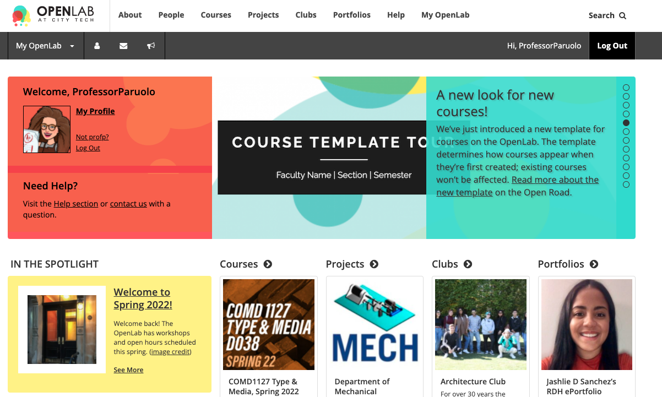
OpenLab (OL) is similar to Blackboard–this is a place where your courses live online. Some professors may use it in the same way as Bb. OL also has projects, clubs, and portfolios, which you will not find on Bb.
Notes:
https://openlab.citytech.cuny.edu/

Slide 24

For this workshop, you must join register & join OpenLab
Go to https://openlab.citytech.cuny.edu/ on your smartphones or laptops.
If you’ve joined OpenLab, log in.
If you haven’t, sign up now!
Notes:
ECRI
20 min
Say: Everyone, please get out your smartphones! Ask: Has anyone NOT logged in on OpenLab before? Will the students who have logged in please coach the students who have not?

Slide 25
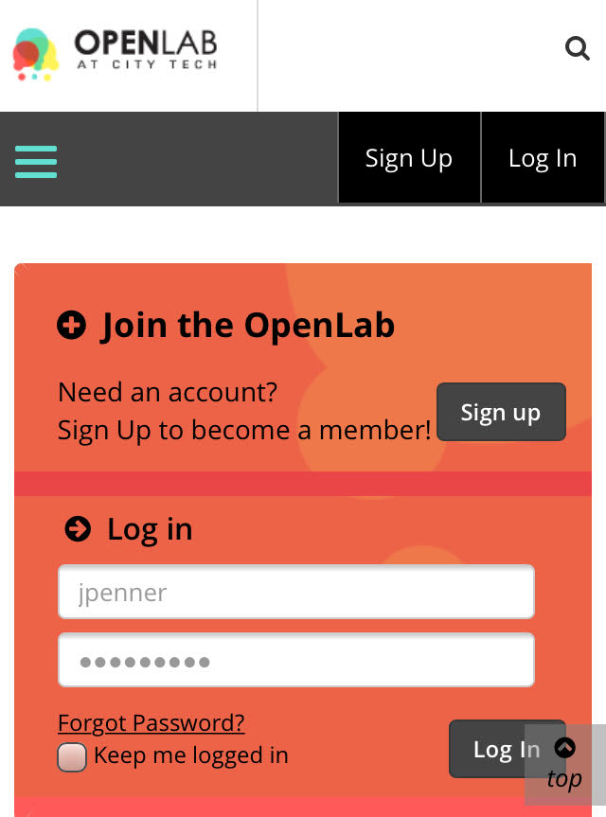
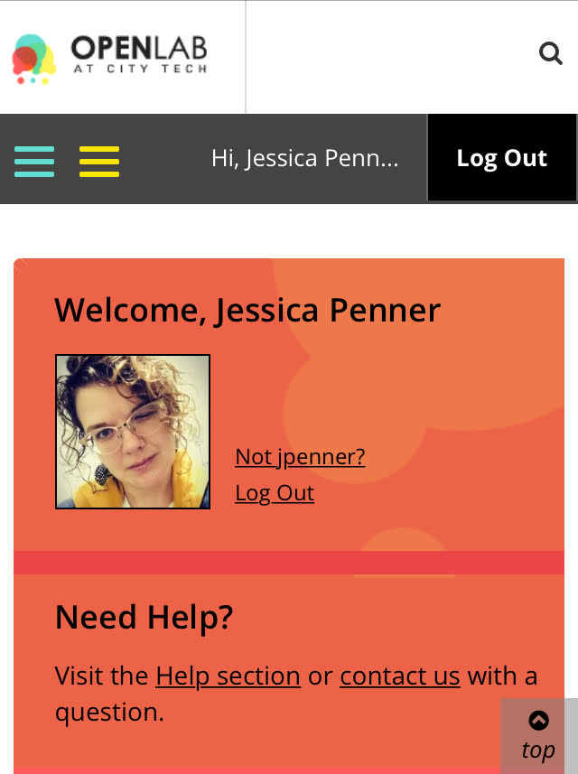
You must use your City Tech-approved email!

Slide 26
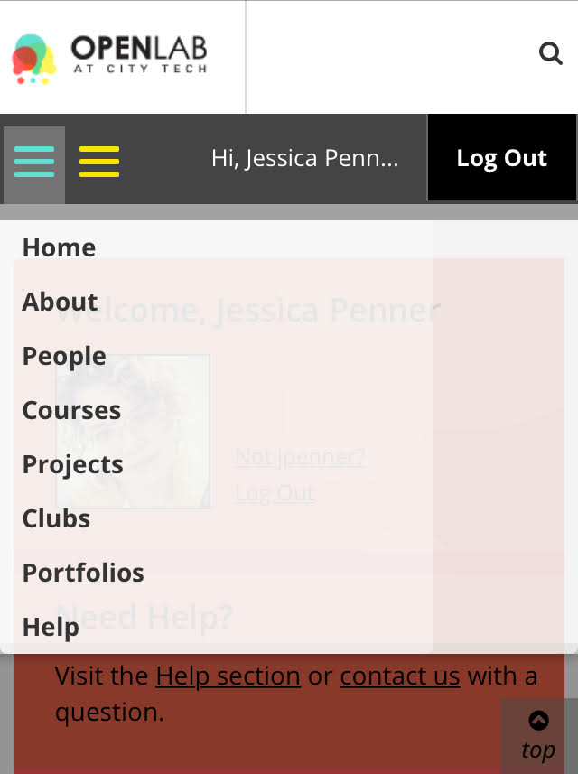
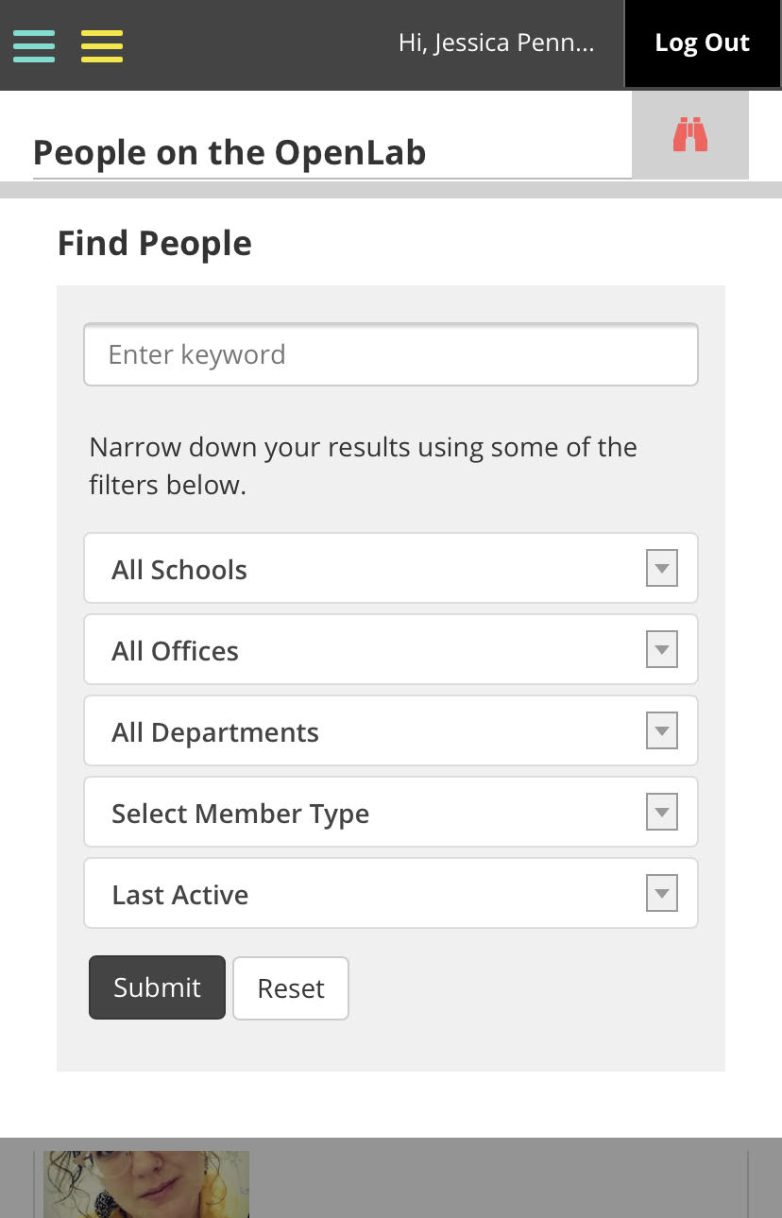
Jessica Penner
The easiest way to find our class is by finding me!

Slide 27
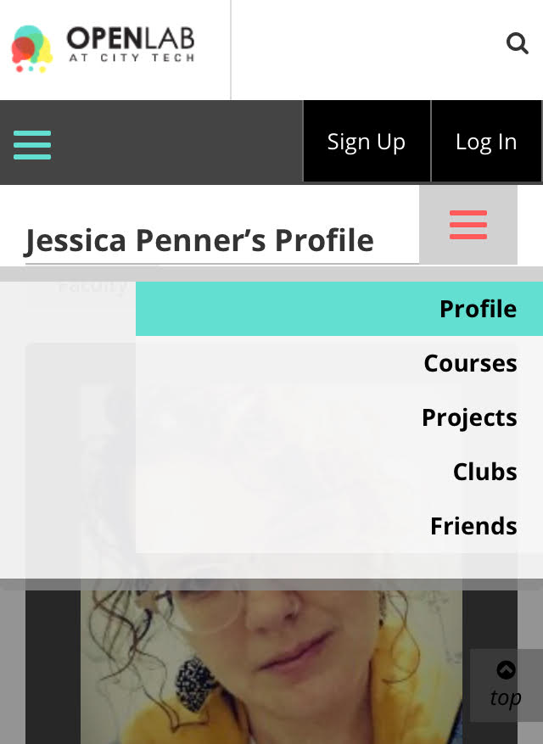

If you’re in LC03 CT101, your class has this avatar:

Slide 28
How to Respond to a Reflection
Read the Reflection post.
Click on Comment.
Write your comment in the box.
Click Post.
Let’s take a minute to start your first reflection! You don’t have to finish it right away, but I want to be sure everyone knows how to do this!
Go to our OpenLab workshop site.
Click on Activities > Reflection > Reflection #1

Slide 29
Electronic Platforms Used at City Tech
General College Activities
CUNYFirst
Schedule Builder
DegreeWorks
Communication
City Tech Email (Outlook)
Microsoft Office
OneDrive (Microsoft)
DropBox
In the Classroom
Blackboard
OpenLab
Zoom
Blackboard Collaborate
Which of these platforms do you have questions about?
If you have issues (or two, or three), type GC, Comm, and/or Class in the chat box now.
Please be honest! ☺
If you’ve got questions, we’ll leave time at the end of class to work on answers!

Slide 30
Learning Etiquette + Engagement

Slide 31
Classroom Learning: Etiquette + Engagement
Prepared to participate
Ready to take notes
Asking and answering questions
Addressing your professors
Active learning doesn’t always mean speaking up
Choose your seat wisely (when in person!)
Headphones off/out (again, in person)
Phones on silent and put away
Arriving late and leaving early
Excusing yourself during class

Slide 32
Online Learning: Etiquette + Engagement
Everything from Classroom Learning plus…
Camera on? Sure!
Camera off? That’s fine too.
Mute your microphone, not your voice!
Chatting to stay connected throughout class.
Breakout Rooms

Slide 33
Instructional Modalities

Slide 34
Instructional Modalities at City Tech
In person
Online
  Synchronous
  Asynchronous
Hybrid

Slide 35
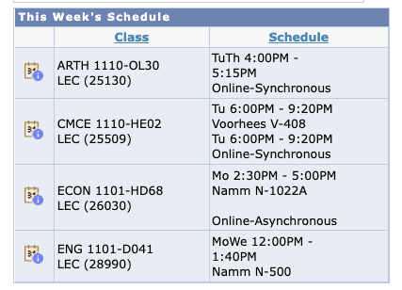
Modalities
Which class is fully in person?
Which class is Online, Synchronous?
Which class is Online, Asynchronous?
Which class is Hybrid?

Slide 36
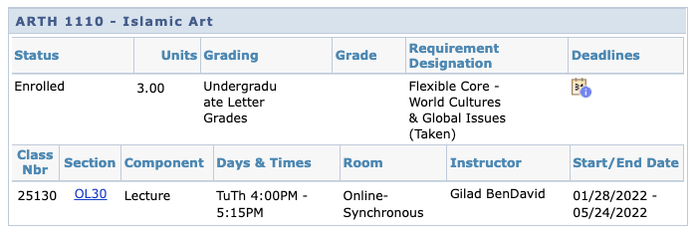
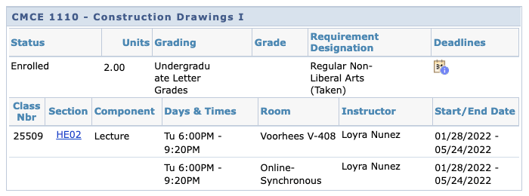

Slide 37
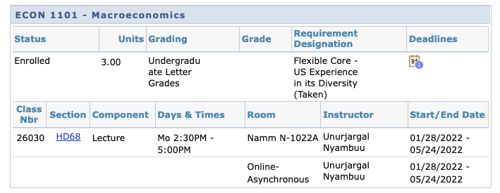
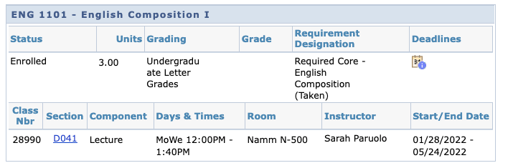

Slide 38
Schedule Issues? CUNYfirst Issues? Communication Issues?
Stay at the end of the session today for help with your schedule or other problems.

Slide 39
If these [online] walls could talk…
Notes:
https://docs.google.com/document/d/1apeK0Zl95Q8qO_o1ixxz18Ud1T1ZhVAz/edit?usp=sharing&ouid=111774375294871248054&rtpof=true&sd=true

Slide 40
Course Information
Next Meeting: 9/9 (Please note we don’t meet next Friday!)
Workshop Location: Zoom
Open Lab site: https://openlab.citytech.cuny.edu/pennerct101lc03friday/
Prof. email: jpenner@citytech.cuny.edu
Peer Mentors: Aneeza Hussain, aneeza.hussain@mail.citytech.cuny.edu & Madelyn Kelly, madelyn.kelly@mail.citytech.cuny.edu

Slide 41
Recap
Introductions
CT101 Syllabus + Schedule Review
Learning Tools
Classroom Learning: Etiquette + Engagement
Online Learning: Etiquette + Engagement
Instructional Modalities
If these [online] walls could talk…

Slide 42
Before Session 2 on 9/9…
Download and review ENG1101 syllabi (plural of syllabus) posted on OpenLab. They can be from your ENG1101 and others you find on OpenLab. If your class uses Blackboard, download that one! This will aid in our discussion of syllabi next session.
There’s an important date that I think you should know about: Connect Day, which is next Thursday: https://openlab.citytech.cuny.edu/connect-days-orientation/
Complete Reflection on OpenLab by replying to Reflection #1 Post by 11:59 PM TONIGHT!
  Remember, you must have an account and be logged in to OpenLab to reply to a post.
  How to Respond to a Reflection
Read the Reflection post.
Click on Comment.
Write your comment in the box.
Click Post.
Reflection #1
What do you want your classmates to know about you? Consider sharing your goals as a college student, why you chose City Tech, what you hope to learn in your first semester at City Tech or anything important to you.
Read other classmates’ posts and help welcome each other by writing a response between now and the next time we meet.
Notes:
ADD LINK

Slide 43
Academic Basics:
#WelcomeToCityTech
Session 1
8/26
Professor Jessica Penner
City Tech 101 by Karen Goodlad and Sarah Paruolo is licensed under a Creative Commons Attribution-NonCommercial-ShareAlike 4.0 International License.

