Slide 1
City Tech 101
Semester Summer 2022
Professor Glenda Perreira
Email gperreira@citytech.cuny.edu
City Tech 101 by Karen Goodlad and Sarah Paruolo is licensed under a Creative Commons Attribution-NonCommercial-ShareAlike 4.0 International License.

Slide 2
#aMAJORdecision
City Tech 101
Session 8
08/24/2022
Professor Glenda Perreira
City Tech 101 by Karen Goodlad and Sarah Paruolo is licensed under a Creative Commons Attribution-NonCommercial-ShareAlike 4.0 International License.

Slide 3
Today’s Topics
University Structure
Your Major Matters
Academic Advisement vs. Registration
Academic Advising Preparation
DegreeWorks Degree Audit
My Academic Career Planner
Academic Advisors
Vocabulary Review

Slide 4
University Structure

Slide 5
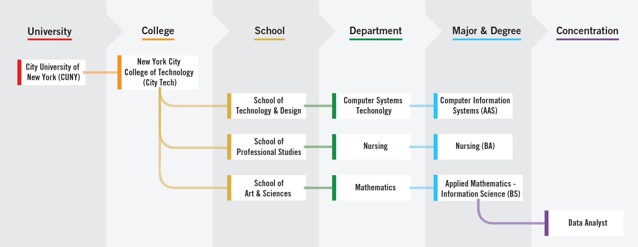
Notes:
4 minutes
Explain the foundation of the organizaiton and where each student fits into the organization. Ask there they fit into the organizaion.
It is exciting to announce that the college now offers New for fall 2021, Minors!
I asked this question using polls so that we can use the information in discussion during the session
1.How confident are you that you chose the right major? (Single Choice)*
I am Not Confident
I am Somewhat Confident
Neutral
I am Confident
I am Very Confident

Slide 6
Your Major Matters

Slide 7
Your Major Matters...
JamBoard!
What is your major and why did you choose it?
Notes:
2 minutes to introduce
10 minutes for contributing and discussion
Create a JamBoard or other collaborative tool. If using a google tool, make sure the people with the link have editing access (not just viewing access).
Encourage creativity and varity in expression. Doing so will allow students to tap into the format they feel most comfortable with.
Add your own contribution so that students can learn more about your
Discuss this activity with your PM for additional ideas and a deeper expression of themselves.
As the images appear, make comments.

Slide 8
Academic advisement and registration, is there really
a difference?
Notes:
This slide brings in important vocabulary. Initially it is the difference between advisement and registration. Next it will be examples of questions that are related to both registration (the act of enrollment, something students do on their own, PM will guide them through the process), academic advisement is the act of discussing ones path to graduation, which includes advice on which classes to register for, but is more. Students work with an Academic Advisor who is a full time faculty member in their department. Academic Advisors should be able to
Discuss prerequisites
Which clubs are available and how to join
Guide a student who is struggling or who is excelling
Offer career advice
Discuss programs available to students.
Advisors will NOT talk about financial aid issues
Some students have additional advisors if they are in SEEK or ASAP programs.

Slide 9
Academic advisement and registration, is there really
a difference?
Which classes should I register for?
How do I enroll in classes?
Which activities will support my academic and career goals?
How can I maximize the value of tuition?
Besides class, what else does City Tech offer me?
How can I connect my education with my future?
Notes:
Peer Mentors helped develop this list of questions.
To engage students, ask if they think these questions are more academic advisement or registration

Slide 10
Find Information About
Your Department and Major
Sample Course of Study on your Department Site
Course Descriptions are found in the College Catalog
Talk to an Academic (Faculty) Advisor
Explore the Academic Advising Webpage
Explore what departments are saying about their degree in Who We Are (City Tech Guide)
Become better prepared by using The Companion (pg 61)
Notes:
Sample Course of Study on your Department Site
Each department offers a sample course of study. This is exactly what it says, a sample. Students should use the sample as a guide but should consider their own specific plan towards graduation
For instance, some students will be enrolled in MAT1272CO but their sample states the first course as MAT1375. An example: https://www.citytech.cuny.edu/computer-engineering/computer-engineering-btech.aspx
Course Descriptions are found with in the department the course if offered

Slide 11
Academic Advising Preparation

Slide 12


Slide 13
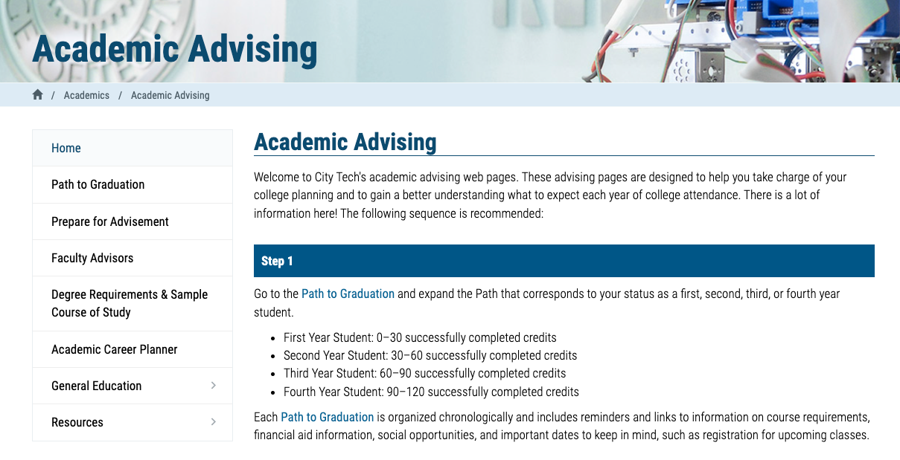
http://www.citytech.cuny.edu/advisement/

Slide 14
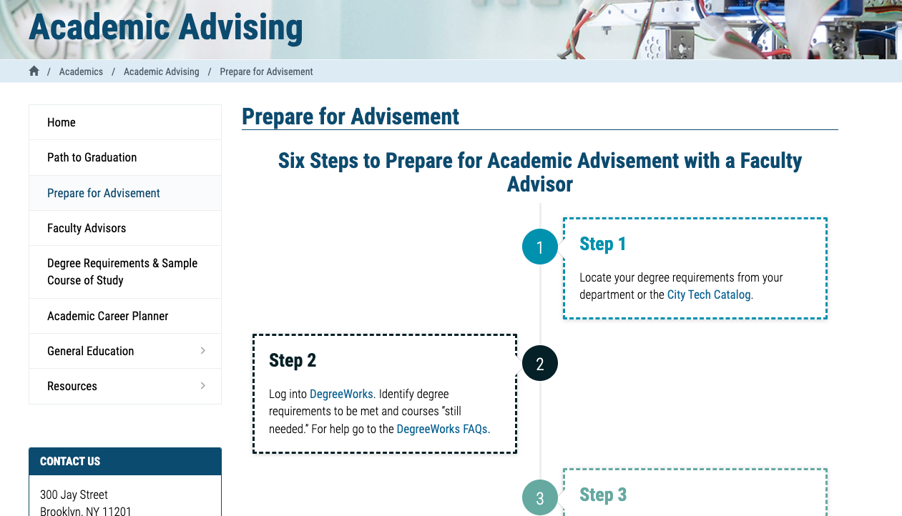
http://www.citytech.cuny.edu/advisement/six-steps.aspx

Slide 15
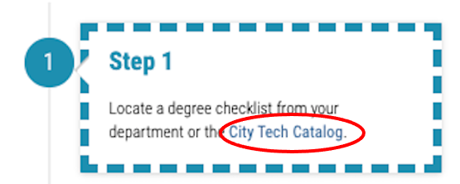

Slide 16
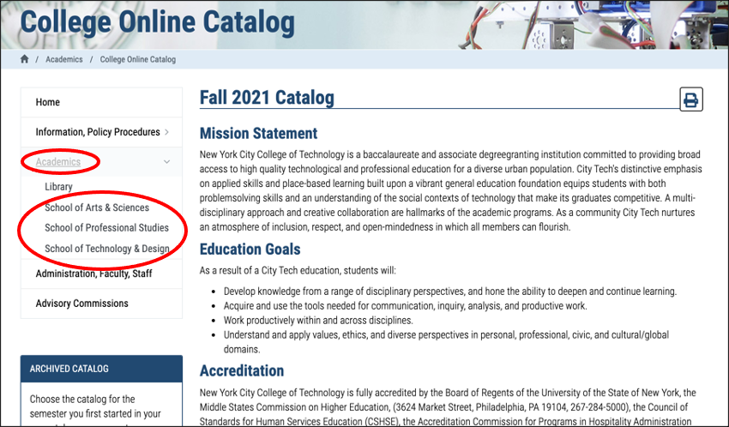

Slide 17
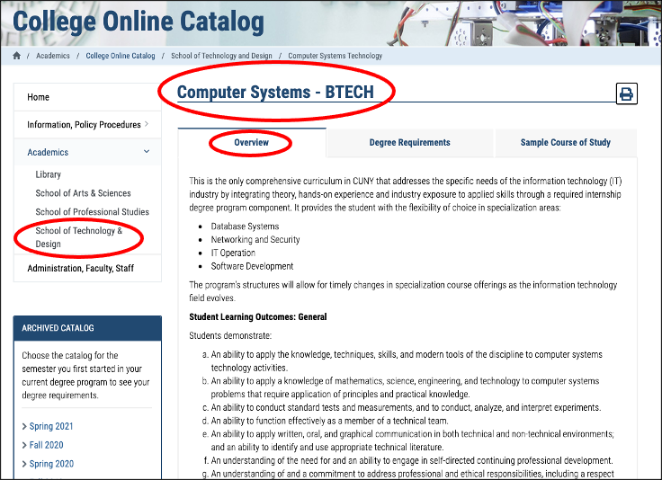

Slide 18
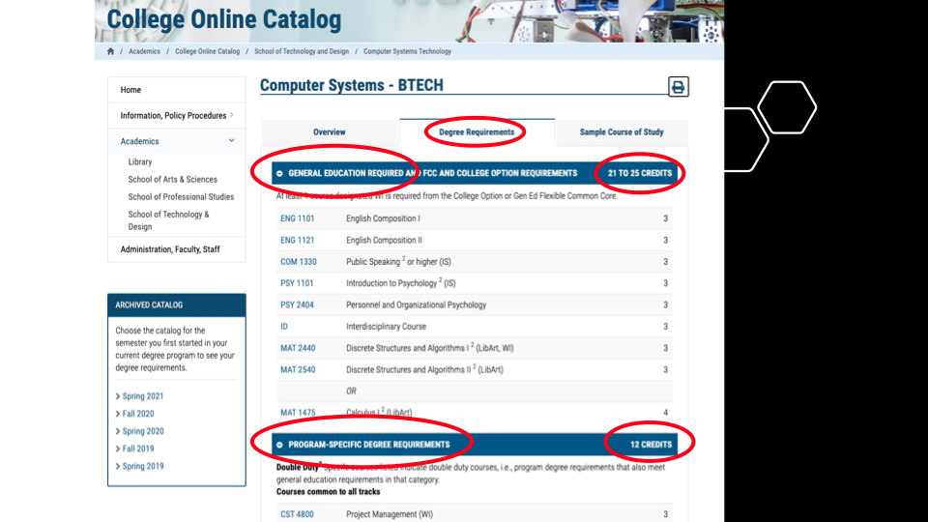

Slide 19
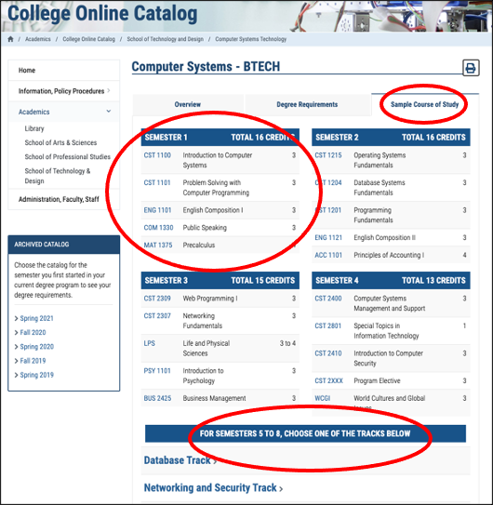

Slide 20
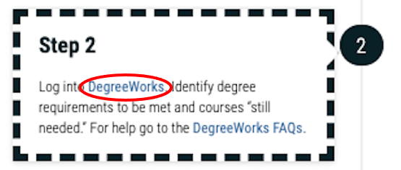

Slide 21
DegreeWorks
Degree Audit

Slide 22
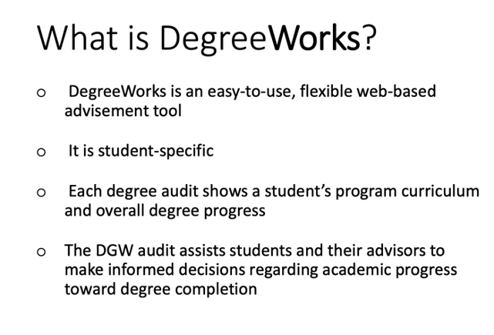
https://www.citytech.cuny.edu/registrar/docs/Student_Guides/How_to_Read_your_DegreeWorks_Presentation.pdf

Slide 23
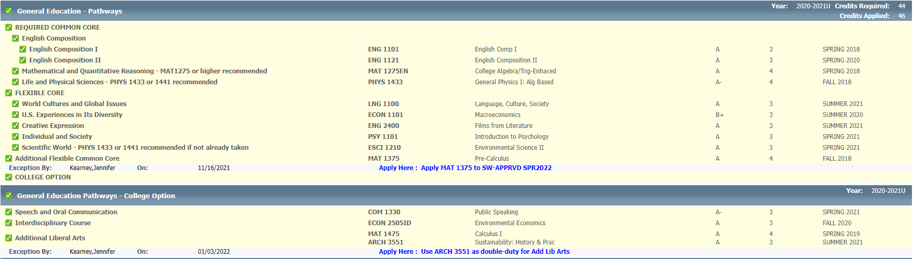

Slide 24
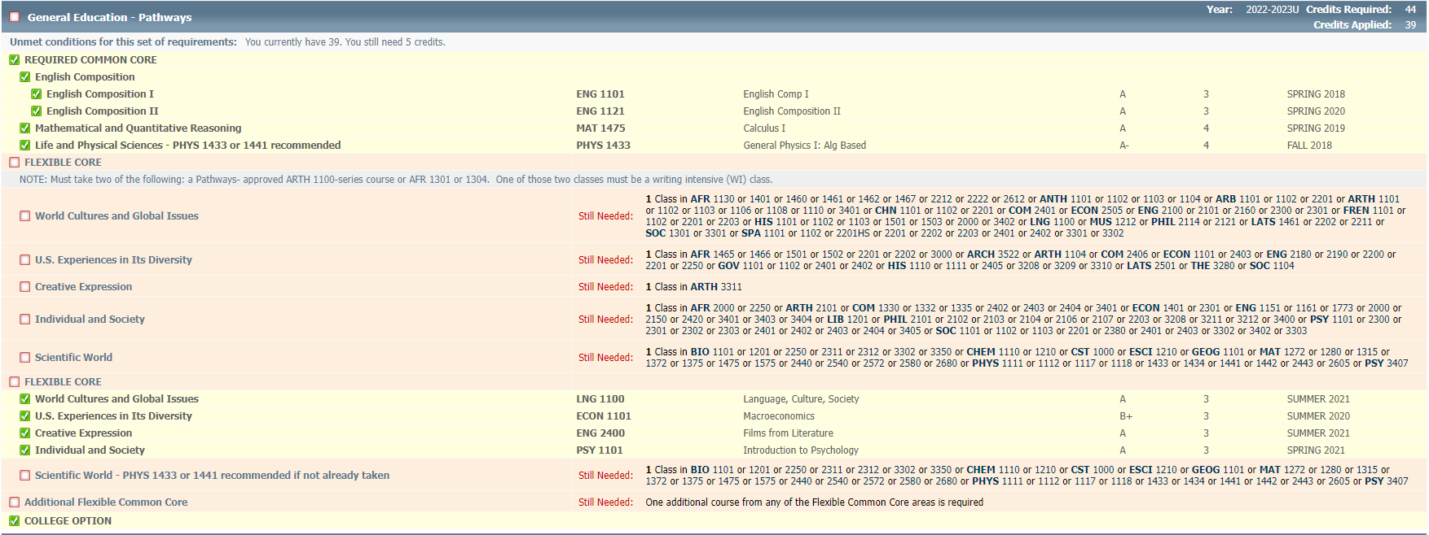

Slide 25
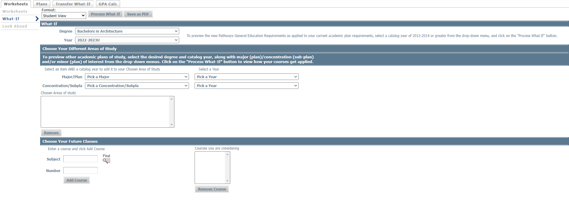

Slide 26
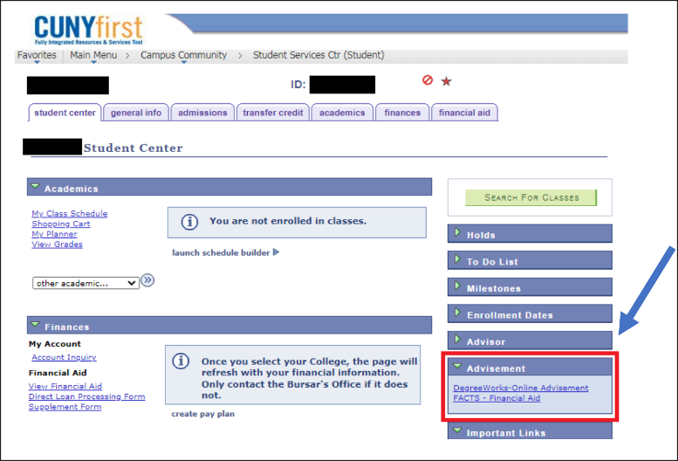

Slide 27
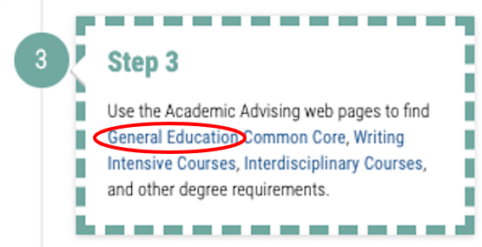

Slide 28
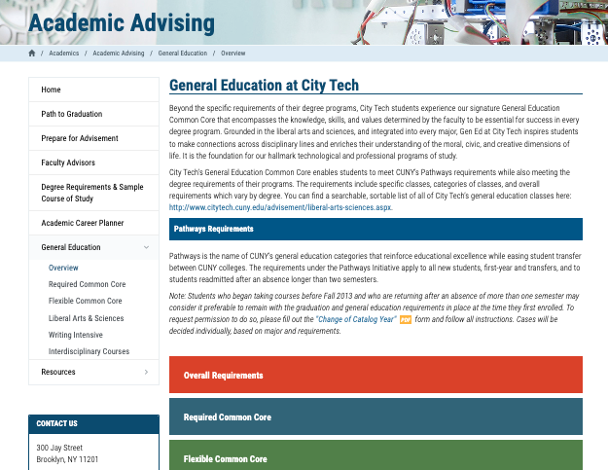
General Education
Writing Intensive
Interdisciplinary
College Requirements
http://www.citytech.cuny.edu/advisement/gen-ed.aspx

Slide 29
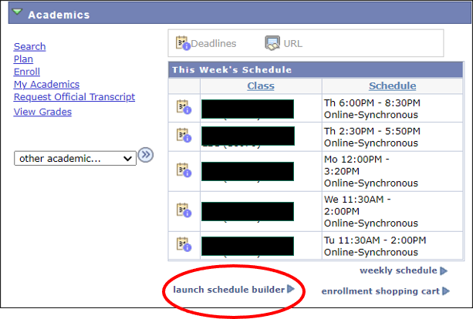
Schedule
Builder
https://www.citytech.cuny.edu/registrar/docs/Student_Guides/How_to_Use_Schedule_Builder_Presentation.pdf

Slide 30
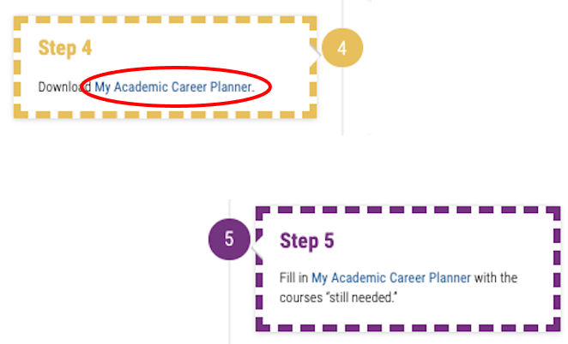

Slide 31
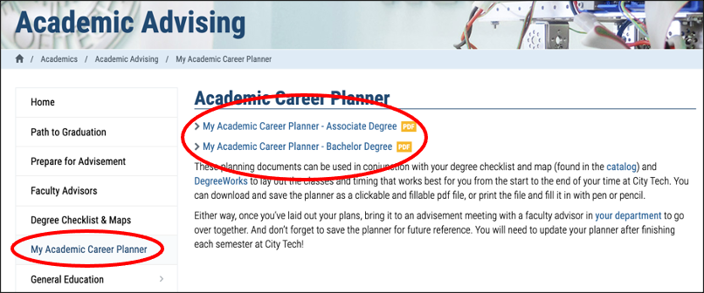
http://www.citytech.cuny.edu/advisement/planner.aspx

Slide 32
My Academic Career Planner

Slide 33
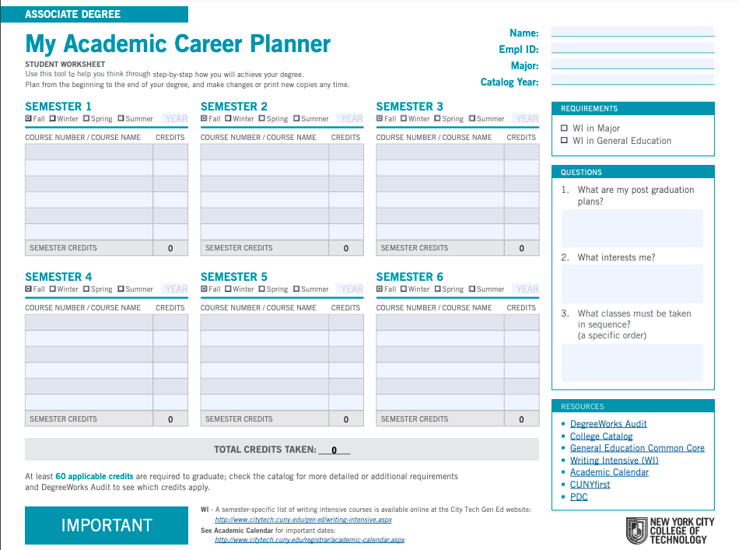
My Academic Career Planner
Download the PDF
(do not complete it on the web, you will lose all your work)
What else will you need?

Slide 34
My Academic Career Planner Review
First fill out your current course enrollment.
Complete the next three semesters of the My Academic Career Planner using the sample course of study as a guide.
Consider which Gen Ed courses you will consider to fulfill the required categories.
Email your planner to INSTRUCTOR EMAIL

Slide 35
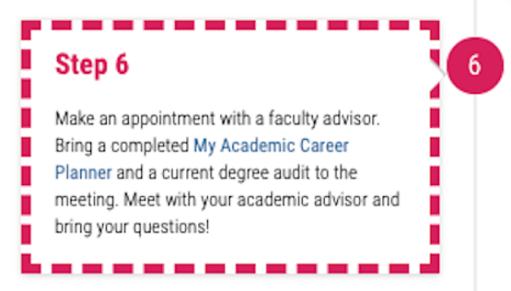

Slide 36
Academic Advisors

Slide 37
Who is your
Academic Advisor?
https://www.citytech.cuny.edu/advisement/virtual-advisors.aspx
Notes:
4 minutes
Share this link with students: https://www.citytech.cuny.edu/advisement/virtual-advisors.aspx
They will need to know the department/degree
It leads to the Academic Advising page and all departments will have something posted. Note, there is no consistency in the listing of the department’s information.

Slide 38
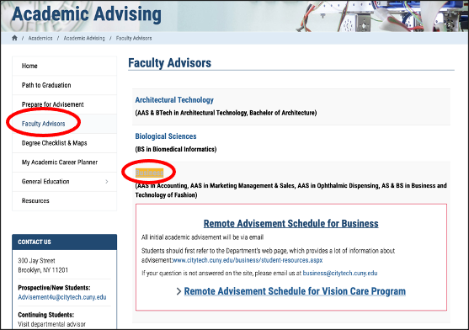

Slide 39
You found your Academic Advisor
Name
Emplid
Email
Phone number
Reason for advising appointment
What do you do now?
Notes:
I asked the PMs to talk about this slide
Remind students to use the city tech email address.

Slide 40
Vocabulary Review

Slide 41
Vocabulary
Prerequisite
Corequisite
General Education Common Core
Pathways
Requirement
Elective
Sequential
Writing Intensive
Interdisciplinary
Certification/Licensing
Clinical
Lab
STAR Center
Advisor
CUNYFirst
DegreeWorks
Schedule Builder

Slide 42
Recap
University Structure
Your Major Matters
Academic Advisement vs. Registration
Academic Advising Preparation
DegreeWorks Degree Audit
My Academic Career Planner
Academic Advisors
Vocabulary Review

Slide 43
No Reflection!
Complete Post-Workshop Survey
https://forms.gle/3ZWGMJoYCWN615YB9

Slide 44
#aMAJORdecision
City Tech 101
Session 8
08/24/2022
Professor Glenda Perreira
City Tech 101 by Karen Goodlad and Sarah Paruolo is licensed under a Creative Commons Attribution-NonCommercial-ShareAlike 4.0 International License.

Slide 45
City Tech 101
Congratulations!
City Tech 101 by Karen Goodlad and Sarah Paruolo is licensed under a Creative Commons Attribution-NonCommercial-ShareAlike 4.0 International License.

