Slide 1

ENG 1101
English Composition 1
Objectives
Annotate Jiang & Douglass’ work individually
Discuss work in small groups

Slide 2
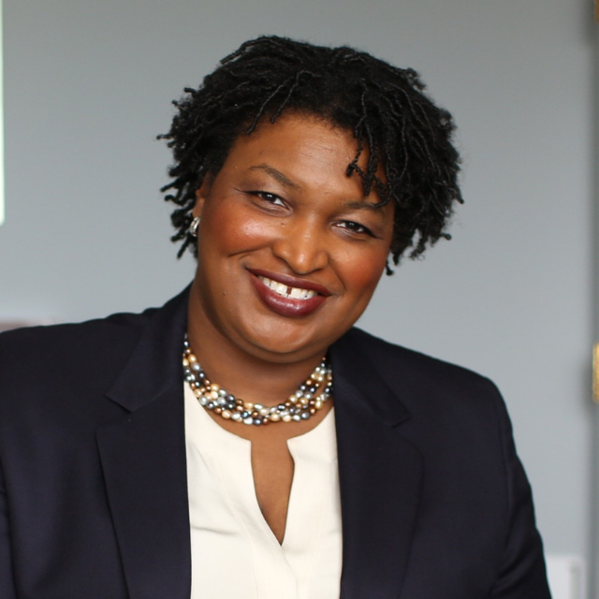
“Effective leaders must be truth seekers, and that requires a willingness to understand truths other than our own.”
Stacey Abrams
Any ideas about how a person goes about understanding “truths other than our own”?

Slide 3

Before you start re-reading
Do you know Jiang’s purpose?
How about Douglass?
Do you know who the intended audience is for Jiang?
How about Douglass?
In what genre is Jiang’s written?
How about Douglass?
Is Jiang’s a published or a student-produced piece of writing?
How about Douglass?

Slide 4

Next…
So, we’ve done the “before” bit as a class for both Anita Jiang and Frederick Douglass’ work.
Now, we’re going to dive in with the rest of Mike Bunn’s “How to Read Like a Writer” questions.
Go to Course Profile > Files > ENG1101 Handouts > How to Read Like a Writer Worksheet. Download it on your device!
Answer as many as you can within the given time frame.
  You have 20 minutes for Jiang’s essay.
  You have 20 minutes for Douglass’ chapter.

Slide 5
Discuss
Join your assigned small group and discuss the questions. Be sure to choose a leader and speaker!
After the time is up, we’ll regroup and talk about the following things:
  Did you have disagreements about any of the answers to the questions?
  Was one piece (Jiang or Douglass) more difficult to understand? If so, why?
  Think about Jiang’s Technique: Choose one technique that Jiang used in her essay to bring you into her story. Was it effective? Why or why not?
  Think about Douglass’ Technique: Choose one technique Douglass used to get his ideas across. Was it effective? Why or why not?
  Why are these pieces considered “Educational Narratives”?

Slide 6
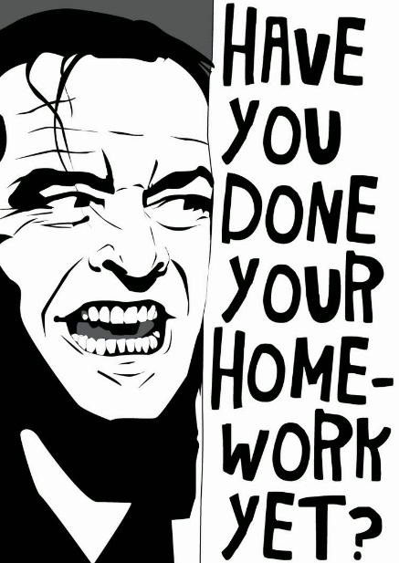
Homework
Please read/review/watch the following before class on Monday (look on the Agenda for the items):
Read “Learning to Read” by Malcolm X.
Review “Double-Entry Reading Journals” (Butte College).
Watch “Understanding Genre Awareness.”
If you haven’t joined our class on OpenLab, please do this soon! This is how all assignments for this class will be posted.

