Slide 1

ENG 1101
English Composition 1
Objectives
Discuss syllabus & schedule
Join OpenLab
Discuss how to read for this class
Write a comment on OpenLab

Slide 2
Take a card…
Take an index card.
Write your full name on one side.
If you have a preferred name or nickname, write that beneath your legal name.
Write your preferred pronouns (he/him, she/her, they/them, etc.)
When you’re finished, bring the card to the front and place it next to the “in” card.
Every day, when you arrive for class, take your card from the “out” pile and put it under the “in” card. Don’t make a new card. Find your old card. This is how I take attendance!

Slide 3
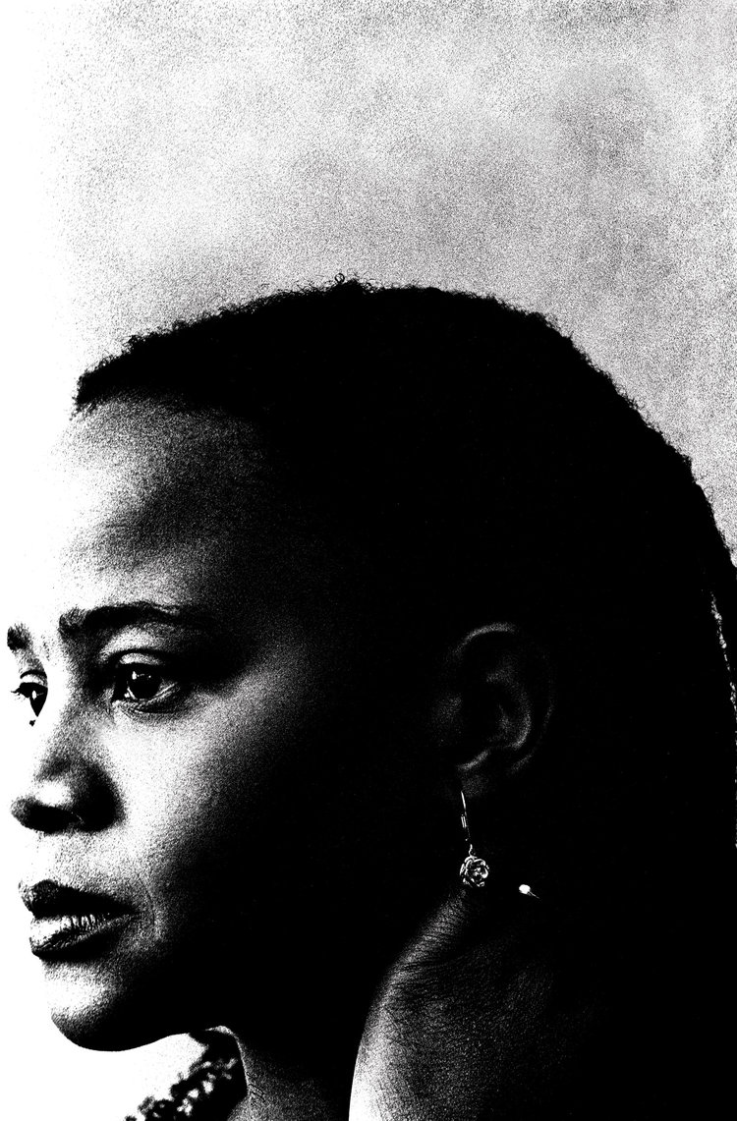
Welcome!
When you write, it’s like braiding your hair. Taking a handful of coarse unruly strands and attempting to bring them unity. Your fingers have still not perfected the task. Some of the braids are long, others are short. Some are thick, others are thin. Some are heavy. Others are light.
– Edwidge Danticat
Why does this writer equate writing with braiding?
There isn’t one “correct” answer—there are as many answers as there are people in this class!

Slide 4

Some Thoughts
Go to the Welcome post. Hopefully, you’ve already read it, but if you haven’t, do so now:
https://openlab.citytech.cuny.edu/pennereng1101fa2022d438/2022/08/10/welcome/
https://openlab.citytech.cuny.edu/pennereng1101fa2022d308/2022/08/10/welcome/

Slide 5
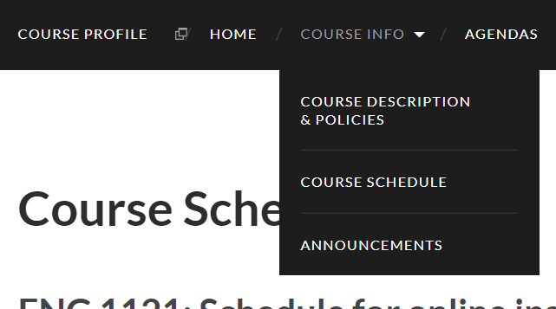
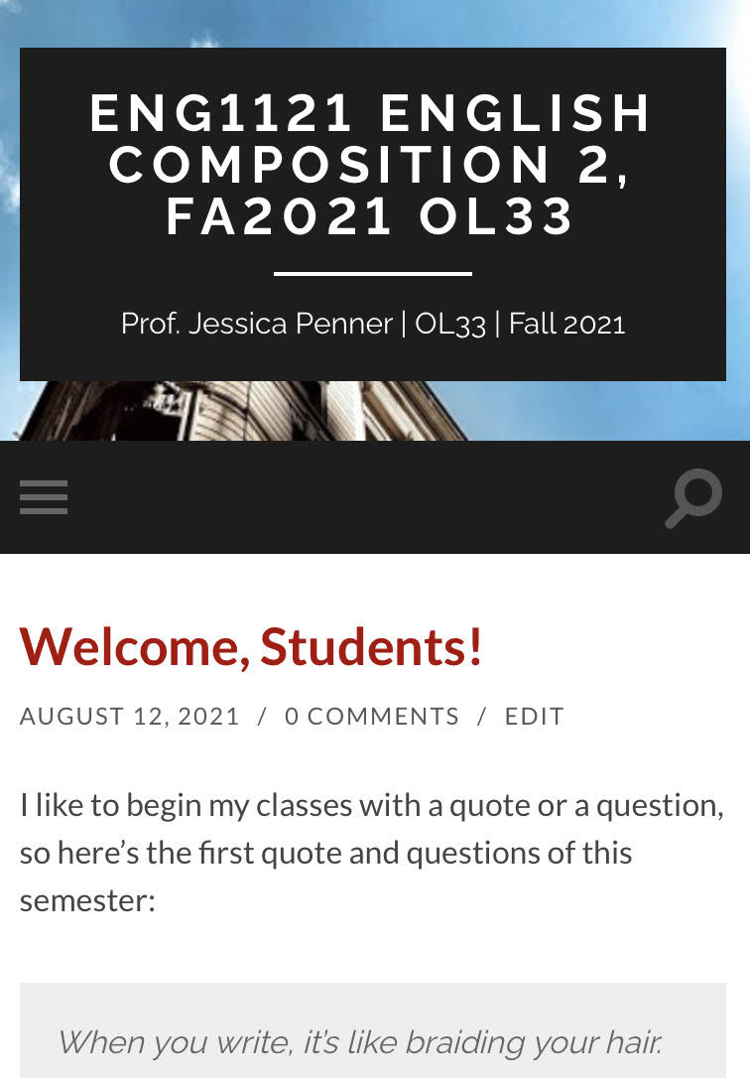
Course Info
Let’s go to the syllabus on our own devices.
  If you’re on a laptop, it’ll look like the image on the top.
  If you’re on a cell, it’ll look like the image on the bottom. (Click on the three gray strips on the left.)
First, find Course Info and then look at Course Descriptions & Policies.
Next, go to Course Schedule.
Now, go to Announcements.
Finally, go to Agendas.

Slide 6

Register/Join OpenLab
Go to https://openlab.citytech.cuny.edu/ on your smartphones or laptops.
If you’ve joined OpenLab, log in.
If you haven’t, sign up now!
Notes:
ECRI
20 min
Say: Everyone, please get out your smartphones! Ask: Has anyone NOT logged in on OpenLab before? Will the students who have logged in please coach the students who have not?

Slide 7
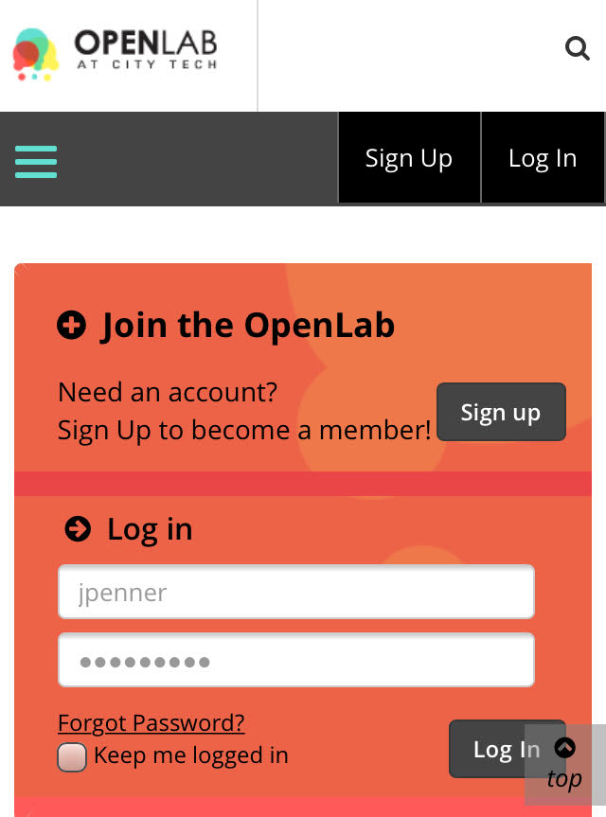
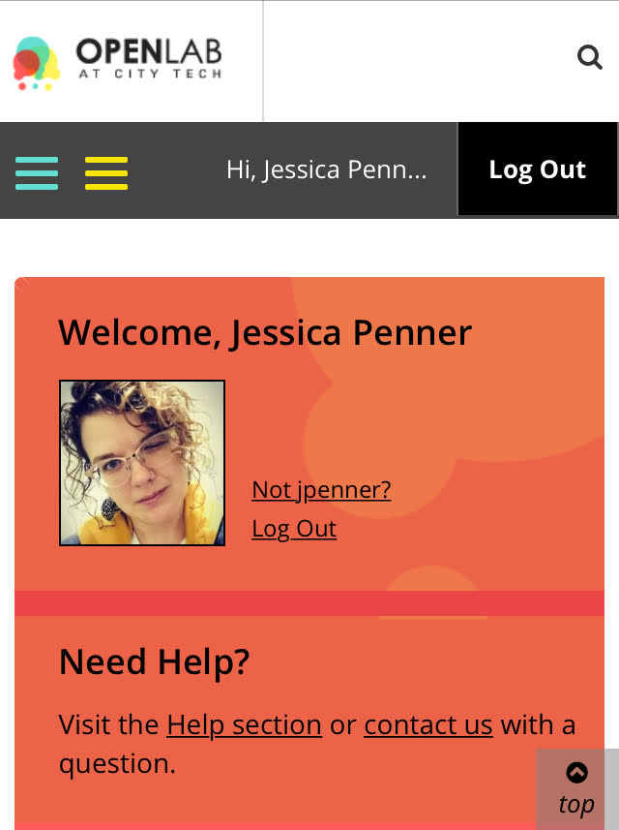
You must use your City Tech-approved email!

Slide 8
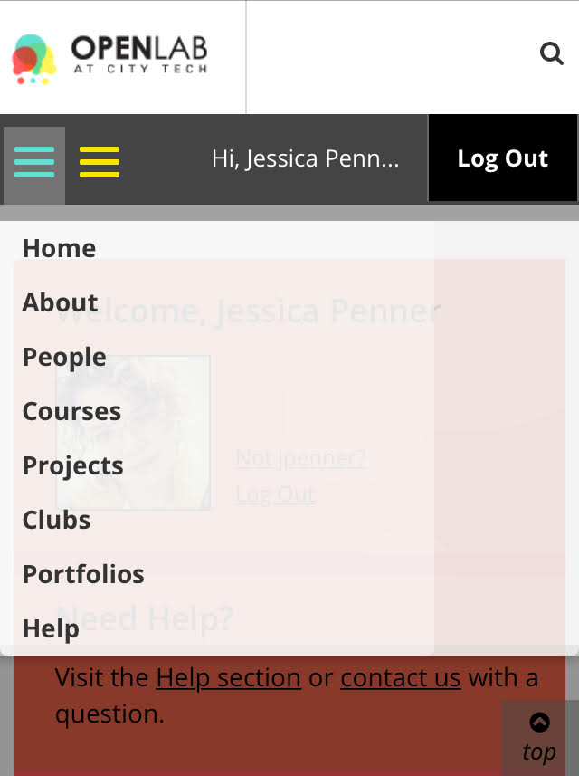
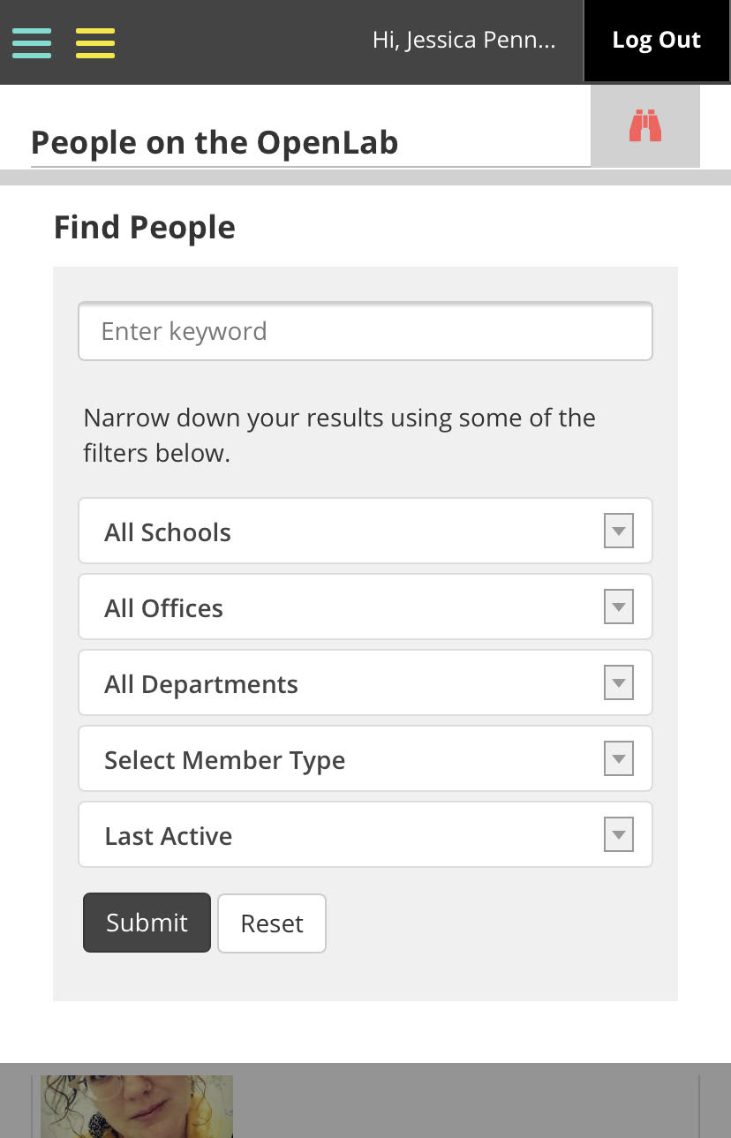
Jessica Penner
The easiest way to find our class is by finding me!

Slide 9
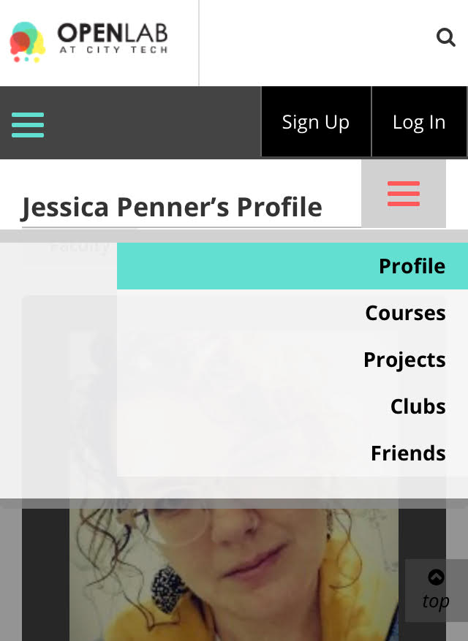
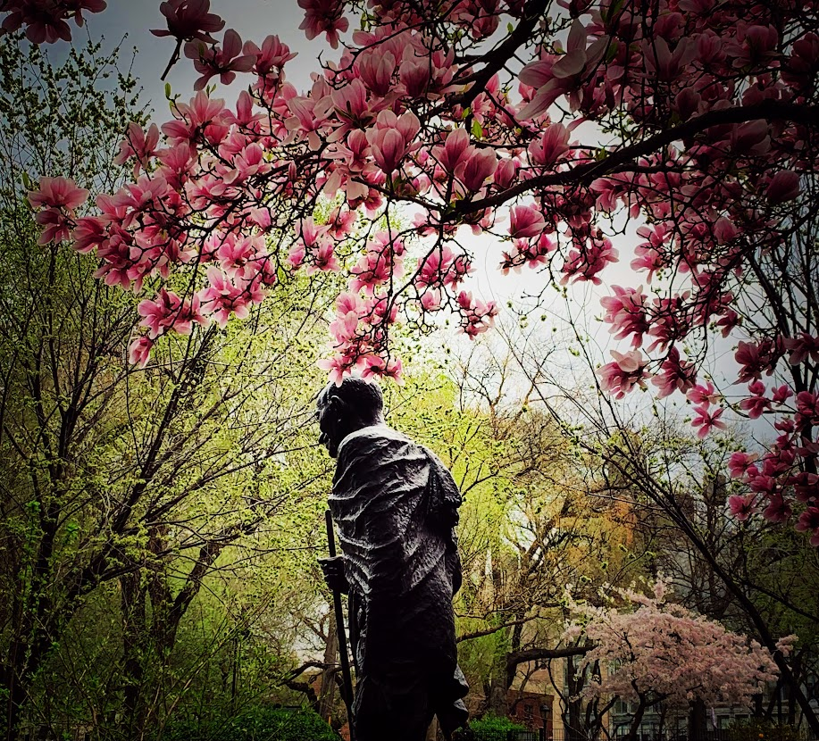

If you’re in the D438 2PM class, your class has this avatar:
If you’re in the D308 4PM class, your class has this avatar:

Slide 10

Discuss: How did you usually read for classes in high school? Be honest!

Slide 11
How to Read (Really) for this Class
Before you read, try to understand why I’m asking you to read this assignment.
Think about what we’ve talked about in class.
Look at the Course Schedule and the Major Assignments pages for clues. Once you’ve done that…read!
But don’t just read it once and then move on to other assignments. Read an assignment at least two times.

Slide 12
How to Read (Really) for this Class
The first time, read for basic understanding. If you don’t know a word, mark it or make a list. Look them up later.
The second time, SLOW THE F&%$ DOWN. If you haven’t looked up words yet, do that now. Write down (either on your device or in a notebook) questions and/or comments on ideas that the reading brings up.
You might be fine with just two rounds; however, if that isn’t the case, read it as many times as you need to until you feel you understand the main ideas presented.

Slide 13

Why are we talking about reading?
After all, this is a writing class!
Clearly, reading published work shows how the pros do it. If we need to see how to write a cover letter for a job, we go the Internet and see how it’s done.
Reading about others’ ideas helps generate our own thoughts on a subject.
The whole class is reading the same assignment, and since there are going to be different ideas/thoughts/opinions, this will spark even more ideas when we discuss them in class.
But we all need to be on the “same page,” right? Which is the reading.
So, if you don’t read and have basic understanding, you won’t be ready to participate in class or be able to generate your own ideas when you’re writing at 3 AM.

Slide 14
Speaking of writing…
Look at the Agenda for this week. You’ll see this in hypertext: Discussion: Introductions.
Click on this link. Scroll down. Read the writing prompt:
  Write a paragraph discussing your academic interests, why you chose your major, what you enjoy reading, listening to, watching, and doing in your spare time, or anything else you want to share (include your pronouns if you wish).
  Write a short paragraph about yourself as a reader and writer. What kinds of readings and writings are you drawn to? What type do you avoid and dislike? Why do you think you lean towards certain types of texts and away from others?
Click on “leave a reply” and respond to the prompts! You should have around 100 words total for both paragraphs.
Feel free to handwrite your response first, if you wish.

Slide 15
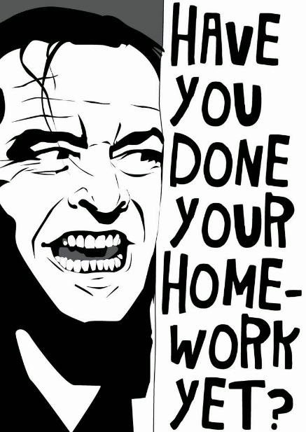
Homework
FYI: The reading assignments will always be homework.
  Hint: This means you need to do it before our class meeting. ☺
You can find the links to Wednesday’s reading assignments on the Agenda page for this week. The font for the links is red.
By Wednesday’s class, read “How to Read Like a Writer” and review the PowerPoint. Again, both links are on the Agenda in the red font.
If you haven’t done this already, write your two paragraphs and put them in the reply section by Wednesday.

