Slide 1

ENG 1121
English Composition 2
Objectives
Discuss Douglass’ speech
Discuss why quotes help with persuasive writing
Practice creating “quote sandwiches,” paraphrasing, and explaining quotes

Slide 2

Research is formalized curiosity. It is poking and prying with a purpose.
– Zora Neale Hurston
For five minutes, I want everyone to research the name “Frederick Douglass” on their own.
Douglass is rather well-known, so attempt to discover a fact about him that you didn’t know already!

Slide 3
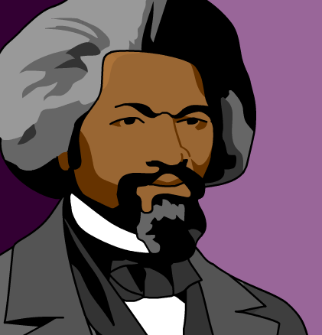
Did Douglass…?
Take 15 minutes to review the text of Douglass’ speech.
Discover if Douglass shows the following elements of persuasive writing (find specific moments—be ready with page numbers and paragraph numbers):
  Did Douglass understand his audience?
  Did Douglass find common ground with his audience?
  Did Douglass establish credibility?
In small groups, discuss if and where you found moments that Douglass used these elements in his speech.
Choose a speaker for your group for the larger group discussion!

Slide 4

Quotes
In your speech or letter, I ask you to quote people you’ve interviewed, articles you’ve read, or statistics you’ve found.
How can a quote assist you in your current project?
What problems might come up when using quotes?
Let’s go to the resource about “quote sandwiches”:
https://www.washoeschools.net/cms/lib/NV01912265/Centricity/Domain/253/Social%20Studies/The%20Quote%20Sandwich.pdf

Slide 5
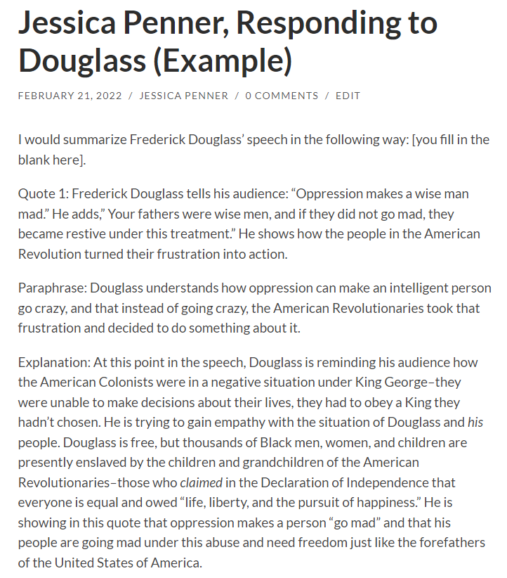
Creating Quote Sandwiches
Write a Post titled Full Name, Responding to Douglass; post it under U1 Work, in which you do the following (approximately 200-250 words):
Having read and listened to Douglass’s speech, what do you believe he is arguing?
Write a short summary of what he is saying.
Now, pick two quotations from the text where Douglass helps his listeners understand the problem he is making visible. Use the “The Quote Sandwich” technique when you initially quote. Follow the template that is on the Agenda for Week 4.
Quote the passage/lines using proper MLA citation formatting (be sure to quote accurately). Use the “quote sandwich” method.
Paraphrase the quote (put it in your own words).
Explain how this quote helps Douglass to illustrate his argument.

Slide 6

Homework
Write a Post titled Full Name, Responding to Douglass; post it under U1 Work, in which you do the following:
Having read and listened to Douglass’s speech, what do you believe he is arguing? Write a short summary of what he is saying. Now, pick two quotations from the text where Douglass helps his listeners understand the problem he is making visible. Use the “The Quote Sandwich” technique. Follow the template that is on the Agenda for Week 4.
  Post this assignment by class time on Tuesday, March 1!
Listen/watch Alexandria Ocasio-Cortez’s “I am Someone’s Daughter too” by class time on Monday, February 28.
  I copied the text and recording on a document and placed it in the Course Profile.

