Slide 1

ENG 1121
English Composition 2
Objectives
Discuss U1 writing assignment
Brainstorm discourse communities
Write about discourse communities & issues they face

Slide 2

There can be no vulnerability without risk; there can be no community without vulnerability; there can be no peace, and ultimately no life, without community.
– M. Scott Peck
Discuss these questions with a neighbor:
What does Peck mean by this quote?
Do you agree or disagree? Why?
How does this quote relate to our discussion about discourse communities?

Slide 3
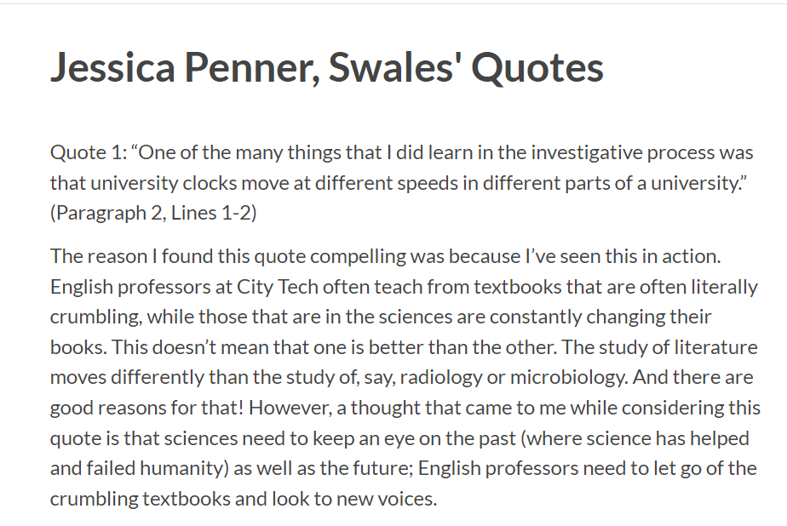
Quick Discussion
What helped you understand Swales’ article better by doing the double-entry journal activity?
Will you use this tool (or a version of it) for future reading assignments? Be honest! ☺

Slide 4

Unit 1: Discourse Community Assignment
Look at the U1 writing assignment. You can find it under Major Assignments.
What, in a few words, are you going to do for this assignment?
When’s the first draft due?
When’s the final draft due?
What questions do you have?

Slide 5
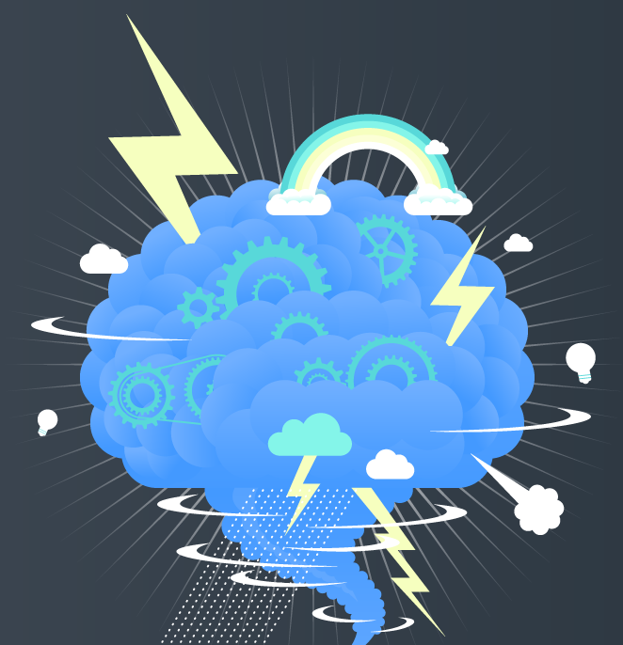
Brainstorm!
Identify at least three discourse communities (DCs) you are involved with. These can be small (a club on campus) or large (a spiritual/faith community). To help you brainstorm about the details of these DCs, look at the list of questions below.
What is this group’s goal?
What are the ways this group communicates with each other?
How does this group communicate with the outside world?
What is the “language” they use within their group?
What does a person need to know before they can join this group?
Are there terms or actions that don’t need to be explained to a group member?
Are there “rhythms of activity,” a sense of history, and a value system that the group members recognize?

Slide 6

Write!
Create a post titled Full Name, My Discourse Communities (saved under U1 Work) that shares three discourse communities you participate in.
Describe each discourse community you listed, and discuss the basic “values, assumptions, and ways of communicating” found in each one.
Name two or three problems or issues that are central to each one.
  Check out my example to see how it’s done (I only did ONE—you must do this three times).

Slide 7
About homework…
Missing class is not an excuse for not keeping up with assignments. I know a few students are dealing with entry issues and so forth—but that is why everything to read or post for this class is on our website.
If you have access to the Internet, you can still see what we've discussed in class via the Announcement, Agenda, and review the actual PowerPoints I use in class (posted in the Course Profile).
  If you don't have reliable access to the Internet, let me know and we can work on that!
I want to remind you that low-stakes assignments are worth 30% of your overall grade (see the grade breakdown in the Course Description & Policies).
  That means that even if you turn in everything else (the Major Writing Assignments, Final Portfolio, Final Reflection) and get top scores on everything, but you don't submit the low-stakes assignments, you will earn, at best, a C in this class—at worst, a D or F.
  I say "earn" rather than "get" because you earn your grades by participating and turning in the work. I don't "give" grades—if you do the work, you earn the points!
  Now is the time to get into the habit of turning in work on the due dates I have posted on the Agenda page.
  Remember, low-stakes work gets all the points if you show effort (writing a paragraph is showing effort, while writing a sentence is not showing effort).

Slide 8
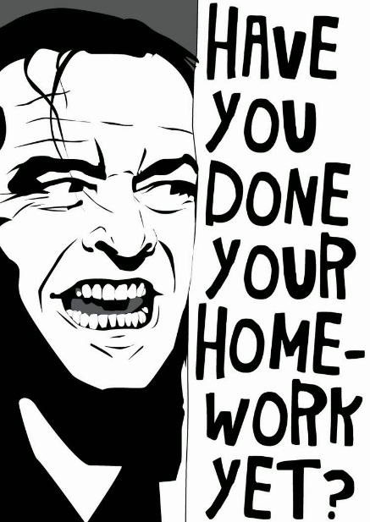
Homework
Create a post that shares three discourse communities you participate in. Name two or three problems or issues that are central to each one. Post it under Unit 1 Work and title it Full Name, My Discourse Communities by class time on Tuesday, February 22.
  This is another low-stakes writing assignment (worth 30% of your grade) that will help you with the U1 Major Writing project!
  You have a whole week to work on this, but don’t wait until the last minute! ☺
Read Mary Wollstonecraft’s “Dedicatory Letter” (pp. 1-3) in A Vindication of the Rights of Woman by class time on Thursday, February 17.
Watch or read the transcript of Stella Young’s TedTalk by class time on Thursday, February 17.

