Slide 1

ENG 1121
English Composition 2
Objectives
Discuss Tan & Beasley’s work
Think & write about their work
Learn how to comment & post on OpenLab

Slide 2
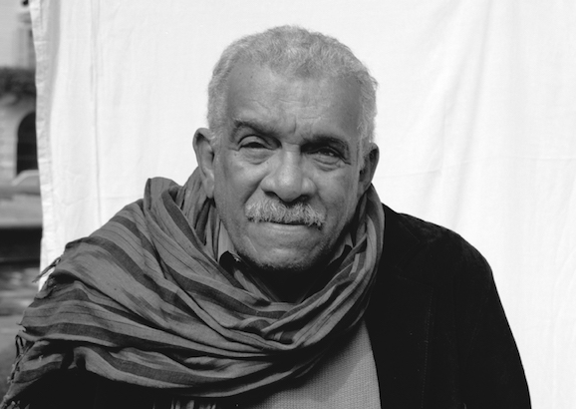
The English language is nobody's special property. It is the property of the imagination: it is the property of the language itself.
Derek Walcott
What does Walcott mean by saying English isn’t anyone’s “special property”?
How does this relate to the assignments for today?

Slide 3
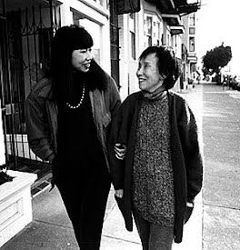
Review/Write/Discuss
Pull up Amy Tan’s “Mother Tongue” on your device. I’ll give you a few minutes to review this piece.
When time’s up, I want you to consider the following questions (these are also on our Agenda). Take notes, because we’ll be discussing these questions:
In Amy Tan’s ‘Mother Tongue,’ Tan writes, “Recently, I was made keenly aware of the different Englishes I do use.”
  What are these different Englishes; when, where and how does she use them?
  What does this piece illustrate about Tan’s responsibility to and feelings about her different communities and the way she moves between these groups?
  Who do you think would benefit or be interested in reading this piece? Why?

Slide 4
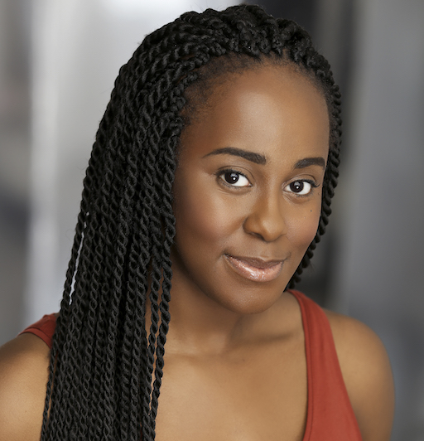
Discuss/Write
Define “code switching.”
Spend some time thinking/writing about the following question:
Choose a word or phrase that you use with one group of people (family, friends, co-workers, etc.) that would not be understood by a different group of people in your life. What is the meaning of this word or phrase and how would you explain it to someone who is an outsider to the group who uses it?

Slide 5
Commenting & Posting
First, we’re going to comment on OpenLab. On your device, go to the Discussion page under Student Work.
Click on the question.
Scroll down and hit “reply.”
Type your answer from the previous slide in the box and click on “submit comment.”
Next, I’m going to show you how to post your Core Values paragraphs (hopefully you’ve joined our class and you have one typed already so you can follow along).

Slide 6
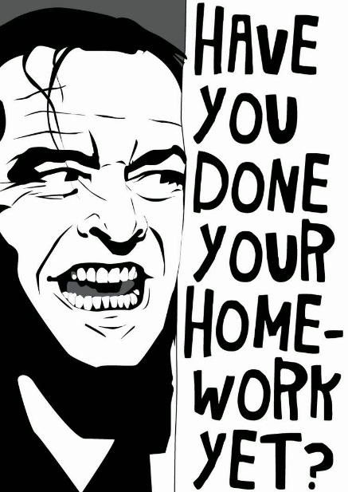
Homework
Classes follow a Friday schedule on Tuesday, February 8! Our next class is Thursday.
Before class, read John Swales, “Reflections on the Concept of Discourse Community.”
While you’re reading Swales’ work, find two quotes you find compelling. Write down each quotation and then explain what you found interesting (or even confusing).
Before class, review Butte College, “Double-Entry Reading Journals.”
Post your completed Full Name, Core Values under Introductory Work by class time on Thursday.
The above assignments can be found on our website under Agenda and Week 1.
Look out for my email on Friday that will detail what we’ll be doing during Week 2.

