Slide 1

ENG 1121
English Composition 2
Objectives
Discuss syllabus & schedule
Register/Join OpenLab
Discuss reading for this class

Slide 2
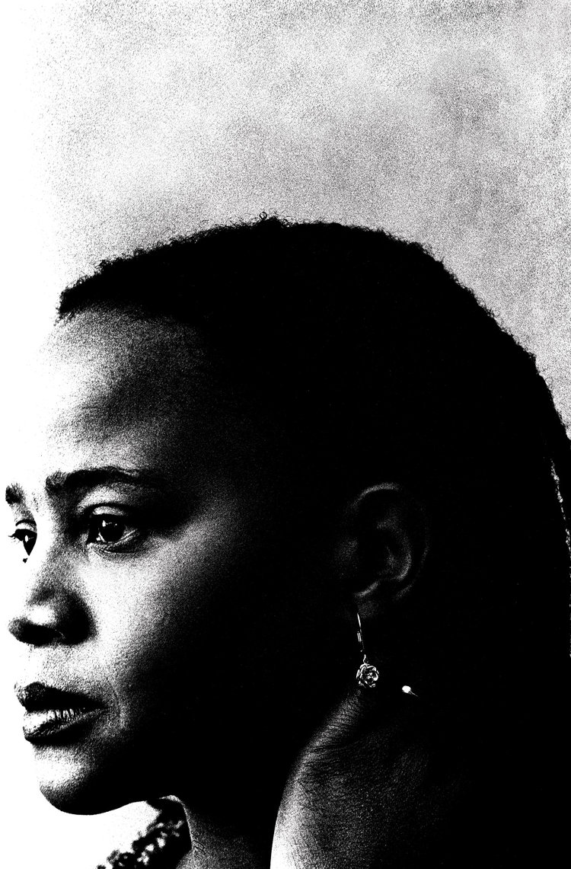
Welcome!
When you write, it’s like braiding your hair. Taking a handful of coarse unruly strands and attempting to bring them unity. Your fingers have still not perfected the task. Some of the braids are long, others are short. Some are thick, others are thin. Some are heavy. Others are light. – Edwidge Danticat
There are other questions to consider on the Welcome page of our website, but let’s focus on this one:
Why does Danticat equate writing with braiding?
There isn’t one “correct” answer—there are as many answers as there are people in this class!

Slide 3

Some Thoughts
Go to the Welcome post I wrote. Hopefully, you’ve already read it, but if you haven’t, do so now:
https://openlab.citytech.cuny.edu/pennereng1121spring2022d463monwed230/

Slide 4
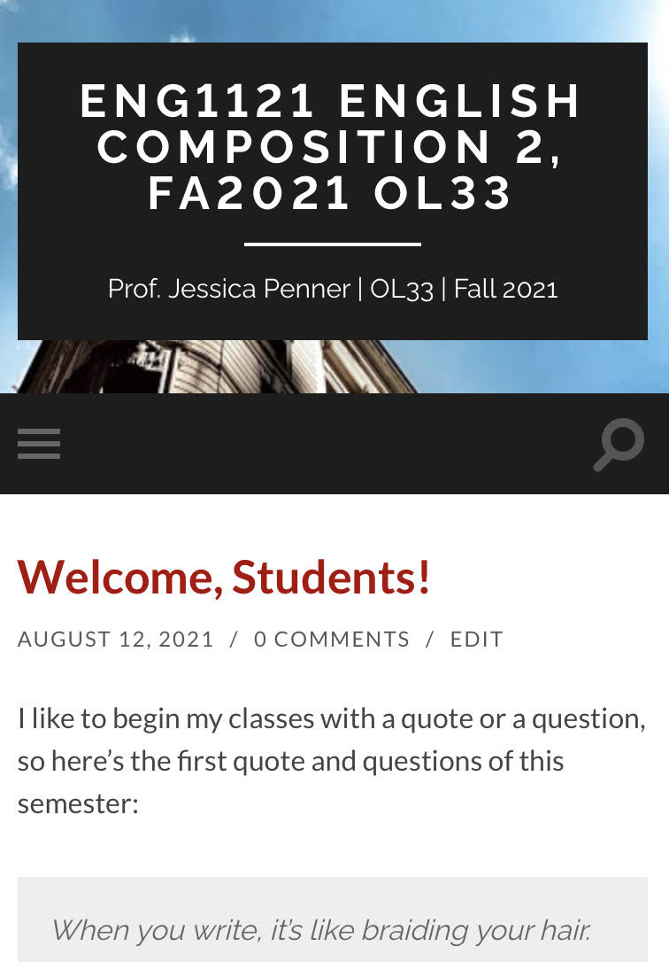
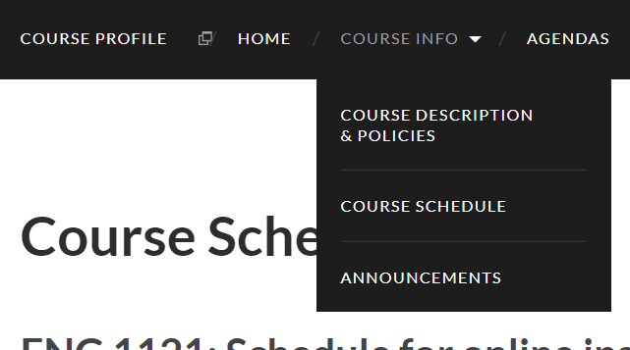
Course Info
Let’s go to the syllabus on our own devices.
  If you’re on a laptop, it’ll look like the image on the bottom.
  If you’re on a cell, it’ll look like the image on the top. (Click on the three gray strips on the left.)
First, find Course Info and then look at Course Descriptions & Policies.
Next, go to Course Schedule.
Now, go to Announcements.
Finally, go to Agendas.

Slide 5

Register/Join OpenLab
Go to https://openlab.citytech.cuny.edu/ on your smartphones or laptops.
If you’ve joined OpenLab, log in.
If you haven’t, sign up now!
Notes:
ECRI
20 min
Say: Everyone, please get out your smartphones! Ask: Has anyone NOT logged in on OpenLab before? Will the students who have logged in please coach the students who have not?

Slide 6
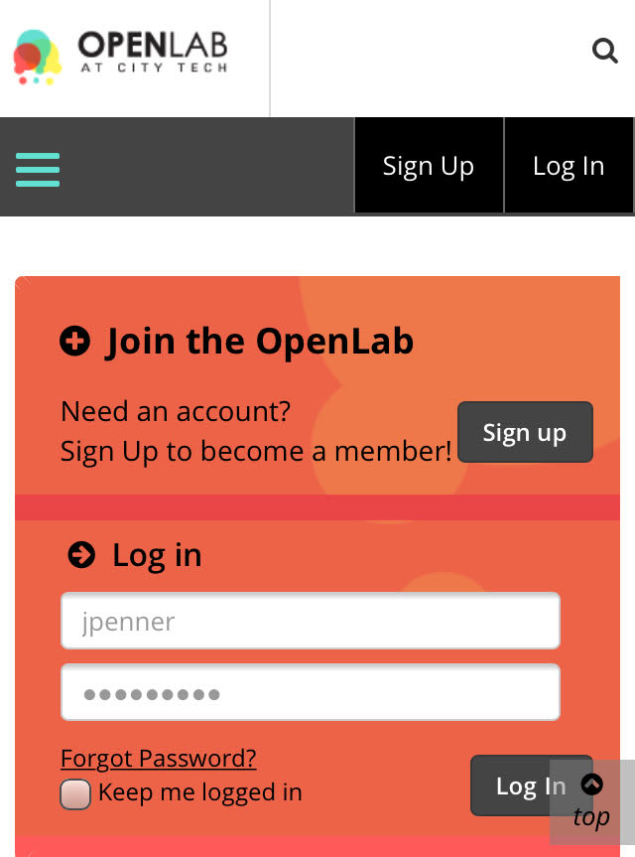
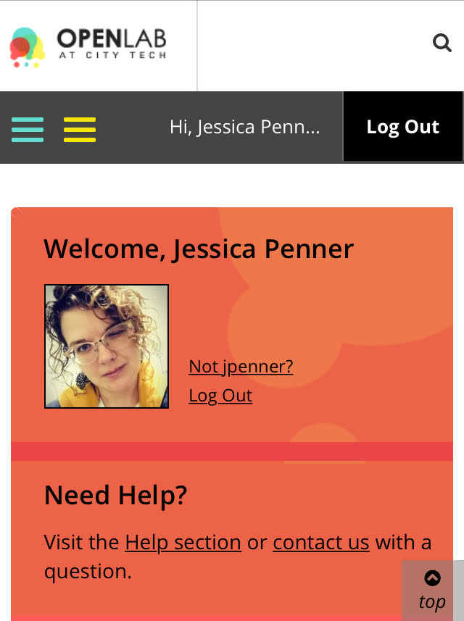
You must use your City Tech-approved email!

Slide 7
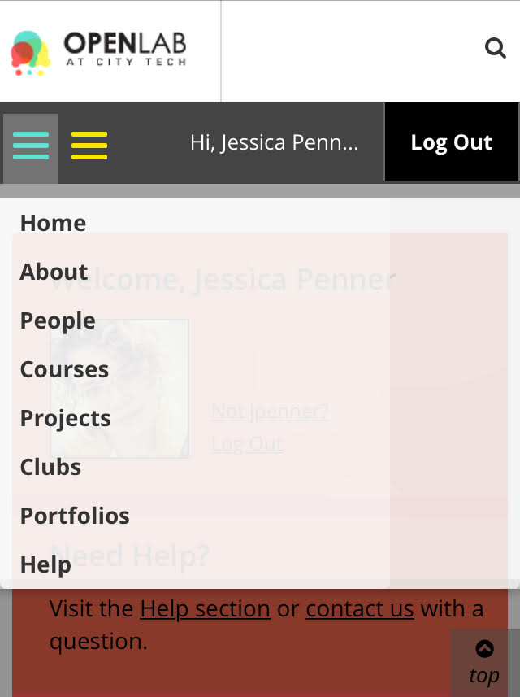
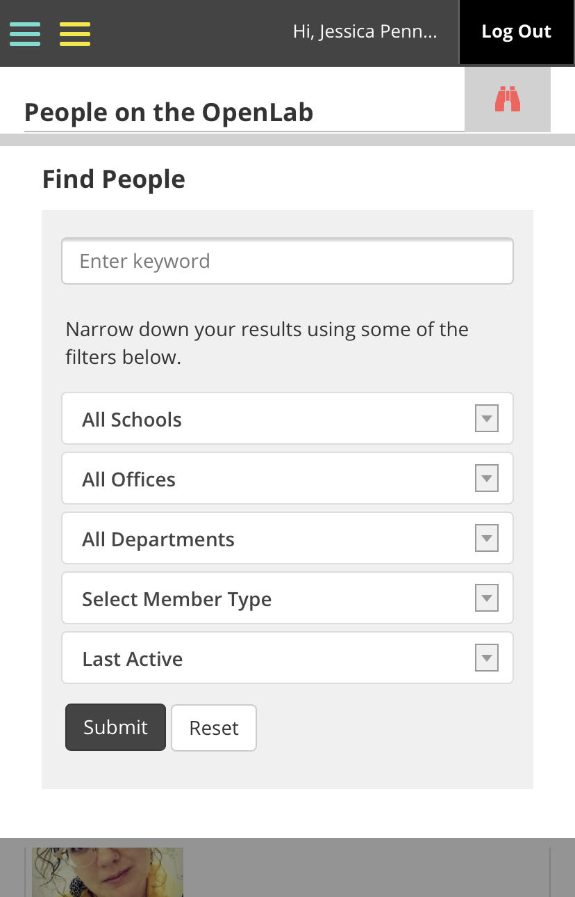
Jessica Penner
The easiest way to find our class is by finding me!

Slide 8
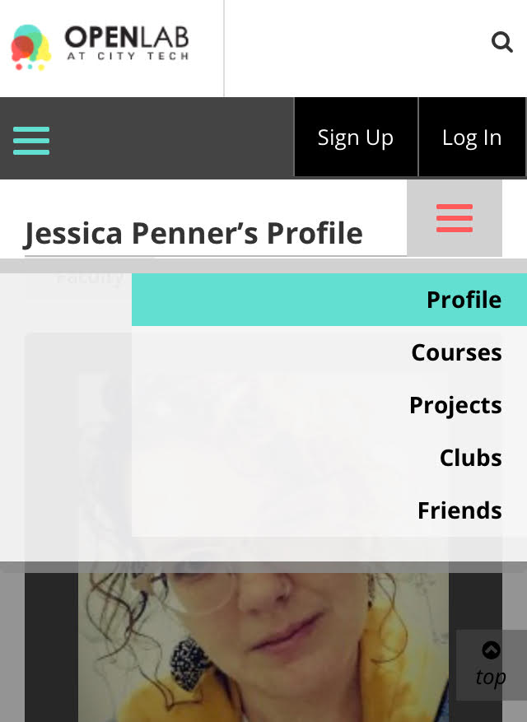

Make sure you join the correct class!
This class has this avatar:

Slide 9

How to Read (Really) for this Class
Before you read, try to understand why I’m asking you to read this assignment.
Think about what we’ve talked about in class.
Look at the Course Schedule and the Major Assignments pages for clues. Once you’ve done that…read!
But don’t just read it once and then move on to other assignments. Read an assignment at least two times.

Slide 10
How to Read (Really) for this Class
The first time, read for basic understanding. If you don’t know a word, mark it or make a list. Look them up later.
The second time, SLOW THE F&%$ DOWN. If you haven’t looked up words yet, do that now. Write down (either on your device or in a notebook) questions and/or comments on ideas that the reading brings up.
You might be fine with just two rounds; however, if that isn’t the case, read it as many times as you need to until you feel you understand the main ideas presented.

Slide 11

Why are we talking about reading? After all, this is a writing class!
Clearly, reading published work shows how the pros do it. If we need to see how to write a cover letter for a job, we go the Internet and see how it’s done.
Reading about others’ ideas helps generate our own thoughts on a subject.
The whole class is reading the same assignment, and since there are going to be different ideas/thoughts/opinions, this will spark even more ideas when we discuss them in class.
But we all need to be on the “same page,” right? Which is the reading.
So, if you don’t read and have basic understanding, you won’t be ready to participate in class or be able to generate your own ideas when you’re writing at 3 AM.

Slide 12
Speaking of writing…
Write three short paragraphs about the following:
Paragraph 1: Define one of your core values. What does the importance of this value in your life say about you?
  Examples of core values: being creative, family, friendships, political engagement, independence, gaining knowledge, athletic ability, community, culture, music, spiritual or religious values, sense of humor. (Feel free to name one that isn’t listed–these are just a few!)
Paragraph 2: How does this value relate to your goals for the future?
Paragraph 3: How will improving your writing and communication skills help you achieve these goals?
Start writing these paragraphs now and be ready to post what you have so far on OpenLab on Wednesday. Title it Full Name, Core Values and save it under Introductory Work.

Slide 13
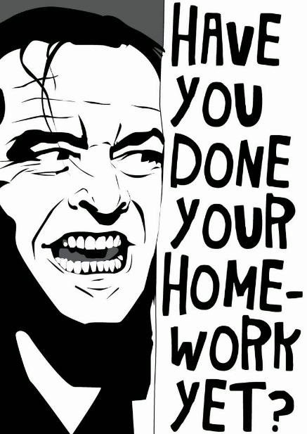
Homework
FYI: The reading assignments will always be homework. Hint: This means you need to do it before our class meeting. ☺
You can find the links to the following class’s reading in the Course Schedule (under Course Info on the OpenLab site).
Work on your paragraphs and have at least one ready to post by Thursday (so you have something to post when I talk about how to post).
By Wednesday’s class, read Amy Tan’s “Mother Tongue” (four pages, single-spaced) and watch Lisa Beasley’s “What is Code Switching?” (three minutes long).

