Slide 1

ENG 1121
English Composition 2
Objectives
Discuss students’ DCs & issues
Discuss research and how to use it for persuasive writing
Practice research

Slide 2

Research is formalized curiosity. It is poking and prying with a purpose.
– Zora Neale Hurston
For four minutes, I want everyone to research the name “Zora Neale Hurston” on their own.
Find out the who, what, when, and where about this person.
What did you learn?

Slide 3

Discussion
In your small group, do the following for 15 minutes:
  Student 1: shares the DCs from their post My Discourse Communities and their issues; mentions whether they’ve decided on one of the DCs to write about for U1.
  Group: responds with things they like, questions to gain clarity, etc.
  Student 2: same as above
  Group: same as above
  Etc.

Slide 4

“Research is formalized curiosity.”
By now, you’ve identified three discourse communities and the issues you want to address in either a letter or speech. You may even know which one you want to write about for U1.
This assignment for U1 (sharing about a DC and an issue facing that DC) is going to be a persuasive speech or letter.
In order to persuade your audience that they should care and act, you need to have at least two sources that you use in your letter or speech. These can be interviews you’ve conducted, news sources, or data you’ve gathered.
Let’s go over some ways of using research to persuade your audience!

Slide 5

What is Persuasive
Writing?
Persuasive writing seeks to convince its readers to embrace the point-of-view presented by appealing to the audience’s reason and understanding through argument and/or entreaty.

Slide 6
Steps for Effective Persuasion
Understand your audience.
Support your opinion.
Know the various sides of your issue.
Respectfully address other points of view.
Find common ground with your audience.
Establish your credibility.

Slide 7
Understanding Your Audience
Who is your audience?
What beliefs do they hold about the topic?
What disagreements might arise between you and your audience?
How can you refute counterarguments with respect?

Slide 8
Understanding Your Audience
Help your audience relate to your topic.
Appeal to their hearts as well as their minds.
Use anecdotes when appropriate
Paint your topic in with plenty of detail
Involve the reader’s senses in these sections

Slide 9
Researching an Issue
Become familiar with all sides of an issue.
You can try to:
Find common ground.
Understand the history of the topic.
Predict counterarguments your audience might make.
Find strong support for your own perspective.

Slide 10
Researching an Issue
Find common ground with your audience.
For example:
  Point of Opposition: You might support a war, whereas your audience might not.
  Common ground: Both sides want to see their troops come home.

Slide 11
Researching an Issue
Predict counterarguments.
For example:
  Your Argument: Organic produce from local Farmers’ Markets is better than store-bought produce.
  The Opposition: Organic produce is too expensive.

Slide 12
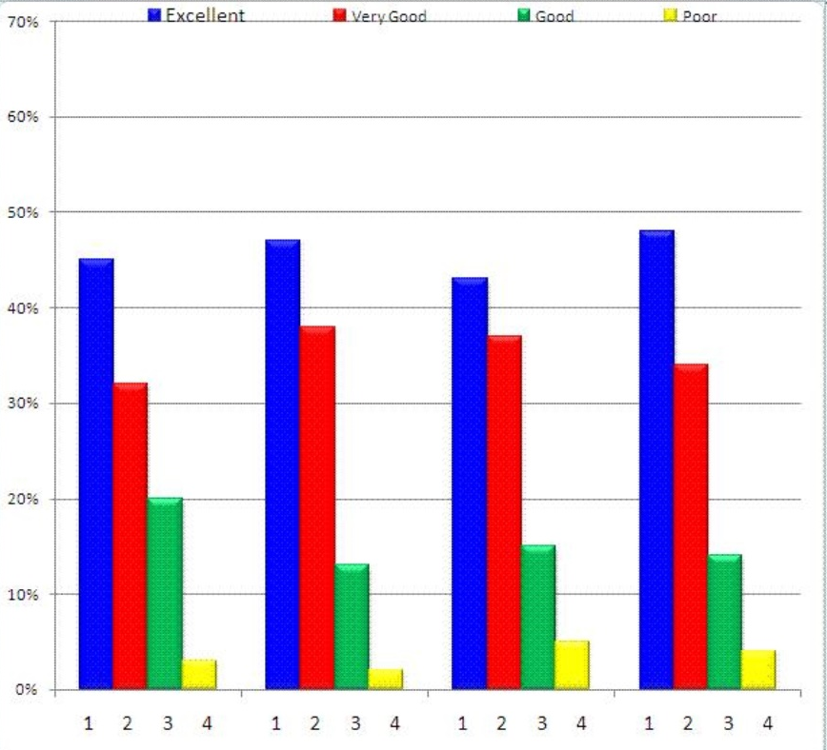
Support Your
Perspective
Appeal to the audience’s reason:
Use statistics and reputable studies.
Cite experts on the topic:
Do they back up what you say?
Do they refute the other side?

Slide 13
Cite Sources with
Some Clout
Which source would a reader find more credible?
The New York Times
http://www.myopinion.com
Which person would a reader be more likely to believe?
Joe Smith from Fort Wayne, IN.
Dr. Susan Worth, Prof. of Criminology at Purdue University.

Slide 14
In class work & homework
Open a blank document on your device. We’re going to spend some time on the Internet. Choose one DC and issue. While researching your issue facing your discourse community, think and take notes about:
Who is already involved in attempting to make the problem visible to outsiders? Name them! What are their positions, views, and strategies as they bring this problem to light? Discover them!
Who needs to know about this problem? Name them! Why would you want to tell this audience about the problem? Explain why!
Make a list of ideas and information that would be persuasive in helping your audience understand that this issue is a problem.
  Refer to the Purdue OWL slideshow to help you with this list: https://owl.purdue.edu/owl/teacher_and_tutor_resources/teaching_resources/effective_persuasion_presentation.html

Slide 15
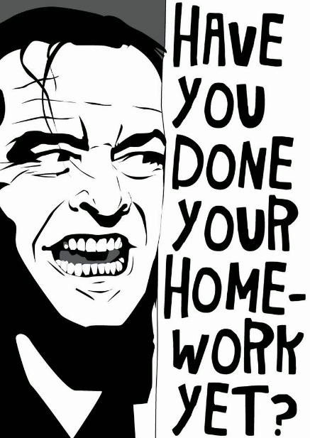
Homework
Using research you’ve completed today + research you do on your own, create a Post about the research you’ve done in this class. Title it: Full Name, Brainstorming DC & Research and post it under U1 Work by class time on Wednesday, February 23. (Details about what’s expected are on the Agenda for Week 3.)
Read Frederick Douglass’ “What to the Slave is the Fourth of July?” Listen to “What to the Slave is the Fourth of July?” Review Washoe School District’s “The Quote Sandwich.” Read/listen before class on Wednesday, February 23.
More details will be provided on Friday with the new Agenda and Announcement!
There is no class on Monday—but don’t forget about the above assignments!

