Slide 1

ENG 1121
English Composition 2
Objectives
Review your classmates’ Core Values
Define “discourse community”
Dissect Swales’ work

Slide 2

Core Values
For the next 8 minutes, read other students’ Core Value paragraphs under Introductory Work (found under Student Work).
Briefly summarize a few of the core values that you read.
Were they like your own? How?

Slide 3
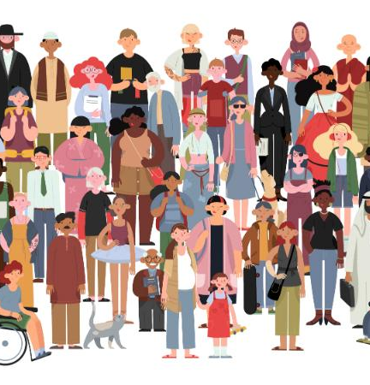
Discourse Community
What was your initial assumption about what a “discourse community” was?
What is the definition you learned through today’s assigned reading?
Here’s the definition in Wikipedia (at the time of Swales’ publication):
A discourse community is a group of people who share a set of discourses, understood as basic values and assumptions, and ways of communicating about their goals.

Slide 4
Discourse Community
One way to decide if a group is a discourse community (DC) is to list criteria and ask questions based on that criteria (these are worded a little differently than in Swales’ text):
Common public goals
What is this group’s goal?
Methods of communicating among members
What are the ways this group communicate with each other?
Genres that define the group
How does this group communicate with the outside world?
A lexis
What is the “language” they use within their group?
A standard of knowledge needed for membership
What does a person need to know before they can join this group?

Slide 5
Discourse Community
Here are the new criteria that Swales introduces:
Develops a sense of “silential relations”
Are there terms or actions that don’t need to be explained to a group member?
Develops horizons of expectation
Are there “rhythms of activity,” a sense of history, and a value system that the group members recognize?

Slide 6
Discourse Community
What discourse communities might you belong to?
For example, one DC I belong to is a writer’s group. We share our drafts of creative writing with each other and critique them in order to make our writing stronger. We mainly communicate through email or Zoom, but we used to meet on a monthly basis before COVID. At times we share our writing at readings, or, if we get published, we let the outside world know via social media. We use vocab like “pacing” “description,” “story arc,” etc. Many of us have MFAs or BFAs in creative writing, but really, the only requirement is a desire to improve one’s writing.
Take a few minutes to think about this. Share your DC with a neighbor.

Slide 7
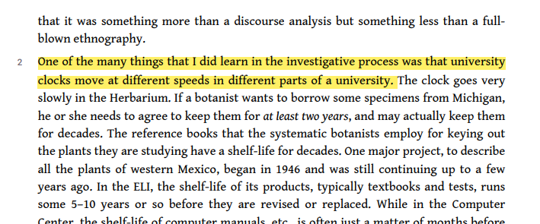
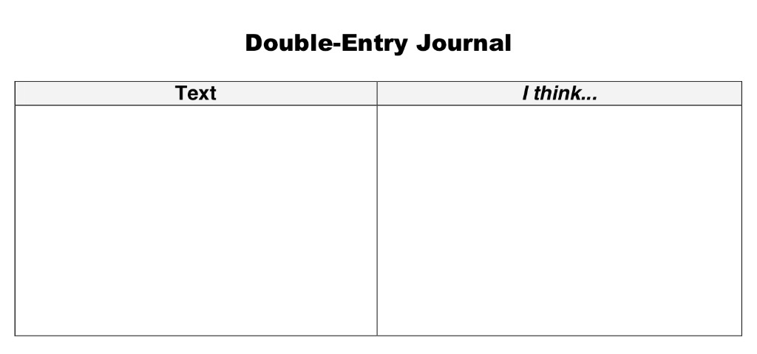
Double-entry journals
“A double entry reading journal is one way to interact with what we read, increase critical thinking skills, and create a meaningful construction–namely, a better understanding of what we read.”
The reason I asked you to review the resource about using double-entry journals is that this can be a tool for you as you go through this class and others.
When you see a section or a quote in any text, you can either highlight or copy it down, and then pose your ideas, questions, etc., next to it, and that way you have a record of these thoughts for later use. (When we do the research section of this class, this will most certainly be handy!)
One example of a double-entry journal.
“One of the many things that I did learn in the investigative process was that university clocks move at different speeds in different parts of a university.”
The reason I found this quote compelling was because I’ve seen this in action. English professors at City Tech often teach from textbooks that are often literally crumbling, while those that are in the sciences are constantly changing their books.

Slide 8
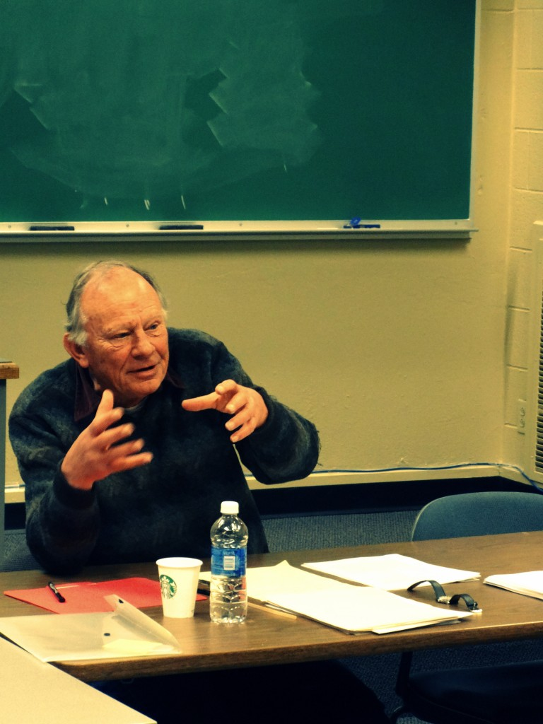
Your turn!
The assignment for today was to read Swales’ work and choose two quotes that you found interesting (or confusing).
Take 10 minutes to look at the two quotes you’ve chosen, and answer this question for BOTH QUOTES INDIVIDUALLY: Why did you find the quote compelling?
Hint: type or write this stuff down, if you haven’t already.
After 10 minutes, you’ll gather into small groups and share one of the quotes and your reasons for choosing that quote.

Slide 9
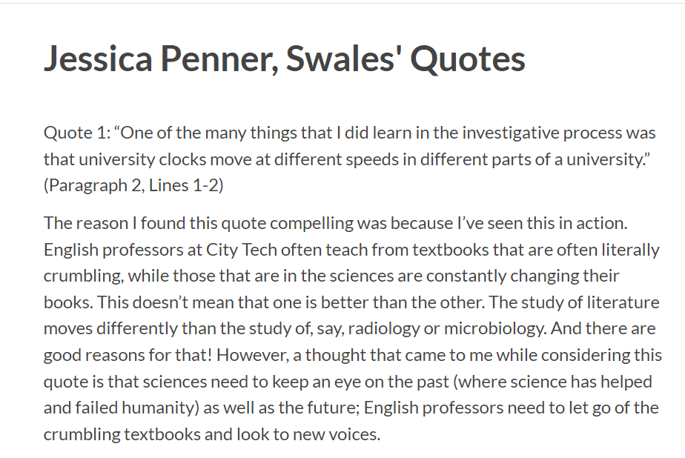
Double-entry journal writing assignment
For our assignment, we’re going to have a slightly different double-entry journal from the one Butte College shows, but you can see the same information is shared here.
Follow the template below for this assignment:
Quote 1: “Quote” (Paragraph X, Lines X-X)
Explain why you feel connected to or confused by this quote:
Quote 2: “Quote” (Paragraph X, Lines X-X)
Explain why you feel connected to or confused by this quote:

Slide 10

Homework
Write a Post/Submit an Assignment in which you do the following (approximately 200-250 words):
  Create a “double-entry journal” exploring two observations that Swales makes about discourse communities. To do this, use the two quotes from Swales’ work you found compelling. Write down each quotation and then explain what you found interesting or confusing.
Publish the post under Unit 1 Work (which is under Student Work) by class time on Wednesday, February 9. Title it Full Name, Swales’ Quotes.
  This is the first low-stakes writing assignment for this class! Remember: low-stakes assignments are worth 30% of your overall grade!

