Slide 1

ENG 1141
Creative Writing
Objectives
Compare the narrators of “The First Day” and “The Wife’s Story”
Discuss Point of View in fiction
Write a Journal (to prep for 1st short story)

Slide 2

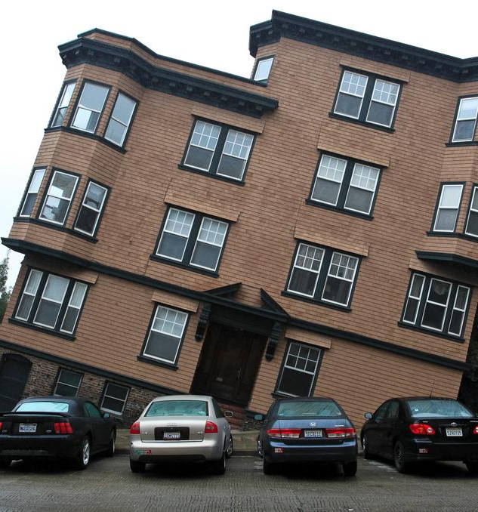
“We don't see the world as it is, we see it as we are.”
– Origin of the quote is unclear
Imagine that the narrator of “The First Day” is the mother, rather than the daughter.
What would the mother tell us that her daughter didn’t?
What about “The Wife’s Story”? What if the narrator was the husband, rather than the wife?
What would the husband tell us that his wife didn’t?

Slide 3

Point of View
Point of view is the eyes through which we see a story.
Whether you’re reading literature, watching/reading/hearing the news, or listening to someone speak, ask yourself:
Who is telling this story?
What does this character see and know?
How does this character’s perspective shape my understanding of events?

Slide 4
Point of View
Go to the Google Doc I’ve emailed you:
https://docs.google.com/document/d/1MCUMtl48xKOt8tvvF8KQU4zrrHFzcAKLTgD1H-NOsyo/edit?usp=sharing
There are questions in red on this worksheet. There are three sections.
I’ll give you a short amount of time to work individually before we discuss the answers as a class.
Overall, I’m giving you 20 minutes for the entire worksheet. The times in blue are the recommended amount of time for each section. (Hint: don’t spend a ton of time on any section!)
Be sure to write your name before each answer! (This will count as your attendance/participation points for the class.)
If you’re using a pen/notebook for class today, write your answers in your notebook and email a screenshot to me.

Slide 5
Point of View
First Person
Example #1:
  What’s the present age of the narrator? Are they sharing the story right when it happens, or later?
Example #2:
  What’s the present age of the narrator? Are they sharing the story right when it happens, or later?
  Why is the present age of the narrator and when they share the story important?
  Define “First Person.”

Slide 6

Reliable vs. Unreliable Narrators
With an unreliable first-person narrator, there’s a gap between what the narrator says and what the reader believes to be the truth.
“Unreliable” doesn’t mean the narrator isn’t telling the truth. It means their version of the story may not be entirely accurate. (Of course, as in life, there may be unreliable narrators that are deliberately lying for various reasons.)
“The First Day” and “The Wife’s Story” are told in first person. Are these narrators reliable or unreliable? Why?

Slide 7
Point of View
Third Person
Example #1:
  How is this passage the same as the previous first-person examples?
  How is it different?
Example #2:
  How is this passage different from the previous third-person example?
  Define “Third Person.”

Slide 8
Let’s take a break!
For the next 15 minutes, you can stretch your legs, wander the web, eat a snack, take a nap, etc.

Slide 9

Journal about Life
Choose ONE of these prompts; title it Full Name, Journal #4 under Journals:
Write about a constant disagreement you’ve had with someone. What is the basis of the disagreement? It can be large or small. (For example, my parents and I have different opinions about how to fry eggs.) When does this disagreement occur? What is usually/often said? How is it resolved–if at all? Share as many details as possible. (Approximately 300-400 words. Feel free to write more!)
Go to a public space where you can practice social distancing and politely people watch for at least 10-15 minutes. Take notes about the people you see and if they say anything. When you get home to your computer or laptop, recreate the experience. Where were you? Who did you see? (What were they wearing? What were their ages? What were they doing?) What did they say–if anything? Be as detailed as possible. (Approximately 300-400 words. Feel free to write more!)
The writer Jane Howard said: “Call it a clan, call it a network, call it a tribe, call it a family. Whatever you call it, whoever you are, you need one.” Who is in your clan or network or tribe or family? Describe each member of that group of people in detail. Need help getting started? Use some (or all) of the four elements of character we’ve talked about: action, dialogue, appearance, and thought. (Approximately 300-400 words. Feel free to write more!)

Slide 10
Journal about Life
For the next 40 minutes, we are going to write using one of these prompts. (The prompts can be found on the Assignment page for Week 7.)
IF you choose #2, you may leave the classroom to find a public space (the 1st floor of the library, the atrium, or even outside on Tillary Street are prime people-watching spots)—however, if you choose to do this one, you may only be gone for 20 minutes, so don’t go far!
At the end of 40 minutes, we’ll briefly talk about what we wrote about and how to transpose these journals into our first short stories!

Slide 11
Journal about Life
Talk to a neighbor about what you wrote about:
What did you end up writing/thinking about?
Did anything surprise you?
Any ideas about how to “fictionalize” this true story?

Slide 12

How to write your first fictional short story, using Journal 4:
  If you used the first option (write about a constant disagreement you’ve had with someone), write about the disagreement from their POV. Focus on the character traits of this individual–action, dialogue, appearance, and thought–that explains why they may disagree with you–the opposition.
  If you used the second option (go to a public space where you can practice social distancing and politely people watch for at least 10-15 minutes), choose one of the people you saw and create a “day in the life” of that person. Focus on plot–get the person up a tree, throw rocks at them, and then get the person down.
  If you used the third option (who is in your clan/network/tribe/family?), choose two of those people and put them in a difficult situation together. A few ideas: out of gas in the middle of nowhere, locked out of their apartment, spending a holiday with just the two of them, waiting for another friend in the freezing cold or sweltering heat (you get the picture). You can focus on both the character traits and plot.
  The only requirements are:
    The story must be at least 350-400 words long
    Told in the Third Person POV! (No “I”–only “he/his,” “she/her,” or “they/their.”)

Slide 13
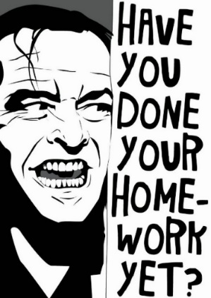
Homework
Revise your second memoir and post it under Memoir by 11:59 PM on Wednesday, March 16. You can revise the version you’ve already posted, just be sure to title it Full Name, Memoir 2 (Revised).
Write a paragraph critique of Le Guin’s work. What did you enjoy? What questions/suggestions do you have for the author? Title it Full Name, Le Guin Critique. Post it under Discussions by class time on Wednesday, March 23.
Finish your first short story. Use the guidelines on the Assignment page for Week 7. The first draft is due by class time on Wednesday, March 23.

