Slide 1

ENG 1141
Creative Writing
Objectives
Reflect on memoir writing
Share your memoir writing
Discuss POV in fiction (or any genre)

Slide 2
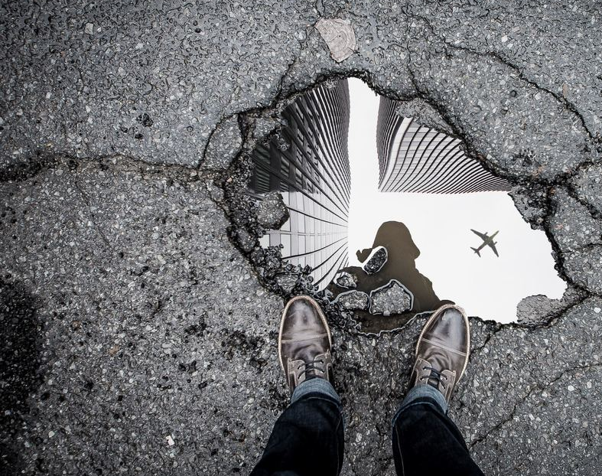
Reflection:
Journal 3
We’re going to spend some time reflecting on writing memoirs. Get out your laptop or cell phone and create a post on OpenLab.
Journal Assignment 3: Reflect on your experience with memoir writing—good, bad, so-so, and why. Title it Full Name, Journal 3. Save it under Journals.
Part of your portfolio (in place of a final exam) will be to reflect on your experiences as a writer over the semester. You are allowed to use your Journals as part of the portfolio. This is VERY helpful at the end of the semester!

Slide 3
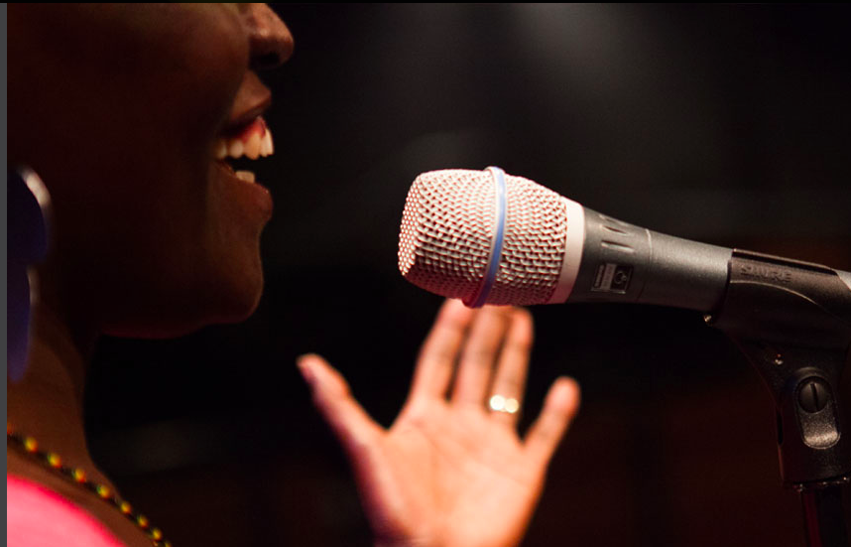
Reading!
Share one of your memoirs (either Memoir 1 or Memoir 2).
You aren’t required to share but it’s encouraged!
Be sure to clap or snap after each person reads—this is a time to celebrate the work you’ve done so far!

Slide 4
Let’s take a break!
For the next 15 minutes, you can stretch your legs, wander the web, eat a snack, read “The First Day,” etc.

Slide 5

Transition to Short Fiction
In small groups, discuss the following questions (choose a speaker and be ready to discuss as a large group):
How is fiction like nonfiction/memoir?
How is it different?
Are there any memorable fictional stories that come to mind? (Either ones you’ve read or watched on TV/film.)
Have you ever written a short story before?
Was it a good experience? Why or why not?

Slide 6
“The First Day,” by Edward P. Jones
In an otherwise unremarkable September morning, long before I learned to be ashamed of my mother, she takes my hand and we set off down to begin my very first day of school. I am wearing a checkeredlike blue-and-green cotton dress, and scattered about these colors are bits of yellow and white and brown. My mother has uncharacteristically spent nearly an hour on my hair that morning, plaiting and replaiting so that now my scalp tingles. Whenever I turn my head quickly, my nose fills with the faint smell of Dixie Peach hair grease. The smell is somehow a soothing one now and I will reach for it time- and time again before the morning ends. All the plaits, each with a blue barrette near the tip and each twisted into an uncommon sturdiness, will last until I go to bed that night, something that has never happened before. My stomach is full of milk and oatmeal sweetened with brown sugar. Like everything else I have on, my pale green slip and underwear are new, the underwear having come three to a plastic package with a little girl on the front who appears to be dancing. Behind my ears, my mother, to stop my whining, has dabbed the stingiest bit of her gardenia perfume, the last present my father gave her before he disappeared into memory. Because I cannot smell it, I have only her word that the perfume is there. I am also wearing yellow socks trimmed with thin lines of black and white around the tops. My shoes are my greatest joy, black patent-leather miracles, and when one is nicked at the toe later that morning in class, my heart will break.

Slide 7
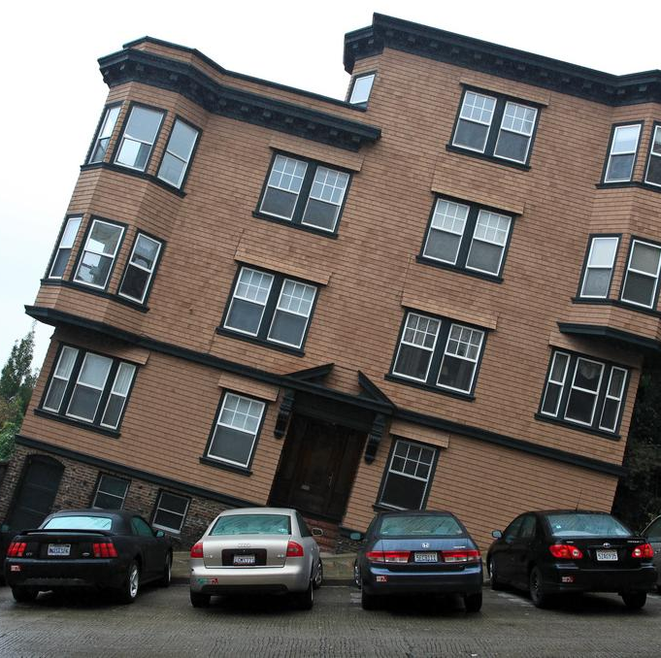
POV in Fiction
What is the point of view of the narrator? (First person? Third person?) How do you know?
What is the age of the narrator when the story occurs? How do you know?
What is the age of the narrator when they share this story? How do you know?
What time period do you imagine this story takes place? (Present, 1990s, 1970s, or a different time?) What are the clues to your guess?

Slide 8
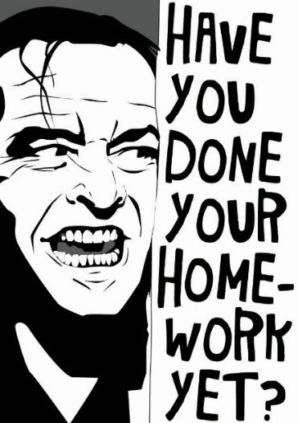
Homework (also on the Assignment page)
Journal Assignment 3: Reflect on your experience with memoir writing—good, bad, so-so, and why. Title it Full Name, Journal 3. Post it under Journals by class time on Wednesday, March 16.
Write a brief paragraph critiquing Jones’ work. What did you enjoy? What questions/suggestions do you have for the author? Post it with your Full Name, Jones Critique under Discussions by class time on Wednesday, March 16.
Read Ursula K Le Guin’s “The Wife’s Story” by class time on by class time on Wednesday, March 16. (Click on the red hypertext on the Assignment page.)
Review your Cohort’s critiques. Revise your second memoir and post it under Memoir by class time on Wednesday, March 16.
You can revise the version you’ve already posted, just be sure to title it Full Name, Memoir 2 (Revised).

