Slide 1

ENG 1141
Creative Writing
Objectives
Discuss plot by dissecting Anonymous, Gurba, & Patchett’s work
Discuss writing Memoir 2

Slide 2
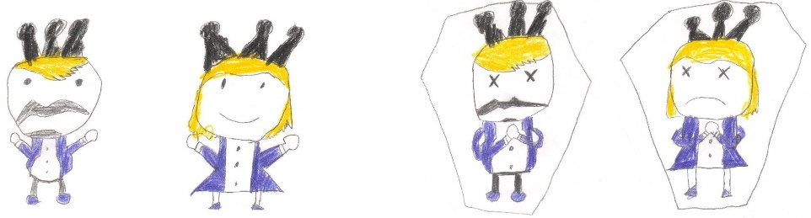
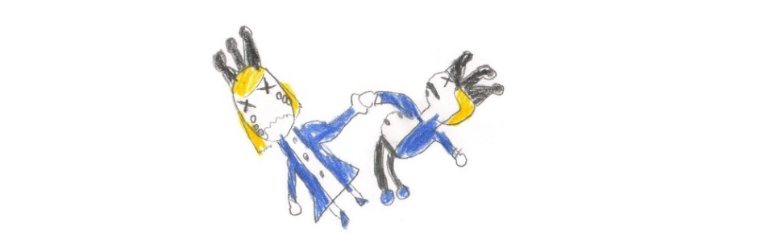
What is “plot,” anyway?
The novelist E. M. Forster famously said the following is a story:
“The king died and then the queen died.”
And the following is a plot:
“The king died, and then the queen died of grief.”
What’s the difference between the two sentences?
Notes:
Pictures from https://blogs.scientificamerican.com/illusion-chasers/tell-me-about-your-research-this-time-with-feeling/

Slide 3
Definition of Plot
The first line tells us the bare facts. With the first line, we don’t know when or in what state the queen was in.
  For all we know, the queen lived quite happily for 50 years before she died.
The second line tells us more–the state in which the queen died.
  Now we know they were very close. They were soul mates. The queen couldn’t adapt to life after the king’s death.

Slide 4

Definition of Plot
Plot is the sequence of events that make up the story.
When you tell someone a story you often say: “X happened and Y happened, and then you’ll never guess what happened next!” Without realizing it, you are plotting your story.
All writers are conscious of plot, whether they’re writing a fantasy novel or a newspaper article.
They are hyper-aware of the need to show that something happened because something else happened.

Slide 5

Parts of Plot
Typically, a plot has three major parts—beginning, middle, and end.
Each of these sections plays a specific role in the storytelling.
There’s an old saying that in telling a story you should:
1) get your protagonist up in a tree,
2) throw rocks at your protagonist, and
3) get your protagonist down.

Slide 6

Plot in memoir (or other genres)
Get Your Protagonist Up in a Tree aka the “Beginning”
What’s the context (year, location, and other important setting details) of the story?
What’s the inciting incident (action that gets things going) in the story?
Throw Rocks aka the “Middle”
What’s the rising action (events that lead to the climax) in the story?
Get Down aka the “End”
What’s the climax (the most exciting or intense moment) in the story?
What’s the resolution (the “wrap up”) of the story?

Slide 7
The Elements of Plot
Go to Course Profiles > Files > ENG1141 Handouts > ENG1141 Plot Analysis Worksheet
Choose either Anonymous, Patchett, or Gurba’s memoir to focus on.
For the next 25 minutes, answer the questions on the worksheet individually.
You’ll be emailing this to me for participation purposes!

Slide 8
The Elements of Plot
Write on the board whether you used Anonymous, Gurba, or Patchett’s memoir.
I’ll give you 15 minutes to discuss your answers with your group.
Choose a speaker for the class discussion.

Slide 9
The Elements of Plot
Let’s talk about Anonymous’ work:
Does she get the protagonist up a tree?
Does she have rocks thrown at her?
Does she get the protagonist down?
How about Patchett?
How about Gurba?
One thing I want everyone to focus on for their next piece is PLOT. Make sure you have these elements present.
Don’t forget to email your doc to me at creative.writing.citytech2@gmail.com!

Slide 10
Let’s take a break!
For the next 15 minutes, you can stretch your legs, wander the web, eat a snack (not in the classroom), etc.

Slide 11

Memoir 2
We’re going to write a new memoir piece!
You can use either Journal 1 or 2 (a friendship that’s important to you or a time when you were anonymous—either by choice or not) as inspiration for Memoir 2.
Or share something else, so long as it fits in the memoir category (telling a particular story about your life from your perspective).
Try to tell a true story! ☺

Slide 12
Write! Write!
Write!
Until 2 pm, we will be focusing on writing for this class.
You can work on the following items ONLY:
  Submitting your final draft of Memoir 1 (formerly known as Meet My ___) to OpenLab (due TODAY).
  Writing your Journal 2.
  Writing your critique of Gurba’s work.
  Writing your Memoir 2.

Slide 13
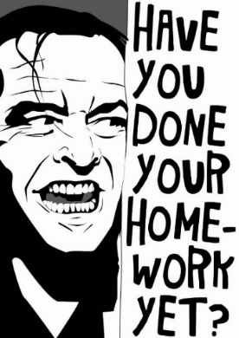
Homework (under Assignments for Week 4)
Post Journal Assignment 2: Write about a time you’ve felt you were anonymous (either by choice or not). Title it Full Name, Journal 2 and post it under Journals. Post this journal by Wednesday, March 2.
Write a critique of Gurba’s work. What did you enjoy? What questions do you have for the author? Title it Full Name, Gurba’s Work. Post it under Discussions. This is due by Wednesday, March 2.
Begin to work on a NEW memoir piece.
  You can use either Journal 1 or 2 as inspiration for the memoir, or share something else, as long as it fits in the memoir category.
  You’ll be submitting it to your Cohort on Wednesday, March 2! Don’t wait until Tuesday night to start working on it!

