Slide 1

ENG 1141
Creative Writing
Objectives
Discuss the genre of memoir & examples
Discuss first round of workshopping
Notes:
Materials:
Index cards for late-comers

Slide 2
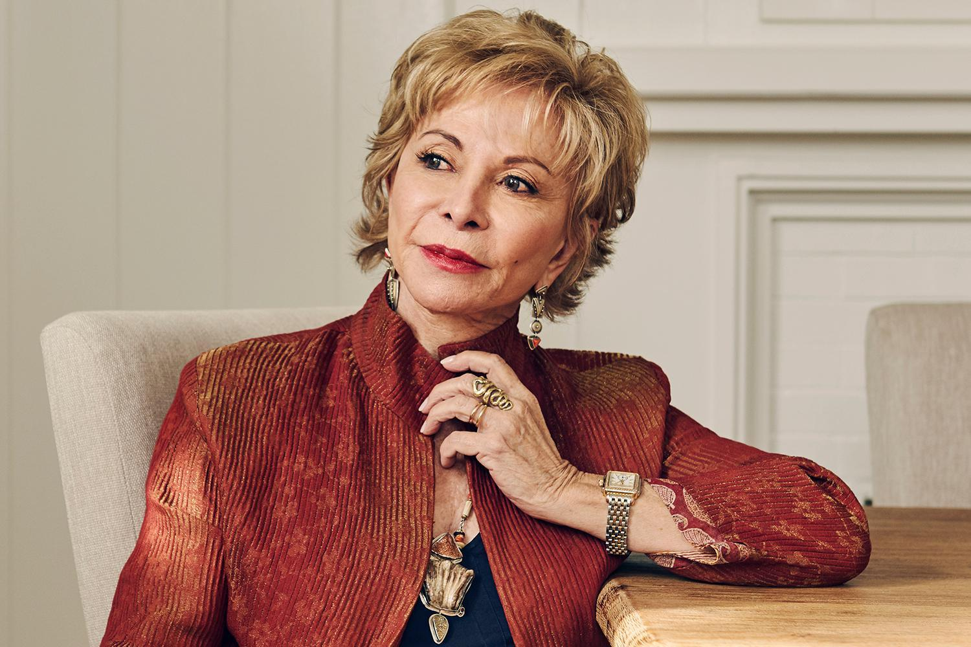
A memoir is my version of events. My perspective. I choose what to tell and what to omit. I choose the adjectives to describe a situation, and in that sense, I'm creating a form of fiction.
– Isabel Allende
Allende calls memoir a “form of fiction.”
Do you agree or disagree? Why or why not?
Are there times when we should “fictionalize” a memoir more than other times?

Slide 3

Becoming a critical reader (and better writer)…
Whenever I’m reading a memoir, an opinion article, a social media post, or a personal essay, I ask myself the following questions:
I need to ask: “Why do I think this person should be trusted? Is it because of bias or proof?”
  If it’s because of bias, I need to question my belief. Just because it’s been written by someone who holds similar viewpoints to mine doesn’t mean I ought to trust them.
  If it’s because this narrator has never been called out for lying or embellishing the truth too often, than I can feel a bit more secure in my belief in their story.
I also need to ask: “What does the narrator have to benefit from this story?”
  If they’re more likely to deal with negative results upon publication or are telling a personal experience that doesn’t “win” anything, I can feel more secure in my belief in their story.
  However, if they might gain politically, socially, or monetarily from their story, I should tread carefully. This doesn’t mean they’re NOT sharing the truth, of course! Sometimes people happen to publish at the time their topic is “hot” in the reading world.

Slide 4
Becoming a critical reader (and better writer)…
No matter what, keep a critical eye open while reading—even when you feel certain about the validity of the narrator’s story.
Being a critical reader has made me more passionate about the writing I come across and push on people (like students, LOL) because I believe more fully in the truth that’s being shared with me.
And it makes me look at my own writing with a more critical eye. If I want people to believe my memoir or personal essay, I need to convince those super critical readers (like me) out there! ☺

Slide 5
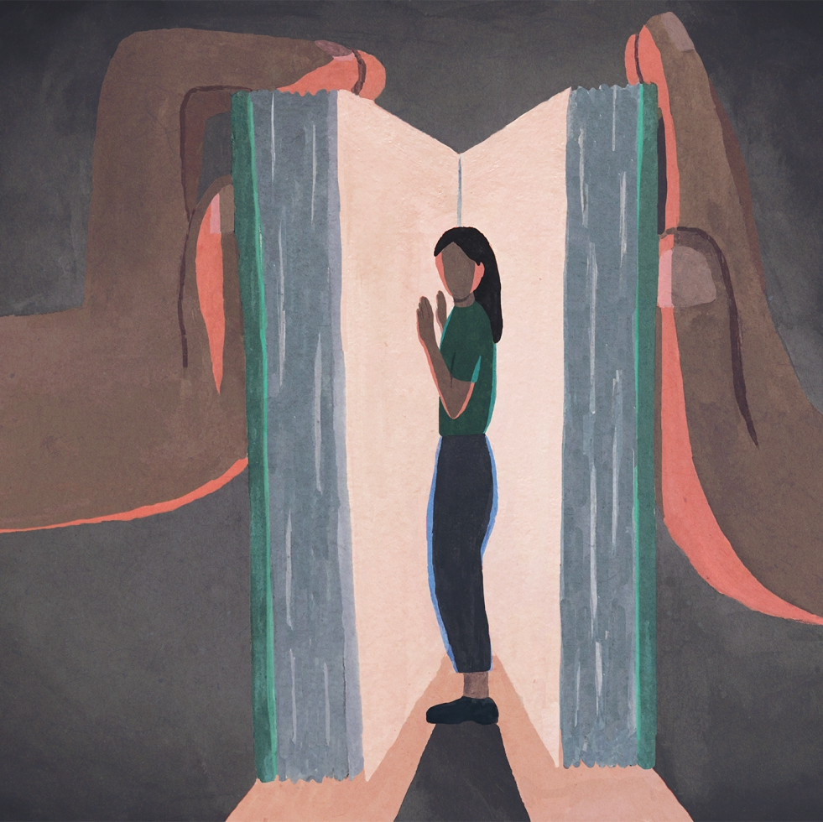
Anonymous’ work
What did you enjoy about “Whatever happened to ____?” Be specific!
What questions would you have for the author if they were here?

Slide 6

“Whatever happened to ___”
by Anonymous
Truth & Beauty,
by Ann Patchett
People ask why a judge would reach this verdict, contrary to all law. I have no answer. A fast, single internet search shows that the judge, too, once held a flicker of a dream of being a writer. She mentioned the lost dream, in an interview.
By the time I was forced into her courtroom … Her dream had fizzled, possibly decades before.
Court was a cult of patriarchy. Writing, while female, was an offense.
I do not remember our love unfolding, that we got to know one another and in time became friends. I only remember that she came through the door and it was there, huge and permanent and first. I felt I had been chosen by Lucy and was thrilled. … She had a habit of pitching herself into my arms like a softball without any notice. She liked to be carried.
What do these memoirs have in common?
How are they different?
Do you prefer one over the other? Why?
How can reading these two examples help you in your own memoir writing?

Slide 7
Let’s take a break!
For the next 15 minutes, you can stretch your legs, wander the web, eat a snack (not in the classroom), email your Cohort’s critiques, etc.

Slide 8
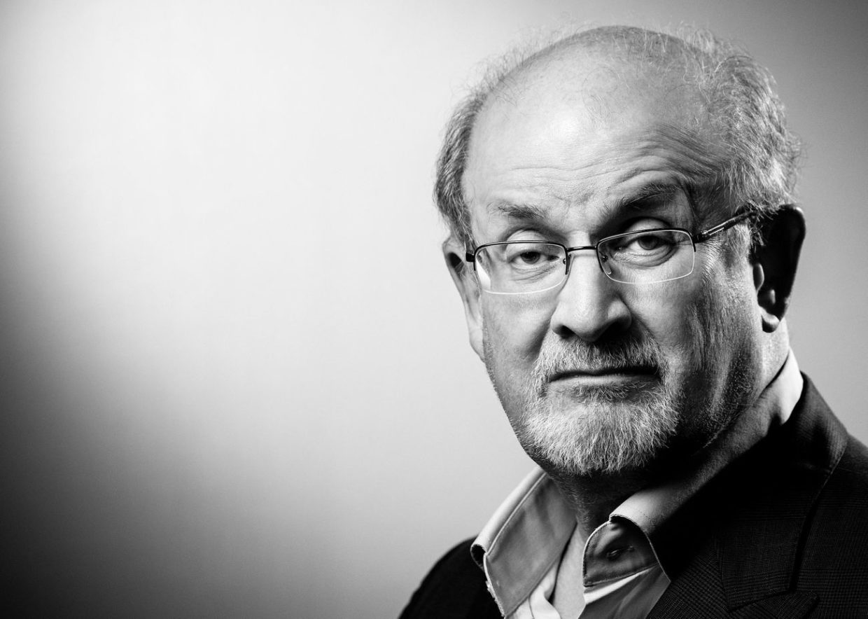
The difference between memoir and autobiography, as far as I see it, is that a memoir is there primarily to tell one particular story, whereas an autobiography tries to be a full account of a life.
–Salman Rushdie
Our present memoirs (aka “Meet My ___”) are telling a particular story.
What have you learned about yourself with this particular story?

Slide 9

Workshop Experience
Take a few minutes to think about the following questions. Write down your answers in the Google doc I just sent everyone:
What worked for you?
What needs improvement?
What will you do differently next time?
What do you need from others next time? Be specific!
  For example, you might want suggestions on vocabulary or grammar.

Slide 10
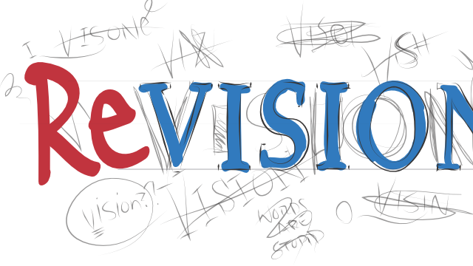
What now?
When you receive critiques of your writing (any writing), what do you do with them? Be honest!
Do you have a process to your revision of writing? If so, what is it?
Are there people you listen to more than others? Why?

Slide 11
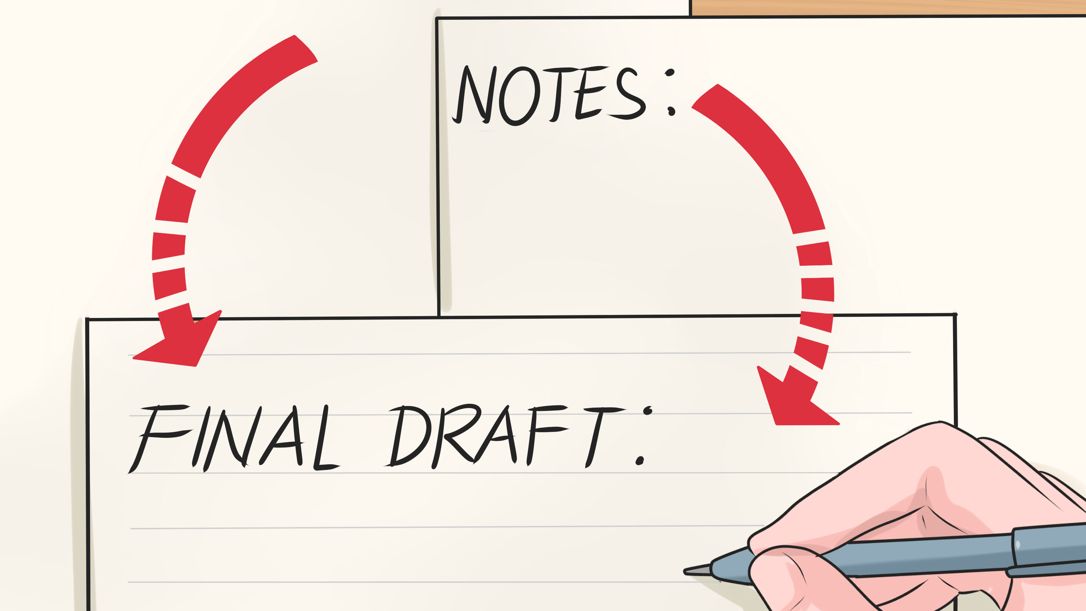
Some suggestions…
First, take a little step back from it and work on something else.
Second, review any questions and suggestions with an open mind.
Third, try out the advice that you don’t agree with, and just see if it does anything.
Finally, know that creative writing is subjective. Even if I give suggestions that you’re not 100% on board with (after step 3, of course) feel free to say: “Thanks, but no thanks!”

Slide 12
Revision time!
Based on your Cohort’s emailed critiques and self-review, spend this time revising your “Meet My _____.”
  If you want some brief feedback from me, come to the front and we can talk.
  Edit the version you posted on the website. You don’t have to create a new post. (Note that the final draft’s title must change—I’ll talk about that later.)
If you haven’t posted anything yet or were not here last week to be assigned a Cohort (and did not email me about this), come to the front and we’ll individually discuss what you need to do during this time.

Slide 13

Cohort Participation
If you've been critiquing your classmates' writing, keep up the good work!
However, if you haven't, please critique your Cohort's work by 11:59 PM Thursday and email it to them and me.
This is a required activity for this class that is worth 20% of your overall grade.
Writing a comment on a member of your Cohort’s post is not enough—you need to use the worksheet I provide. (They’re found on the Course Profile of our website.)

Slide 14
About reading & writing for this class…
Missing class is not an excuse for not keeping up with assignments. I know a few students are dealing with entry issues, illness, and so forth—but that is why everything to read or post for this class is on our website.
If you have access to the Internet, you can still see what we've discussed in class via the Announcement, Assignment, and review the actual PowerPoints I use in class (posted in the Course Profile).
If you don't have reliable access to the Internet, let me know and we can work on that!
We only meet once a week, which can be nice, but it also means that the assignments for an entire week are going to be due each week. You need to hold yourself accountable to keep track of what’s due.
Now is the time to get into the habit of turning in work on the due dates I have posted on the Assignment page.
I can be flexible about some due dates (things like journals and the published author critiques) but NOT about others (like major writing assignments and Cohort reviews).

Slide 15
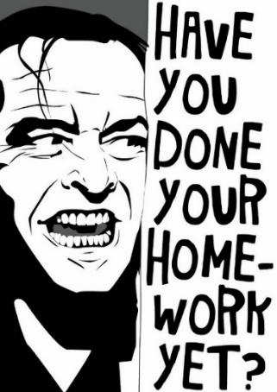
Homework
Revise and rename “Meet My ____” to Full Name, Memoir 1 (Revised) and post it under Memoir by class time on Wednesday, February 23.
Critique Anonymous’ work. What did you enjoy? What questions do you have? Post it under Discussions. Title it Full Name, Anonymous’ Critique by class time on Wednesday, February 23.
Read Myriam Gurba’s “Pendeja, You Ain’t Steinbeck: My Bronca with Fake-Ass Social Justice Literature” by class time on Wednesday, February 23.
Look out for my new Announcement and Assignment posts on Friday!

