Slide 1

ENG 1141
Creative Writing
Objectives
Discuss syllabus & schedule
Register/join OpenLab
Practice critiquing someone’s writing
Learn how to comment & post on OpenLab
Begin work on “Meet My _____”

Slide 2
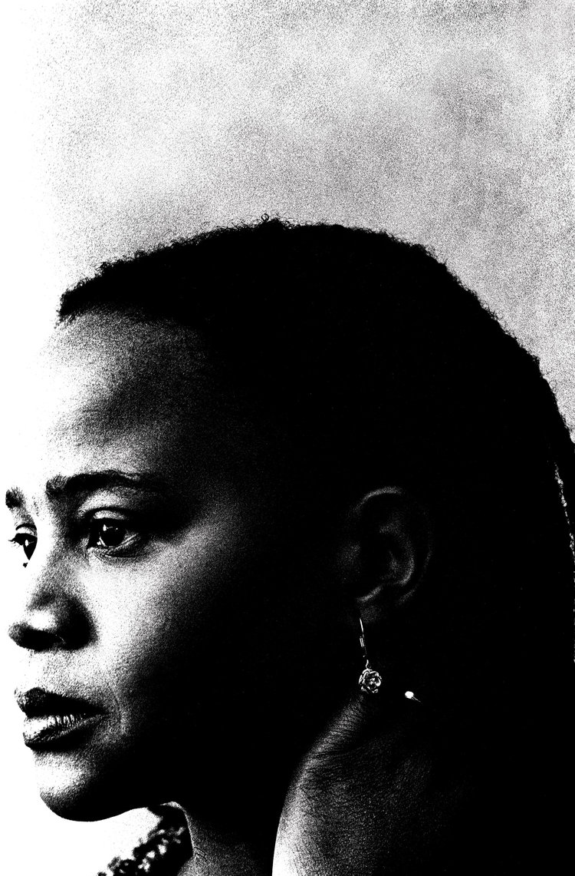
Welcome!
When you write, it’s like braiding your hair. Taking a handful of coarse unruly strands and attempting to bring them unity. Your fingers have still not perfected the task. Some of the braids are long, others are short. Some are thick, others are thin. Some are heavy. Others are light. – Edwidge Danticat
There are other questions on the Welcome page of our site, but let’s focus on this one:
Why does Danticat equate writing with braiding?

Slide 3

Some Thoughts
Go to the Welcome post I wrote. Hopefully, you’ve already read it, but if you haven’t, do so now:
https://openlab.citytech.cuny.edu/pennereng1141sp2020d304wednesday/

Slide 4
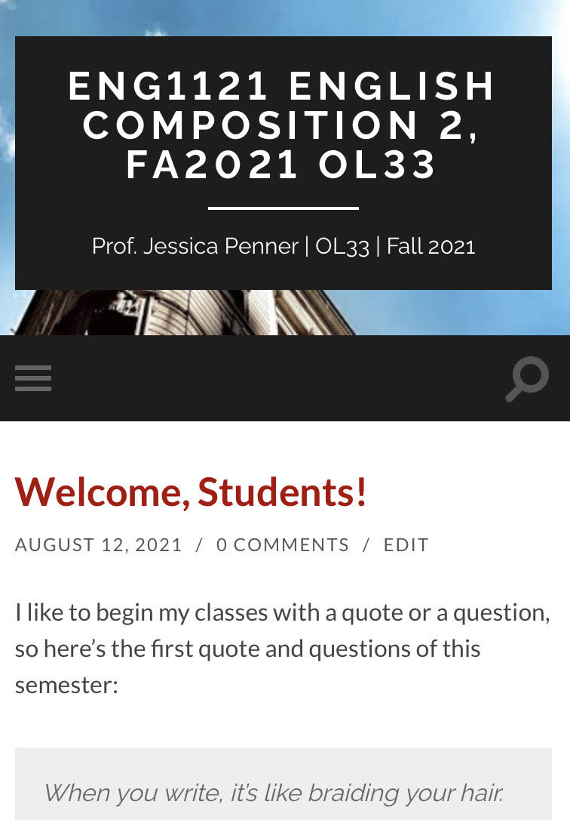

Course Info
Let’s go to the syllabus on our own devices.
  If you’re on a laptop, it’ll look like the image on the bottom.
  If you’re on a cell, it’ll look like the image on the top. (Click on the three gray strips on the left.)
First, find Course Info and then look at Course Descriptions & Policies.
Next, go to Course Schedule.
Now, go to Announcements.
Finally, go to Assignments.

Slide 5

Register/Join OpenLab
Go to https://openlab.citytech.cuny.edu/ on your smartphones or laptops.
If you’ve joined OpenLab, log in.
If you haven’t, sign up now!
Notes:
ECRI
20 min
Say: Everyone, please get out your smartphones! Ask: Has anyone NOT logged in on OpenLab before? Will the students who have logged in please coach the students who have not?

Slide 6
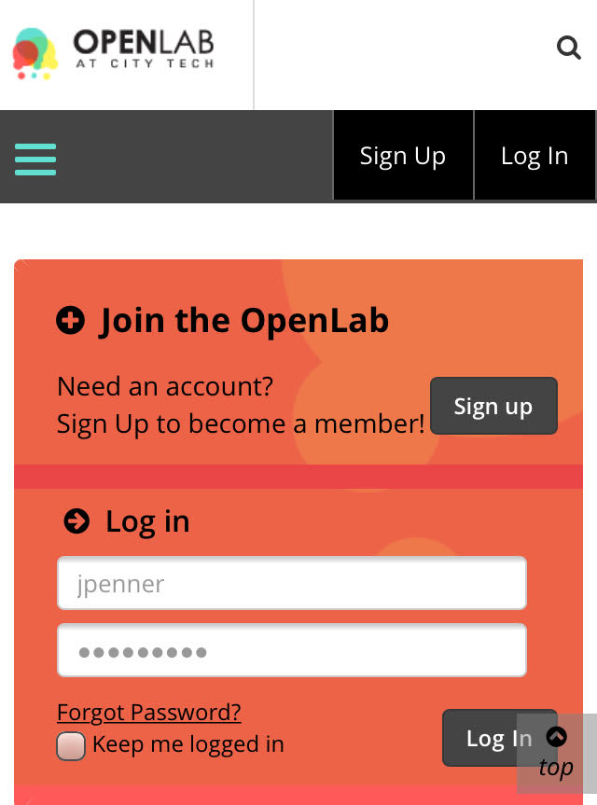
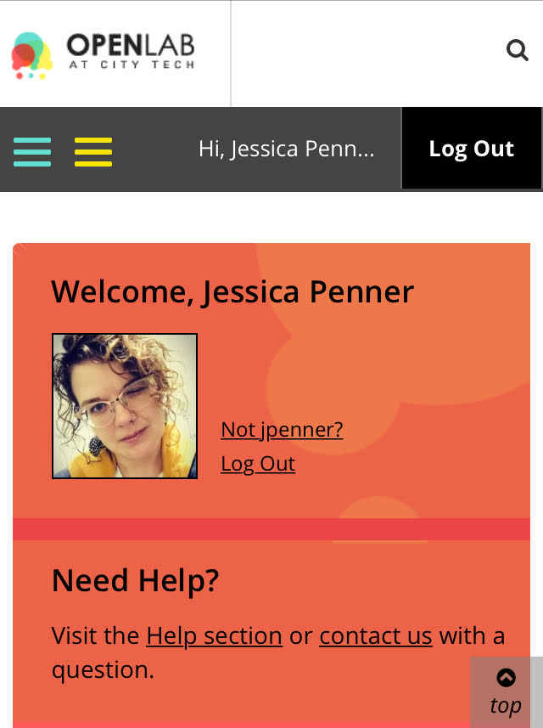
You must use your City Tech-approved email!

Slide 7
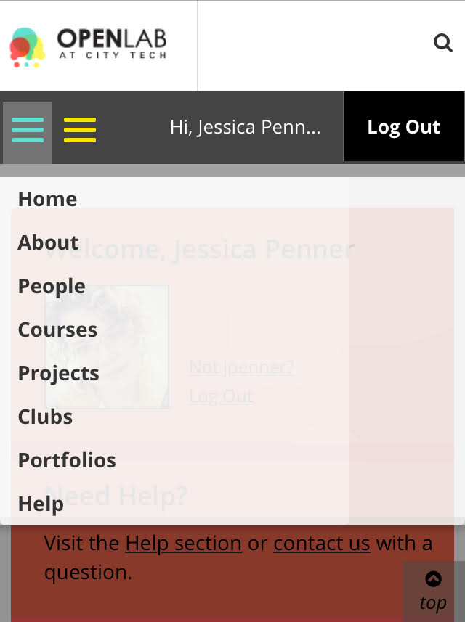
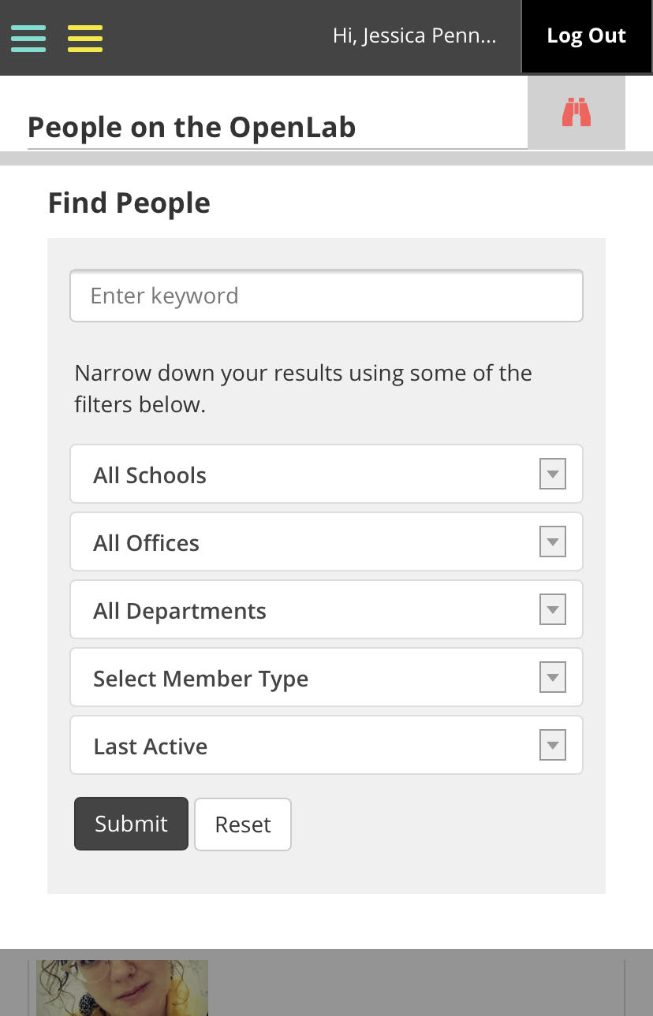
Jessica Penner
The easiest way to find our class is by finding me!

Slide 8
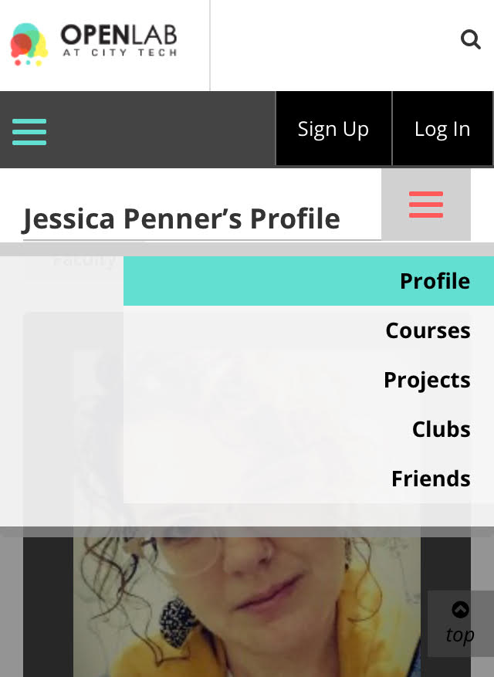

Make sure you join the correct class!
This class has this avatar:

Slide 9
Let’s take a break!
For the next 15 minutes, you can stretch your legs, wander the web, eat a snack (not in the classroom), etc.

Slide 10
Commenting & Posting
First, we’re going to see how to comment on OpenLab. On your device, go to the Discussion page under Student Work.
Next, I’m going to show you how to post your work for this class (hopefully you’ve joined our class—you can’t post work unless you’ve joined).

Slide 11
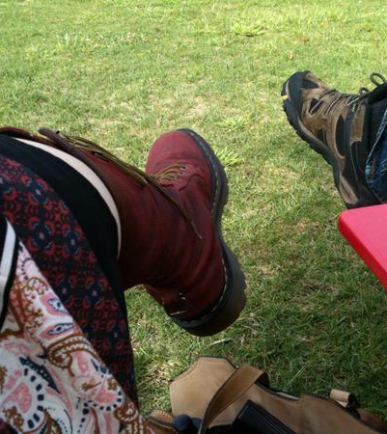
Meet My Feet
Take a minute to review my story and comment in the reply section on what you enjoyed and write a question. (This can be found under Student Work and Discussions.)
When sharing what you liked, be specific! “I liked it,” is nice, but unhelpful. “I liked how you described your pet gerbil,” is much more specific.
When you are giving a critique, formulate questions and give suggestions rather than make judgements.
Judgment: “This is confusing.”
Question: “Can you explain this part more? Perhaps give us a description of your pet?”

Slide 12
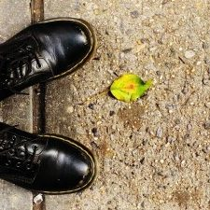
Let’s practice!
Share the story behind your favorite pair of shoes.
After a person’s told their story, give specific compliments and ask questions about the story.
Try to focus on suggestions or ask for specific clarification!
You have 10 minutes total!
Now, we need two volunteers to share shoe stories with the entire class.
Class:
What did you enjoy?
What questions do you have?

Slide 13

Brainstorm your “Meet My _____”
Discovery
When and how did you first receive or encounter the object?
What was your first impression of it?
Who was there?
Description
Describe your object.
What does it look like?
What does it feel like?
What does it smell like?
Meaning
Did you know it was significant from the beginning?
How did your object gain meaning?
Has its meaning changed over time?
Value
What does the object say about you?
What event or person taught you the importance of this object?
Reward
What is the best reward of owning your object?
Conclusion
If you had to give it to someone, who would that be and what would you say to them?
Take some time to answer these questions and start composing your “Meet My _____.”

Slide 14

Need more inspiration?
Object Stories is a personal storytelling project and exhibition series hosted by the Portland Art Museum.
The project has grown the application of storytelling with objects from a way to interrupt the traditional authoritative museum voice into a platform where Portland and the Pacific Northwest’s many communities can directly address issues affecting their lives.
Object Stories helps drive the Portland Art Museum to become a safe and responsive space open for dialogue, conversation, and the exchange of ideas.
Go to the following link on your own device. I’ll give you 5 minutes to listen to the stories shared.
As you listen/watch, pay attention the object in the story and what it means to the storyteller.
Notes:
If time…

Slide 15

Homework
Write your own “Meet My _____.” You can use your shoes or another object that you feel shares something about you. Post it under Memoir on OpenLab and title it Full Name, Meet My ____.”
Read Chapter One from Ann Patchett’s Truth & Beauty.

