Slide 1
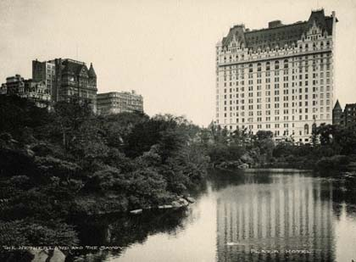
Chapter 3 and 4: Hotel Operations
Prof. Karen Goodlad
Fall 2021

Slide 2
Class Objectives
Identify the scope of the hospitality and tourism industry.
Explore the roles and responsibilities of key executives and department heads in the hospitality industry.
Differentiate hotel classifications.

Slide 3
Travel Blog Barcelona Air BnB…
Industry Research Assignment
Hotel and Lodging Operations Lecture
Small Group Discussion

Slide 4
What about Air B&B?
CBRE Air B&B Study 2017
NY Time Article: Barcelona Takes on AirBnB

Slide 5
U.S. Conference of Mayors Tourism, Hotel and Lodging Survey, 2017
A Historical Perspective
Hotel and lodging businesses are mainstays of their communities, and an important source of quality jobs.
Seventy percent of mayors surveyed said hotel jobs provide the most opportunity, good benefits and wages within the tourism industry.
Hotels support their communities through increased tax revenue, capital investment, tourism-related development and promotion, civic leadership, and charitable contributions and sponsorship.
Hotels benefit the communities in which they operate, with nine out of 10 mayors saying they believe their community would benefit from additional hotels, inns or bed and breakfasts.
One-fifth of all mayors surveyed say tourism and hospitality is the largest sector of their economy – second only to healthcare as a top industry.

Slide 6
Industry Research Assignment
Guided Review
Notes:
Title Page: https://apastyle.apa.org/style-grammar-guidelines/paper-format/title-page
Annotated Bibliography definition: https://owl.purdue.edu/owl/general_writing/common_writing_assignments/annotated_bibliographies/index.html
Ann Bib, Format: https://owl.purdue.edu/owl/general_writing/common_writing_assignments/annotated_bibliographies/annotated_bibliography_samples.html
Reference list: https://owl.purdue.edu/owl/research_and_citation/apa_style/apa_formatting_and_style_guide/reference_list_author_authors.html

Slide 7
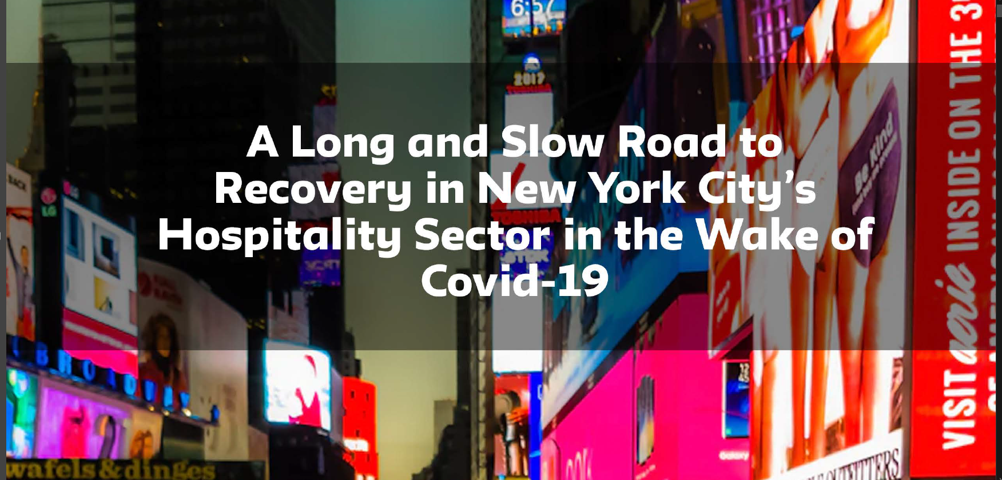

Slide 8
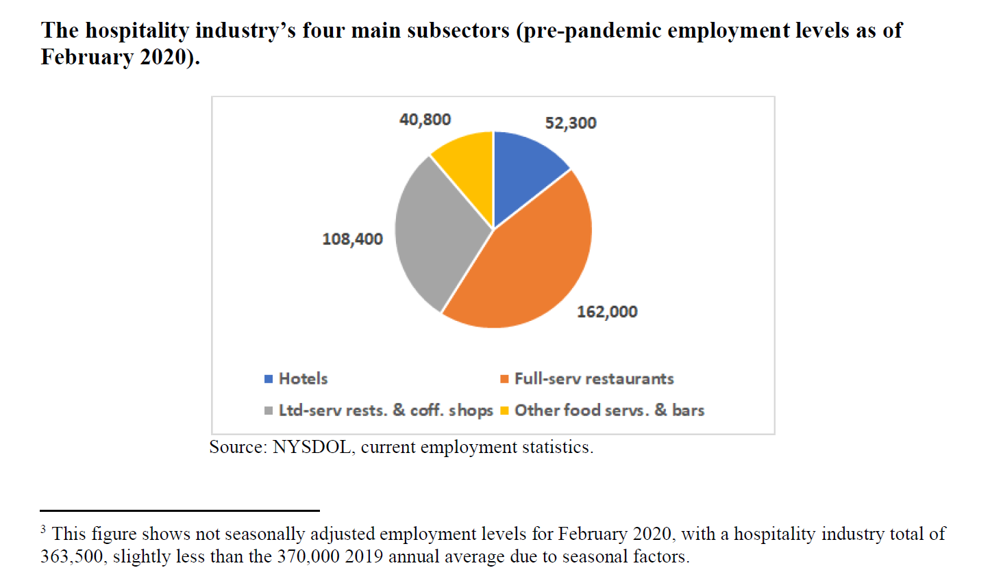
Covid Conversations

Slide 9
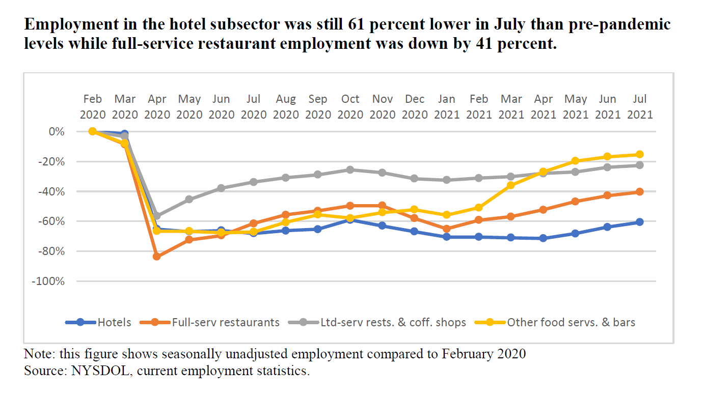

Slide 10
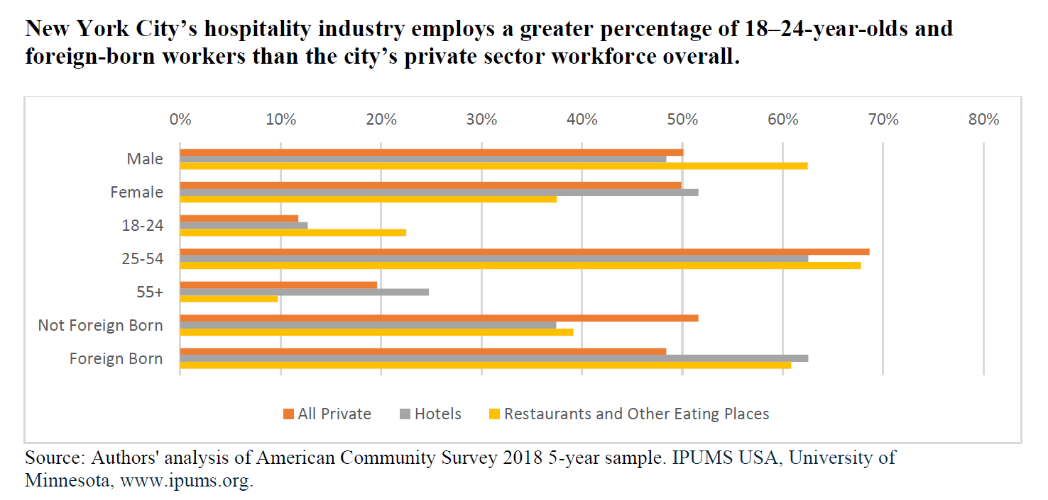

Slide 11
Attendance Check
The TextBook presented information about GMs and said one GM of the Fours Seasons deliberately hired division heads who knew more than he did. Why?

Slide 12
Introduction to the Concierge Assignment
What is a concierge?
Why do we ask that you identify a hotel for this assingment?
Name some NYC tourist attractions.
What makes these attractions significant to tourism in NYC?
Who says so?
Notes:
https://openlab.citytech.cuny.edu/hmgt-eng-fylc-f2021/2021/09/27/concierge-assignment/

Slide 13
The format students will submit their choice of attraction:
  OpenLab
  Reply to the Concierge Assignment post including the name of the attraction, the reference, and a quote with citation,

Slide 14
Some APA Standards for Citations
Library Assistance with APA Standards Found here.
Purdue OWL Assistance with APA Standards Found here.
Oz Clarke, wine writer
  Books: (Clarke, p140, 2008) (Clarke, 2008)
  Articles: (Clarke, p12, 2010) (Clarke, 2010)
  Website: (Clarke, para 4, nd) (Clarke, nd)

Slide 15
What is Plagiarism?
For More Information: http://library.citytech.cuny.edu/instruction/plagiarism/index.php

Slide 16
What is Plagiarism
For More Information: http://library.citytech.cuny.edu/instruction/plagiarism/index.php
Plagiarism is representing someone else's ideas, words, images, music, video, etc. as your own, either intentionally or unintentionally, without citing the source of the information.

Slide 17
Tips for avoiding plagiarism

Slide 18
Tips for avoiding plagiarism
Taking notes (often and early)
Write an outline
Start with the first draft, record all books, articles, websites, and other resources that you consult
Know which citation style your instructor requires (we use APA) and know how to use it
Plan time to complete research, write, and revise
Seek assistance from the research librarian
Utilize the writing tutors

Slide 19
Executive Committee Members
General Manager
Dir. of HR
Dir. of F&B
Dir. of Rooms Division
Director of Marketing & Sales
Dir. of Engineering
Dir. of Accounting

Slide 20
Jam Board
Consider the responsibilities of leading a hotel kitchen staff. What position would you be best at? Why?
Notes:
https://jamboard.google.com/d/1mdgdxlA2d7HyOs4AKoi4QaoZMTyZ38no5AXJC9qcBOQ/edit?usp=sharing

Slide 21
Talk about the chapter…

Slide 22
Covid Conversations
Watch starting at 6 minute mark (gold color on the progress bar)
https://youtu.be/MjAI1ihNLX0

