Slide 1

Public Speaking &
Information Literacy
Prof. Karen Goodlad
Perspectives in Hospitality Management
Fall 2021

Slide 2
Announcements
The City Tech Tea Club will host our first meeting, “Cooking with Tea” on Thursday, September 23 from 12:45-2:00. Register here to join us.
Social Media Accounts to Follow
  HMGT FaceBook: https://www.facebook.com/groups/165674010120641
  HMGT Instagram https://www.instagram.com/citytechhmgt/
  City Tech Facebook: https://www.facebook.com/groups/citytechcuny
  City Tech Instagram: https://www.instagram.com/citytechnews/
Notes:
Tea club: https://us02web.zoom.us/meeting/register/tZArcuCgqjsqGdwEWIv-1JDyVTPaBh6DQ_ET

Slide 3
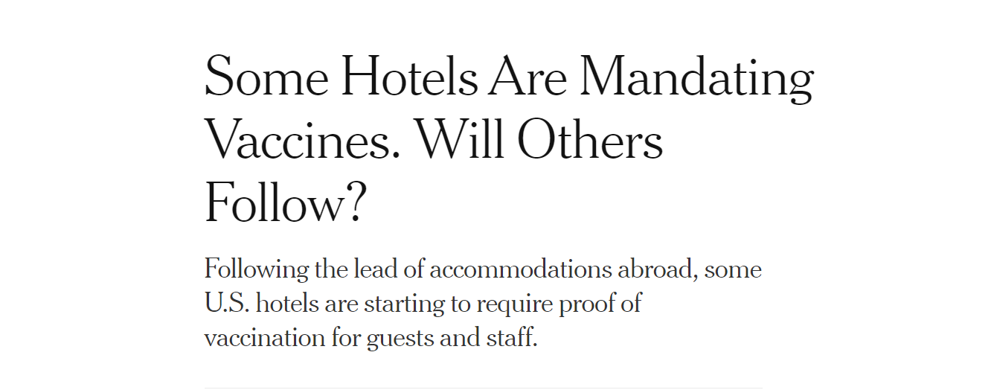
“What is the issue presented in the article?”
“What does the information mean to me as a hospitality professional?”
Notes:
https://www.nytimes.com/2021/08/27/travel/hotels-vaccine-mandate.html

Slide 4
How does a Student Develop “Information Literacy”?
For more information: http://library.citytech.cuny.edu/services/faculty/teaching/instruction.php
Notes:
What is Information Literacy?
An information literate individual can:
• determine the nature and extent of the information needed
• access relevant information effectively and efficiently
• evaluate information and its sources critically
• use information effectively to accomplish a specific purpose
• understand the economic, legal, and social issues surrounding the use of information and access and use information ethically and legally.
(from the Association of College and Research Libraries Information Literacy Competency Standards)

Slide 5
What should you look for when you evaluate information?
Accuracy: Is the information correct? Are the sources (references) cited? Can you verify the information in another source?
Expertise: Who is the author or organization that is responsible for the information? Is the author/organization an expert on the subject? Can you verify their credentials?
Objectivity: Is the information biased in any way? Is the author or organization trying to sell you something or convince you of something? Is the information based on fact or opinion?
Currency: Can you find a publication date for this source? If it's a website, when was the website last updated? Does the information seem relevant or is it out of date?

Slide 6
What Does the Ursula C. Schwerin Library Offer Students?
HMGT Research Guides
Research Appointments
Library services: Ask a librarian

Slide 7
Why use
Books, Journals & Articles
Finding Books on the Library Website
  Are books available on your topic/industry leaner/leading organization?
Finding Articles on the Library Website
  Are articles available on your topic/industry leaner/leading organization?
Hospitality Management Specific Resources

Slide 8
Some APA Standards for Citations
Oz Clarke, wine writer
  Books: (Clarke, p140, 2008) (Clarke, 2008)
  Articles: (Clarke, p12, 2010) (Clarke, 2010)
  Website: (Clarke, para 4, nd) (Clarke, nd)
Library Assistance with APA Standards Found here.
Purdue OWL Assistance with APA Standards Found here.

Slide 9
Individual Activity
Identify a segment of the hospitality industry in which you wish to build your career.
Conduct a google search using a keyword search such as: “Trends in [enter segment of the hospitality industry]”.
Identify three trends you found.
Choose one trend from the above list, enter the trend into the library search tool, share the articles found
  Save this information in a safe place, we will use it again at mid semester.

Slide 10
What is Plagiarism?
For More Information: http://library.citytech.cuny.edu/instruction/plagiarism/index.php

Slide 11
Tips for avoiding plagiarism
Taking notes (often and early)
Write an outline
Start with the first draft, record all books, articles, websites, and other resources that you consult
Know which citation style your instructor requires (we use APA) and know how to use it
Plan time to complete research, write, and revise
Seek assistance from the research librarian
Utilize the writing tutors

Slide 12

A visit From Evelyn
And A Discussion of Self-Advocacy

Slide 13
Public Speaking
“There are always three speeches, for everyone you actually gave. The one you practiced, the one you gave, and the one you wish you gave.”
-Dale Carnegie

Slide 14
Let thy speech be better than silence, or be silent.
-Dionysius Of Halicarnassus

Slide 15

“It usually takes me more than three weeks to prepare a good impromptu speech.”
Link to Professor Davis’ website for information about how to best approach public speaking assignments.
- Mark Twain

Slide 16
Until we meet again
Review the homework page
Schedule time in your calendar to complete your homework

