Slide 1

ENG 1141
Creative Writing
Objectives
Discuss setting & context
Analyze Coates’ work

Slide 2


“No word is absolutely wrong or dirty or insulting. It all depends upon context and intention.”
- Janet Jackson
Do you agree or disagree with Jackson?
Why?

Slide 3

Setting & Context
Think about a specific word that is considered “wrong or dirty or insulting.”
Imagine someone says this word to you or in your presence.
Is there a person/time/place where this word wouldn’t offend you?
Is there a person/time/place where this same word would offend you?
Is this word always offensive, no matter what?
Right there, you’re already thinking about setting and context. We’re going to focus on setting and context and how authors do it in fiction.

Slide 4
Setting & Context
So, what do we mean when we talk about setting and context in literature?
First, watch this YouTube Video.
What’s the setting?
Next, look at this picture.
And these pictures.

Slide 5
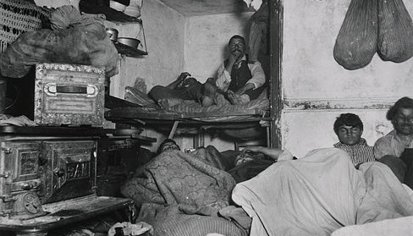
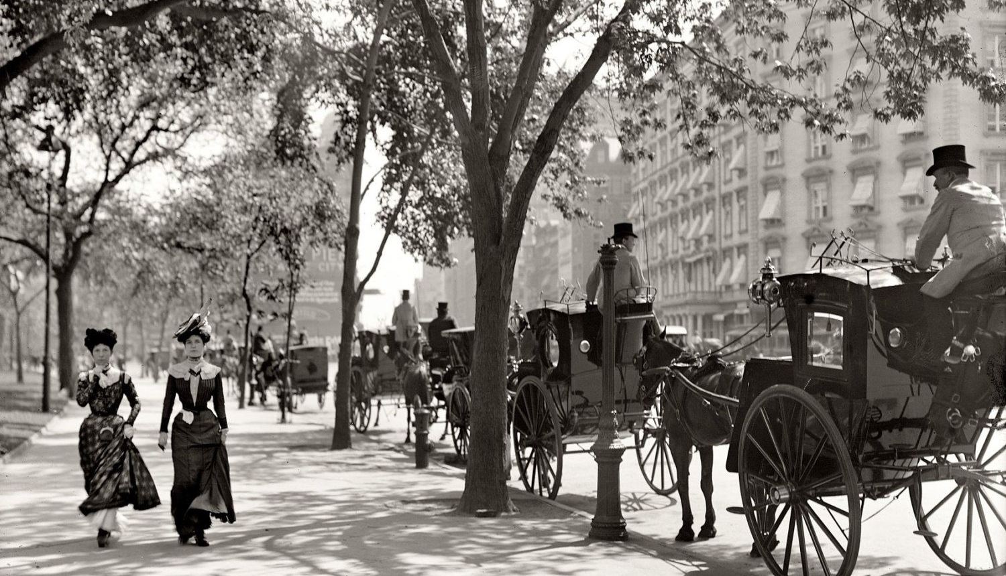
Setting & Context
These pictures were taken around the same time as the pictures shown on YouTube.
The essential setting (NYC in the early 1900s) is the same…
but the context (circumstances) for each picture is different.

Slide 6
Setting & Context
Obviously, these are extreme examples of poverty and wealth (context), not to mention set in a time (setting) none of us have first-hand experience.
Let’s look at two pictures that are more contemporary (setting) and familiar (context).

Slide 7
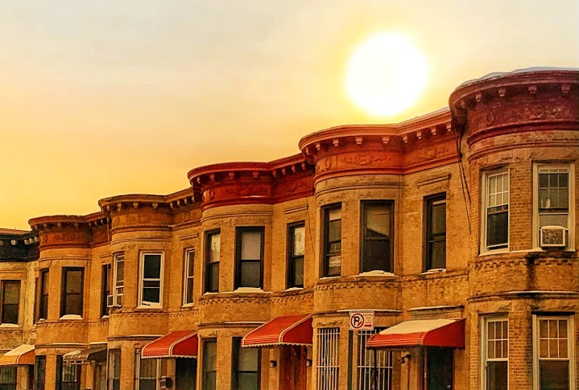
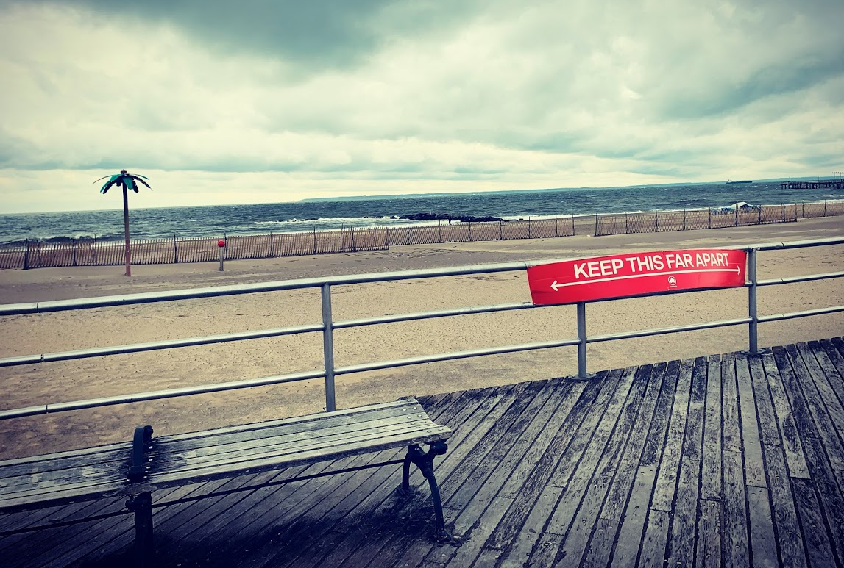
Both are in Brooklyn around the same time (setting), but the context is different (circumstances).
Imagine a story in the left-hand image (two childhood enemies meet in 2020). Now imagine the same story happens in the right-hand image. What’s the same? What’s different?

Slide 8

Consider The Water Dancer
Take a few minutes to think about these questions—don’t post any answers until I ask for them!
What is the setting?
What is one specific clue that helps you decide where/when this novel takes place?
What is the context?
What is one specific clue that helps you decide the circumstances the narrator is in?

Slide 9
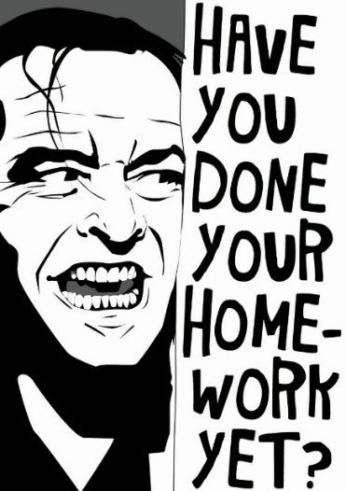
Homework
A critique of Coates’ work. What did you enjoy? What questions/suggestions do you have for the author? Title it Full Name, Coates’ Critique, and post it under Discussions.
Journal Assignment 5: Write about a moment from your past that changed you. It can be a large or small change—but focus on what, exactly, happened and how you changed. Title it Full Name, Journal #5 and save it under the category Journals only by 11:59 on Tuesday, October 26.
Respond to your Cohort’s work by 11:59 PM on Tuesday, October 26 and email it to them and me. (Remember, these critiques are worth 10% of your overall grade!)
On Thursday, October 28, students will…

