Slide 1

ENG 1141
Creative Writing
Objective
Practice speed writing with POV in mind
Notes:
Materials

Slide 2
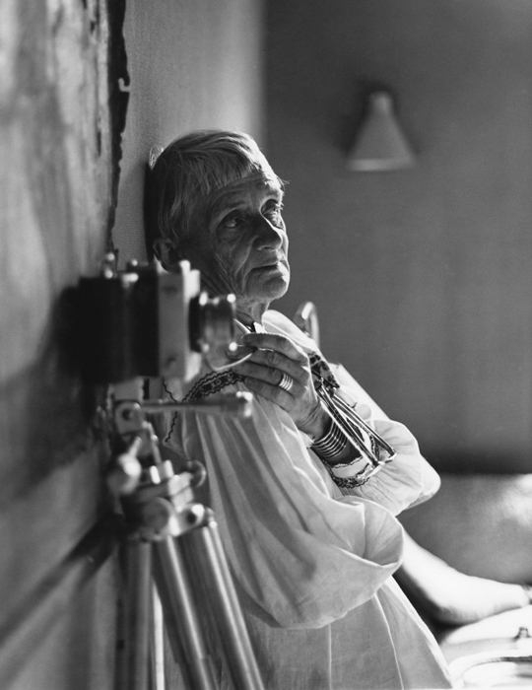
While there is perhaps a province in which the photograph can tell us nothing more than what we see with our own eyes, there is another in which it proves to us how little our eyes permit us to see.
― Dorothea Lange
We’re going to write a short story today, but first, we’ll do a warm-up activity to prepare you!

Slide 3
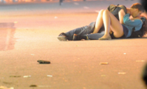
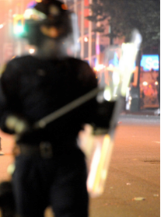

Who is involved?
What is happening?
Why is this happening?
When did this happen?
Where did this happen?
Adapted from http://youthandmedia.org

Slide 4
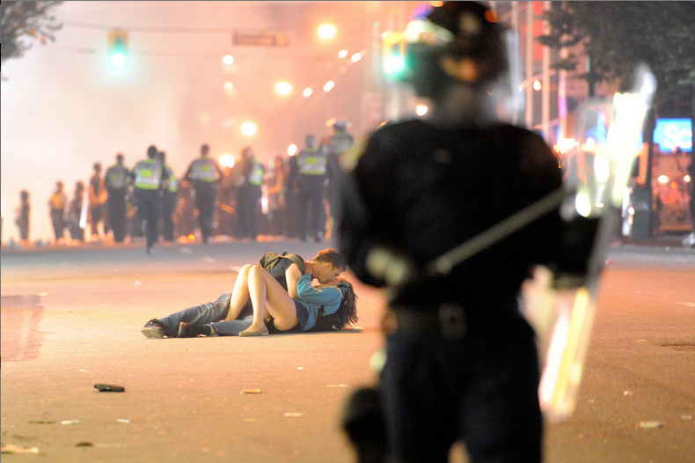
Now, what do you think happened?
Has your interpretation changed, now that you’re seeing the whole picture? Why or why not?
What does this tell us about POV?
Adapted from http://youthandmedia.org

Slide 5

A Picture Worth a Thousand Words
Get ready to write!
First, go to the URL in the chat box:
https://openlab.citytech.cuny.edu/groups/eng1141-creative-writing-fa2021-ol20/files/?category=41649
POV Story, Group A (Last name A through H)
POV Story, Group B (Last name I through N)
POV Story, Group C (Last name O through Z)

Slide 6
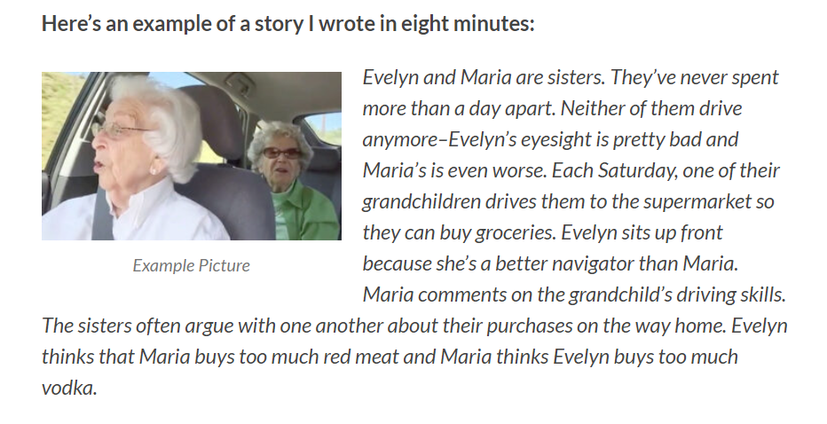
Remember this story from the Assignment page?
You have 20 minutes to examine your picture and create a short story based on what you see. Keep these questions in mind to help you:
  Who is involved?
  What is happening?
  Why is this happening?
  When did this happen?
  Where did this happen?

Slide 7

Directions
Look at your picture.
Write a short (very short) story in the Third Person about the picture (again, 150-300 words).
Answer the questions in your story and post it under Assignment Posts. Title it: Full Name, POV Story for Picture ___ under Assignment Posts. (Be sure to insert A, B, or C in the blank space.)
Who is involved?
What is happening?
Why is this happening?
When did this happen?
Where did this happen?

Slide 8
A Picture Worth a Thousand Words
When time is up, go to the Assignment Posts (under Student Work) and read at least three stories that weren’t in your letter group!
That means if you are in Group A, find stories that were in Group B or C. If you’re in Group B, find stories that were in Group A or C, and so on.
Comment on the stories. What did you enjoy? What questions/suggestions do you have for the author?

Slide 9

Homework
Finish writing a short story based on your Journal 4 entry. Remember, you must tell it in Third Person and write 350-400 words!
By Thursday, create a post, title the story Full Name, Short Story 1, and save it under the category Short Stories.
By Thursday at 11:59 PM: Send the link to your short story to your Cohort and review your Cohort’s work. Remember to email it to your Cohort and me (creative.writing.citytech2@gmail.com). People may have been added to your Cohort, so be sure to check the page with the names of students.
It is YOUR responsibility to send your short story link to your Cohort. If your Cohort doesn’t receive anything from you, they aren’t responsible for your story.
Read and respond to your Cohort’s stories by the due date under “WRITE,” using the worksheet on the Course Profile, titled “ENG1121 Critique for Short Story 1.”
Journal Assignment 5: Write about a moment from your past that changed you. It can be a large or small change—but focus on what, exactly, happened and how you changed. Title it Full Name, Journal #5 and save it under the category Journals only by 11:59 on Tuesday, October 26.
Respond to your Cohort’s work by 11:59 PM on Tuesday, October 26 and email it to them and me. (Remember, these critiques are worth 10% of your overall grade!)
Read Chapter One from Ta-Nehisi Coates’ The Water Dancer.

