Slide 1

ENG 1141
Creative Writing
Objectives
Compare the narrators of “The First Day” and “The Wife’s Story”
Discuss Point of View in fiction
Quick discussion about cohorts

Slide 2

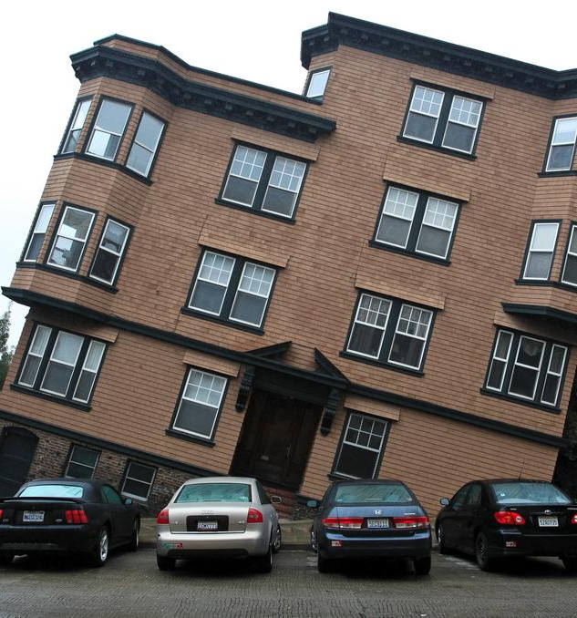
“We don't see the world as it is, we see it as we are.”
– Origin of the quote is unclear
Imagine that the narrator of “The First Day” is the mother, rather than the daughter.
All the actions shared by the mother and daughter are the same.
Briefly write a response in the chat box:
Would the story be told differently? Explain why or why not.
What about “The Wife’s Story”? What if the narrator was the husband, rather than the wife?
Again, briefly write a response in the chat:
Would the story be told differently? Explain why or why not.

Slide 3

Point of View
Point of view is the eyes through which we see a story.
Whether you’re reading literature, watching/reading/hearing the news, or listening to someone speak, ask yourself:
Who is telling this story?
What does this character see and know?
How does this character’s perspective shape my understanding of events?

Slide 4
Point of View
Go to the Google Doc I’ve put in the chat box:
https://docs.google.com/document/d/1Ufpvt14mco5U-OPLENDKUsRF8k_F2nuvxI9Qc0cDtH8/edit?usp=sharing
There are questions in red on this worksheet. There are three sections.
I’ll give you a short amount of time to work individually before we discuss the answers as a class.
Overall, I’m giving you 20 minutes for the entire worksheet. The times in blue are the recommended amount of time for each section. (Hint: don’t spend a ton of time on any section!)
Be sure to write your name before each answer! (This will count as your attendance/participation points for the class.)
If you’re using a phone for class today, write your answers in your notebook and send a screenshot to me.

Slide 5
Point of View
First Person
Example #1:
  What’s the present age of the narrator? Are they sharing the story right when it happens, or later?
Example #2:
  What’s the present age of the narrator? Are they sharing the story right when it happens, or later?
  Why is the present age of the narrator and when they share the story important?
  Define “First Person.”

Slide 6

Reliable vs. Unreliable Narrators
With an unreliable first-person narrator, there’s a gap between what the narrator says and what the reader believes to be the truth.
“Unreliable” doesn’t mean the narrator isn’t telling the truth. It means their version of the story may not be entirely accurate. (Of course, as in life, there may be unreliable narrators that are deliberately lying for various reasons.)
“The First Day” and “The Wife’s Story” are told in first person. Are these narrators reliable or unreliable? Why?

Slide 7
Point of View
Third Person
Example #1:
  How is this passage the same as the previous first-person examples?
  How is it different?
Example #2:
  How is this passage different from the previous third-person example?
  Define “Third Person.”

Slide 8

How to write you first fictional short story, using Journal 4:
  If you used the first option (write about a constant disagreement you’ve had with someone), write about the disagreement from their POV. Focus on the character traits of this individual–action, dialogue, appearance, and thought–that explains why they may disagree with you–the opposition.
  If you used the second option (go to a public space where you can practice social distancing and politely people watch for at least 10-15 minutes), choose one of the people you saw and create a “day in the life” of that person. Focus on plot–get the person up a tree, throw rocks at them, and then get the person down.
  If you used the third option (who is in your clan/network/tribe/family?), choose two of those people and put them in a difficult situation together. A few ideas: out of gas in the middle of nowhere, locked out of their apartment, spending a holiday with just the two of them, waiting for another friend in the freezing cold or sweltering heat (you get the picture). You can focus on both the character traits and plot.
  The only requirements are:
    The story must be at least 350-400 words long
    Told in the Third Person POV! (No “I”–only “he/his,” “she/her,” or “they/their.”)

Slide 9

Cohorts
Why do you think we have cohorts?
Some students either didn’t send their Cohort links to their drafts to be peer reviewed or that peer reviews were turned in past the due date.
This activity is not optional or “busy work.”
  This shows that you are reading work and applying the topics we discuss in class to real life by using the guided peer review sheets.
  This also is a way to learn how to self-critique your own work, which is a great skill to have when you’re applying to jobs or working on a project that you want to impress your future boss with!
It is worth 10% of your overall grade to
  1) email your link by the due date to your cohort and
  2) peer review your cohort’s work and send it back to them (and me) by the due date!
10% may not seem like a lot, but it’s the difference between an A and a B, a B and a C, etc.
For those that are doing the peer reviews and turning them in on time: Keep up the good work!
For those who are having trouble keeping up with this part of the class, there’s still time to improve, but the semester is nearly half over!

Slide 10
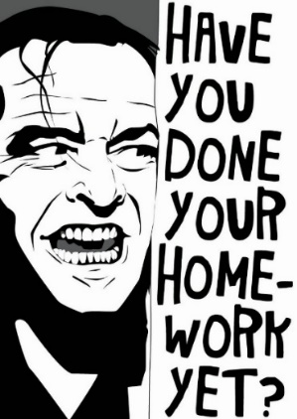
Homework
Revise your second memoir and post it under Memoir by 11:59 PM on Tuesday, October 12. You can revise the version you’ve already posted, just be sure to title it Full Name, Memoir 2 (Revised).
Write a paragraph critique of Le Guin’s work. What did you enjoy? What questions/suggestions do you have for the author? Title it Full Name, Le Guin Critique. Post it under Discussions. This is due by 11:59 on Thursday, October 14.
Work on your first short story. The first draft is due October 21.

