Slide 1

ENG 1141
Creative Writing
Objectives
Discuss POV in fiction (or any genre)
Share your memoir writing

Slide 2
“The First Day,” by Edward P. Jones
In an otherwise unremarkable September morning, long before I learned to be ashamed of my mother, she takes my hand and we set off down to begin my very first day of school. I am wearing a checkeredlike blue-and-green cotton dress, and scattered about these colors are bits of yellow and white and brown. My mother has uncharacteristically spent nearly an hour on my hair that morning, plaiting and replaiting so that now my scalp tingles. Whenever I turn my head quickly, my nose fills with the faint smell of Dixie Peach hair grease. The smell is somehow a soothing one now and I will reach for it time- and time again before the morning ends. All the plaits, each with a blue barrette near the tip and each twisted into an uncommon sturdiness, will last until I go to bed that night, something that has never happened before. My stomach is full of milk and oatmeal sweetened with brown sugar. Like everything else I have on, my pale green slip and underwear are new, the underwear having come three to a plastic package with a little girl on the front who appears to be dancing. Behind my ears, my mother, to stop my whining, has dabbed the stingiest bit of her gardenia perfume, the last present my father gave her before he disappeared into memory. Because I cannot smell it, I have only her word that the perfume is there. I am also wearing yellow socks trimmed with thin lines of black and white around the tops. My shoes are my greatest joy, black patent-leather miracles, and when one is nicked at the toe later that morning in class, my heart will break.

Slide 3
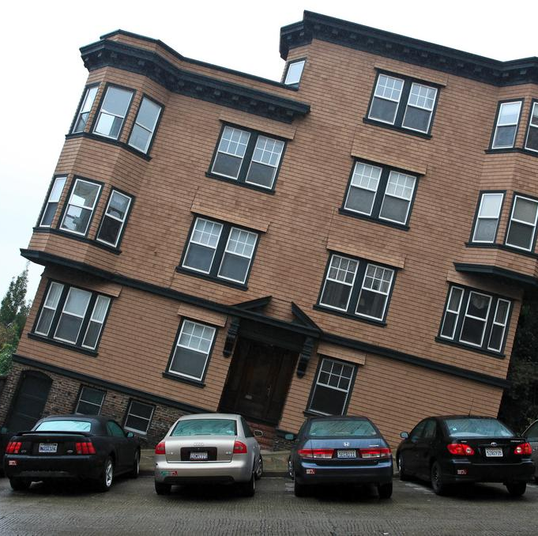
POV in Fiction
What is the point of view of the narrator? (First person? Third person?) How do you know?
What is the age of the narrator when the story occurs? How do you know?
What is the age of the narrator when they share this story? How do you know?
What time period do you imagine this story takes place? (Present, 1990s, 1970s, or a different time?) What are the clues to your guess?

Slide 4

Reading!
I’m going to put you in breakout rooms in a moment.
Share one of your memoirs (either the “Meet My ___” or Memoir 2) with your group.
Read them out loud to each other! You’ll have 20 minutes, so that’s about 5 minutes per person!
Be sure to clap or snap after each person reads—this is a time to celebrate!

Slide 5
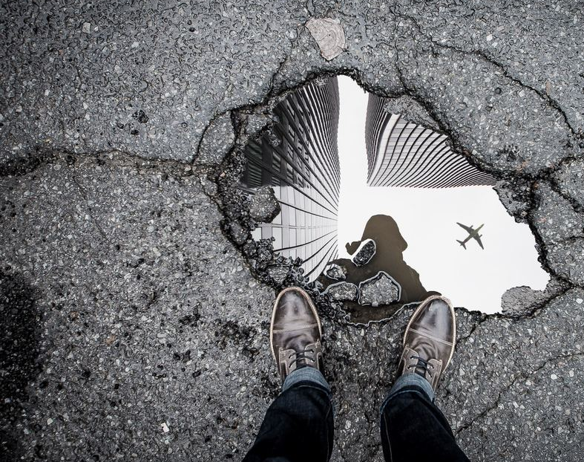
Transition to Fiction
How is fiction similar to nonfiction/memoir?
How is it different?
Have you ever written a short story before?
Was it a good experience? Why or why not?

Slide 6
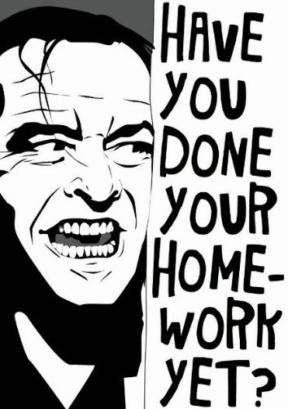
Homework (also on the Assignment page)
Journal Assignment 3: Reflect on your experience with memoir writing—good, bad, so-so, and why. Title it Full Name, Journal #3. Post it under Journals by 11:59 PM on Wednesday, October 6. (This assignment will be helpful at the end of the semester!)
A brief paragraph critiquing Jones’ work. What did you enjoy? What questions/suggestions do you have for the author? Post it with your Full Name, Jones Critique under Discussions by 11:59 PM on Wednesday, October 6.
By 11:59 on Thursday, October 7, students will: Journal Assignment 4. Choose ONE of the four prompts on the Assignment page; title it Full Name, Journal #4 under Journals. (This assignment will help you write your first short story!)
Read Ursula K Le Guin’s “The Wife’s Story” by class time on Tuesday, October 12.
Revise your second memoir and post it under Memoir by 11:59 PM on Tuesday, October 12. You can revise the version you’ve already posted, just be sure to title it Full Name, Memoir 2 (Revised).

