Slide 1

ENG 1141
Creative Writing
Objectives
Discuss character in memoir (or other genres)
Analyze Gurba’s characterization

Slide 2
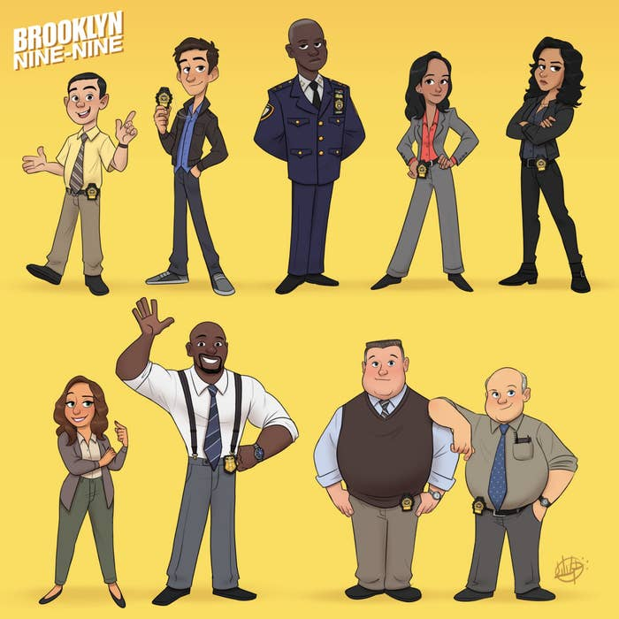
Brainstorm
What are your favorite characters from literature, television, or film?
Why are they your favorite?
Type your answers in the chat box (or say them out loud).

Slide 3
Character in memoir (or other genres)
There are four ways that a writer can show a reader a character’s personality: action, dialogue, appearance, and thought.
Go to the document I’ve put in the chat box:
  https://docs.google.com/document/d/1VeSJ12BdHJwYqNS3rEqXeCY1NLHd6x6_/edit?usp=sharing&ouid=114859666301185600515&rtpof=true&sd=true
There are four pages with four questions. Respond to all four (write your name before your answer).
Focus on the questions about the quotes and be ready to discuss your responses with the class.
You have 20 minutes!
Notes:
https://docs.google.com/document/d/1VeSJ12BdHJwYqNS3rEqXeCY1NLHd6x6_/edit?usp=sharing&ouid=114859666301185600515&rtpof=true&sd=true

Slide 4

Action
One Sunday Connie got up at eleven—none of them bothered with church—and washed her hair so that it could dry all day long in the sun. Her parents and sister were going to a barbecue at an aunt's house and Connie said no, she wasn't interested, rolling her eyes to let her mother know just what she thought of it.
  Joyce Carol Oates, “Where Are You Going, Where Have You Been?”
What have we learned about Connie through her actions?

Slide 5

Dialogue
“Who is speaking?” a woman demanded. Her voice was bold and clamorous.
“Yes, good afternoon, madame. I am calling about the room for rent.”
“Harvard or Tech?”
“I beg your pardon?”
“Are you from Harvard or Tech?”
Gathering that Tech referred to the Massachusetts Institute of Technology, I replied, “I work at Dewey Library,” adding tentatively, “at Tech.”
“I only rent rooms to boys from Harvard or Tech!”
“Yes, madame.”
  Jhumpa Lahiri, “The Third and Final Continent”
What do we learn about the woman through their conversation?
What do we learn about the narrator?

Slide 6

Appearance
Today Charis is wearing a sagging mauve cotton jersey dress, with a fuzzy grey cardigan over top and an orange-and-aqua scarf with a design of meadow flowers draped around her neck. Her long straight hair is grey-blonde and parted in the middle; she has her reading glasses stuck up on top of her head.
  Margaret Atwood, The Robber Bride
What do Charis’ physical features and fashion choices tell us about her?

Slide 7

Thought
Morse found it nerve-racking to cross the St. Jude grounds just as the school was being dismissed, because he felt that if he smiled at the uniformed Catholic children they might think he was a wacko or pervert and if he didn't smile they might think he was an old grouch made bitter by the world, which surely, he felt, by certain yardsticks, he was. Sometimes he wasn't entirely sure that he wasn't even a wacko of sorts, although certainly he wasn't a pervert. Of that he was certain. Or relatively certain.
  George Saunders, “The Falls”
What do we learn about Morse by seeing his innermost thoughts?

Slide 8
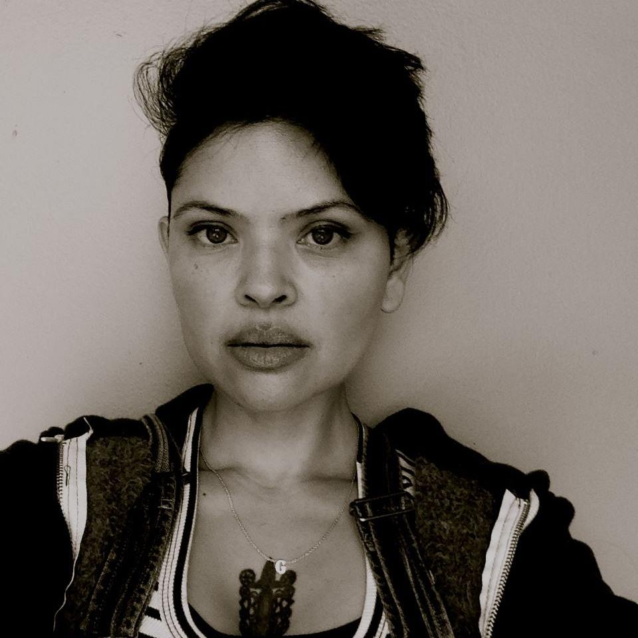
When I tell gringos that my Mexican grandfather worked as a publicist, the news silences them.
Shocked facial expressions follow suit.
Their heads look ready to explode and I can tell they’re thinking, “In Mexico, there are PUBLICISTS?!”
I wryly grin at these fulanos and let my smile speak on my behalf. It answers, “Yes, bitch, in México, there are things to publicize such as our own fucking opinions about YOU.”
How does this quote share the narrator’s character?

Slide 9
A Deeper Look @ Gurba’s Work
Open your copy of Gurba’s work.
Think about the four ways we’ve discussed how author’s share character through action, dialogue, appearance, and thought.
Brainstorm how Gurba shares her personality (character) in this piece in these four ways.
Find specific moments in the essay where she does this!

Slide 10
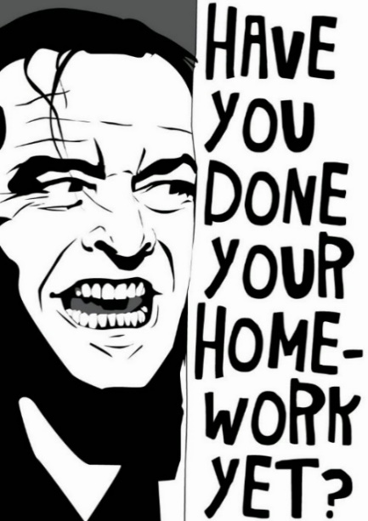
Homework
Continue working on your BRAND NEW, never before seen by this class memoir piece!
On Thursday, September 30, please do the following by 11:59 PM: Send the NEW memoir piece for your Cohort to respond to.
  Be sure to post it first. Title it Full Name, Memoir 2 and post it under Memoir.
  Email the link to your Cohort members and me at creative.writing.citytech2@gmail.com.
  Refer to the Google Doc that has our Cohorts listed–there are a few changes since “Meet My X.”
By class time on Tuesday, October 5, please do the following:
Critique your Cohort’s work using the “ENG1141 Critique for Plot in Memoir 2,” which is found in the Course Profile.
DO NOT just comment on peers’ posts. You MUST use the document listed above!
Email this document to your Cohort and me at creative.writing.citytech2@gmail.com.

