Slide 1

ENG 1141
Creative Writing
Objectives
Discuss the genre of memoir & examples
Discuss first round of workshopping
Notes:
Materials:
Index cards for late-comers

Slide 2

While Lucy and I would later revise our personal history to say we had been friends since we met as freshmen, just for the pleasure of adding a few more years to the tally, the truth was we did not know each other at all in college. Or the truth was that I knew her and she did not know me. – Ann Patchett
Consider these questions and share out loud or in the chat box:
How does this quote help us define “memoir”?
Should we expect memoirs to be factual?
Why or why not?

Slide 3

“Whatever happened to ___”
by Anonymous
Truth & Beauty,
by Ann Patchett
People ask why a judge would reach this verdict, contrary to all law. I have no answer. A fast, single internet search shows that the judge, too, once held a flicker of a dream of being a writer. She mentioned the lost dream, in an interview.
By the time I was forced into her courtroom … Her dream had fizzled, possibly decades before.
Court was a cult of patriarchy. Writing, while female, was an offense.
I do not remember our love unfolding, that we got to know one another and in time became friends. I only remember that she came through the door and it was there, huge and permanent and first. I felt I had been chosen by Lucy and was thrilled. … She had a habit of pitching herself into my arms like a softball without any notice. She liked to be carried.
What do these memoirs have in common?
How are they different?
Do you prefer one over the other? Why?
How can reading these two examples help you in your own memoir writing?

Slide 4

Workshop Experience
Take a few minutes to think about the following questions. Write down your answers (privately at first—we’ll have time to share with the class later):
What worked for you?
What needs improvement?
What will you do differently next time?
What more do you need from others in this process?

Slide 5

What now?
When you receive critiques of your writing (any writing), what do you do with them? Be honest!
Do you have a process to your revision of writing? Why or why not?
Are there people you listen to more than others? Why?

Slide 6
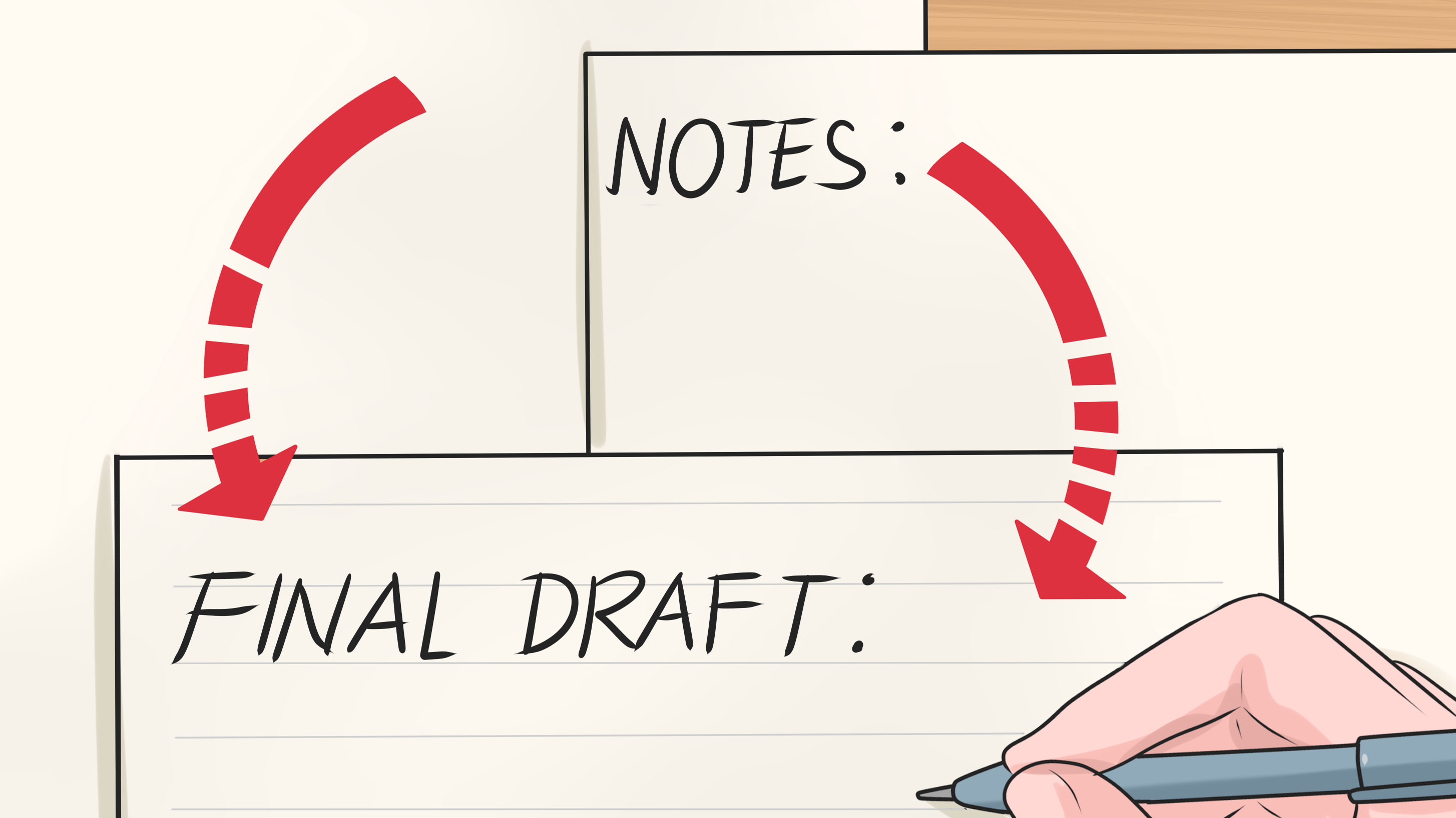
Some suggestions…
First, take a little step back from it and work on something else.
Second, review any questions and suggestions with an open mind.
Third, try out the advice that you don’t agree with, and just see if it does anything.

Slide 7

Cohort Participation
I noticed that some of you haven't participated in your cohort for this class.
Either you never submitted a “Meet My X” on OpenLab or you haven’t emailed me the critiques of your cohort’s work.
This is not an optional activity.
Submitting your work and critiquing your cohort's work earns you points for the course and is a way to improve your writing.

Slide 8
Cohort Participation
If you've been critiquing your classmates' writing, keep up the good work!
However, if you haven't, please critique your Cohort's work by 11:59 PM TONIGHT and email it to them and me.
You MUST use the worksheet I provided on the Course Profile page. Commenting on someone’s post does not count.
If you didn’t submit a “Meet My X,” do so by 11:59 PM TONIGHT and I’ll put you in a cohort for your next writing assignment.
If you’re having trouble keeping up with the work, come to an office hour and talk to me about it. Know that you’re not alone!

Slide 9
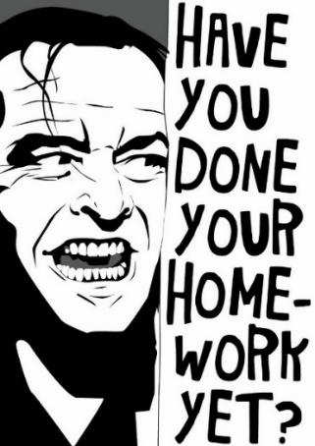
Homework
Revise “Meet My ____” for my evaluation. Post it under Memoir (note this is a different category than it was originally posted) by 11:59 PM on Thursday, September 16.
A critique of Anonymous’ work. What did you enjoy about the work? What questions do you have for the author? Post it under Discussions. Title it Full Name, Anonymous’ Critique. Critiques are due by class time on September 21.
I’ll be posting about other homework on Friday, but glance at the course schedule for a hint of what’s coming!

