Slide 1

ENG 1121
English Composition 2
Objectives, Part 1
Review MLA formatting for quotes
Review formatting for U1 speech or letter
Prepare your speech or letter for peer review

Slide 2

Speech or Letter? Why?
In the chat box, write whether you’re writing a speech or letter and briefly state why.
This is how I’m taking attendance, so everyone needs to participate. ☺

Slide 3

MLA Formatting for Quotes
Let’s go to Purdue OWL to review how to format quotes in either speeches or letters.
This link is on the Agenda for Week 7!

Slide 4
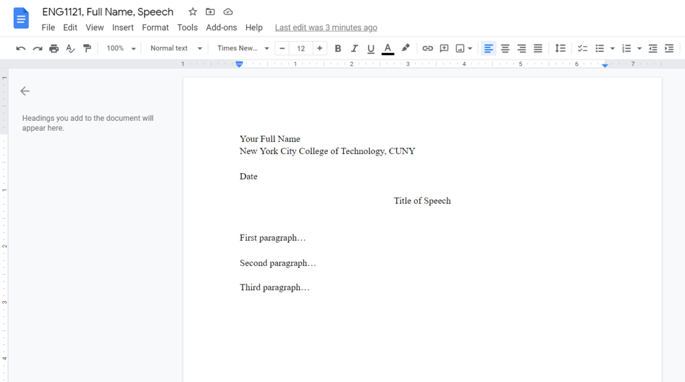
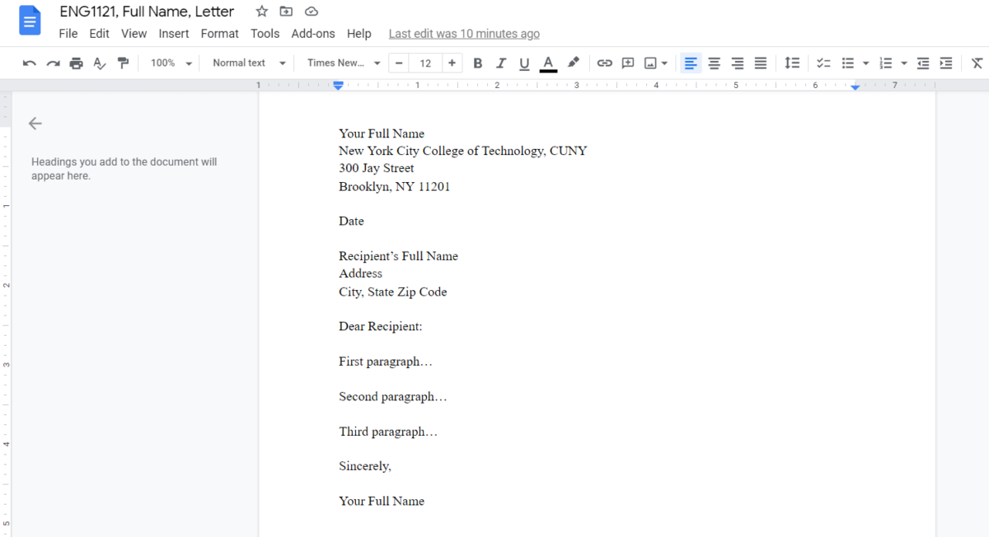
Speech & Letter Format
For both, you must create your document with 1-inch margins, double space the body of the text, and use 12-point Times New Roman font.
Your speech or letter needs to be at least 1,000 words (2-3 pages).
All this info is on the Agenda for Week 7.

Slide 5
Write!
For the remainder of part 1 class time, work on your own project as you see fit to get it ready for the peer review session in part 2.
  If you need to write, do that. If you need to do some research, do that. If you need to format your work, do that. If you have questions for me, do that. (Note the main idea here!)
Do not leave our Zoom class.
At about 7:05, I’m going to ask a question. Be ready to answer!

Slide 6

Quick Question
What is one thing you’ve learned about your discourse community, the issue you’re addressing, or yourself as a writer during this project?
Put it in the chat box.
Notes:
https://www.facebook.com/ICTexploration/

Slide 7
ENG 1121
English Composition 2
Objective, Part 2
Peer Review!

Slide 8
Speech! Letter!
Open an email and put your speech or letter in it as an attachment.
To earn your 50 points for this first draft, put me as a “cc” and be ready to add your future partner’s email in the “to” in a few minutes.
My email: eng1121.citytech2@gmail.com
If you don’t have a letter or speech to be peer reviewed, let me know now. You can privately message me.

Slide 9
Peer Review!
Go to the Course Profile on OpenLab.
Find “Peer Review Worksheet for Unit 1.”
Download a copy NOW.
While you’re waiting for a partner, review the worksheet.
You must fully complete this document and email it to your partner and me by the end of class.

Slide 10
Speech! Letter!
I’ve created breakout rooms for groups of 2 or 3. Before I open them up, know that you must:
email your speech or letter to your partner—get their email as soon as you go to your rooms;
DO NOT just copy and paste your work into an email—attach the document or the link to the Google doc in the email;
if your partner doesn’t respond to you within a minute of joining the breakout room, please exit and I’ll put you with another group;
if you accidentally get knocked out of Zoom, come back ASAP;
if you’re in a group of 3, you’ll have to discuss who will peer review whose work—for example, A will review B, B will review C, and C will review A.

Slide 11
Peer Review!
You must fully complete this document and email it to your partner and me.
My email: eng1121.citytech2@gmail.com
This is how each of you seal those 50 points for U1, so 1) don’t forget to do this before you go to the next thing, and 2) make sure your partner does the same!

Slide 12
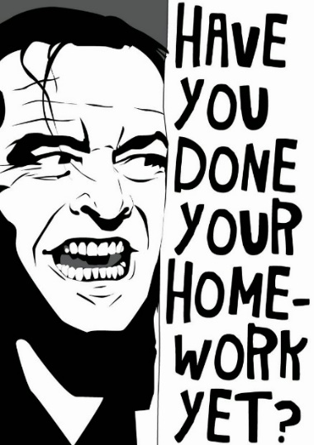
Homework
Continue working on your draft of your letter or speech.
The final draft is due by 11:59 PM on Wednesday, October 13.
“Where do we submit?” you may be asking yourself and others. All will be answered in Friday’s Announcement and Agenda for Week 8.
If you want me to look at your draft, come to an office hour on Thursday or Tuesday and be ready with specific questions!

