Slide 1

ENG 1121
English Composition 2
Objectives, Part 1
Discuss Wollstonecraft’s work
Discuss Young’s work
Discuss how they shared their DCs & issues in different genres

Slide 2

No tears in the writer, no tears in the reader. No surprise in the writer, no surprise in the reader.
– Robert Frost
We often hear the word “strategy” in reference to gaming or business, but there are writing strategies as well.
What you think a “writing strategy” is?
Give an example of a writing strategy.

Slide 3

Prep for Discussion
Before we discuss the two assignments for today, we’re going to spend some time thinking individually.
I put a shared Google Doc link in the chat box: https://docs.google.com/document/d/1PNz0foJlHuclRgK7QKa353E7YomW-N3EQUUM8tUk7OA/edit
Click on it and answer the questions for Discussion #1 and Discussion #2.
You have 15 minutes to answer both sets of questions.
This activity will help with today’s homework, so participation is crucial!
Notes:
https://docs.google.com/document/d/1PNz0foJlHuclRgK7QKa353E7YomW-N3EQUUM8tUk7OA/edit

Slide 4

Small Group Discussion
I’ve divided the class into small groups to discuss your answers.
Each group needs to choose a speaker for our larger class discussion after this activity.
You have 10 minutes.

Slide 5
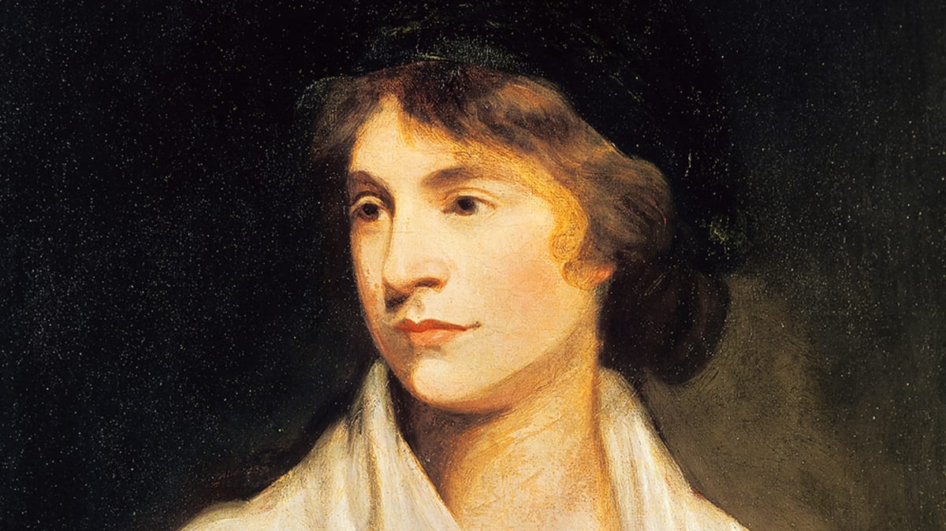
Discussion #1
What is Wollstonecraft’s discourse community?
What’s the issue she is sharing about her discourse community?
Who is the intended audience?
What is one strategy she uses to persuade her audience?

Slide 6

Discussion #2
What is Young’s discourse community?
What’s the issue she is sharing about her discourse community?
Who is the intended audience?
What is one strategy she uses to persuade her audience?

Slide 7

The Power of Language
Answer out loud or put it in the chat box:
Which did you feel more connected with: the letter or the speech? Why?
Why does this matter—to have the audience moved by a letter or a speech?

Slide 8
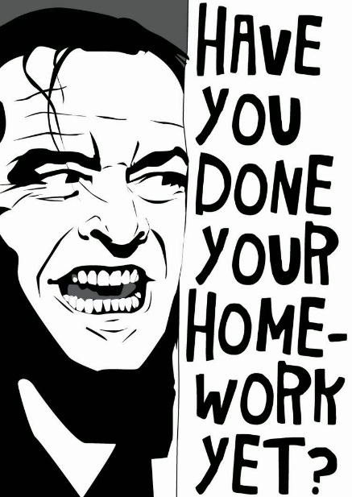
Homework for Part 1
Create a post under the category Introductory Work, titled Full Name, Wollstonecraft & Young. Please do the following:
  Write two paragraphs in a single post, one paragraph about Wollstonecraft's letter, the second paragraph about Young's speech.
  Details on how I want this done can be found on the Agenda for Week 5.
Respond to the Discussion Question “Wollstonecraft & Young’s Writing Strategies”:
  Describe one of Wollstonecraft and one of Young's writing strategies that gets your attention. Explain what she is doing and why it caught your attention. Just hit "reply" for this assignment--you don't have to make a new post!
Both assignments are due by 11:59 PM on Wednesday, September 22 (tonight).

Slide 9
ENG 1121
English Composition 2
Objectives, Part 2
Discuss research and how to use it for persuasive writing
Practice research

Slide 10

Research is formalized curiosity. It is poking and prying with a purpose.
– Zora Neale Hurston
For five minutes, I want everyone to research the name “Zora Neale Hurston” on their own.
Find out the who, what, when, and where about this person.
When time’s up, put ONE detail in the chat box.

Slide 11

Research is formalized curiosity
By now, you’ve identified the discourse community and the issue you want to address in either a letter or speech.
You need to have at least two sources that you use in your letter or speech. These can be interviews you’ve conducted, news sources, or data you’ve gathered.
Let’s go over some ways of using research to persuade your audience!
The following slides are from the Purdue Online Writing Lab (or OWL). They’ve been edited for length.

Slide 12

What is Persuasive
Writing?
Persuasive writing seeks to convince its readers to embrace the point-of-view presented by appealing to the audience’s reason and understanding through argument and/or entreaty.
Notes:
First, let’s establish what we mean by persuasive writing.

Slide 13
Steps for Effective Persuasion
Understand your audience.
Support your opinion.
Know the various sides of your issue.
Respectfully address other points of view.
Find common ground with your audience.
Establish your credibility.
Notes:
In order to create an effective persuasive document, you should consider these important steps. We’ll go over how to accomplish each of these. Let’s start with audience.

Slide 14
Understanding Your Audience
Who is your audience?
What beliefs do they hold about the topic?
What disagreements might arise between you and your audience?
How can you refute counterarguments with respect?
Notes:
Here are some questions you should ask yourself at the start of any persuasive writing project.
It’s important to know something about what your audience believes. For example, you might use different tactics to persuade an audience who knows little about a topic versus an audience who already has strong beliefs on a topic. If you understand where your audience is coming from, you can predict how they might react and what kinds of arguments they might find convincing.

Slide 15
Understanding Your Audience
Help your audience relate to your topic.
Appeal to their hearts as well as their minds.
Use anecdotes when appropriate
Paint your topic in with plenty of detail
Involve the reader’s senses in these sections
Notes:
It’s important to back up your argument with plenty of reputable sources and information. But people make decisions with their hearts as well as their minds. While you don’t want to become sentimental about your topic, you do want your audience to be able to relate to your topic and to feel connected to your concern. If they don’t care about the topic, why should they bother to change their minds?
Here are some ways you can get your audience more involved. People tend to feel more involved in issues that are local or that directly affect them. For example, if you’re trying to persuade your town to give more funding to local programs for the homeless, paint an accurate but detailed picture of what someone who’s homeless might go through in one day, or discuss in detail the current lack of resources that are available in your area.

Slide 16
Researching an Issue
Become familiar with all sides of an issue.
You can try to:
Find common ground.
Understand the history of the topic.
Predict counterarguments your audience might make.
Find strong support for your own perspective.
Notes:
We’ve already discussed why it’s important to find some common ground, and you need to research both sides of a topic to be able to do so. Often, it’s tempting to only research the side of the topic for which we’re arguing. However, if you’re going to be persuasive and sound educated about the topic, you’ll need to be able to address the opposing viewpoint. Also, when writing a persuasive essay, you’ll often need to include a counterargument; this is the section in which you can acknowledge and then refute major arguments made by the opposing viewpoint. Being able to predict what arguments a reader might make against you will give the opportunity to disarm these readers ahead of time. This is why it’s so important to think about your audience before you start writing.

Slide 17
Researching an Issue
Find common ground with your audience.
For example:
  Point of Opposition: You might support a war, whereas your audience might not.
  Common ground: Both sides want to see their troops come home.
Notes:
The most effective persuaders know how to find common ground and let their audience know that they understand where they’re coming from. This is especially true if the topic is controversial and/or your audience has strong opinions about it already. Here’s one example of common ground that you might find for such a topic. The best way to find that common ground is to research both sides of the issue at hand.

Slide 18
Researching an Issue
Predict counterarguments.
For example:
  Your Argument: Organic produce from local Farmers’ Markets is better than store-bought produce.
  The Opposition: Organic produce is too expensive.
Notes:
If you know how the opposition might react to your argument, you’ll be better equipped to disarm their arguments by creating a strong counterargument. Here’s one example of how the opposition might react. Can you think of a good counterargument off the tops of your heads?

Slide 19
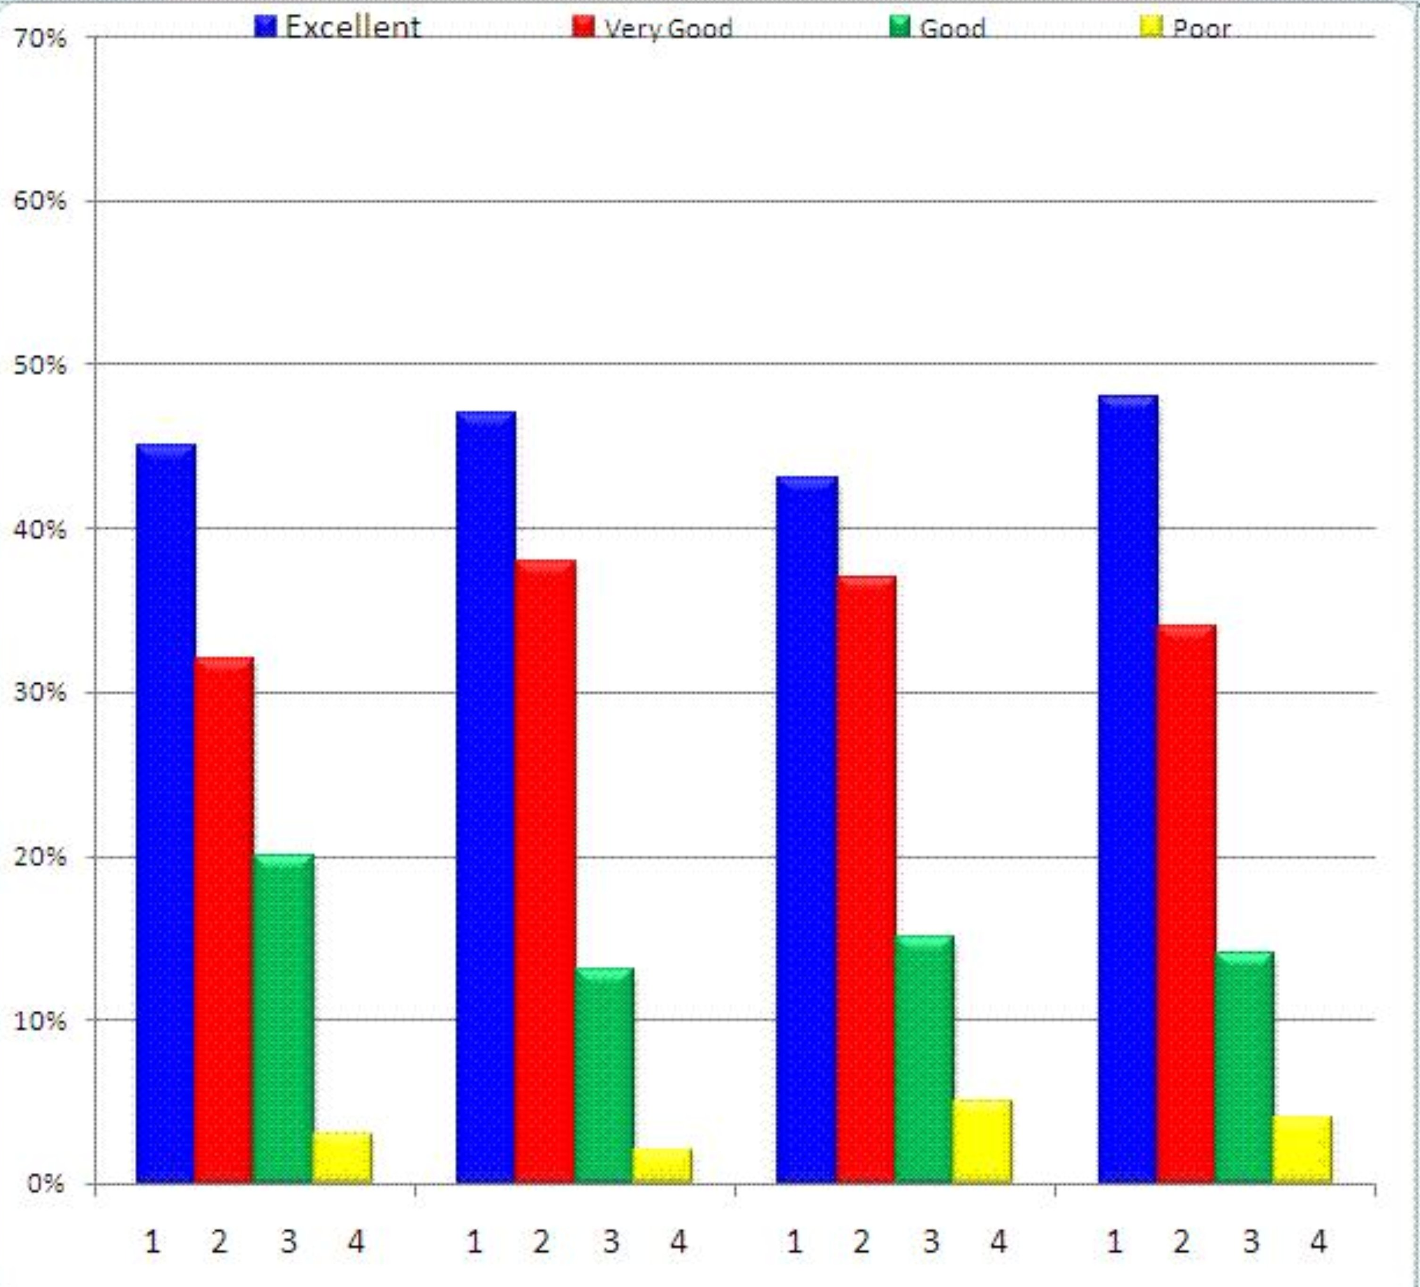
Support Your
Perspective
Appeal to the audience’s reason:
Use statistics and reputable studies.
Cite experts on the topic:
Do they back up what you say?
Do they refute the other side?
Notes:
Hard evidence is always more convincing than simply stating your opinion. Anyone can disagree with your opinion, but if you have statistics to back up your opinion, your argument will be harder to simply dismiss as personal opinion. When it’s clear to your audience that you know what you’re writing and speaking about, this will help establish your credibility.

Slide 20
Cite Sources with
Some Clout
Which source would a reader find more credible?
The New York Times
http://www.myopinion.com
Which person would a reader be more likely to believe?
Joe Smith from Fort Wayne, IN.
Dr. Susan Worth, Prof. of Criminology at Purdue University.
Notes:
Let’s say you’re doing a persuasive paper on crime, and you want to convince your audience that crime rates are down. Which source has more clout? If you were going to cite an expert to back up your argument, which person would be more convincing for your readers? Joe Smith, who was interviewed by the local paper? Or Dr. Susan Worth, who has recently published a study on the rate of violent crime in the United States?

Slide 21
Research Time!
Open a blank document on your device. We’re going to spend some time on the Internet. While researching your issue facing your discourse community, think and take notes about:
Who is already involved in attempting to make the problem visible to outsiders? Name them! What are their positions, views, and strategies as they bring this problem to light? Discover them!
Who needs to know about this problem? Name them! Why would you want to tell this audience about the problem? Explain why!
Make a list of ideas and information that would be persuasive in helping your audience understand that this issue is a problem.
  Refer to the Purdue OWL slideshow to help you with this list. I’ll put the link to the longer version in the chat box.
Notes:
https://owl.purdue.edu/owl/teacher_and_tutor_resources/teaching_resources/effective_persuasion_presentation.html

Slide 22
Homework for Part 2
Create a Post about the research you’ve done in this class. Title it: Full Name, Brainstorming DC & Research and post it under Introductory Work. (Details are on the Week 5 Agenda.) Publish this post by 11:59 PM on Friday, September 24.
Before class on Wednesday, read/listen to Frederick Douglass’ “What to the Slave is the Fourth of July?” & Alexandria Ocasio-Cortez’s (A.O.C), “I am Someone’s Daughter too.”
More details will be provided on Friday with the new Agenda and Announcement!

Slide 23
Reminder: Homework for Part 1
Create a post under the category Introductory Work, titled Full Name, Wollstonecraft & Young. Please do the following:
  Write two paragraphs in a single post, one paragraph about Wollstonecraft's letter, the second paragraph about Young's speech.
  Details on how I want this done can be found on the Agenda for Week 5.
Respond to the Discussion Question “Wollstonecraft & Young’s Writing Strategies”:
  Describe one of Wollstonecraft and one of Young's writing strategies that gets your attention. Explain what she is doing and why it caught your attention. Just hit "reply" for this assignment--you don't have to make a new post!
Both assignments are due by 11:59 PM on Wednesday, September 22 (tonight).

