Slide 1

ENG 1121
English Composition 2
Part 1 Objectives
Discuss syllabus & schedule
Register/Join OpenLab
Discuss reading for this class
Part 2 Objectives
Watch & discuss Beasley’s work
Read & discuss Tan’s work
Think & write about their work

Slide 2
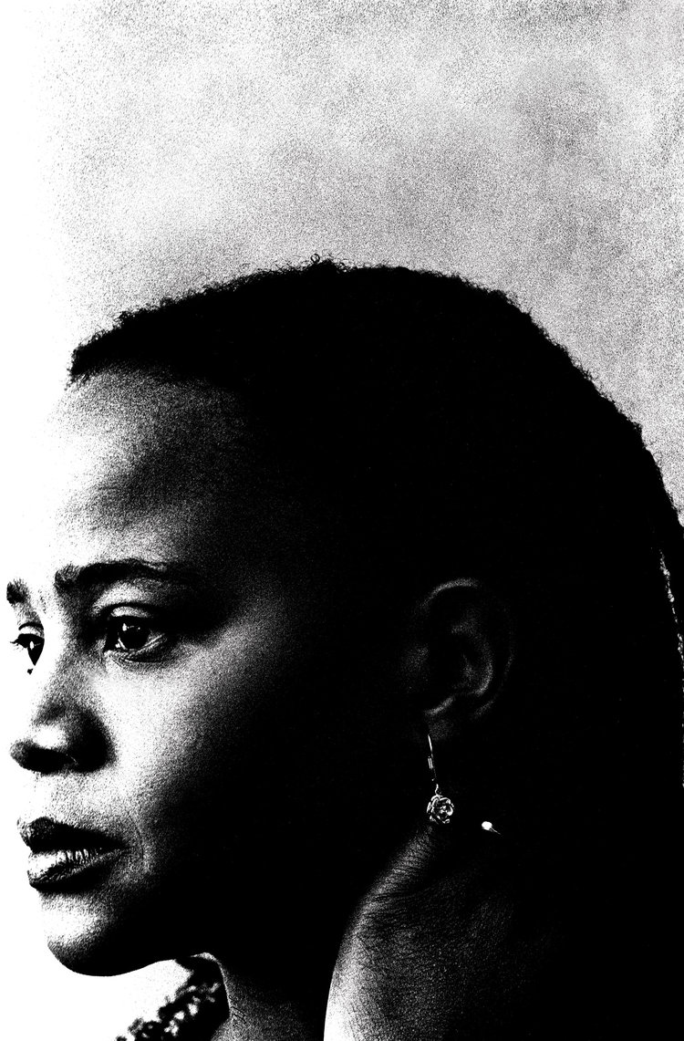
Welcome!
When you write, it’s like braiding your hair. Taking a handful of coarse unruly strands and attempting to bring them unity. Your fingers have still not perfected the task. Some of the braids are long, others are short. Some are thick, others are thin. Some are heavy. Others are light. – Edwidge Danticat
There are other questions to consider on the Welcome page of our website, but let’s focus on this one:
Why does Danticat equate writing with braiding?
In the chat box, please share your thoughts. There isn’t one “correct” answer—there are as many answers as there are people in this class! (This is how I’m taking attendance for this class, BTW!)

Slide 3

Some Thoughts
Go to the Welcome post I wrote. Hopefully, you’ve already read it, but if you haven’t, do so now:
https://openlab.citytech.cuny.edu/pennereng1121fall2021ol12wed6pm/2021/08/12/welcome/

Slide 4
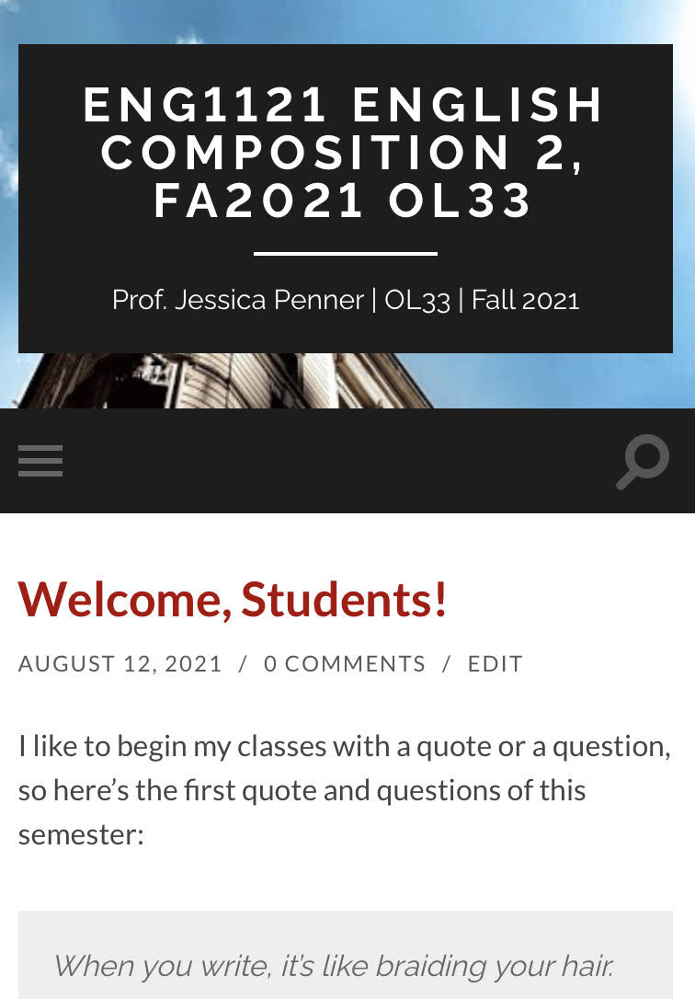
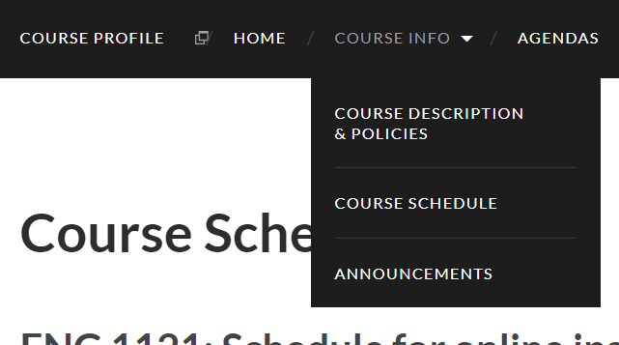
Course Info
Let’s go to the syllabus on our own devices.
  If you’re on a laptop, it’ll look like the image on the bottom.
  If you’re on a cell, it’ll look like the image on the top (different background and course number). Click on the three gray strips on the left.
First, find Course Info and then look at Course Descriptions & Policies.
Next, go to Course Schedule.
Now, go to Announcements.
Finally, go to Agendas.

Slide 5

Register/Join OpenLab
Go to https://openlab.citytech.cuny.edu/ on your smartphones or laptops.
If you’ve joined OpenLab, log in.
If you haven’t, sign up now!
Notes:
ECRI
20 min
Say: Everyone, please get out your smartphones! Ask: Has anyone NOT logged in on OpenLab before? Will the students who have logged in please coach the students who have not?

Slide 6
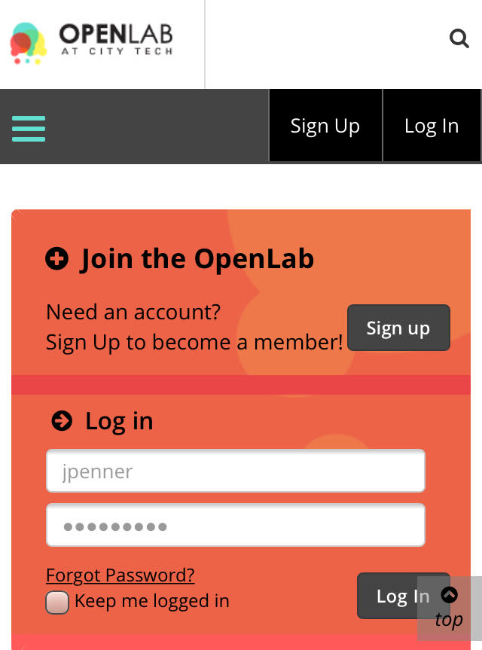
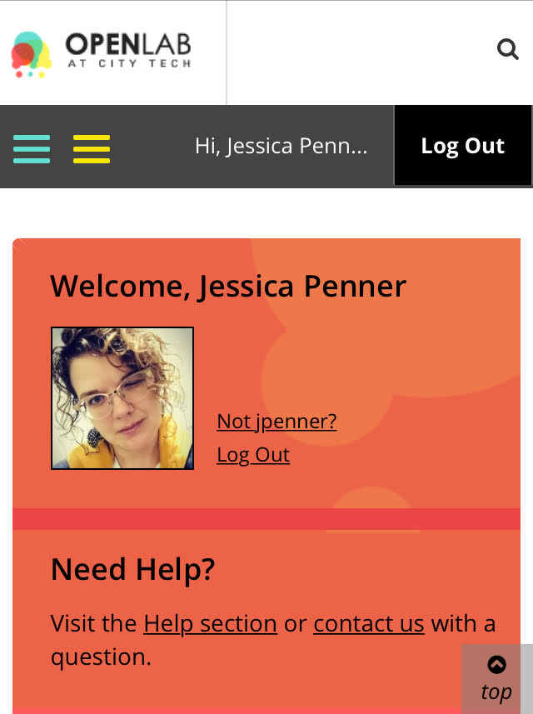
You must use your City Tech-approved email!

Slide 7
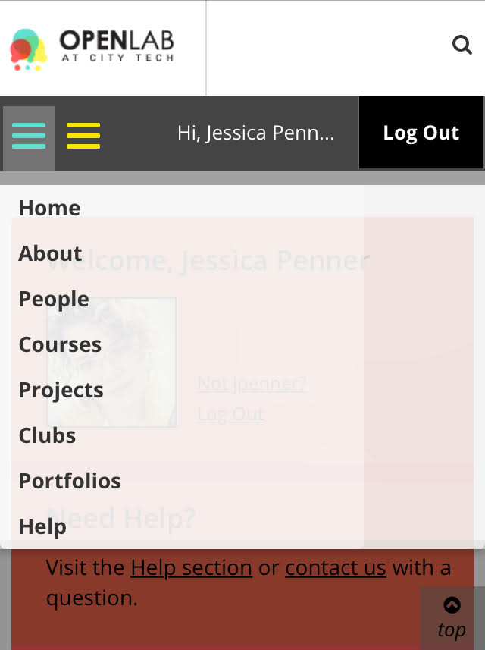
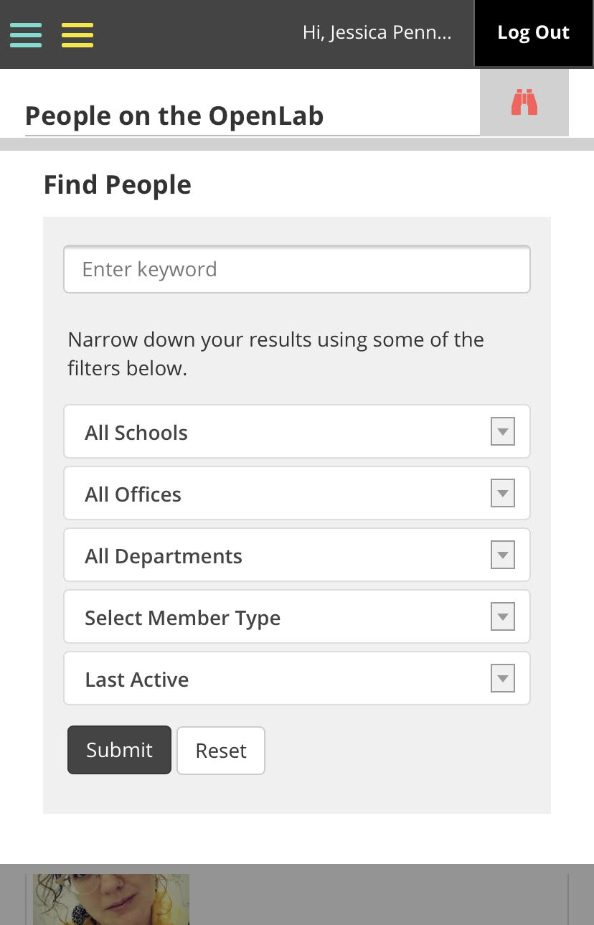
Jessica Penner
The easiest way to find our class is by finding me!

Slide 8
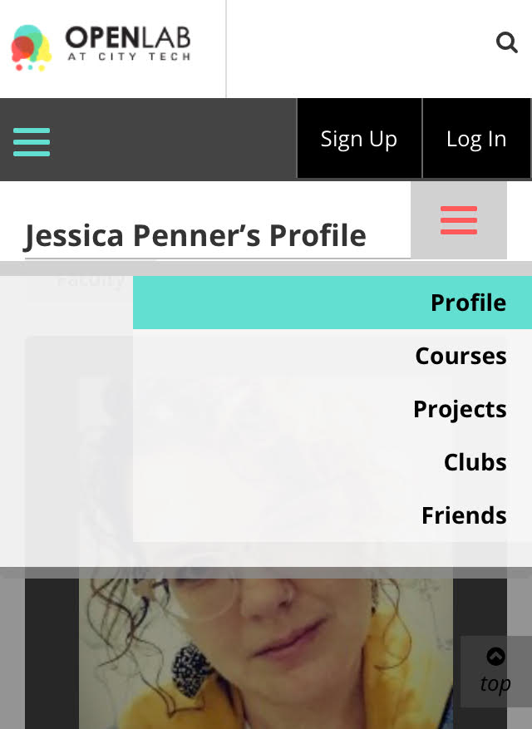
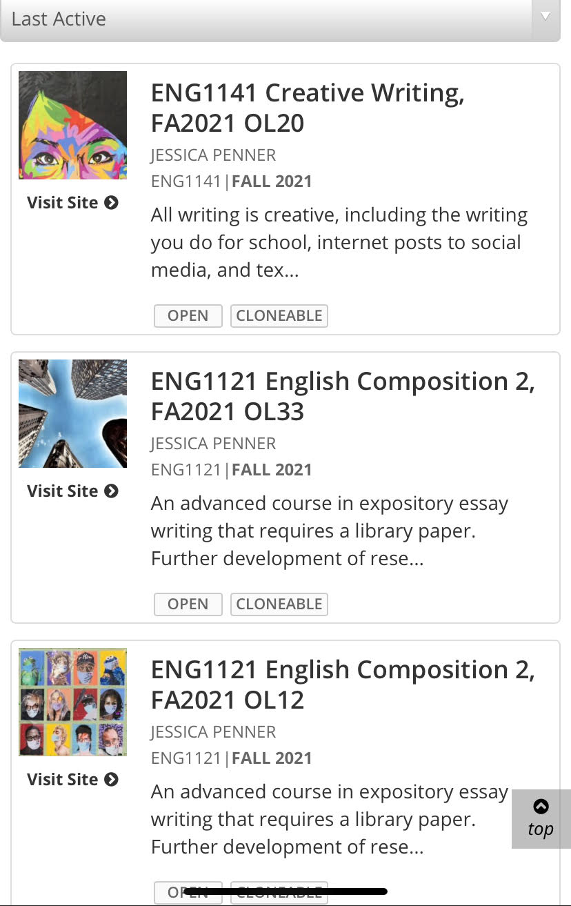
Make sure you join the correct class!

Slide 9

How to Read (Really) for this Class
Before you read, try to understand why I’m asking you to read this assignment.
Think about what we’ve talked about in class.
Look at the Course Schedule and the Major Assignments pages for clues. Once you’ve done that…read!
But don’t just read it once and then move on to other assignments. Read an assignment at least two times.

Slide 10
How to Read (Really) for this Class
The first time, read for basic understanding. If you don’t know a word, mark it or make a list. Look them up later.
The second time, SLOW THE F&%$ DOWN. If you haven’t looked up words yet, do that now. Write down (either on your device or in a notebook) questions and/or comments on ideas that the reading brings up.
You might be fine with just two rounds; however, if that isn’t the case, read it as many times as you need to until you feel you understand the main ideas presented.

Slide 11

Why are we talking about reading? After all, this is a writing class!
Put your thoughts in the chat box or say them out loud!
Clearly, reading published work shows how the pros do it. If we need to see how to write a cover letter for a job, we go the Internet and see how it’s done.
Reading about others’ ideas helps generate our own thoughts on a subject.
The whole class is reading the same assignment, and since there are going to be different ideas/thoughts/opinions, this will spark even more ideas when we discuss them in class.
But we all need to be on the “same page,” right? Which is the reading.
So, if you don’t read and have basic understanding, you won’t be ready to participate in class or be able to generate your own ideas when you’re writing at 3 AM.

Slide 12
Speaking of writing…
There are three small (but important) writing assignments. Go to the Discussions section. You’ll see six posts—just look at the first three: Introductions, Online Learning, and Our Syllabus.
I’ll give you a short time to work on them now!
You don’t have to complete them—yet—but this will give you a chance to practice “replying.”
By class next Wednesday, be sure to respond to at least three of your classmates’ comments.
Don’t just say: “Cool” or “I agree.” Write an answer to one of the questions, some advice, or just a general response to an introduction.

Slide 13
ENG 1121
English Composition 2
Part 1 Objectives
Discuss syllabus & schedule
Register/Join OpenLab
Discuss reading for this class
Part 2 Objectives
Watch & discuss Beasley’s work
Read & discuss Tan’s work
Think & write about their work

Slide 14
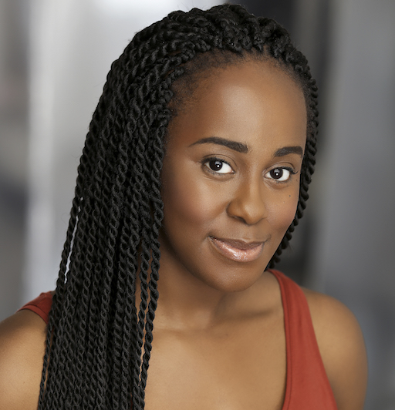
Watch/Discuss/Write
We’re going to watch Beasley’s presentation on “code switching.”
I’m going to give you 5 minutes to consider the following: Think about language and the different ways you communicate or speak. Choose a word or phrase that you use with one group of people (family, friends, co-workers, etc.) that would not be understood by a different group of people in your life. What is the meaning of this word or phrase and how would you explain it to someone who is an outsider to the group who uses it?
Take notes on your thoughts, because you’ll need to remember for a Discussion assignment titled Language & Community!
When the time’s up, I’m going to place you in breakout rooms to discuss the word/phrase you chose. Ask each other questions about their term. You’ll have about 8 minutes total to talk.
Be sure to choose one person to be your group speaker, because we’ll be discussing this question as a class.

Slide 15
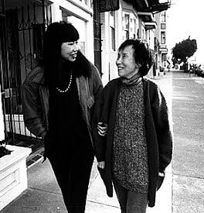
Read/Write/Discuss/Write More
Since today’s our first class, we’ll be doing the reading a bit differently than usual.
I’ll give you around 20 minutes to read. Take note of any words you aren’t sure of.
If you finish before time’s up, read again! Write down thoughts/comments you have.
Go to the two Discussions: Amy Tan’s Mother Tongue and Audience.
I’ll give you 5 minutes to prepare to talk to your breakout group about these two questions.
If we have time, we’ll discuss this a bit as a class.

Slide 16
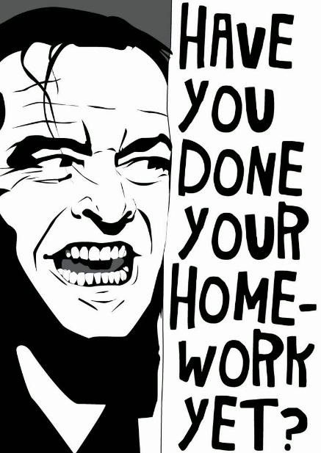
Homework
By EOD Monday, finish answering the following Discussions: Introduction, Online Learning, and Our Syllabus. By Wednesday’s class, respond to at least three of your classmates’ answers.
By Wednesday’s class, finish the following Discussions: Language & Community, Amy Tan’s “Mother Tongue,” and Audience.
FYI: The reading assignments will always be homework after this class. You can find the links to the following class’s reading in the Course Schedule (under Course Info on the OpenLab site).
By Wednesday’s class, read John Swales, “Reflections on the Concept of Discourse Community,” Assignment guidelines for “Unit 1: Investigating a Discourse Community” (under Major Assignments), Butte College, “Double-Entry Reading Journals,” Bobby Henderson, “Open Letter to the Kansas School Board,” and Encyclopedia Britannica, “Flying Spaghetti Monster.” Start reading now, since you will have writing assignments about these things!
There will be a detailed Agenda with writing assignments and an Announcement posted on Friday! I’ll email you when that is on the website.

