Slide 1

ENG 1121
English Composition 2
Objectives
Review MLA formatting for quotes
Review formatting for U1 speech or letter
Work on your speech or letter

Slide 2

Speech or Letter? Why?
In the chat box, write whether you’re writing a speech or letter and briefly state why.
You can use the explanation part of your post that was due on Friday!
This is how I’m taking attendance today, so everyone needs to participate. ☺

Slide 3

MLA Formatting for Quotes
Let’s go to Purdue OWL to review how to format quotes in either speeches or letters.
This link is on the Agenda for Week 7!

Slide 4
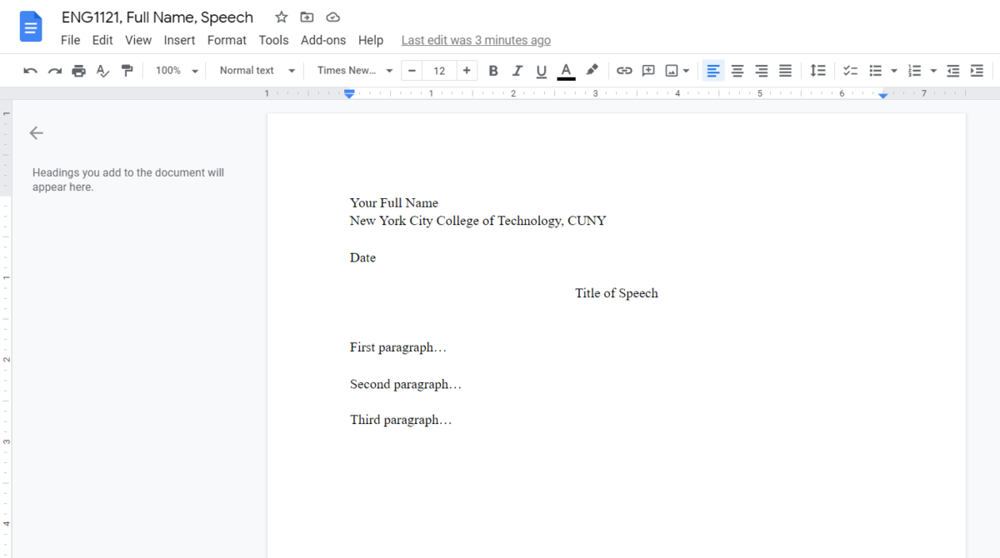
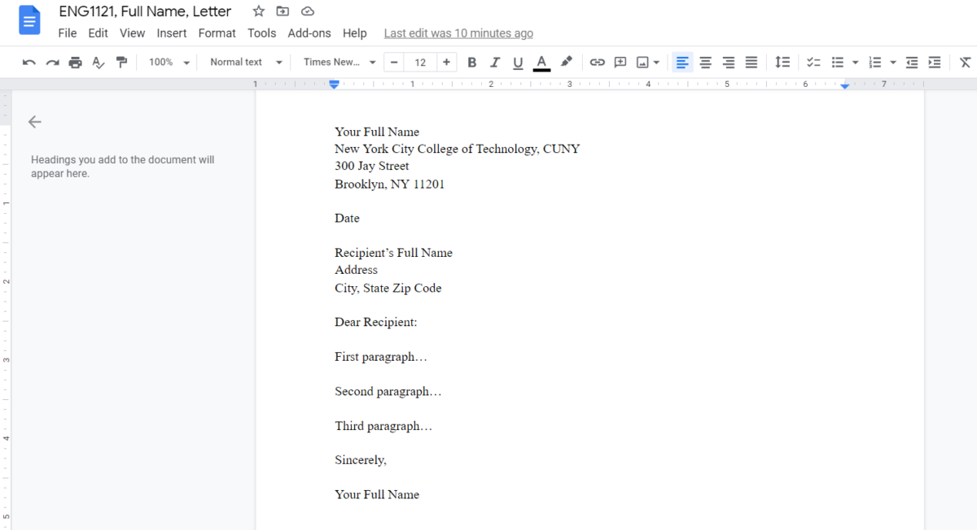
Speech & Letter Format
For both, you must create your document with 1-inch margins, double space the body of the text, and use 12-point Times New Roman font.
Your speech or letter needs to be at least 1,000 words (2-3 pages).
All this info is on the Agenda for Week 7.

Slide 5
Write!
For the rest of class time, work on your own project as you see fit.
  If you need to write, do that. If you need to do some research, do that. If you need to format your work, do that. If you have questions for me, do that. (Note the main idea here!)
Do not leave our Zoom class.
At about 3:40, I’m going to ask a question. Be ready to answer!

Slide 6

Quick Question
What is one thing you’ve learned about your discourse community, the issue you’re addressing, or yourself as a writer during this project?
Put it in the chat box.
Notes:
https://www.facebook.com/ICTexploration/

Slide 7
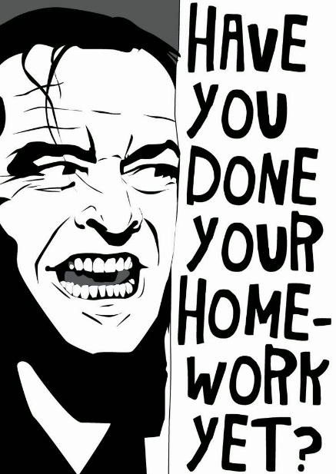
Homework
Continue working on your draft of your letter or speech and have it formatted and ready to share with your peers on Wednesday.
Have whatever you have ready to share with a partner—even if it’s incomplete! Simply having a draft to be peer reviewed in class will earn 50 points for your U1 grade!
Be on time for class! I will be assigning partners at the beginning of class. If you arrive after 2:40, you won’t receive a partner.
If you miss class or are too late, you can ask a friend or family member to review your work so you can get feedback for the final draft (and earn those 50 points). The Peer Review sheet will be posted on the Course Profile by Wednesday.

