Slide 1

ENG 1121
English Composition 2
Objectives
Discuss Douglass’ speech
Discuss why quotes help with persuasive writing
Practice creating “quote sandwiches,” paraphrasing, and explaining quotes

Slide 2

Research is formalized curiosity. It is poking and prying with a purpose.
– Zora Neale Hurston
For five minutes, I want everyone to research the name “Frederick Douglass” on their own.
Douglass is rather well-known, so attempt to discover a fact about him that you didn’t know already!
Put that fact in the chat box!

Slide 3
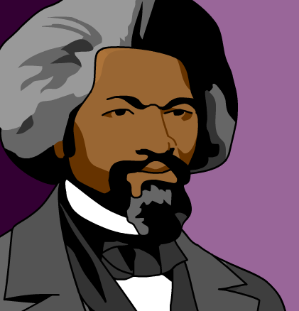
Did Douglass…?
Take 15 minutes to review the text of Douglass’ speech.
Discover if Douglass shows the following elements of persuasive writing (find specific moments—be ready with page numbers and paragraph numbers):
  Did Douglass understand his audience?
  Did Douglass find common ground with his audience?
  Did Douglass establish credibility?
I’m going to put you in breakout rooms.
Discuss if and where you found moments that Douglass used these elements in his speech.
Choose a speaker for your breakout room for the larger group discussion!

Slide 4

Quotes
In your speech or letter, I encourage you to quote people you’ve interviewed, articles you’ve read, or statistics you’ve found.
How can a quote or two assist you in your current project?
What problems might come up when using quotes?
Let’s go to the resource about “quote sandwiches”:
https://www.washoeschools.net/cms/lib/NV01912265/Centricity/Domain/253/Social%20Studies/The%20Quote%20Sandwich.pdf

Slide 5

Creating Quote Sandwiches
Write a Post titled Full Name, Responding to Douglass; post it under Introductory Work, in which you do the following (approximately 200-250 words):
  Having read and listened to Douglass’s speech, what do you believe he is arguing? Write a short summary of what he is saying.
  Now, pick two quotations from the text where Douglass helps his listeners understand the problem he is making visible. Use the “The Quote Sandwich” technique when you initially quote. Follow the template that is on the Agenda for Week 6.
    Quote the passage/lines using proper MLA citation formatting (be sure to quote accurately). Use the “quote sandwich” method.
    Paraphrase the quote (put it in your own words).
    Explain how this quote helps Douglass to illustrate his argument.

Slide 6

Homework
Write a Post titled Full Name, Responding to Douglass; post it under Introductory Work, in which you do the following:
  Having read and listened to Douglass’s speech, what do you believe he is arguing? Write a short summary of what he is saying.
  Now, pick two quotations from the text where Douglass helps his listeners understand the problem he is making visible. Use the “The Quote Sandwich” technique. Follow the template that is on the Agenda for Week 6.
Hit “reply” to the Discussion Question “Douglass’s Writing Strategies”: Describe one of Douglass’s writing strategies that gets your attention. Explain what he is doing and why it caught your attention.
BOTH assignments are due by class time on Wednesday, September 29.

