Slide 1

ENG 1121
English Composition 2
Objectives
Discuss “discourse community”
Discuss Swales’ work
Learn how to post on OpenLab

Slide 2
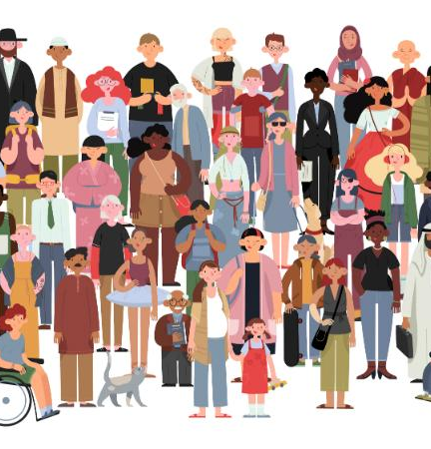
Discourse Community
What was your initial assumption about what a “discourse community” was?
What is the definition you learned through today’s assigned reading?
Put BOTH in the chat box! ☺
Here’s the definition in Wikipedia (at the time of Swales’ publication):
A discourse community is a group of people who share a set of discourses, understood as basic values and assumptions, and ways of communicating about their goals.

Slide 3
Discourse Community
One way to decide if a group is a discourse community (DC) is to list criteria and ask questions based on that criteria (these are worded a little differently than in Swales’ text):
Common public goals
What is this group’s goal?
Methods of communicating among members
What are the ways this group communicate with each other?
Participatory communication methods
How does this group primarily communicate with its members?
Genres that define the group
How does this group communicate with the outside world?
A lexis
What is the “language” they use within their group?
A standard of knowledge needed for membership
What does a person need to know before they can join this group?

Slide 4
Discourse Community
Here are the new criteria that Swales introduces in today’s text:
Develops a sense of “silential relations”
Are there terms or actions that don’t need to be explained to a group member?
Develops horizons of expectation
Are there “rhythms of activity,” a sense of history, and a value system that the group members recognize?

Slide 5
Discourse Community
What discourse communities might you belong to?
For example, one DC I belong to is a writer’s group. We share our drafts of creative writing with each other and critique them in order to make our writing stronger. We mainly communicate through email or Zoom, but we used to meet on a monthly basis before COVID. At times we share our writing at readings, or, if we get published, we let the outside world know via social media. We use vocab like “pacing” “description,” “story arc,” etc. Many of us have MFAs or BFAs in creative writing, but really, the only requirement is a desire to improve one’s writing.
Take a few minutes to think about this and put at least one DC you’re a part of in the chat box. You don’t have to answer all the questions now to see if it fits the definition—we’ll do that later.

Slide 6
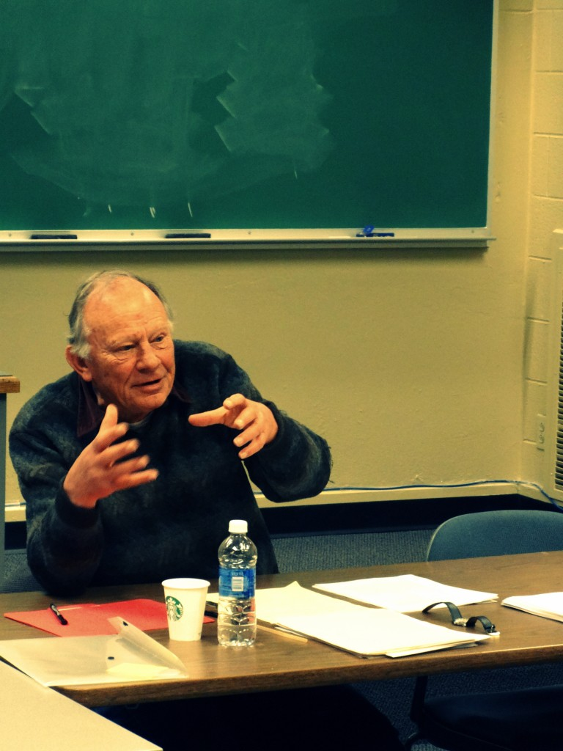
Dissecting Swales
“One of the many things that I did learn in the investigative process was that university clocks move at different speeds in different parts of a university.”
The reason I found this quote compelling was because I’ve seen this in action. English professors at City Tech often teach from textbooks that are often literally crumbling, while those that are in the sciences are constantly changing their books.
This doesn’t mean that one is better than the other. The study of literature moves differently than the study of, say, radiology or microbiology. And there are good reasons for that!
However, a thought that came to me while considering this quote is that sciences need to keep an eye on the past (where science has helped and failed humanity) as well as the future; English professors need to let go of the crumbling textbooks and look to new voices.

Slide 7
Dissecting Swales
The assignment for today was to read Swales’ work and choose two quotes that you found interesting (or confusing).
Take 10 minutes to look at the two quotes you’ve chosen, and answer this question for BOTH QUOTES INDIVIDUALLY, if you haven’t already: Why did you find the quote compelling?
When time’s up, I’m going to put you in breakout rooms. I want you to talk about your quotes with your group and explain your reasons. I’ll give you about 10 minutes for this—depending on the size of the groups.
When time’s up, we’ll regather. Depending on time, I’ll ask for a few volunteers to share with the class. Be prepared!

Slide 8
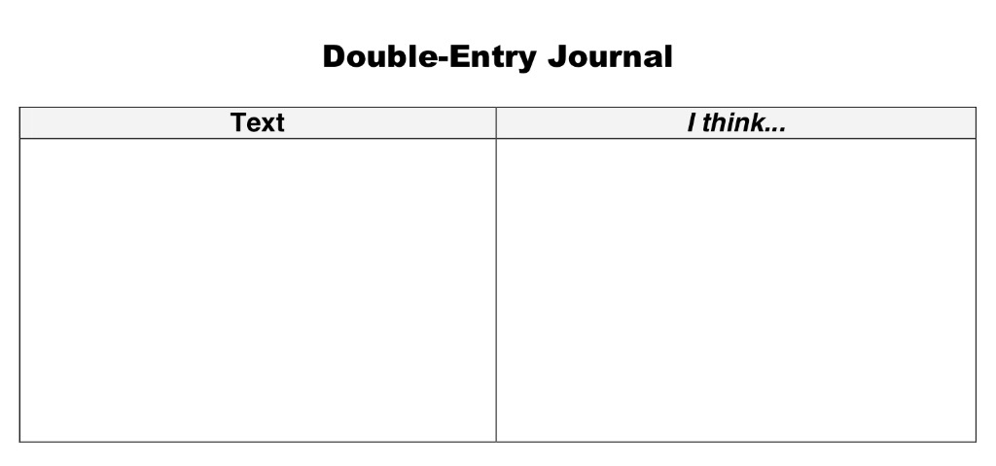
Double-entry journals &
First Posting on OpenLab
One example of a double-entry journal.
“A double entry reading journal is one way to interact with what we read, increase critical thinking skills, and create a meaningful construction–namely, a better understanding of what we read.”
The reason I asked you to review the resource about using double-entry journals is that this can be a tool for you as you go through this class and others.
When you see a section or a quote in any text, you can either highlight or copy it down, and then pose your ideas, questions, etc., next to it, and that way you have a record of these thoughts for later use. (When we do the research section of this class, this will most certainly be handy!)

Slide 9
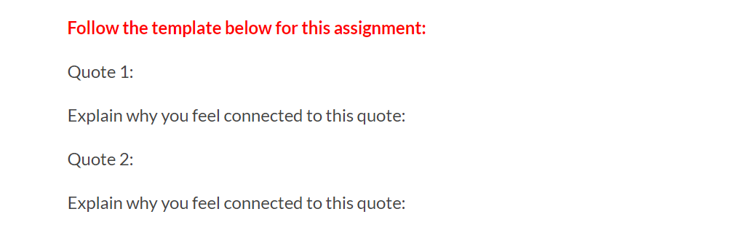
Double-entry journals &
First Posting on OpenLab
For our class, we’re going to have a slightly different double-entry journal, but you can see the same information is shared here.
This post must be complete and published under Introductory Work (which is under Student Work) by the end of the day (11:59 PM) on Thursday, September 2. Title it Full Name, Swales’ Quotes.
Let’s talk about how to post an assignment on OpenLab.
You MUST have joined the class in order to do this!

Slide 10

Homework
We won’t be seeing each other until September 13. There are no classes at City Tech between Friday, September 3 and Wednesday, September 8, BUT I will still be sending out an email this Friday with small assignments to keep us on track. Here’s a sneak-peek:
  Create a post that shares a list of three discourse communities you participate in. Use a couple of sentences to describe each discourse community you listed, and discuss the basic “values, assumptions, and ways of communicating” found in each one. Post it under Introductory Work and title it Full Name, My Discourse Communities.
  Read the major writing assignment for Unit 1 on OpenLab under Major Assignments. We’ll talk more about it during our next class, but you should start thinking/planning/writing it now (the above assignment will help).
  Respond to the Discussion Question “Problems and Issues”: Go back to your list of Discourse Communities and name two or three problems or issues that are central to each one.

