Slide 1

ENG 1121
English Composition 2
Objectives
Unit 1 writing assignment debrief
Review how to upload U1 onto OpenLab
Introduction to Unit 2 writing assignment

Slide 2

Unit 1 Debrief
Take time to consider the following questions and respond out loud or in the chat box:
What worked? Why?
What didn’t? Why?
What would you do differently, if you had the chance? Why?

Slide 3

Upload!
I’ve made a step-by-step guide on how to upload your U1 writing assignment:
Unit 1 Upload Instructions.pdf
Let’s go to it now!

Slide 4

Unit 2 Writing Assignment
For this assignment, you will compile a 1500-word annotated bibliography. This document will include three sources exploring the research question you developed regarding a social justice issue.
This is not a traditional research essay. It does not begin with a thesis. Instead, you begin with a question and do research to seek answers.
A quick note: You will use the research from this assignment for a later assignment, so be sure you truly are interested in your topic.

Slide 5

Social Justice
What does “social justice” mean?
Dictionary.com says social justice is “fair treatment of all people in a society, including respect for the rights of minorities and equitable distribution of resources among members of a community.”

Slide 6
Social Justice Brainstorm
What are some examples of social justice issues?
What social justice issues are you interested in researching?
What questions would you like to research about this issue?
For example, if an issue you are passionate about is homelessness, you could research one of the following questions:
  How does homelessness affect elementary school-age children?
  How does capitalism attribute to homelessness in the United States?
  How did the COVID pandemic affect homeless people in New York City?

Slide 7
Discussion Question: “Annotated Bibliography Project”
Go to this Discussion on OpenLab.
  Take a few minutes to think about the words used to identify this assignment (“annotated” and “bibliography”), and free write what those words mean to you.
  If you did an annotated bibliography in a previous class (such as English 1101), briefly mention your experience with the assignment.
  As you look through the guidelines of this project, write down questions you have about this project.
Just hit “reply.” You don’t have to make a post!
You have 10 minutes.
We’ll briefly discuss this after the time’s up.

Slide 8
Discussion Question: “Student Samples — Annotated Bibliography Project”
Go to this Discussion on OpenLab.
Skim the student samples again.
  Notice the formatting and technical elements. What makes the pieces look finished and professional? What might need improvement?
  What does this tell you about the work you’ll need to be doing over the next few weeks?
Just hit “reply.” You don’t need to make a post!
You have 10 minutes!
We’ll briefly discuss this after the time’s up.

Slide 9
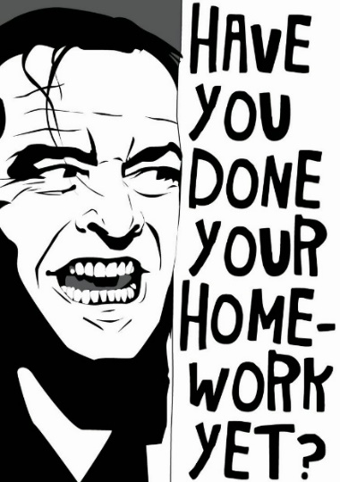
Homework
Finish answering the Discussion Questions.
Submit U1 Writing Assignment to OpenLab by 11:59 PM TONIGHT.
Write a Post that includes the following:
  A short letter to me explaining your thoughts on writing in the genre you chose. Answer the following prompts:
    Did you find it easier to express your thoughts through a letter or speech writing a traditional academic essay? Why or why not?
    Reflect on how the pieces we reviewed by A.O.C., Young, Douglass, and Wollstonecraft helped you create your piece.
    Reflect on what you’ve learned about yourself as a writer during this project. Respond to any (or all) of the following questions: What didn’t you know at the beginning that you know now? Has anything surprised you? If so, what is it? How do you see using the skills you’ve developed in other classes or your chosen field?
Title the post Full Name, Reflection on Unit 1 and save it under the category Unit 1 Work. This post is due by 11:59 PM on Friday, October 15!
Start brainstorming your social justice issue and questions that surround it for your U2 project now! More to follow on Friday!

