Slide 1

ENG 1121
English Composition 2
Objectives
Discuss Wollstonecraft’s work
Discuss Young’s work
Discuss how they shared their DCs & issues in different genres

Slide 2
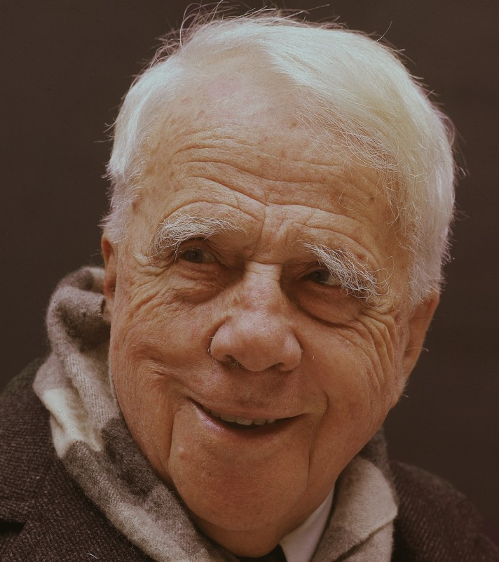
No tears in the writer, no tears in the reader. No surprise in the writer, no surprise in the reader.
– Robert Frost
We often hear the word “strategy” in reference to gaming or business, but there are writing strategies as well.
What you think a “writing strategy” is?
Give an example of a writing strategy.

Slide 3

Prep for Discussion
Before we discuss the two assignments for today, we’re going to spend some time thinking individually.
I put a shared Google Doc link in the chat box: https://docs.google.com/document/d/18NilD0_K4ucVWzL-wc9dD0LPSgXWpD_uX4-ljJm3JUI/edit?usp=sharing
Click on it and answer the questions for Discussion #1 and Discussion #2.
You have 15 minutes to answer both sets of questions.
This activity will help with today’s homework, so participation is crucial!
Notes:
Link: https://docs.google.com/document/d/18NilD0_K4ucVWzL-wc9dD0LPSgXWpD_uX4-ljJm3JUI/edit?usp=sharing

Slide 4

Small Group Discussion
I’ve divided the class into small groups to discuss your answers.
Each group needs to choose a speaker for our larger class discussion after this activity.
You have 10 minutes.

Slide 5
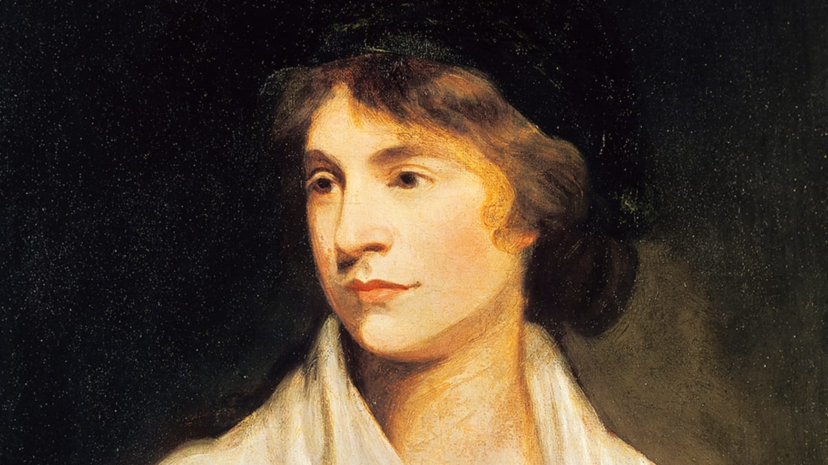
Discussion #1
What is Wollstonecraft’s discourse community?
What’s the issue she is sharing about her discourse community?
Who is the intended audience?
What is one strategy she uses to persuade her audience?

Slide 6

Discussion #2
What is Young’s discourse community?
What’s the issue she is sharing about her discourse community?
Who is the intended audience?
What is one strategy she uses to persuade her audience?

Slide 7

The Power of Language
Answer out loud or put it in the chat box:
Which did you feel more connected with: the letter or the speech? Why?
Why does this matter—to have the audience moved by a letter or a speech?

Slide 8
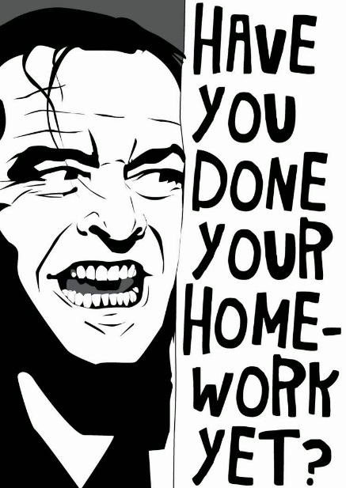
Homework
Create a post under the category Introductory Work, titled Full Name, Wollstonecraft & Young. Please do the following:
  Write two paragraphs in a single post, one paragraph about Wollstonecraft's letter, the second paragraph about Young's speech.
  Details on how I want this done can be found on the Agenda for Week 5.
Respond to the Discussion Question “Wollstonecraft & Young’s Writing Strategies”:
  Describe one of Wollstonecraft and one of Young's writing strategies that gets your attention. Explain what she is doing and why it caught your attention. Just hit "reply" for this assignment--you don't have to make a new post!
Both assignments are due by class time on Wednesday, September 22.

