Slide 1
YOU WILL STILL HAVE:
Class Presentations (You will categorize them as STUDENT POSTS. And you'll be able to present your mini lecture to our class via ZOOM.)
Guest Speaker (You will review their work ahead of time and post your questions on our Guest Speaker page.)
IN CLASS Critique: We will use ZOOM for real time critique and feedback.
Work in Class: During our regularly scheduled Class Session TH 6-9
We will have a ZOOM meeting and you can join early should you want to co-work or chat with anyone.

Slide 2
CHANGES to Structure:
We will have 2 class sessions:
PREGAME: You can JOIN Meeting EARLY if you would like to. So why not begin at 5:30 and get a little social time in with the rest of the class?
PART 1 from 6-7pm, which is for US to chat and share work.
PART 2 from 7:30-8:30pm Which is for our GUEST SPEAKERS.
* The Reason for the break is we will all need to get up after about an hour. Also, if you miss either part of class the file won't take 3 hours to watch.

Slide 3
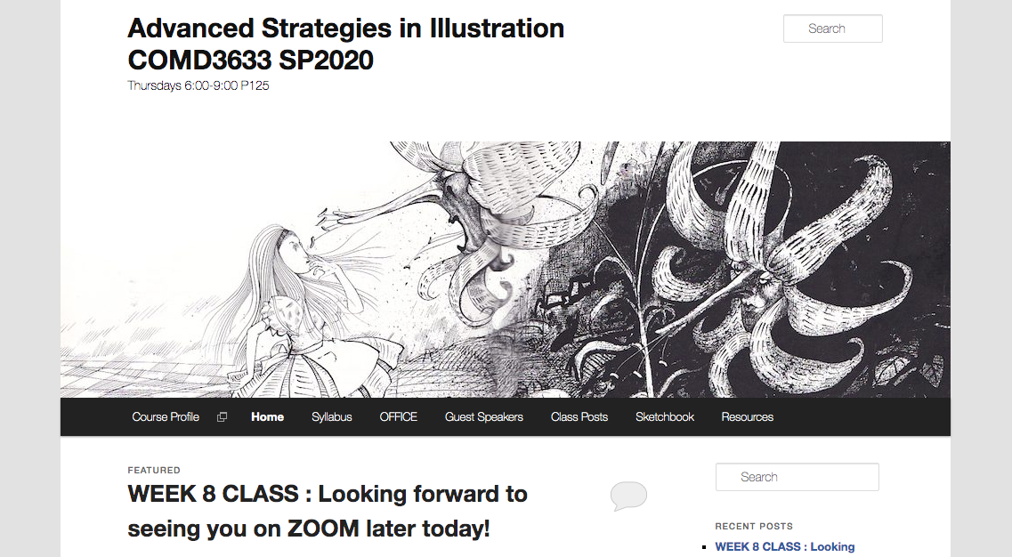
PLEASE DON’T USE HOME. THAT’S MINE.
ASK ME QUESTIONS. I’ll check here daily.
Give a 5 min ONLINE presentation through ZOOM
We can all post useful links and resources here.
Here is where DISCUSSION and COURSE FILES are.
This is the SAME. Post your Questions!
This is NEW. You’ll post new sketches weekly HERE.
Notes:
Although we will always have the Weekly ZOOM meetings, but we will use it mainly for Critiques and Guest Speakers.
This course will progress on a weekly basis.
Weekly Lectures, Discussion, Quizzes, and Readings will be found the OpenLab so that you can access them 24/7. You’ll always have one week to complete them.
Since our course date is Thursday, your new content will appear on open lab at 12:01 am every week. Your course work for that week is due WED at 11:59pm.

Slide 4
Asynchronous Learning
Although we will always have the Weekly ZOOM meetings, but we will use it mainly for Critiques and Guest Speakers.
This course will progress on a weekly basis.
Weekly Lectures, Discussion, Quizzes, and Readings will be found the OpenLab so that you can access them 24/7. You’ll always have one week to complete them.
Since our course date is Thursday, your new content will appear on open lab at 12:01 am every week. Your course work for that week is due WED at 11:59pm.

Slide 5
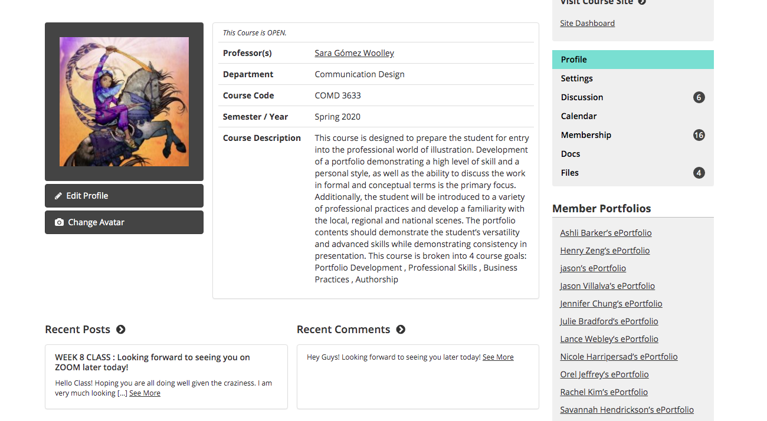
Discussion found Here
Class Files Found Here
Completed Projects Will be Shared Here
Work in Progress Will be sent to DROPBOX

